Slide 1
AKABANE DISEASE
Congenital Arthrogryposis – Hydranencephaly Syndrome, A–H Syndrome, Akabane Disease, Congenital Bovine Epizootic A-H Syndrome, Acorn Calves, Silly Calves, Curly Lamb Disease, Curly Calf Disease, Dummy Calf Disease, Bovine Epizootic Encephalomyelitis

Slide 2
Akabane disease is an arthropod-borne viral disease that can affect cattle, sheep and goats. In the predominant syndrome, inapparent infections in adults can lead months later to abortions, stillbirths and congenital defects in newborns.

Slide 3
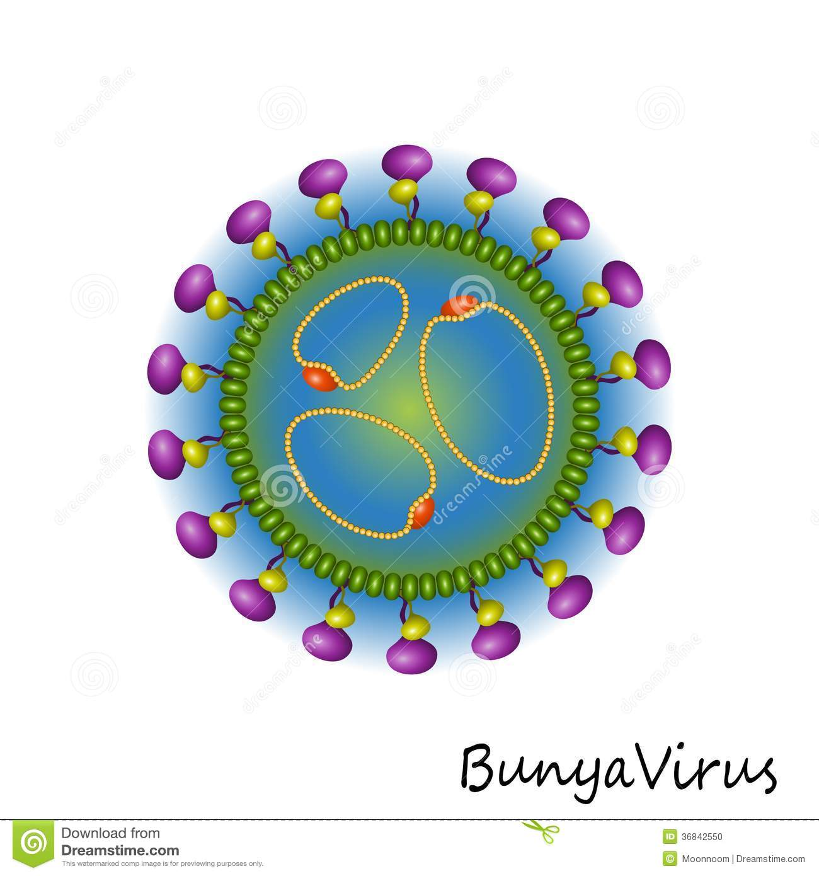
Ethiology
Bunyaviridae genus Orthobunyavirus Akabane virus (arbovirus)
The single-stranded RNA virus causes intrauterine infection of the fetus in pregnant cattle, sheep and goats by invading the endothelial cells of the placenta, replicating in the trophoblastic cells and finally in the fetus itself.
The result is abortions, stillbirths, premature births and deformities of the fetus or newborn with no clinical signs in the dam during pregnancy.

Slide 4
Akabane is named after the Japanese village where the virus was first isolated from mosquitoes (Aedes vexans, Culex tritaeniorhychus) in 1959.
In 1969-70, a major epizootic of Akabane occurred in Israel affecting 3,000 dairy calves, 700 lambs, and 600 kids.
In Australia, the Akabane virus was first identified in 1972, however sporadic undiagnosed outbreaks (resembling the disease) had been observed as early as the mid-1940’s.

Slide 5
Clinical cases have been seen only in cattle, sheep and goats.
Antibodies to Akabane virus have been found in horses, donkeys, buffalo, deer, camels, pigs and wild boar, but there has been no indication that the virus is pathogenic in these species.
Serological evidence of infection has also been reported in wild ruminants and other ungulates.
Our livestock population is highly susceptible to the virus.
Based on the severe mortality that can occur with Akabane disease in naïve populations, the economic impact of the disease can be great.
Additionally, the potential vectors for the disease are found in the Turkey.

Slide 6
Geographic Distribution
Akabane virus is common in many tropical and subtropical areas in the Eastern Hemisphere, including parts of Asia, Africa, the Middle East and Australia. However, outbreaks tend to occur mainly in the far northern and far southern ranges of its distribution. Some countries that have reported Akabane disease include Japan, Korea, Taiwan, Australia, Israel and Turkey.

Slide 7
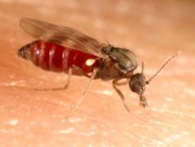
Transmission
Akabane virus is transmitted primarily by biting midges (gnats) in the genus Culicoides.
Vertical transmission is important in the epidemiology of this disease.
In animals that are not immune to Akabane virus, it is transmitted across the placenta to the fetus, and causes congenital defects.
This virus does not appear to be contagious by casual contact; horizontal transmission has only been reported via insect vectors.
It has not been found in the semen of bulls.
Ruminants do not become long-term carriers of Akabane virus.

Slide 8
Pathogenesis and Pathology
Culicoides
Maternal Viremia
Transplasental
Transmission
Encephalomylitis +
Polymyelitis
(AH Syndrome)
Fetus

Slide 9
Clinical Signs
Akabane virus infections are asymptomatic in most adult animals, but viremia usually occurs 1 to 6 days after infection, and Akabane virus is transmitted across the placenta to the fetus.
Fetal infections do not become evident until the animal is either born or aborted due to severe defects.

Slide 10
Most strains of Akabane virus infect non-pregnant animals subclinically, but a few can cause encephalomyelitis in calves and adult cattle.
Neurological signs that have been reported in these animals include tremors, ataxia, lameness, paralysis, nystagmus, opisthotonos and hypersensitivity.
More often, Akabane disease is characterized by asymptomatic infections in postnatal animals, and abortions, stillbirths, premature births and congenital defects (arthrogryposis and congenital malformations of the brain) in fetuses and newborns.
Birth complications may cause injuries to the dam that result in infertility or death, particularly when the fetus has malformed joints.

Slide 11
The effects of AKAV infection of a fetus depend on when during gestation the infection occurs; this is more evident in cattle, due to their longer gestation periods:
Congenital lesions in the brain may be present in calves born to cows infected early in pregnancy. These calves exhibit behavioral abnormalities even though their motor faculties seem normal. Neurological signs may occur, and calves may be blind, deaf, depressed, or unaware of surroundings; they may have difficulty suckling and generally die soon after birth or must be euthanized.
Infection in the second trimester of pregnancy is likely to result in a calf born with arthrogryposis, or rigid joints with atrophied muscles.

Slide 12
Fetuses infected at a later stage tend to be aborted, stillborn, or premature; often signs of disease are not noticeable until examination of the cranial cavity reveals hydranencephaly.
Newborn calves may be alert but typically cannot stand, and they are likely to be uncoordinated, partially or fully paralyzed, have bulging or tearing eyes, and make unusual vocalizations.
Bovine calf, calvarium. The cerebral hemispheres consist of thin-walled sacs that contained cerebralspinal fluid prior to necropsy

Slide 13
Post Mortem
Post mortem lesions of the fetuses and newborns follow the previously mentioned clinical signs.
Arthrogryposis and hydranencephaly are the most commonly noted lesions.
Most of the affected joints are ankylosed and cannot be straightened even by force. [Arthrogryposis (persistent flexion of jointsis the most frequently observed lesion.
Hydranencephaly (absence of the cerebral hemispheres and their normal site being occupied by cerebrospinal fluid) can also be seen with Akabane infection.

Slide 14
Bovine neonate. This live calf cannot stand due to severe arthrogryposis, primarily affecting the hindlimbs.
Bovine neonate (Aino). This stillborn calf exhibits torticollis and arthrogryposis.
Bovine neonate, brain. The entire brain is reduced in size (microencephaly), and surrounded by cerebrospinal fluid.
Bovine calf. The head is hyperextended. The limb joints are fixed and vary from hypercontracted to hyperextended.
Bovine calf. The head is rotated and tilted to the side (torticollis). There is abnormal rotation of the thoracic limbs and the joints are fixed at unusual angles (arthrogryposis). The thoracolumbar spine is curved to the right (kyphosis).
The cerebral hemispheres have failed to develop.

Slide 15
Central nervous system lesions may include hydrocephalus, agenesis of the brain, microencephaly, proencephaly, cerebellar cavitation.
Other abnormalities may include fibrinous leptomeningitis or ependymitis, spinal cord agenesis or hypoplasia, torticollis, scoliosis, brachygnathism, cataracts, ophthalmia [severe inflammation of the eye], hypoplastic skeletal muscles and lungs, fibrinous polyarticular synovitis.

Slide 16
Diagnosis
Clinically
Fetal arthrogryposis ve hydranencephaly (AH Syndrome)
Congenital Akabane disease is often diagnosed by serology, using serum samples or body fluids (pericardial, pleural or peritoneal) from the fetus or presuckle neonate.
Most affected fetuses and full term calves have mounted an antibody response to this virus, although fetuses that were infected before they became immunocompetent may be seronegative.
Virus neutralization and ELISAs are the most commonly used serological tests.
Other assays that have been employed include agar gel immunodiffusion, hemagglutination inhibition and hemolysis inhibition assays.

Slide 17
Antigenic tests can also be useful sometimes in fresh fetuses aborted before they have developed an immune response. Samples should be taken from the placenta and fetal skeletal muscle, brain and spinal cord.
RT-PCR, qRT-PCR
Akabane virus can be isolated in a number of cell lines (e.g., Vero, HmLu-1, BHK-21) cells), and the virus can be identified by immunofluorescent or immunohistochemical straining or virus neutralization.

Slide 18
Differential Diagnosis
Schmallenberg virus;
disease caused by Aino or Cache Valley (Chuzan) viruses;
bovine viral diarrhea virus;
border disease;
Wesselsbron disease;
bluetongue (in sheep); and
other nutritional, genetic, and toxic diseases.

Slide 19
Prevention and Control
Akabane virus does not appear to be transmitted between animals except by arthropods.
If this virus is introduced into an area where it is not endemic, care should be taken to prevent it from infecting potential vectors, especially Culicoides spp. gnats.
Vaccines are available in some countries, and can prevent fetal losses.
Akabane disease can also be controlled in pregnant animals by moving them into an endemic area in time to develop immunity before they are first bred.
Seropositive aniimals have no problem with the pregnancy.

Slide 20
References
http://www.cfsph.iastate.edu/Factsheets/pdfs/akabane.pdf
AKABANE STANDARD OPERATING PROCEDURES: 1. OVERVIEW OF ETIOLOGY AND ECOLOGY https://www.aphis.usda.gov/animal_health/emergency_management/downloads/sop/sop_akabane_ee.pdf

Slide 21
BLUETONGUE DISEASE

Slide 22
Reoviridae
Non-enveloped, spherical, medium sized (60-80 nm) virions composed of concentric rings of capsomeres giving characteristic appearances in the electron microscope.
Segmented genome (10 or 11 segments),
double-stranded RNA;
each segment codes for a separate viral protein.
Resistant viruses which can persist
in the environment.

Slide 23
Bluetongue is a viral disease of ruminants transmitted by midges in the genus Culicoides.
Bluetongue virus is very diverse: there are more than two dozen serotypes, and viruses can reassort to form new variants.
To date, 27 serotypes have been identified, including BTV25 identified in Switzerland in 2007, BTV26 from Kuwait in 2010 and BTV27 detected in goats in Corsica (France) in 2014. In addition, two putative new serotypes, respectively BTV28 and BTV29 were recently detected.
This virus is endemic in a broad, worldwide band of tropical and subtropical regions from approximately 35°S to 40°N; however, outbreaks also occur outside this area, and the virus may persist long-term if the climate and vectors are suitable

Slide 24
Bluetongue virus can replicate in many species of ruminants, often asymptomatically. Clinical cases tend to occur mainly in sheep, but cattle, goats, South American camelids, wild or zoo ruminants, farmed cervids and some carnivores are occasionally affected.
Control of this vector-borne disease is difficult, except by vaccination. The existence of multiple serotypes complicates control, as immunity to one serotype may not be crossprotective against others.

Slide 25
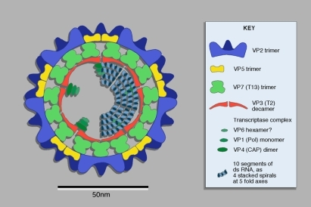
Ethiology
Reoviridae Orbivirus
dsRNA, segmented
Non-enveloped
Not affected by Ether and Chloroform
Inoculation to ECE ---- Egg yolk
TC ---- Lamb Kidney, BHK, Vero
EA----- mice, Hamster
Diagram of orbivirus structure. Figure published in Virus Taxonomy: VIIIth Report of the International Committee on Taxonomy of Viruses, Mertens P.P.C., Attoui H., Duncan R., Dermody T.S. (Eds.), Reoviridae, pp. 447–454, © Elsevier. (A color version of this figure is available at www.vetres.org.)

Slide 26
At least 26 serotypes have been identified worldwide. A few bluetongue viruses have additional names (e.g., Toggenburg orbivirus for the prototype strain of serotype 25).
Isolates differ in virulence, and some strains seem to cause few clinical signs.
Like some other viruses such as influenza virus, bluetongue viruses can reassort and recombine to produce new variants.

Slide 27
Bluetongue virus can infect many domesticated and wild ruminants including sheep, goats, cattle, water buffalo, African buffalo, bison, various cervids, wild relatives of sheep and goats, wildebeest and other species.
Both domesticated ruminants (especially cattle) and wild ruminants can be maintenance hosts.

Slide 28
Endemic areas exist in Africa, Europe, the Middle East, North and South America and Asia, as well as on numerous islands (e.g., Australia, the South Pacific, the Caribbean).
Multiple serotypes can be found in many regions.
Map of the estimated global range of bluetongue virus prior to 1998.

Slide 29
Transmission
Bluetongue virus is mainly transmitted by biting midges in the genus Culicoides, which are biological vectors
These midges can fly short distances of 1- 2 km, but they can be blown much farther by wind.
Ticks and mosquitoes might be capable of transmitting the virus mechanically, but their role, if any, is thought to be minor.

Slide 30
The transmission of bluetongue virus, showing putative secondary transmission routes. Figure modified from Wilson et al. (2008). PLoS Biol. 6(8); distributed under a Creative Commons Attribution License

Slide 31
Bluetongue virus can persist in the blood of some animals for relatively long periods, facilitating transmission to Culicoides.
Live virus has been isolated from some cattle for as long as 5 to 9 weeks, and viral RNA has been found much longer. The most important reservoir is the Cattle. Blue tongue virus can survive for 14 weeks in cattle blood.
At least some bluetongue strains (including members of serotypes 1, 8 and 26) can be transmitted directly between ruminants in close contact.
Transmission with semen has been reported. Source of virus;
Infected Culicoides
Blood
Semen
Type 4, 9, 16 were isolated in Turkey, 2 serologically.

Slide 32
Pathogenesis
After cutaneous instillation of BTV (by inoculation or through the bite of a BTV-infected Culicoides vector) the virus travels to the regional lymph node, where initial replication occurs
The virus then is disseminated to a variety of tissues throughout the body, where replication occurs principally in mononuclear phagocytic and endothelial cells, lymphocytes and perhaps other cell.
Viraemia is highly cell associated and may be prolonged but not persistent in domestic ruminants.
BTV associates with all blood cells during viraemia, thus titres of virus in each cell fraction are proportionate to the numbers of each cell type; specifically, BTV is quantitatively associated most with platelets and erythrocytes and, because of the short lifespan of platelets, virus is largely or exclusively associated with erythrocytes late in the course of BTV infection of ruminants.
BTV infection of erythrocytes facilitates both prolonged infection of ruminants and infection of haematophagous insect vectors that feed on viraemic ruminants, and infectious virus can co-circulate for several weeks with high titres of neutralizing antibody.
Maclachlan, N. J., Drew, C. P., Darpel, K. E., & Worwa, G. (2009). The pathology and pathogenesis of bluetongue. Journal of comparative pathology, 141(1), 1-16.

Slide 33
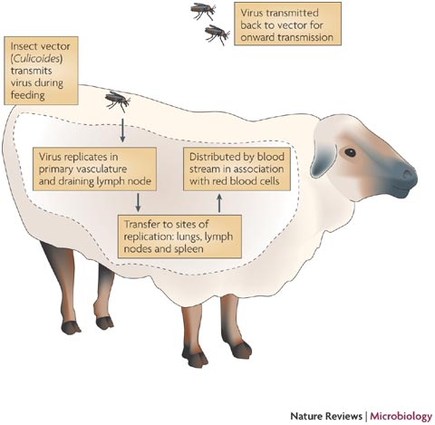
The pathogenesis can vary according to both the virus serotype and the ruminant species.
There is a great difference in expression of the disease between cattle and sheep, which may be due to a different response of the endothelial cells following infection: in contrast to sheep, cattle usually develop only a subclinical infection with the exception of infection with serotype 8 as has occurred in northern Europe.
https://microbewiki.kenyon.edu/index.php/File:Bluetongue_pic_5.jpg
In sheep, lesions in the endothelial cells of small blood vessels provoke vascular thrombosis and ischaemic necrosis of the affected tissue. These lesions result in buccal ulcers, infl ammation of the coronary band, muscular necrosis, and extravasation leading to facial and pulmonary oedema and pleural and pericardial effusions
https://www.oie.int/doc/ged/D11509.PDF

Slide 34
Culicoides
→
the regional lymph node
→
endothelial cells.
→
VIREMIA (RBC&WBC)
Transplacental
Transition
Encephalomylitis +
Polymyelitis
(AH Syndrome)
←
Fetal Circulation
Clinical Signs
←
SYSTEMİC endothelial cells
degeneration.

Slide 35
In addition to the external lesions seen in living animals, such as facial edema and coronary band lesions, sheep may have
hyperemia,
hemorrhages,
erosions and/or ulcers in the mucosa of the gastrointestinal tract from the mouth to the forestomachs, particularly where mechanical abrasion occurs (e.g., the buccal surface of the cheek and the mucosa of the esophageal groove and omasal fold).
The heart may contain petechiae, ecchymoses and necrotic foci; in bluetongue, focal necrosis is particularly common in the papillary muscle of the left ventricle. Subintimal hemorrhage at the base of the pulmonary artery is also characteristic

Slide 36
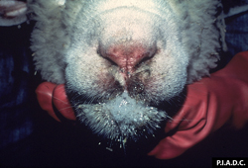
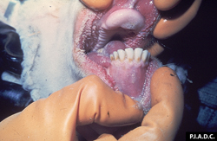
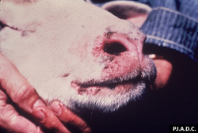
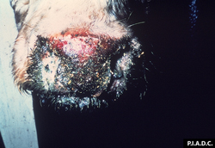
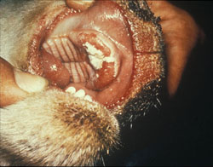
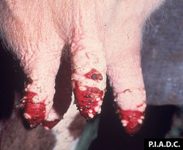
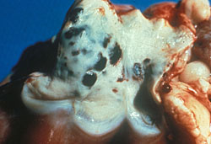
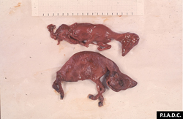
Sheep. There is bilateral nasal exudate, erosion of the nasal planum, and excessive salivation
Sheep, mouth. There is linear erosion and reddening of the right buccal mucosa.
Sheep. There are multiple erosions and crusts on the muzzle and lips.
Bovine. The muzzle is covered by an adherent crust, and the underlying (eroded) tissue is hyperemic.
Sheep, mouth. Most of the dental pad is eroded; the remaining pale mucosa is necrotic.
Bovine, mammary gland. There is extensive coalescing ulceration of the teat skin.
Sheep, pulmonary artery. There are multiple ecchymoses on the intimal surface
Sheep, fetuses. The larger of these aborted macerated fetuses exhibits torticollis.

Slide 37
Pulmonary edema, which may be accompanied by pleural and pericardial effusion, is a common cause of death in fatal cases, and may be a prominent finding.
Hyperemia, hemorrhages and/or edema may also be detected in other internal organs.
In addition, the skeletal muscles may have focal hemorrhages or necrosis, and the intermuscular fascial planes may be expanded by edema fluid.
Lesions in fetuses and newborn lambs can include cavitating lesions in the brain, hydranencephaly, porencephaly, retinal dysplasia and skeletal abnormalities. A.H. SYNDROME

Slide 38
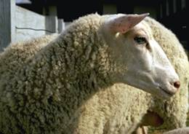
Morbidity and Mortality
Seroprevalence rates vary widely in endemic regions, 1% - 80% in domesticated and wild ruminants.
Sheep are usually the most severely affected species, and in endemic regions, they are often the only domesticated animal with obvious clinical signs. Morbidity rates in sheep range from < 5% to 50-75% (or higher), and are usually at their highest when the virus is first introduced.
Notes:
Seroprevalence rates vary widely in endemic regions, ranging from 1% to more than 80% in domesticated and wild ruminants such as sheep, goats, cattle and cervids, as well as in some other species such as camels.

Slide 39
Other species such as cattle and goats can also be affected when a bluetongue virus is introduced into a naive population.
Many cattle became ill during recent serotype 8 outbreaks in Europe.
Generally, cases in cattle and goats are milder than in sheep, and the mortality rate is lower.
Few cases have been documented in llamas and alpacas, and they were generally fatal.
Among wildlife, whitetail deer and pronghorn antelope can be severely affected, with morbidity rates reported to be as high as 100% and case fatality rates up to 80-90%.
Disease severity can also be influenced by factors such as the virus strain, host factors (e.g., immunity, general health, genetic factors, age and possibly breed) and environmental stressors.

Slide 40
Clinical Signs
The incubation period is estimated to be approximately a week, with a range of 2-10 days.
Sheep infected with bluetongue virus may remain asymptomatic, or become mildly to severely ill.
Common clinical signs include
fever;
hemorrhages and ulcerations of the oral and nasal tissue;
excessive salivation, and nasal discharge and swelling of lips, tongue, and jaw;
infl ammation of the coronary band (above the hoof) and lameness;
weakness, depression, weight loss;
profuse diarrhea, vomiting, pneumonia;
‘blue’ tongue as a result of cyanosis (rare);
pregnant ewes may abort;
may have ‘break’ in wool growth in recovering sheep resulting in partial or complete loss of wool.

Slide 41
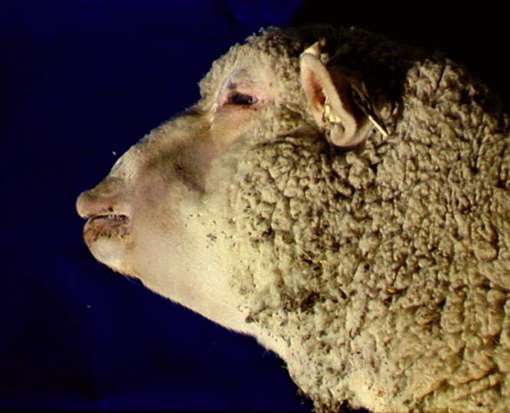
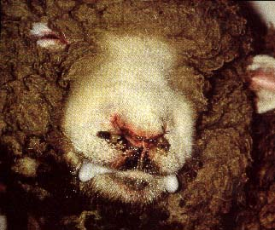
Edema on the face and lips, hyperemia in the nose wings
(followed by hemorrhage), hypersalivation.

Slide 42
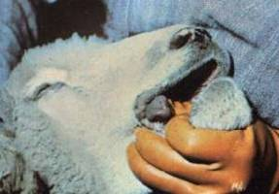
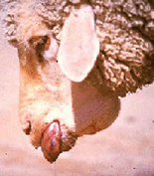

Slide 43
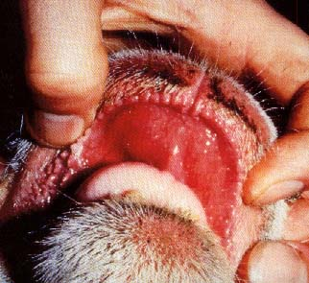
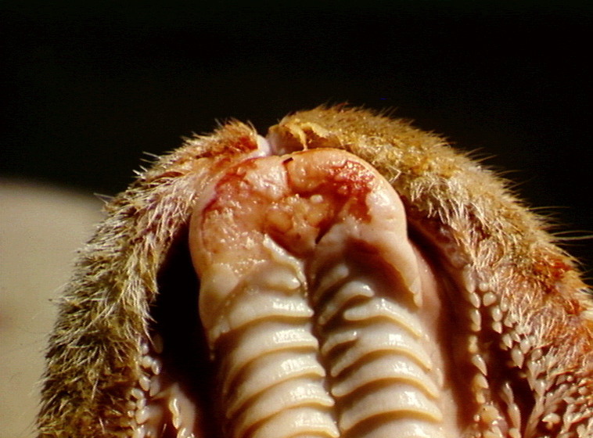
Upper lip and palate
swelling and hyperemia
Hard palate lesions,
hemorrhagic and erosive

Slide 44
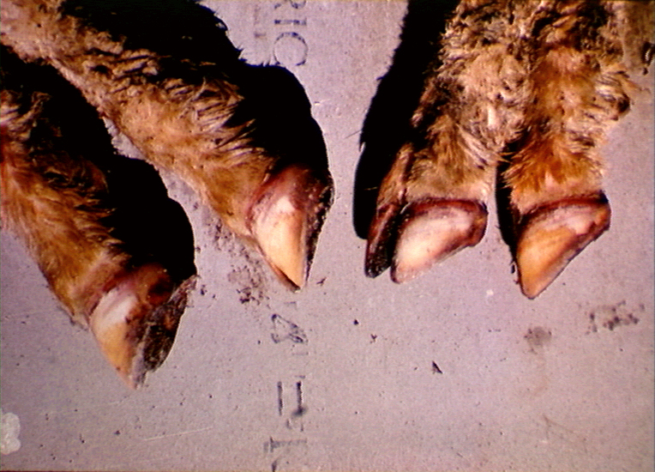
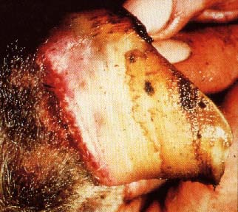
coronitis and pododermatitis

Slide 45
Infections in cattle and goats are usually subclinical in endemic areas.
These species are more likely to be affected when a naive population is first exposed to bluetongue virus, such as during recent serotype 8 outbreaks in Europe. Clinical cases resemble the disease in sheep, but tend to be milder.
Reported signs in cattle include
inappetence,
lethargy,
facial edema,
submandibular edema,
oral inflammation with vesicles or ulcers in the mouth,
excess salivation,
nasal discharge,
an elevated respiratory rate,
edema of the distal limbs, and
hyperemia of the coronary band with lameness.
Abortions and stillbirths have been reported in both species, and congenital abnormalities including CNS lesions have been observed in newborn calves.

Slide 46
Diagnosis and Differential Diagnosis
Bluetongue virus can be found in blood from living animals, and in spleen, lymph node or bone marrow samples collected at necropsy.
RT-PCR tests are widely used to identify viral RNA in clinical samples, and can also identify the serotype.
Bluetongue virus isolation
embryonated chicken eggs or
various mammalian or insect cell lines (e.g., KC [Culicoides variipennis] cells).

Slide 47
Immunofluorescence/immunoperoxidase staining,
ELISAs
Viruses can be serotyped by RT-PCR, gene sequencing or virus neutralization tests.
Serology can be used to identify animals that have been infected or exposed to bluetongue virus.
Antibodies typically appear 7 to 14 days after infection and are usually persistent.
ELISAs are often used, but agar gel immunodiffusion (AGID) or virus neutralization can also be employed.

Slide 48
Differential Diagnosis;
Food and Mouth Disease
Stomatitis Vesicularis
Sheep Pox
Bovine Viral Diarrhoea
Peste des Petits Ruminants
Akabane
İberaki
Malignant Catarrhal Fever
Contaagious pustular dermatitis

Slide 49
Immunology
Type-specific immunity occurs.
Neutralizing antibodies provide immunity for 2 years.
Antibodies pass through the colostrum. Passive immunity protects the lambs/calves for 2-6 months.

Slide 50
Prevention and Control
Notifable Disease
Bluetongue is mainly controlled by vaccination.
Vaccines should be matched to the viral serotype; protection against other serotypes can be limited or nonexistent.
Both attenuated and killed vaccines are currently made (although not necessarily sold in all regions), and multivalent vaccines are available.
Attenuated vaccines are considered to be more effective than killed vaccines; however, midges may transmit these vaccine strains to unvaccinated animals during the vector season.

Slide 51
Attenuated vaccine strains can also cause fetal malformations in pregnant ewes thus vaccine are not implemented to them.
Surveillance of sentinel animals may detect bluetongue viruses before outbreaks occur, and allow vaccination campaigns or other controls to be implemented early.
Measures to reduce exposure to the Culicoides vectors may also be helpful during outbreaks or in endemic regions, although they are unlikely to be effective as the sole control measure.
In Turkey, attenuated Serotype 4 Vaccine

Slide 52
References
http://www.cfsph.iastate.edu/Factsheets/pdfs/bluetongue.pdf
Maclachlan, N. J., Drew, C. P., Darpel, K. E., & Worwa, G. (2009). The pathology and pathogenesis of bluetongue. Journal of comparative pathology, 141(1), 1-16.
https://www.oie.int/doc/ged/D11509.PDF
http://www.oie.int/doc/ged/D13959.PDF
Anthony J. Wilson, Philip S. Mellor, (2009) Bluetongue in Europe: past, present and future, Phil. Trans. R. Soc. B 364, 2669–2681 DOI: 10.1098/rstb.2009.0091

Slide 53
African Horse Sickness (AHS) Pestis Equorum

Slide 54
African horse sickness (AHS) is a serious arthropod-borne viral disease of equids, with a mortality rate that can reach 95% in some species, such as horses.
At present, AHS virus (AHSV) is only endemic in Africa; however, suitable vectors exist outside this area, and infected animals or vectors may carry the virus into AHS-free regions.

Slide 55
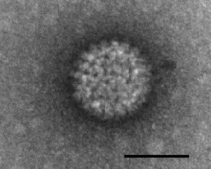
Ethiology
Reoviridae Orbivirus
«orbis» = ring (latin) - ring-shaped capsomeres are seen on the surface of virions by electron microscopy.
RNA, segmented
Non-enveloped
Not affected by Ether and Chloroform
HA
There are 9 serotypes of this virus, and while some serotypes are cross-protective (e.g., serotypes 6 and 9), others are not.
Inoculation to T.C: MS, BHK, Vero, Foal Kidney.
EA: Mouse Brain (i.C) ATTENUATION
ECE: CAB

Slide 56
Equids including horses, donkeys, mules and zebras are the primary hosts for AHSV; however, this virus is also known to affect dogs.
Among equids, the most serious infections occur in horses and mules, which are thought to be accidental hosts. Zebras, which are often asymptomatic, are thought to be the natural reservoir hosts in most regions of Africa.
Within Africa, additional AHSV serotypes have recently spread to some areas where only one serotype was previously found.
Although vaccines are available, cross-protection between serotypes is limited, and the introduction of a new serotype into an area may result in outbreaks.

Slide 57
Transmission
AHSV is transmitted by the midges Culicoides imicola and C. bolitinos in Africa. Additional species of Culicoides might also be able to act as vectors.
The virus replicates in the horse and salivary glands of the vector, the midge Culicoides imicola .
Once, the virus was found only in Africa. Since 1987 it has re-appeared in Spain (as far north as Madrid) & Portugal where the vector occurs. The virus may be endemic there. In the recent Spanish outbreaks hundreds of horses have died or been destroyed.

Slide 58
Wind has been implicated in the dispersal of infected vectors during some epidemics.
Zebras are thought to be the natural reservoir hosts for AHSV, but horses, mules and donkeys can also develop viremia sufficient to infect Culicoides
Dogs can be infected if they eat contaminated horsemeat, and experimental infections have been established by the oral route as well as by subcutaneous or intravenous inoculation.

Slide 59
Pathogenesis and Pathology
Pantropic, fatal disease. Predominantly infects endothelial cells and myocardium.
Once the virus enters the blood, it multiplies in the lymph.
After the virus replicates in the lymph vessels, it creates edema the head, under neck, throat and chest. Then virus settle in the lungs, where it causes edema and Hydrotoraks.
near 2 liters of fluid in the pericardium (gelatinous, fibrinous),
petechial hemorrhage and hyperemia are observed.

Slide 60
Pathology
Culicoides
Local Lymph Node.
I. VIREMIA
Hematopoietic
Organs
Endothelial cells of large and small vessels
II. VIREMIA
Edema in the lung and subcutis, interstitial hemorrhagie, pleural effusion,
hydrothorax, mycocardial hemorrhagie, infarctus

Slide 61
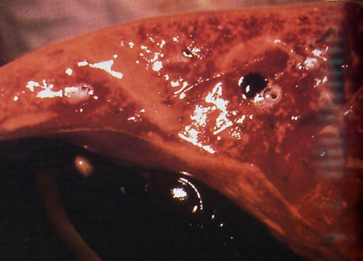
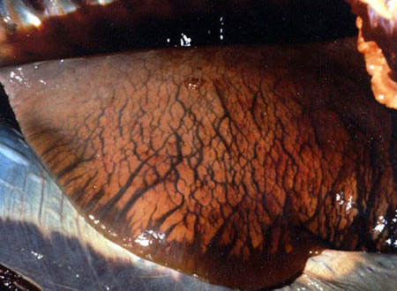
Pathology
Pulmonary cross-section, edema
Pleural effusion and pulmonary edema

Slide 62
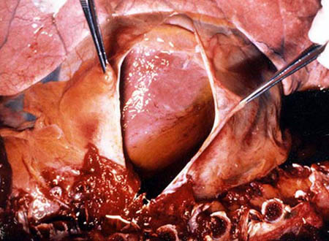
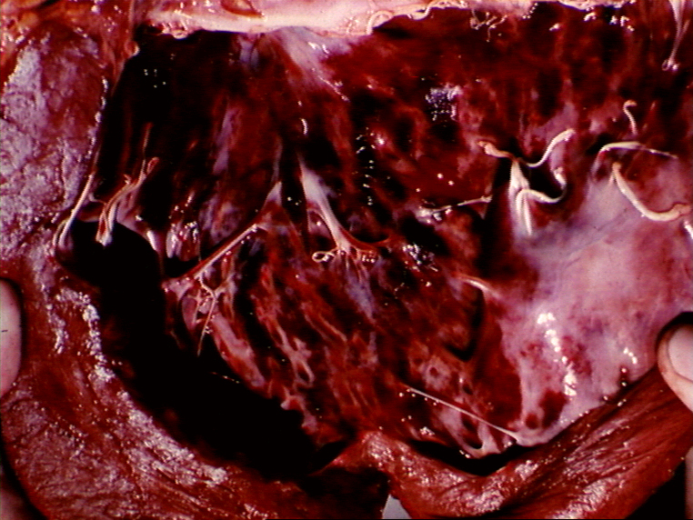
Pathology
Hydropericardium
Myocard, haemorrhagie

Slide 63
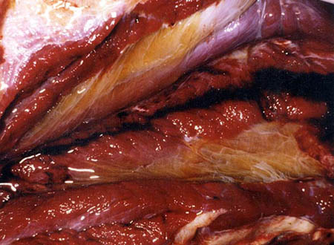
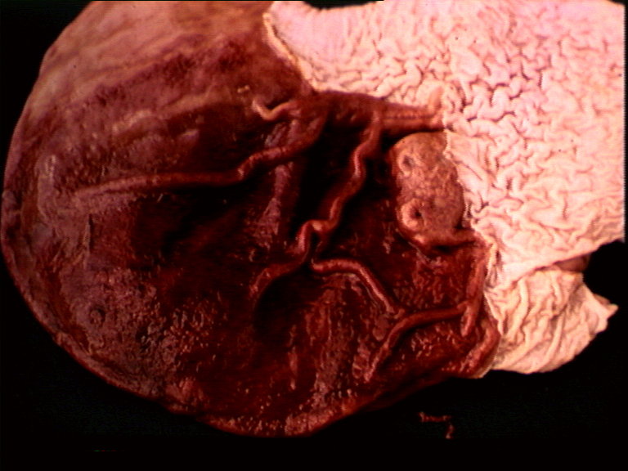
Pathology
Intermuscular Edema, Gelatinous deposits
Glandular stomach bleeding

Slide 64
Incubation Period
The incubation period for African horse sickness in equids is approximately 3 days to 2 weeks (usually < 9 days), with the cardiac form typically developing later than the pulmonary form.

Slide 65
Clinical Signs
Four different forms of African horse sickness exist:
the peracute (pulmonary) form,
the subacute edematous (cardiac) form,
the acute (mixed) form,
horsesickness fever.

Slide 66
1-Peracute and Pulmunal Form:
- The incubation period is very short (3-5 days).
- Fever 40-41 ° C
- Increased respiratory rate (> 70 / min).
- Dispnea, Animals with this form often stand with forelegs spread, head extended, and nostrils fully dilated.
- Edema in alveoli and fluid in brochures
- death after a few hours from the initial clinical indication

Slide 67
2- Subacute edematous (cardiac) form
The incubation period is 7-14 days.
- Fever lasts 3-6 days.
Shortly before the fever starts to subside, edematous swellings appear in the supraorbital fossae and eyelids.
These swellings later spread to involve the face, tongue, intermandibular space, laryngeal region, and sometimes the neck, shoulders and chest.
- Hydroperikardium
Myocardial infarction
Death often occurs from cardiac failure.
If the animal recovers, the swellings gradually subside over a few days to a week.

Slide 68
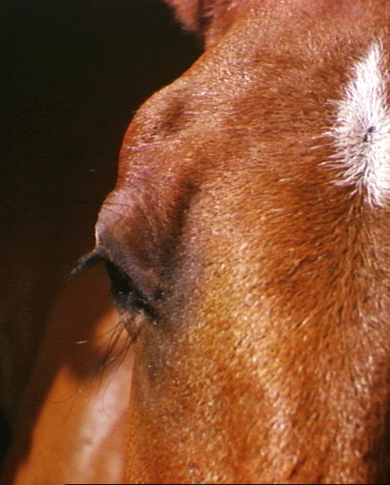
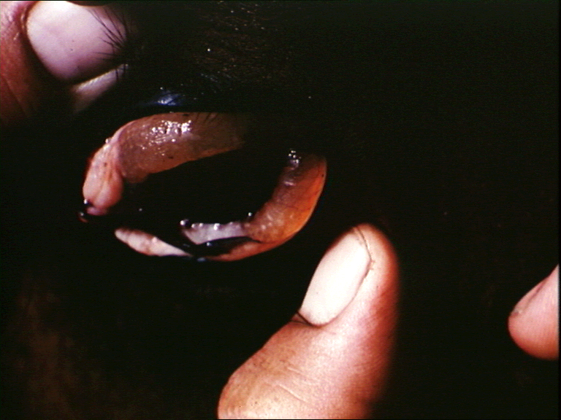
Supraorbital edemz

Slide 69
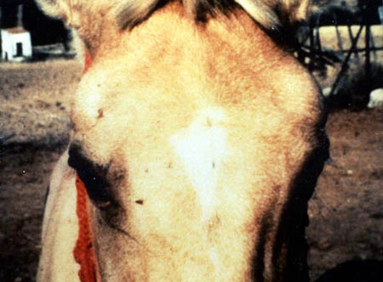
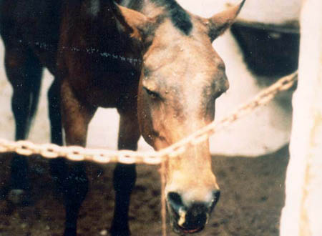
Supraorbital edema

Slide 70
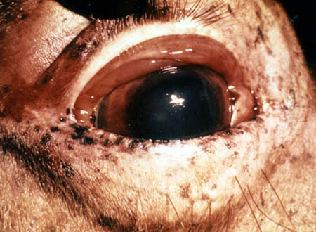
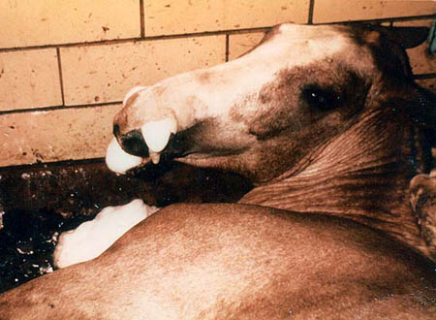
Conjunctival edema and hyperemia
Pulmonary foaming due to pulmonary edema

Slide 71
3- The acute or mixed form
Clinical signs of both the pulmonary and cardiac forms are seen in the mixed form.
In most cases, the cardiac form is subclinical and is followed by severe respiratory distress.
Occasionally, mild respiratory signs may be followed by edema and death from cardiac failure.
Although the mixed form is common, it may not be recognized except at necropsy.

Slide 72
4- Subclinical form (Horse sickness fever)
Fever (40–40.5°C/104°F–105°F)
Mild form; general malaise for 1–2 days
Very rarely results in death

Slide 73
Diagnosis and Differential Diagnosis
Clinical diagnosis is possible.
Intracerebral inoculation from suspected cases causes the death of suckling mice from which the virus can be identified by complement fixation tests and haemagglutination inhibition tests.
AHSV can be isolated from the blood of live animals, or from tissue samples, especially spleen, lung and lymph nodes, collected at necropsy.
AHSV antigens can be detected in the blood and tissues (e.g., spleen) with ELISAs.
Various RT-PCR assays are used to detect viral RNA.
Some RT-PCR assays can also be used for rapid serotyping of field isolates.

Slide 74
Serology can also be used to diagnose African horse sickness, with antibodies usually detected within 8 to 14 days after infection.
Paired serum samples are recommended, and are particularly important in areas where the disease is endemic.
Available serologic tests include ELISAs, complement fixation, immunoblotting and virus neutralization.
Immunodiffusion and hemagglutination inhibition tests have also been described.
Cross-reactivity between AHSV serotypes is variable, and AHSV does not cross-react with other known orbiviruses.

Slide 75
Prevention and Control
Strong preventative control measures are required - bans on movements of all susceptible animals; protection against vectors; slaughter or immediate isolation of sick animals; mandatory & immediate vaccination of the entire equine population with the appropriate serotype; monitoring for the presence of the virus and the vector.
Protection zones (where animals are vaccinated to contain the spread of the disease) and Surveillance zones (no vaccination but animals monitored for disease) are set up around outbreaks.
Annual vaccination
Vector control

Slide 76
ROTAVIRUS INFECTIONS

Slide 77
Neonatal diarrhea in calves is an important disease, which causes economic loss in the cattle industry due to high mortality and morbidity.
Rotaviruses are the most common cause of neonatal diarrhoea in calves.
Calves are most commonly affected at 8 to 14 days old when there is an acute onset of diarrhoea with the passage of very watery yellow/green faeces.

Slide 78
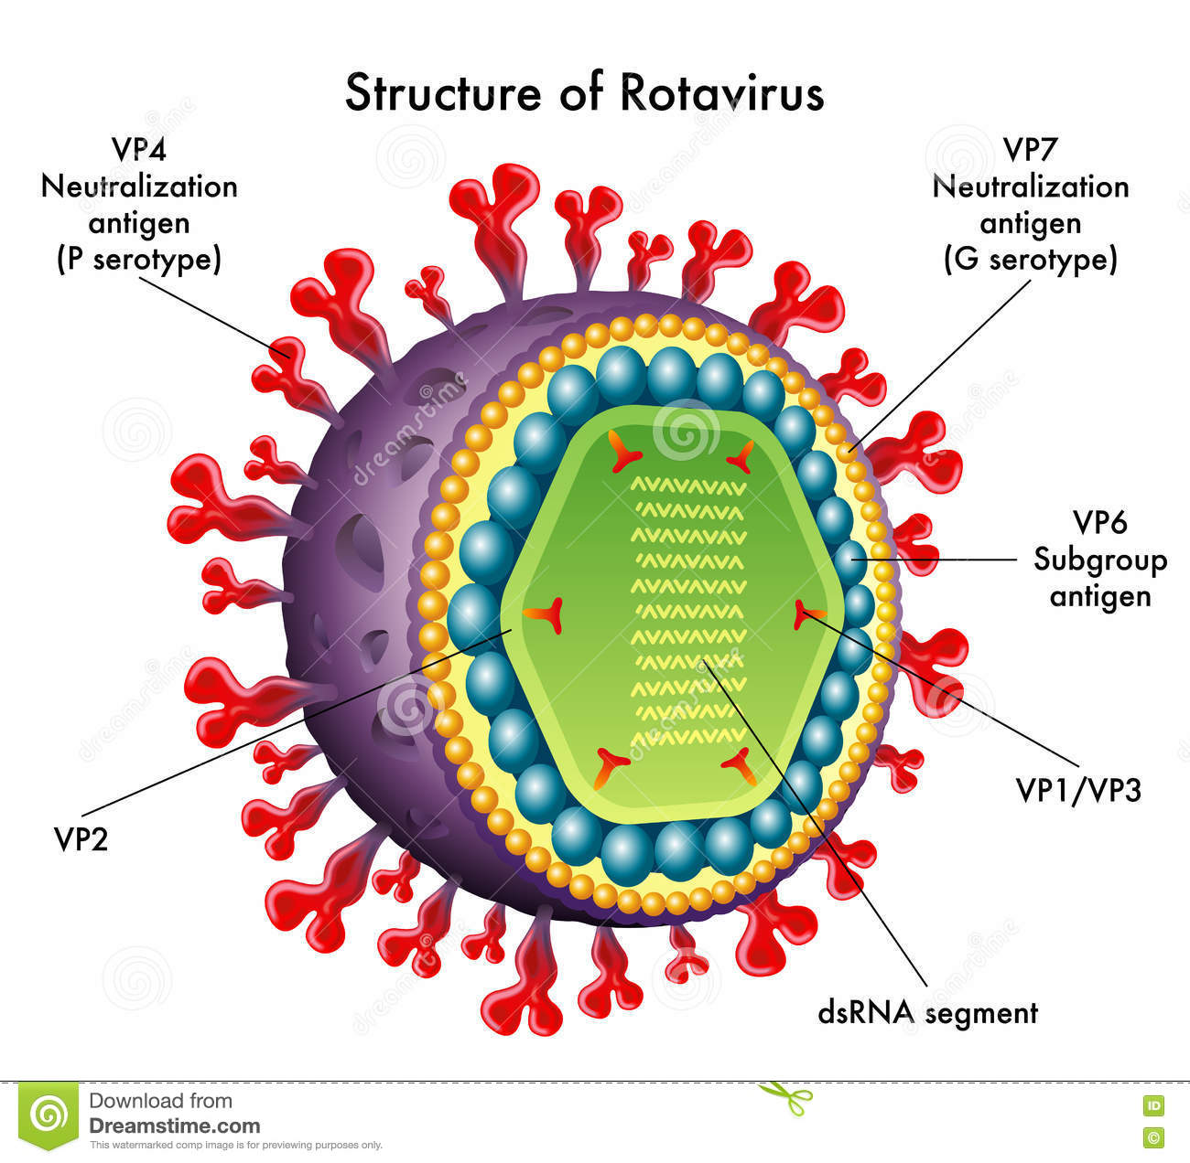
Ethiology
REOVIRIDAE ROTAVIRUS
11 segmented dsRNA (Double Strand)
Non-enveloped
HA
Not Affected by Ether and Chloroform
CPE MDBK, MA-104, Calf Kidney Cell. Should be treated with Tripsin
It is seen in Cattle, Human, Mouse, Pig, Sheep, Monkey, Deer, Rabbit, Antelope and Horse.

Slide 79
Based on the antigenic sites located on the VP6 protein of the inner capsid, Rotavirus strains are classified into five main (A, B, C, D, E) and two additional tentative (F, G) serotype groups (also known as serogroups).
Strains classified into serogroups A, B and C are pathogenic for humans and various animal species.
Group A: present in all mammals examined. Important role in calf and piglet diarrhoea; role in lambs & foal diarrhoea less certain; not associated with diarrhoea in cats & dogs.
Group B: pigs, sheep, cattle, rats, man.
Group C: pigs, man, ferrets
Group E: pigs.
serogroup D, F and G strains have been isolated only from avian species.
RVs from different animal species thought of as distinct but some transmission between species may occur naturally.

Slide 80
RVAs are classified into G (glycoprotein) and P (protease sensitive) types according to the sequence diversity of the outer capsid proteins VP7 and VP4, respectively, which independently generate serotype-specific neutralizing antibodies in vivo.
To date, at least 27 G and 37 P genotypes have been defined in mammals and avians (da Silva Medeiros et al., 2015).
the most common G and P genotypes in cattle are
G6, G8, G10 (for VP7)
P[1], P[5], P [11] P[15], and P[21] (for VP4)

Slide 81
Transmission
Infection may be acquired in the calving accommodation then spread between young calves in the calf house by direct contact.
Virus sheds via feces.
Main source of the virus is clinically infected calves or subclinically infected mothers.
The virus is taken orally by the infected food, water and milk.
FECAL ORAL ROUTE

Slide 82
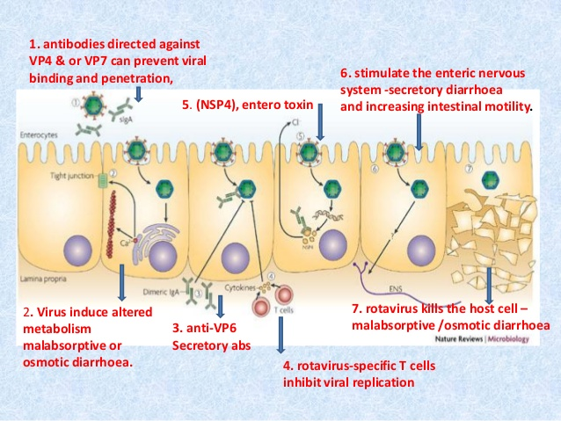
Pathogenesis
Virus entry – By ingestion
Viral replication occurs in small intestinal epithelium.
Up to two-thirds of children with severe rotavirus gastroenteritis show the presence of rotavirus antigen in serum (antigenemia).
Infection may result in decreased intestinal absorption of sodium, glucose, and water, - decreased levels of intestinal lactase, alkaline phosphatase, and sucrase activity, and may lead to isotonic diarrhea.

Slide 83
Crypt
SÜT
Villus
SU
VİRUS
Laktoz → ETEC
Na+, Cl-, K+ vs
Villus
LAKTAZ
Crypt
1- Villusların virus tarafından dejenere edilmesi
2- Transport fizyolojisinin bozulması
3- Lümende su birikimi
4- Sindirilemiş Laktoza bağlı ETEC üremesi
5- Sarı (SÜT), pis kokulu (ETEC) ishal

Slide 84
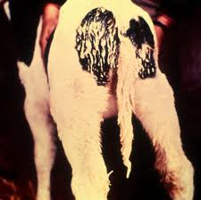
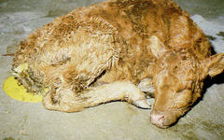
Clinical Signs
- Usually occurs in the neonatal period.
- Acute, self-limiting, malaborption diarrhoea (calf/piglet scour) with anorexia, vomiting (pigs),
weight loss,
depression,
dehydration,
death.
Incubation period 1-4 days.

Slide 85
Diagnosis
On feces:
ELISAs available commercially for group A RVs. ELISAs for human RV OK for animal RV.
Latex agglutination: commercially available for group A; calf-side test.
Electron microscopy: RVs have a distinctive morphology. Also allows visualization of other enteropathogenic viruses Eg. coronaviruses & caliciviruses.
PAGE (Polyacrylamide gel electrophoresis) of segmented viral nucleic acid: Used in some Veterinary Investigation Centres. Distinctive band patterns.
On tissues:
Immunocytostaining - allows intestinal damage & RV infection to be correlated. Useful for smaller farm animals (pigs); early tissues samples at the beginning of diarrhoea essential before infected enterocytes lost. Single animal can give diagnosis.
Rising antibody titres: not useful because majority of animals have high levels of rotavirus antibody in serum.

Slide 86
Prevention and Control
The following relates to group A RVs but may also relate to the other groups.
By an inter-relationship between passive immunity & virus exposure.
It is impossible to prevent infection of the young but disease can be supressed/eliminated by keeping the infection pressure low and ensuring neonatal animals receive adequate levels of passive antibody orally while at risk.

Slide 87
Remove dirty bedding, sanitize hands, gloves, boots, clothing after dealing with sick animals; deal with sick animals first; steam clean/fumigate premises. Practise all-in, all-out system where possible.
Antibody must be present in the gut lumen to neutralize the infectivity of the virus and this requires daily feeding of colostrum. Disease occurs when passive immunity wanes (either naturally or by weaning).
Diseased animals usually have good levels of circulating antibody derived from the early ingestion of maternal antibody. These are NOT protective because the pathogenesis is confined to the gut.
Bovine RV: A dam vaccine is available in the Turkey to boost & prolong secretion of RV neutralizing antibody in colostrum/milk.
1. to mother i.m. 45 days before birth
2. to mother 15 days before birth
Canine & Feline RVs: No vaccines thought necessary.

Slide 88
https://www.news-medical.net/health/Rotavirus-in-Animals.aspx
http://www.thecattlesite.com/diseaseinfo/234/rotaviral-diarrhoea/
PETER H. RUSSELL, BVSc, PhD, FRCPath, MRCVS, REOVIRIDAE: Rotaviruses And Orbiviruses Department of Pathology and Infectious Diseases, The Royal Veterinary College, http://www.pitt.edu/~super1/Virology/virology.htm

