Slide 1
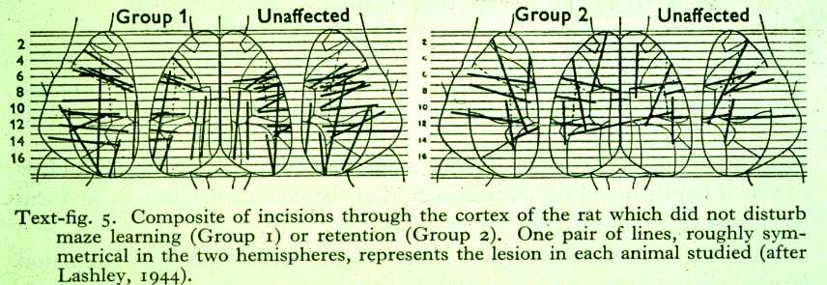
LASHLEY ENGRAM (1944)
Lashley trained the rats to solve the maze
disrupted connections between two brain area’s or removed part of the brain
Results:
Disrupted connections did not affect maze performance
Maze performance was only decreased when large amounts of brain were removed
Conclusion: learning, and the retention of what had been learned, did not depend upon specific areas of the brain

Slide 2
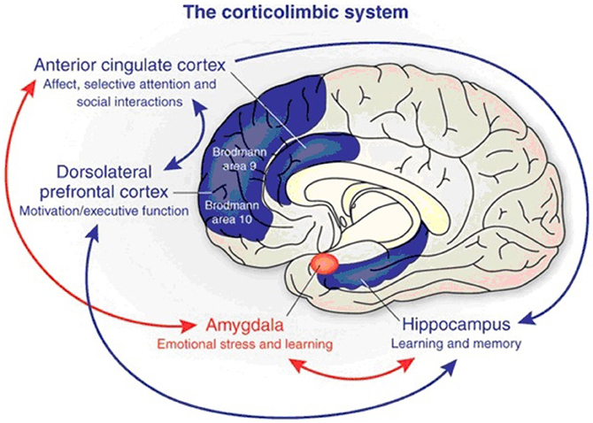

Slide 3
TYPES OF LEARNING
Incidental learning (Non-associative learning):
Behavior change is not immediate
Habituation, sensitization
Reflex learning (Associative learning)
Immediate behavior change
Classical conditioning
S-S learning
Operant Conditioning
R-S learning

Slide 4
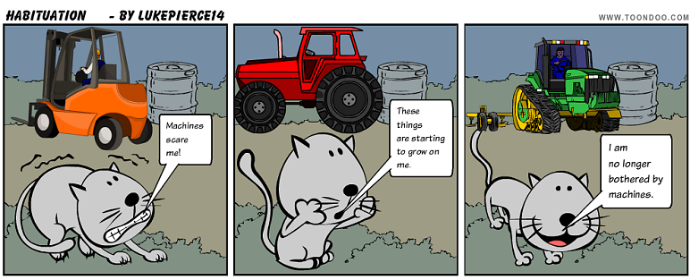
Non-associative learning
Most basic form of learning
Habituation
Decrease in response to a (benign) stimulus after repeated exposure to that stimuli
generally neutral, non-noxious stimuli

Slide 5
Non-associative learning
Sensitization
Decrease in response to a (hedonic) stimulus (pain/joy) after repeated exposure to that stimuli
strong hedonic valence (+ or -)
also refers to augmentation of responding following exposure to a second stimulus

Slide 6
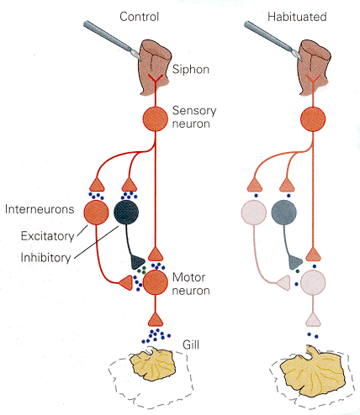
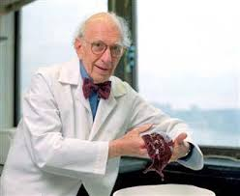
CELLULAR BASIS OF HABITUATION (Squire & Kandel, 1999)
Repeated stimulus
Inactivation of Ca influx at axon endings
Decreased neurotransmitter release in synapsis

Slide 7
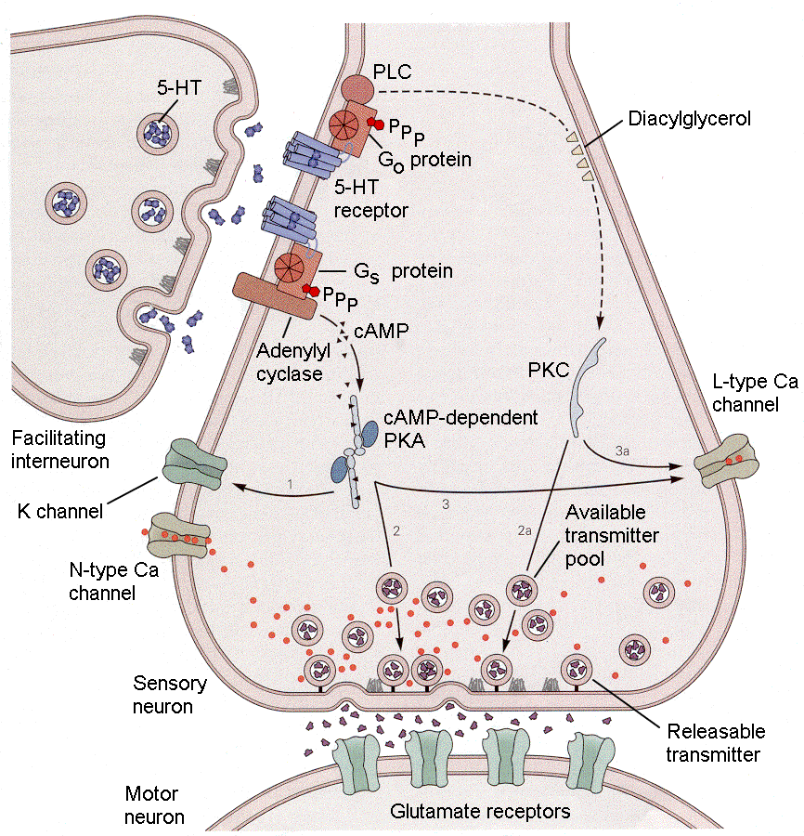
CELLULAR BASIS OF SENSITIZATION (Squire & Kandel, 1999)
Repeated exposure
Modulatory interneuron releases serotonin
Presynaptic K+ channel blocked, Action Potential prolonged
CA++ channels open, more Ca++ in presynaptic
More neurotransmitter
More AP from motor neuron

Slide 8
NON-ASSOCIATIVE LEARNING IN PRACTICE
Habituation is used in puppy socialization
the puppy is repeatedly exposed to novel experiences
The puppy learns that they’re “no big deal”

Slide 9
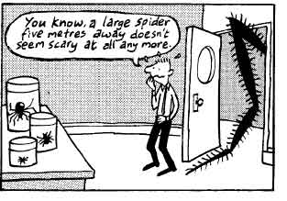
Systematic desensitization: structured plan based on the process of making a dog less sensitive to a stimulus

Slide 10
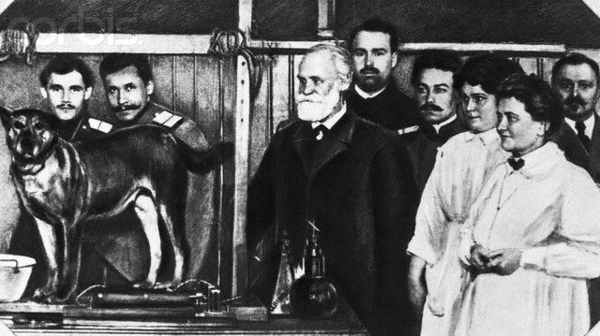
ASSOCIATIVE LEARNING
Classical conditioning - Ivan Pavlov (1849-1936)
is a form of learning that occurs when two stimuli—a neutral stimulus and an unconditioned stimulus—that are paired (presented together) become associated with each other.

