Slide 1
Food safety
Food safety is defined as protection of consumer from adverse health effects of food under the responsibility and control of legislation
In terms of food safety, legislations are responsible to
Control of food hygiene during production and distribution
Limit the levels of food additives
Limit the levels of food contaminants which can be naturally found or occured as a result of heat treatment
Approve new unit operations
Determine specifications for packaging materials

Slide 2
Parameters threatening the food safety
The parameters which threaten the food safety are given below
Natural toxins: They are generally plant origin. They cause poisoning. Some mushrooms species, some herbal teas, some types of honey can be considered as an example for natural toxins in foods
Allergens: Food allergies cause negative impact on immune system, which is originated from specific food proteins. Food allergies generally attributed to milk, eggs, peanuts, tree nuts, soy, wheat, fish and shellfish

Slide 3
Organizations responsible for food safety in the World (International Organizations)
Organization name | Its responsibility
World Health Organization (WHO) | WHO works to provide international public health in the world. It is a specialized organization of United Nations
Food and Agricultural Organization (FAO) | FAO lead international efforts to defeat hunger and improve nutritional conditions. It is a specialized organization of United Nations
The Joint FAO/WHO Expert Committee on Food Additives (JECFA) | It is an international scientific committee administrated by FAO/WHO to evaluate the safety of food additives, contaminants, naturally occurring toxicants and residues of veterinary drugs in food

Slide 4
Organizations responsible for food safety in the World (Regional Organizations)
Organization name | Its responsibility
European Food Safety Authority (EFSA) | EFSA is the agency of the European Union (EU) that provides independent scientific advice to protect consumers, animals and the environment from food-related risks
United States Food and Drug Administration (FDA) | FDA is charged with protecting consumers against impure, unsafe, and fraudulently labeled foods, drugs and cosmetic products
United States of Enviromental Protection Agency (US-EPA) | EPA is established to protect the human health and the environment. In terms of food, the EPA determines the usage of pesticides in agriculture under controlled condition
United States Department of Agriculture (USDA) | USDA is a department of Agricultural Ministry to provides leadership on food, agriculture, natural resources, and related issues

Slide 5
Organizations of Turkey

Slide 6
Organizations of Turkey

Slide 7
FOOD ADDITIVES

Slide 8
The necessity of food additives
It is estimated that the world’s population will reach 8 billion people by 2025
This increase means that larger amounts of safe and high quality foods must be produced to feed the increasing population
Current and future technologies are effective in the production of high quality and safe food products; however the usage of food additives are necessary to preserve and maintain this quality

Slide 9
The definition of food additives
Food additives are defined as “any substance not normally consumed as a food by itself and not normally used as a typical ingredient in the food, whether or not it has nutritive value, the intentional addition of which to food for a technological purpose in the manufacture, processing, preparation, treatment, packaging, transport or holding of such food” by FAO and WHO

Slide 10
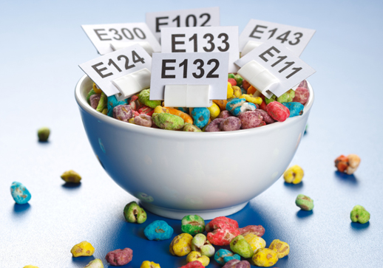
What is the meaning of E-codes?
In the European Union, each food additive is labelled with the letter “E” and a spesific number to easily identify food additives in the worldwide
It represent the subgroup
E 407
The whole number is the code of additive
It represents Europe

Slide 11
Food additives
Preservatives
Nutritional additives
Flavoring agents
Coloring agents
Texturizing agents
Miscellaneous agents
Antimicrobials
Sweeteners
Emulsifiers
Antioxidants
Natural and synthetic flavors
Stabilizers
Antibrownings
Flavor enhancers

Slide 12
E-codes of food additives
The range of E-codes for each subgroup is given below
E100-E199 …… coloring agents
E200-E399 …… preservatives
E400-E499 …… emulsifiers, stabilizers
E500-E599 …… acidity regulators, anti-caking agents
E600-E699 …… flavor enhancers
E700-E799 …… antibiotics
E900-E999 …… sweeteners
E1000-E1599 …. additional chemicals

Slide 13
References
Carocho, M., Barreiro, M.F., Morales, P. and Ferreira CFR. (2014) Adding Molecules to Food, Pros and Cons: A Review on Synthetic and Natural Food Additives. Comprehensive Reviews in Food Science and Food Safety, 13, 377-399.
Ortega-Rivas, E. (2010) Processing effects on safety and quality of foods. Chapter 2: Overview of Food Safety (pages 11-65) CRC Press Taylor & Francis Group, Florida, USA.

