Slide 1
SPERMATOZOON
Ovoid
20 micron
5 micron head
No Akrozom
Head, midpiece, tail
Posterior nuclear cavity
Tail aksonema (9+2)
SEMINAL PLASMA
Na, K, Ca, Cl, Mg
Glucose, sucrose
Protein
Antioxydant vitamins
Uric acide
Osmotic pressure
(240-300 mOsm)
pH 7-8

Slide 2
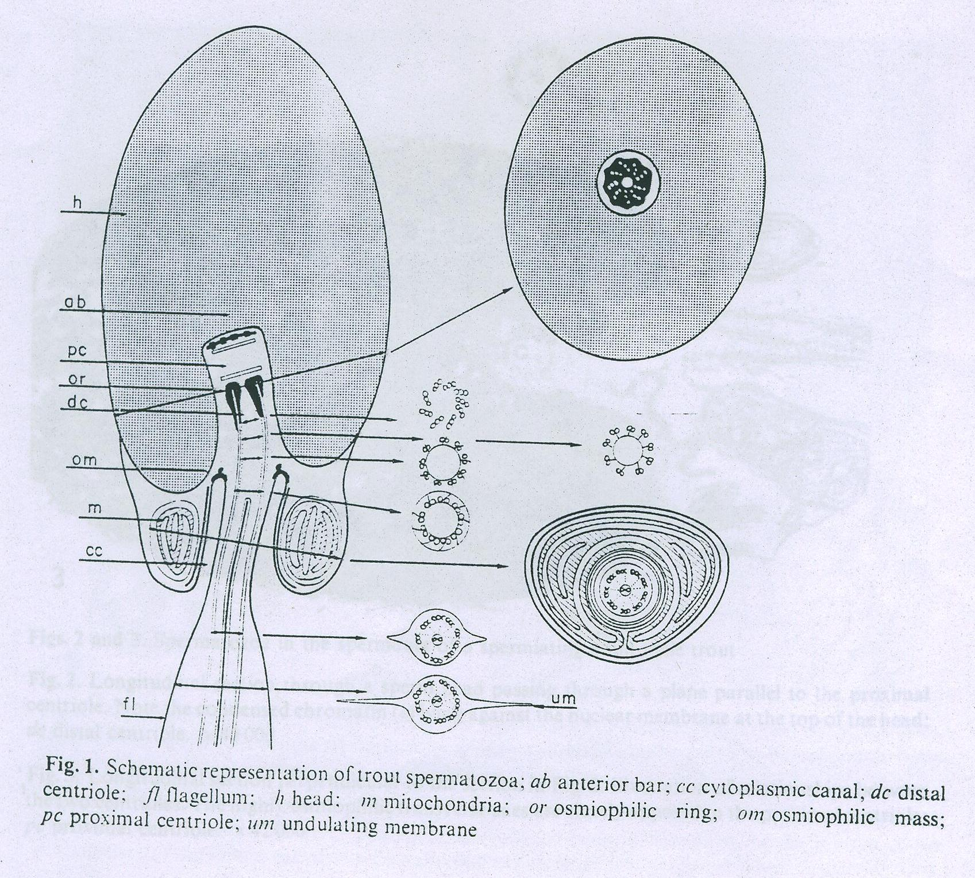
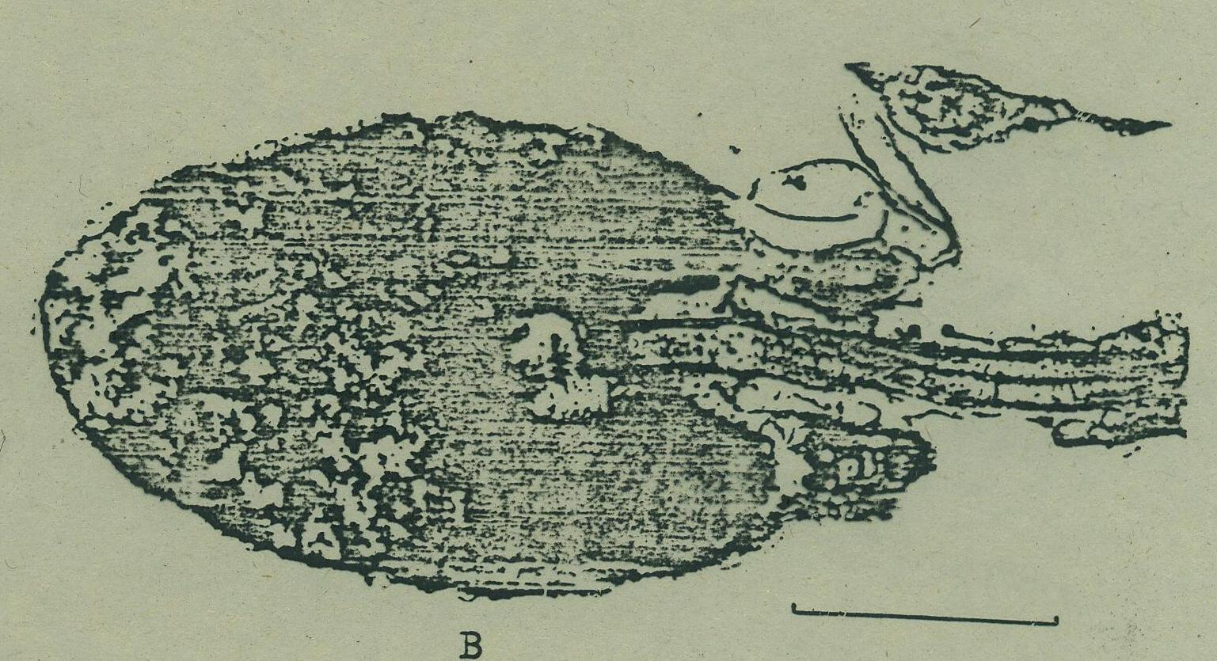

Slide 3
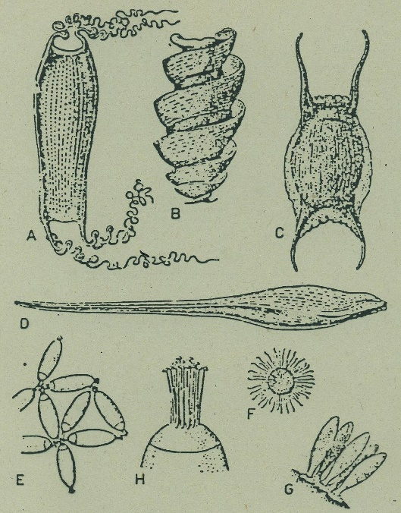
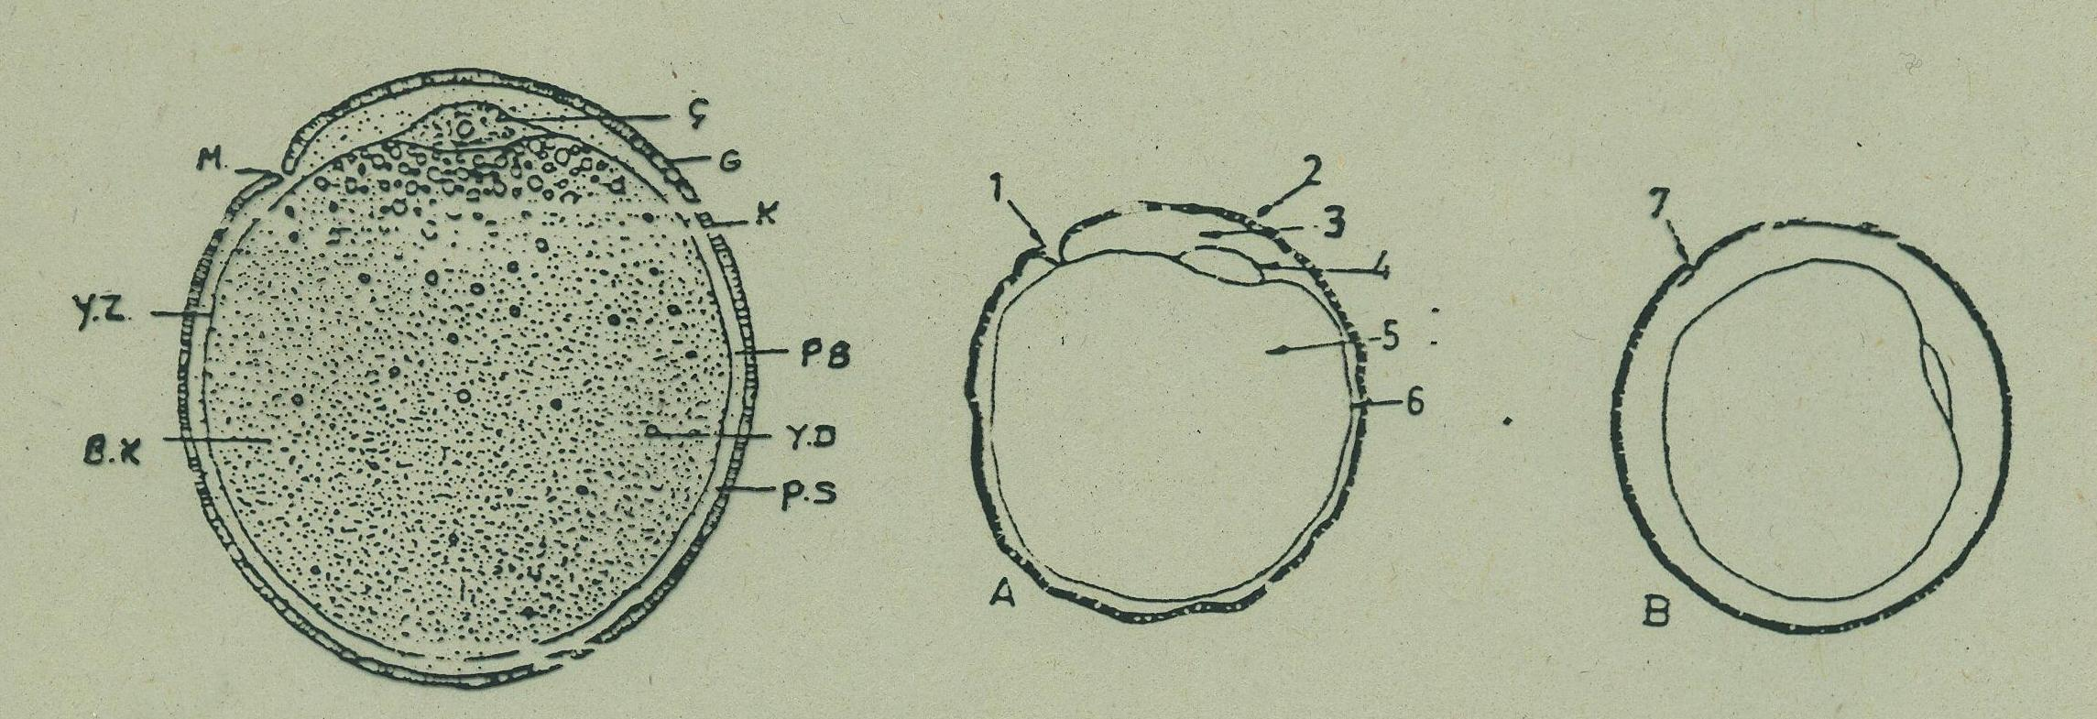
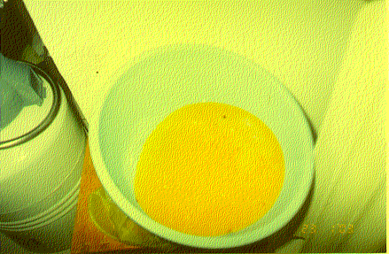
EGGs, OVA
DEMERSAL EGG (Spesific gravity (Weight), sticky, or some organelles)
Diameter 3-5 mm for trout, 1 mm for carp (depends on age, body weight, feeding)
500-2000 egg/1 kg BW for trout,
200.000-300.000 egg/1 kg BW for carp
Micropyle

Slide 4
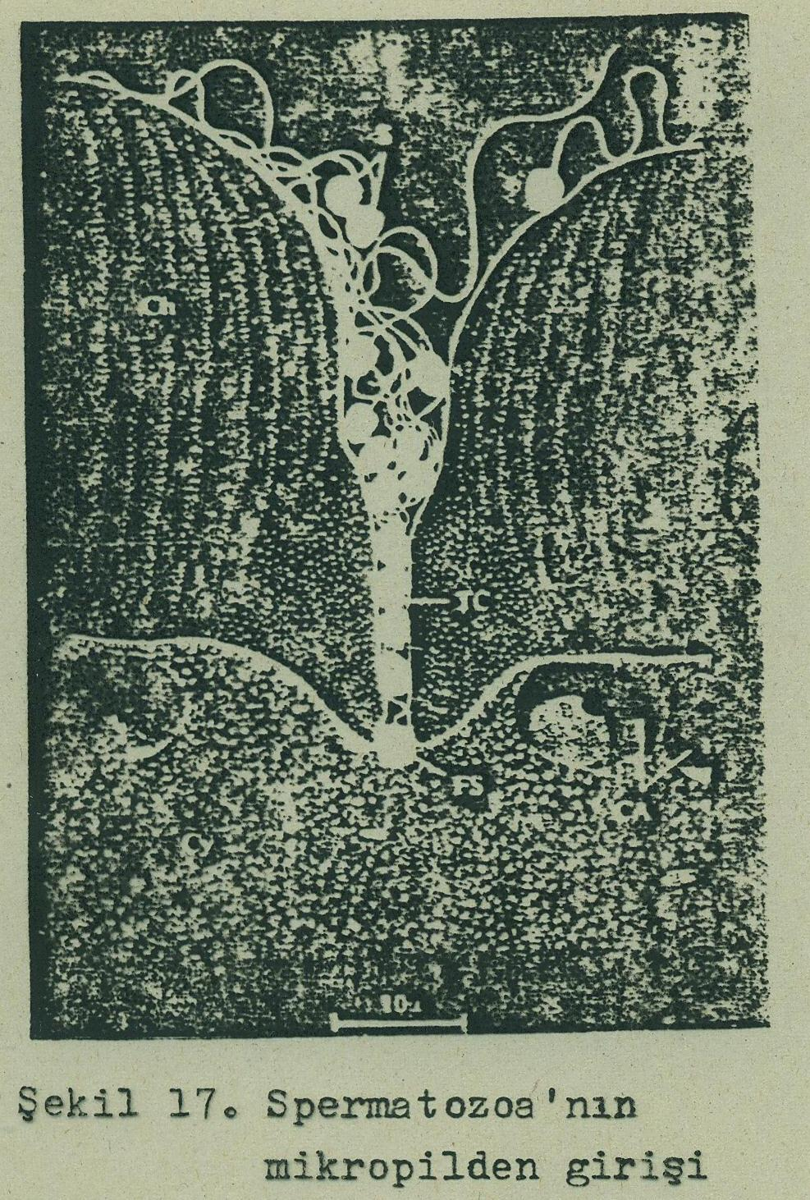
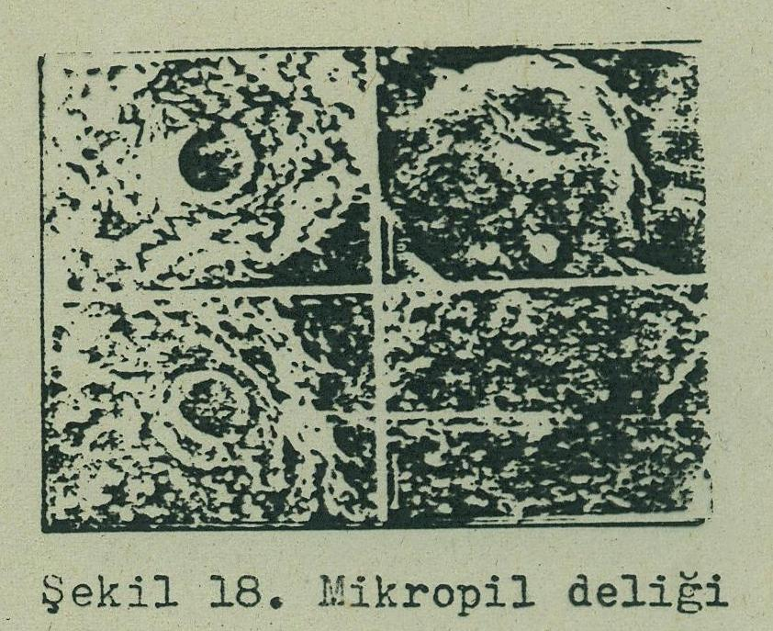

Slide 5
Mechanism of Fertilization
Temperature, light, flow, food, salinity, pH
Eggs releasing
Ejaculation
Activation of spermatozoa
Fertilization
Fertilized egg and incubation
1. Male and female spawn by swimming side by side.
2. When eggs are extruded into water, they are surrounded by milt.
High motility of sperm only lasts for 30-60 sec.
Usually, one sperm enters the micropyle, fertilizing the egg.
The micropyle closes, the egg absorbs water and enlarges (Egg becomes sticky for carp).

