Slide 1
FIELD GEOLOGY
Lecture 1
Equipments in the field, measured sections

Slide 2
https://www.slideshare.net/khchaotel/structural-geology

Slide 3
https://www.slideshare.net/khchaotel/structural-geology

Slide 5
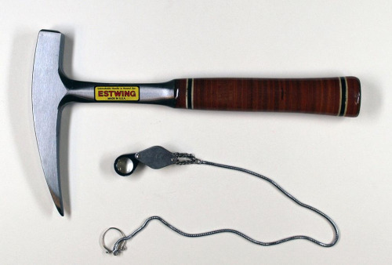

Slide 6
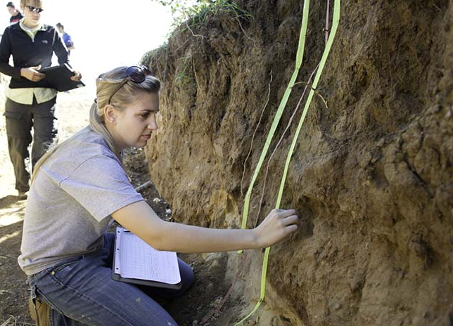
https://www.uwrf.edu/PES/Geology/

