Slide 1
MOLECULAR BASIS OF CANCER -I
1

Slide 2
Cellular Basis of Cancer
•
Cancer is a collection of diseases characterized by abnormal and uncontrolled growth
•
Cancer arises from a loss of normal growth control
•
In normal tissues, the rates of new cell growth and old cell death are kept in balance
•
In cancer, this balance is disrupted
•
This disruption can result from
uncontrolled cell growth or
loss of a cell's ability to undergo apoptosis
2

Slide 3
Cancer Cell Do Not Grow Faster Than Normal Cells
Rather, Their Growth is Just Uncontrolled
3

Slide 4
Invasion and Metastasis
Abnormal cells proliferate and spread (metastasize) to other parts of the body
Invasion - direct migration and penetration into neighboring tissues
Metastasis - cancer cells penetrate into lymphatic system and blood vessels
4

Slide 5
Malignant versus Benign Tumors
Benign tumors generally do not spread by invasion or metastasis
Malignant tumors are capable of spreading by invasion and metastasis
5

Slide 6
What causes Cancer?
Cancer is caused by alterations or mutations in the genetic code
Can be induced in somatic cells by:
Carcinogenic chemicals
Radiation
Some viruses
•
Heredity - 5%
10

Slide 7
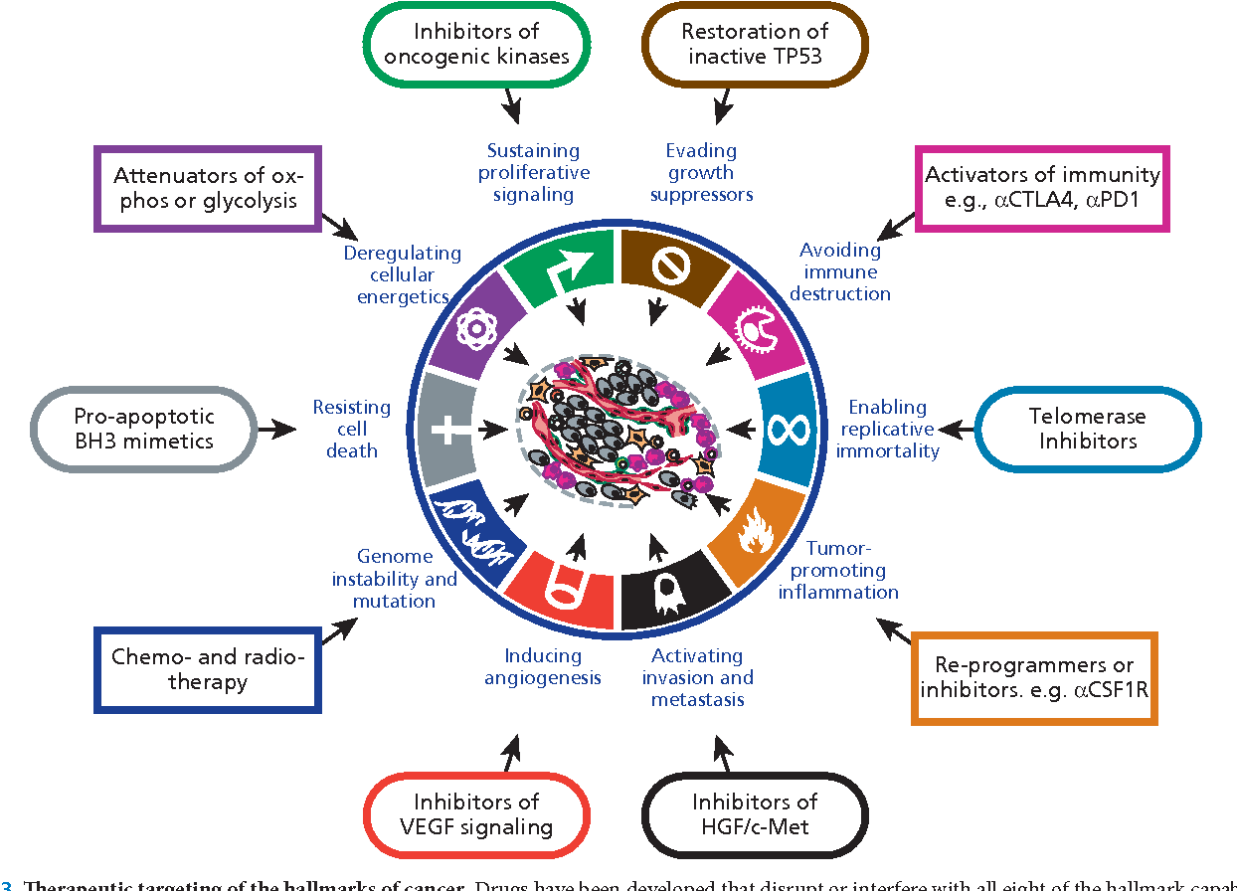
Hanahan and Weinberg, Cell 100: 57, 2011

