Slide 1
CONDUCTOMETRIC TITRATION

Slide 2
CONDUCTOMETRIC TITRATION
Conductivity ( C ) is the measure of the material's ability to transmit electrical current. C = 1 / R. Thus, it is the opposite of R. Unit is S/m. (The Siemens unit is dedicated to German scientist and inventor Werner von Siemens).
As it is known, pure water does not transmit electric current, it is said that there is no conductivity because it is theoretically not containing ions. In practice, however, if there is very little in pure water, a conductivity is read around the microsiemens that contains the ionic layer. Whether or not a water is pure can be understood by looking at the conductivity value. For example, when the conductivity of ultrapure water is 0.055 μS / cm and the conductivity of distilled water is about 0.5 μS / cm, this value is around 56000 μS / cm in seawater.

Slide 3
CONDUCTOMETRIC TITRATION
The conductivity of the ions to the solvent depends on some properties, such as viscosity of the solvent, the number of dissolved ions, the size and the charge.
The analysis method based on the conductivity changes in the solution is called conductivity measurement (conductometry). The means used to measure conductivity is called a conductometer.

Slide 4
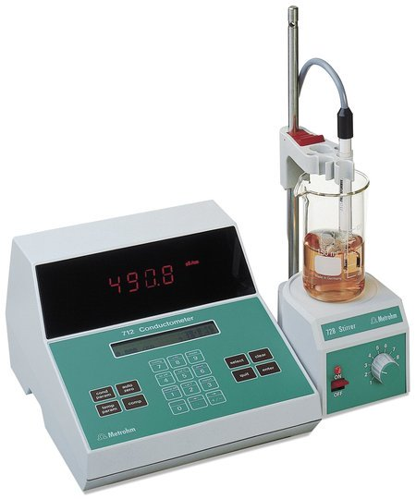
CONDUCTOMETRIC TITRATION
Conductometer consist of an electrical source, a conductivity cell in which the analysis solution is located, and a resistance meter. Platinum electrodes coated with platinum black are usually used in the conductivity cell, which is the most sensitive region of the vehicle.
https://www.metrohm.com/en-us/products-overview/27120010

Slide 5
CONDUCTOMETRIC TITRATION
In conductometric titrations, the turning point is determined by using the changes in conductivity during the reaction.
Advantages of conductometric titration:
It is very useful for the titration of very dilute solutions and weak acids.
It is applicable for coloured and turbid solutions.
Also it is suitable for the titrations which the end point of the can not be observed easily by eye (using indicators).

Slide 6
CONDUCTOMETRIC TITRATION
Titration of a strong acid with a strong base
HCl and NaOH solutions may be used in strong base titration with a strong base. Take 50 mL of the prepared analyte, (a strong acid (HCl)) solution and place it in the conductivity cell of the conductometer. The conductivity at the beginning is measured. The magnetic stirrer is started. Titration is started by dropping from titrant (a strong base, (NaOH)) solution flowing from the burette. Conductivity is measured after each 0.1 - 0.2 mL of titrant is added. Conductivity values are plotted on the Y axis of the coordinate plane and in mL as the titrant volumes are on the X axis of the coordinate plane.

Slide 7
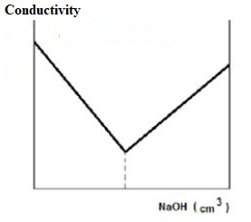
CONDUCTOMETRIC TITRATION
Titration of a strong acid with a strong base
As NaOH is added to the HCl solution in the titration of a strong base with a strong acid, the hydrogen ion concentration decreases and the conductivity decreases rapidly to the equivalence point. After the point of equivalence, since there are more hydroxyl ions in the environment, the conductivity increases again rapidly.
The concentration of the acid is found by using the NaOH amount at the equivalent point obtained from the graph.

Slide 8
CONDUCTOMETRIC TITRATION
Calculations
These values obtained for identification of the equivalence point are loaded into a data processing program such as "Microsoft Excel" or "Open Office Calc". The data is divided into two parts, the reduced conductivity and the increased parts. The correct equations of these two data sets are subtracted and the equations are equalized to find the cut point of these two lines. The x value found is the equivalence point. For example;
y =150x + 47.6 and y = -150x + 211.2 when the two equations are equal to each other,
150x + 47.6 = -150x + 211.2
300x = 163.6
x =0.545 can be found.
These operations can also be performed using the linear regression functions of scientific calculators.

Slide 9
CONDUCTOMETRIC TITRATION
a: Strong acid-strong base
b: Weak acid-strong base
c: Very weak acid-strong base
titration of a mixture of a strong acid and a weak acid

Slide 10
Reference
Onur, Feyyaz; Analitik Kimya II, Ankara Üniversitesi Eczacılık Fakültesi Yayın No:101, s:135-149; Ankara 2011.

