Slide 1
The Spread of Islam and the Turks

Slide 2
Spread of Islam after Hz. Muhammad
In one century, Islam spread from the Hijaz to an empire that stretched from India to Spain
Muslim armies marched across West Europe until they were defeated in France, Battle of Poltiers / Puvatya, 732
632 Arabian Peninsula, 636 Damascus, Syria, 638 Jerusalem, 640 Egypt, 670 Attempt to conquer Constantinople/Byz. Empire, 680 All of North Africa,710 Crossed Oxus River to Turkestan, 710 Crossed Strait of Gibraltar into Spain, 724 Reached borders of China and India.

Slide 3
What caused the rapid expansion of Islam?
Religious belief that
a. Islam must be reached to everyman
b. Allah was on their side
c. Fath, ihad and ghaza
2 . Military power:
a. Soldiers had stability and precision in battle
b. camel and horse cavalries were faster than traditional armies.
c. invention of the stirrup
3. Growing Arab population/need for more land
4. Muslim tolerance and justice: Allowing conquered people to keep their culture and belief. Many people converted to Islam

Slide 4
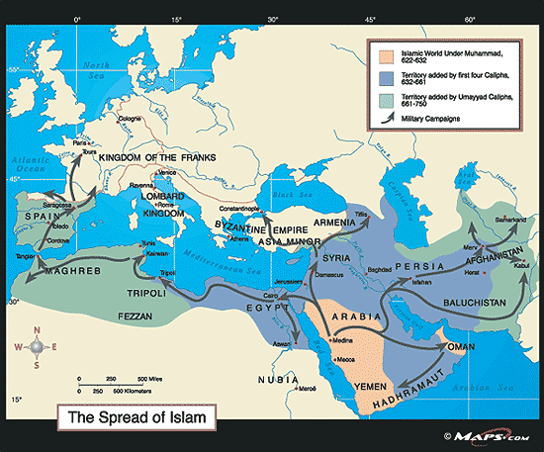

Slide 5
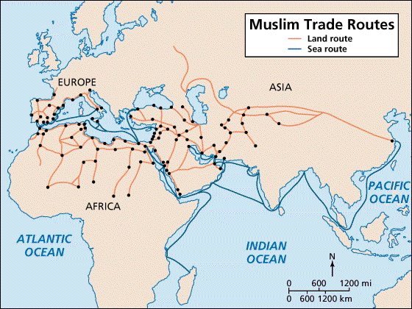
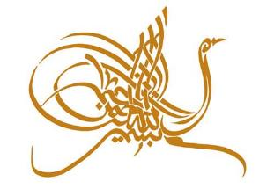
Spread of Islam, 632-732
Notes:
5

Slide 6
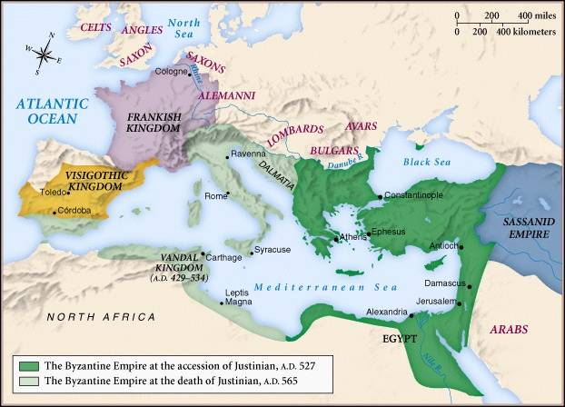
The Byzantine Empire During the Reign of Justinian

Slide 7
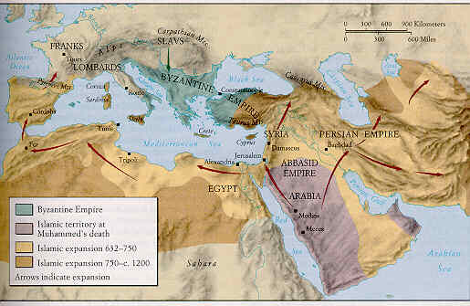
Spread of Islam

Slide 8
1. Umayyad Dynasty (601-750)
How did the Umayyads treat the people they conquered?
allowed people to follow own belief systems and culture
non-Muslims sometimes paid higher taxes
Jews and Christians held important gov’t. positions
many people converted to Islam in the late 8th century
Cross regional and cultural exchange occurred for many years among Christians, Jews, Muslims and polytheistic people.
Arabic became language of many conquered people and helped unify them under Islam
improved farming by new technology and irrigation

Slide 9
2. Abbasid Dynasty (750-1250)
The spread of Islam was rapid and engulfed areas (Middle East and North Africa) that had been long-accustomed to other faiths
Reinforced a strong sense of community and attachment to family
A series of schools were established to reinforce Islamic teaching -- these schools were attached to mosques
The Islamic empire began in the 11th century to be squeezed on three sides, from the Turks in the north, the Spanish on the West and the Mongols in the east
This pressure had shrunk the Islamic empire by the 15th century to the Middle East, Arabian peninsula, and the western part of Persia

Slide 10
1. Conversion to Islam
In the first centuries conversion to Islam followed the rapid growth of the Muslim World.
The conquests in the first centuries soon established Muslim dynasties in Africa, the Middle East, and Asia such as the Abbasids, the Fatimids, the Almoravids, the Seljukids, the Mughals, the Safavids, and the Ottomans.
The activities of this quasi-political community of believers and nations, or ummah, resulted in the spread of Islam over the centuries, spreading from Mecca to the Atlantic Ocean in the west and the Pacific Ocean in the east. Today there are 1.7 billion Muslims, making Islam the second-largest religion in the world.

Slide 11
Prosesse of Conversion
Religious conversion is the experience of the following phenomena.
1. At the fundamental level conversion is the awakening of religious knowledge or understanding within a human being who had previously no belief in or concern with religious or spiritual matters.
2. This awakening to moral and spiritual realities thus precedes a transformation of lifestyle and thought patterns often taking place over a long period of time and requiring a significant level of effort and commitment as described in the spiritual teachings of the world's great religions. This transformation is the first and basic meaning of religious conversion.

Slide 12
Reasons of Conversion
People convert to a religion for various reasons, including:
active conversion by free choice,
secondary conversion by secondary reasons or motivations,
deathbed conversion,
conversion for convenience,
marital conversion,
forced conversion.
Conversion or reaffiliation for convenience is an insincere act, sometimes for relatively trivial reasons such as a parent converting to enable a child to be admitted to a good school associated with a religion, or a person adopting a religion more in keeping with the social class he or she aspires to.

Slide 13
Reasons of Conversion
When people marry one spouse may convert to the religion of the other.
Forced conversion is adoption under pressure of a different religion. The convert may secretly retain the previous beliefs and continue, covertly, with the practices of the original religion, while outwardly maintaining the forms of the new religion. Over generations a family forced against their will to convert may wholeheartedly adopt the new religion.

Slide 14
Islamic Perspective on Conversion
A newly converted one to Islam is called muhtady or muallaf. A person who decieded to convert to Islam sincerely makes the declaration of faith, the shahadah and become mu’min / believer
From the Qur'anic perspective the issue of “conversion by force” is very clear:
“There is no compulsion in religion; verily the guidance has become clear from the error. So whosoever rejects the idol and believes in God, he has laid hold onto the most firm rope which will not break; God is All-hearing, All-knowing.” (Baqara, 2:256)
By forced conversion, you only increase the numbers of hypocrites, not the number of true believers.

Slide 15
Islamic Perpective on Conversion
Prophet Muhammad’s role was just to remind the people of their natural instinct of believing in God. In Qur’an He was mentioned as a reminder/muzakkir, not as a person who forces Islam upon others:
“Therefore, you remind (them), for you are only a reminder; you are not a watcher over them.” (Ghaashiya, 88:21-22)
In many other verses, the Prophet is described as “a bearer of good news” and as “a warner of God's punishment.” (Baqara, 2:119; Saba, 34:28)
The Prophet Muhammad (pbuh) states that
“Everyone is Muslim at birth (fıtrah) because every child that is born has a natural inclination to goodness and to worship the one true God alone, but his or her parents or society can cause him or her to deviate from the straight path. When someone accepts Islam he/she is considered to revert to his/her original condition.”

Slide 16
Main factors in conversion and the spread of Islam
Abulfazl Ezzati states that
1. Religious factor,
2. Religious leadership factor, 3. Intellectual factor,
4. Moral and ethical factor, 5. Cultural factor,
6. Humanitarian factor, 7. Political factor,
8. Social factor, 9. Economic factor,
10. Educational factor, 11. Factors relating to Civilization.

Slide 17
Main Factor of Conversion to Islam
Content and Attraction of Islam:
Islam spread through more spontaneous conversions as people learned of it through trade and the other activities.
The religion was clearly attractive, with an explicit set of beliefs / teachings about halal and haram in order to win access to heaven and avoid a lamentable eternity in hell.
Islam appealed to lower-class groups because of its commitment to charity and spiritual equality;
Islam also legitimated merchant activity more than did most belief systems at the time, and so could attract traders.
The cultural and political achievements of Islam drew people eager to advance their societies in a variety of ways, including religious ones.

Slide 18
Orientalist Perspective to Conversion in Muslim Lands Ira Laipdus 1
American historian, distinguishes between two separate strands of converts of the time:
The animists and polytheists of tribal societies of the Arabian peninsula and the Fertile crescent;
The monotheistic populations of the Middle Eastern agrarian and urbanized societies.
For the polytheistic and pagan societies, conversion to Islam,
apart from individual religious and spiritual reasons,
"represented the response of a tribal, pastoral population to the need for
a larger framework for political and economic integration,
a more stable state,
a more imaginative and encompassing moral vision to cope with the problems of a tumultuous society."

Slide 19
Reasons of Conversion in Muslim Lands I. Lapidus 2
For sedentary and often already monotheistic societies, "Islam was substituted
for a Byzantine or Sassanian political identity,
for a Christian, Jewish or Zoroastrian religious affiliation."
Conversion initially was neither required nor necessarily wished for: "(The Arabs) did not require the conversion as much as the subordination of non-Muslim peoples. At the outset, they were hostile to conversions because new Muslims diluted the economic and status advantages of the Arabs."
In next centuries, with the development of the religious doctrine of Islam and with that the understanding of the Muslim ummah, mass conversion took place. The new understanding by the religious and political leadership in many cases led to a weakening or breakdown of the social and religious structures of parallel religious communities.

Slide 20
Reasons of Conversion in Muslim Lands Albert Hourani
British-Lebanese historian, believes that
Muslims lived within an elaborated system of ritual, doctrine and law clearly different from those of non-Muslims. (...)
The status of Christians, Jews and Zoroastrians was more precisely defined, inferior, as the 'People of the Book' / Ahl al-Kitab / 'People of the Covenant' / Ahl al-Ahd / Ahl al-Zimmah.
In general they were not forced to convert, but they suffered from restrictions.
1.They paid a special tax;
2. they were not supposed to wear certain colors;
3. they could not marry Muslim women.

Slide 21
Some terms of Conversion
Islamiz(s)ation / Islamification (Ar. aslamah / Tr. İslamlaşma) is the process of a society's conversion to Islam voluntarily. In contemporary usage, it may refer to the perceived imposition of an Islamic social and political system on a society with an indigenously different social and political background.
Islamizing: (Tr. İslamlaştırma) is a process of religious, emotional, cultural or political change in which something or someone who is not a Muslim becomes one, involuntarily. Involving religious conversion, cultural and linguistic assimilation, and interethnic relationships.
The English synonyms, muslimization and arabization, in use since before 1940 convey a similar meaning. Due to the trend towards identifying all Muslims with Arabs, common in the Western world, the latter tends to be applied to non-Arab (e.g. Berber, Pakistani or Iranian) influence as well. Muslimization has recently been used as a term coined to describe the overtly Muslim practices of new converts to the religion who wish to reinforce their newly acquired religious identity.
Apostasy (Ar. Irtidad): From a Greek term meaning, "to revolt," apostasy is the act of abandoning or rejecting a previously held religious faith. An apostate / murtad is one who has defected from or ceased to practice his or her religion

