Slide 1
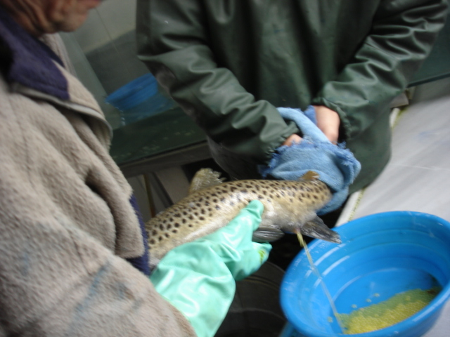
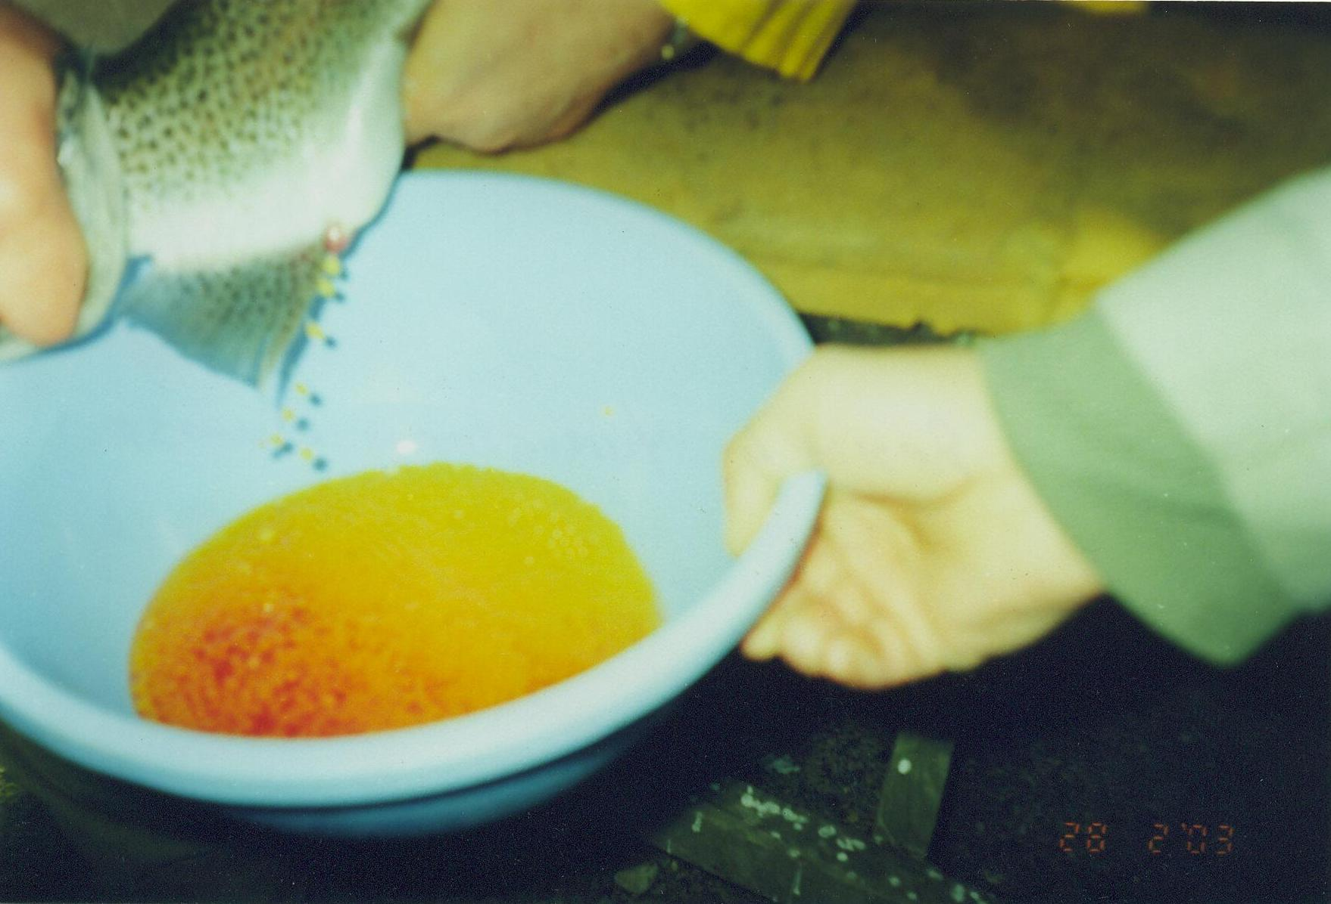
EGG COLLECTION
Eggs are removed manually from females by applying pressure from the pelvic fins to the vent area or by air spawning, causing the fish less stress and producing cleaner, healthier eggs.
Insertion of a hypodermic needle about 10 mm into the body cavity near the pelvic fins and air pressure (2 psi) expels the eggs. The air is removed from the body cavity by massaging the sides of the fish.
Up to 2000 eggs/kg body weight are collected in a dry pan and kept dry, improving fertilization.
Farmer should be attempting to always have a fresh set of 3-year-old females ready for stripping annually.

Slide 2
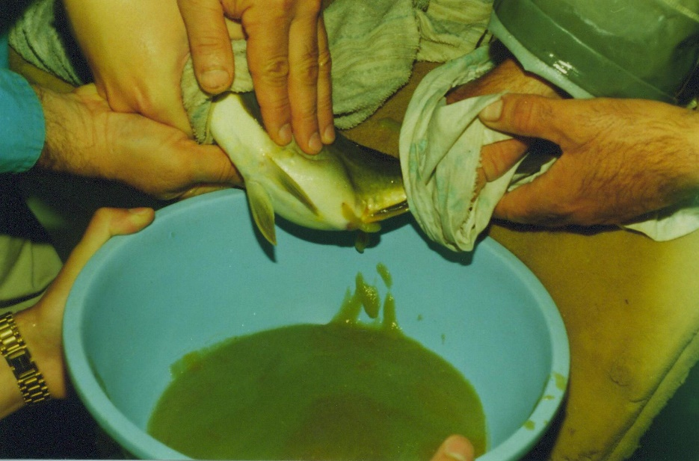
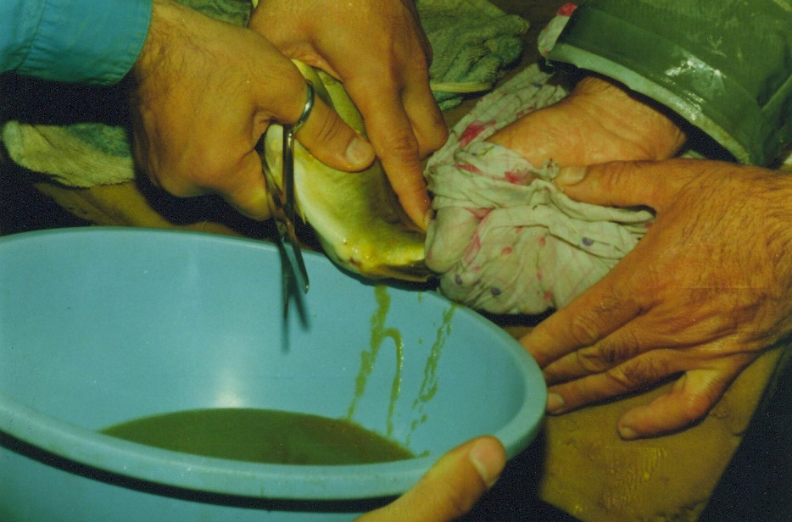
Egg collection from carp
Eggs were collected by hand stripping 10-12 h after a double injection of 2-4 mg/kg of CPE (or 1000-1500 IU/kg HCG).
For example, the first injection, 10% (0.4 mg/kg) CPE was given 10 h before the second (3.6 mg/kg).

Slide 3
FERTILIZATION TECHNIQUES
WET INSEMINATION: Stripped eggs are emptied into a bowl which contains a quantity of water
DRY INSEMINATION: The bowl contains no water in the dry method. Thus the eggs reside only in ovarian fluid after expulsion.
There is some controversy as to whether egg stripping should be done dry or wet.
It is generally believed that an expert stripper using the dry method can secure a higher degree of successful fertilization than by using the wet method.

Slide 4
FERTILIZATION Trout
Milt from more than one male is mixed with the eggs. It is recommended that milt from three or four males is mixed prior to fertilization to reduce inbreeding.
Water or activating solution is added to activate the sperm
Insemination dose should be 100.000-1.000.000 sp per egg
After fertilization, the eggs should not be handled for about 20 minutes.
Fertilised eggs can be transported after 20 minutes, and up to 48 hours after fertilization, but then not until the eyed stage.
Direct exposure to light should be avoided during all development stages, as it will kill embryos.

Slide 5
FERTILIZATION Carp
The sperm-egg ratio should be about 250,000 sp/egg. Semen added over the eggs and gently mixed before activation with 20 ml of fertilization solution (3 g of urea, 4 g of NaCl in 1 l of water).
After fertilization the eggs should be stirred for 1 h
at the end of the stirring they are treated with tannic acid (0.5 g/l) for
30 s to remove the stickiness of eggs.
Then the eggs are rinsed with hatchery water and placed into incubation trays.

