Slide 1
OPU
Mezbahada Kesilen Hayvanlar
Canlı Hayvanlar
LAPU-Laparotomic ovum pick-up
(Laparatomik ovum eldesi)
FAPU- Follicle aspiration ovum pick-up
(aspirasyon yöntemiyle ovum eldesi)
LOPU-Laparoscopic ovum pick-up
(laparoskopik ovum eldesi)
SOPU- Slicing ovum pick-up
(dilimleme yöntemiyle ovum eldesi)
TVOR- Transservical ovum recovery
(transservikal ovum eldesi)
http://videocirurgiavet.blogspot.com.tr/p/videocirurgia-em-animais-de-companhia.htmlhttp://www.ansci.wisc.edu/jjp1/ansci_repro/misc/project_websites_fa06/tues06/oocyte/TVOR.htm
http://videocirurgiavet.blogspot.com.tr/p/videocirurgia-em-animais-de-companhia.html
Notes:
15 OPU
Ovum pick up, known as OPU is another technique that we can collect oocyte from slaughtered and live animals.
important facts;
transport medium, temperature and time
collected material should be transferred to the lab less than 4 hours (optimum 2) and temperature should not be decrease 25 celsius and medium should be warmed before use.
A higher maturation rate observed at 22ºC than at 5 or 37ºC. Temperature effects were also evident in studies in which oocytes from ovaries held at 20ºC during transport showed greater competence than those transported at 30 and 37ºC.
LOPU
Hazırlık: Keçiler 24-36 saat aç ve 12-24 saat susuz bıraklılacak,
Anestezi: 300 mg Ketamine + 6 mg Xyilazine = 3 ml i.v.
Xylazine: 0.1 mg/kg i.m. and 0.05 mg/kg i.v. 40 kg için= 4-5 mg /kg i.m. and 2-3 mg/kg i.v.
Ketamine: 10 mg/kg i.m. and 6-7,5 mg/kg i.v. 40 kg için= 400-500 mg /kg i.m. and 240–300 mg/kg i.v.
Diazem: 0.25-0.1 mg/kg i.v. 40 kg için= 20-30 mg/kg i.v.
Lidokain Local
Diazepam+Ketamine+Butorphanol = 0.2-0.3 mg/kg i.v. Diazem + 6-7.5 mg/kg i.v. Ketamine + 5-7 mg/kg i.v. Propofol
LOPU starts 60 h after last FSH or hCG injection
Aspiration pressure: 30-100 mmHg
Aspiration flow rate: 7-7,5 mL/min

Slide 2
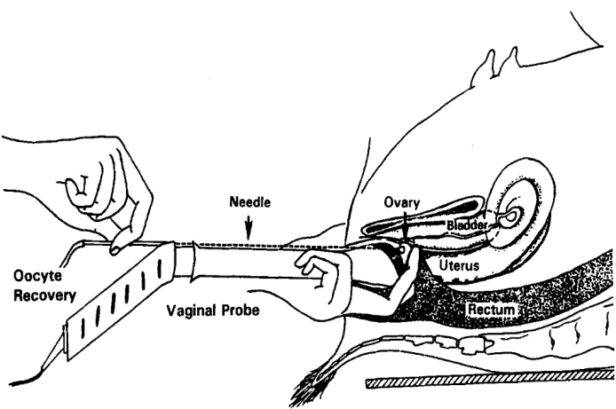
Graff et al., 1998
http://videocirurgiavet.blogspot.com.tr/p/videocirurgia-em-animais-de-companhia.htmlhttp://www.ansci.wisc.edu/jjp1/ansci_repro/misc/project_websites_fa06/tues06/oocyte/TVOR.htm
http://videocirurgiavet.blogspot.com.tr/p/videocirurgia-em-animais-de-companhia.html
Notes:
15 OPU
Ovum pick up, known as OPU is another technique that we can collect oocyte from slaughtered and live animals.
important facts;
transport medium, temperature and time
collected material should be transferred to the lab less than 4 hours (optimum 2) and temperature should not be decrease 25 celsius and medium should be warmed before use.
A higher maturation rate observed at 22ºC than at 5 or 37ºC. Temperature effects were also evident in studies in which oocytes from ovaries held at 20ºC during transport showed greater competence than those transported at 30 and 37ºC.
LOPU
Hazırlık: Keçiler 24-36 saat aç ve 12-24 saat susuz bıraklılacak,
Anestezi: 300 mg Ketamine + 6 mg Xyilazine = 3 ml i.v.
Xylazine: 0.1 mg/kg i.m. and 0.05 mg/kg i.v. 40 kg için= 4-5 mg /kg i.m. and 2-3 mg/kg i.v.
Ketamine: 10 mg/kg i.m. and 6-7,5 mg/kg i.v. 40 kg için= 400-500 mg /kg i.m. and 240–300 mg/kg i.v.
Diazem: 0.25-0.1 mg/kg i.v. 40 kg için= 20-30 mg/kg i.v.
Lidokain Local
Diazepam+Ketamine+Butorphanol = 0.2-0.3 mg/kg i.v. Diazem + 6-7.5 mg/kg i.v. Ketamine + 5-7 mg/kg i.v. Propofol
LOPU starts 60 h after last FSH or hCG injection
Aspiration pressure: 30-100 mmHg
Aspiration flow rate: 7-7,5 mL/min

Slide 3
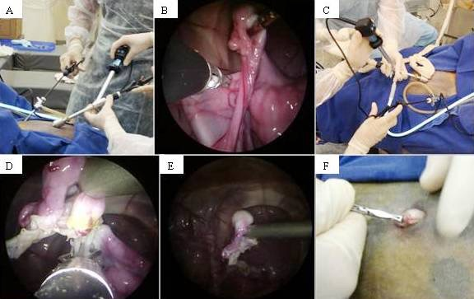
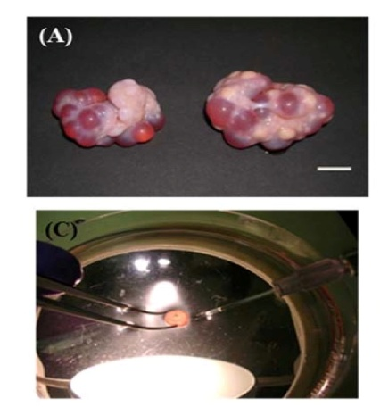
http://videocirurgiavet.blogspot.com.tr/p/videocirurgia-em-animais-de-companhia.htmlhttp://www.ansci.wisc.edu/jjp1/ansci_repro/misc/project_websites_fa06/tues06/oocyte/TVOR.htm
http://videocirurgiavet.blogspot.com.tr/p/videocirurgia-em-animais-de-companhia.html
Notes:
15 OPU
Ovum pick up, known as OPU is another technique that we can collect oocyte from slaughtered and live animals.
important facts;
transport medium, temperature and time
collected material should be transferred to the lab less than 4 hours (optimum 2) and temperature should not be decrease 25 celsius and medium should be warmed before use.
A higher maturation rate observed at 22ºC than at 5 or 37ºC. Temperature effects were also evident in studies in which oocytes from ovaries held at 20ºC during transport showed greater competence than those transported at 30 and 37ºC.
LOPU
Hazırlık: Keçiler 24-36 saat aç ve 12-24 saat susuz bıraklılacak,
Anestezi: 300 mg Ketamine + 6 mg Xyilazine = 3 ml i.v.
Xylazine: 0.1 mg/kg i.m. and 0.05 mg/kg i.v. 40 kg için= 4-5 mg /kg i.m. and 2-3 mg/kg i.v.
Ketamine: 10 mg/kg i.m. and 6-7,5 mg/kg i.v. 40 kg için= 400-500 mg /kg i.m. and 240–300 mg/kg i.v.
Diazem: 0.25-0.1 mg/kg i.v. 40 kg için= 20-30 mg/kg i.v.
Lidokain Local
Diazepam+Ketamine+Butorphanol = 0.2-0.3 mg/kg i.v. Diazem + 6-7.5 mg/kg i.v. Ketamine + 5-7 mg/kg i.v. Propofol
LOPU starts 60 h after last FSH or hCG injection
Aspiration pressure: 30-100 mmHg
Aspiration flow rate: 7-7,5 mL/min

Slide 4
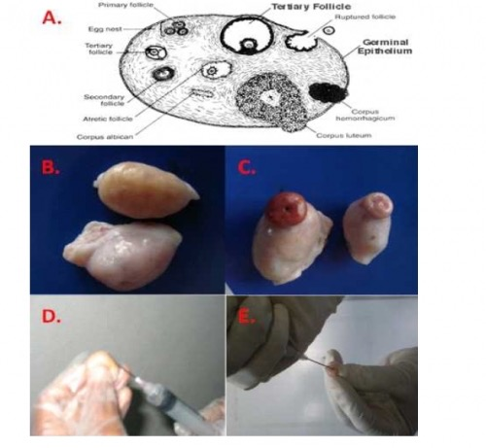
Graff et al., 1998
Paulista et. al. 2011
http://videocirurgiavet.blogspot.com.tr/p/videocirurgia-em-animais-de-companhia.htmlhttp://www.ansci.wisc.edu/jjp1/ansci_repro/misc/project_websites_fa06/tues06/oocyte/TVOR.htm
http://videocirurgiavet.blogspot.com.tr/p/videocirurgia-em-animais-de-companhia.html
Notes:
15 OPU
Ovum pick up, known as OPU is another technique that we can collect oocyte from slaughtered and live animals.
important facts;
transport medium, temperature and time
collected material should be transferred to the lab less than 4 hours (optimum 2) and temperature should not be decrease 25 celsius and medium should be warmed before use.
A higher maturation rate observed at 22ºC than at 5 or 37ºC. Temperature effects were also evident in studies in which oocytes from ovaries held at 20ºC during transport showed greater competence than those transported at 30 and 37ºC.
LOPU
Hazırlık: Keçiler 24-36 saat aç ve 12-24 saat susuz bıraklılacak,
Anestezi: 300 mg Ketamine + 6 mg Xyilazine = 3 ml i.v.
Xylazine: 0.1 mg/kg i.m. and 0.05 mg/kg i.v. 40 kg için= 4-5 mg /kg i.m. and 2-3 mg/kg i.v.
Ketamine: 10 mg/kg i.m. and 6-7,5 mg/kg i.v. 40 kg için= 400-500 mg /kg i.m. and 240–300 mg/kg i.v.
Diazem: 0.25-0.1 mg/kg i.v. 40 kg için= 20-30 mg/kg i.v.
Lidokain Local
Diazepam+Ketamine+Butorphanol = 0.2-0.3 mg/kg i.v. Diazem + 6-7.5 mg/kg i.v. Ketamine + 5-7 mg/kg i.v. Propofol
LOPU starts 60 h after last FSH or hCG injection
Aspiration pressure: 30-100 mmHg
Aspiration flow rate: 7-7,5 mL/min

Slide 5
İntrasitoplazmik Sperm Enjeksiyonu (ICSI)
İntrasitoplazmik sperm enjeksiyonu (ICSI), in vitro embriyoların üretilmesi için başka bir tekniktir ve tek bir spermin, oosit zarına mikroenjeksiyonundan oluşur.
Bu teknik döllenme sırasında normal sperm seçimini ve oosit-sperm etkileşimini atlar.
Normalde bu prosedür sadece düşük sperm kalitesine sahip olan ve spermin yumurtaları kendi kendine dölleyemeyeceğinden şüphelendiğimiz hastalar için kullanılır.
Bu teknik, yabani ve evcil hayvanların üretilmesi için genetik açıdan önemli erkek gametlerin kullanımını içerir.
Keçilerde döllenme yöntemi olarak ICSI üzerinde sadece birkaç çalışma vardır.
Notes:
16 Intracytoplasmic sperm injection ICSI
Intracytoplasmic sperm injection (ICSI) is another technique for producing in vitro embryos, consisting of the microinjection of a single sperm across the membrane of a oocyte leading to fertilization. This technique bypasses the normal sperm selection and oocyte–sperm interaction during fertilization. Normally this procedure is only used for patients that have poor sperm quality and where we suspect that sperm may not be able to fertilize eggs on their own.
A major application of this technique for animal production includes use of genetically important male gametes for procreating wild and domestic animals. There are only a few studies on ICSI as a method of fertilization in goats and there is only one report of live offspring.

Slide 6
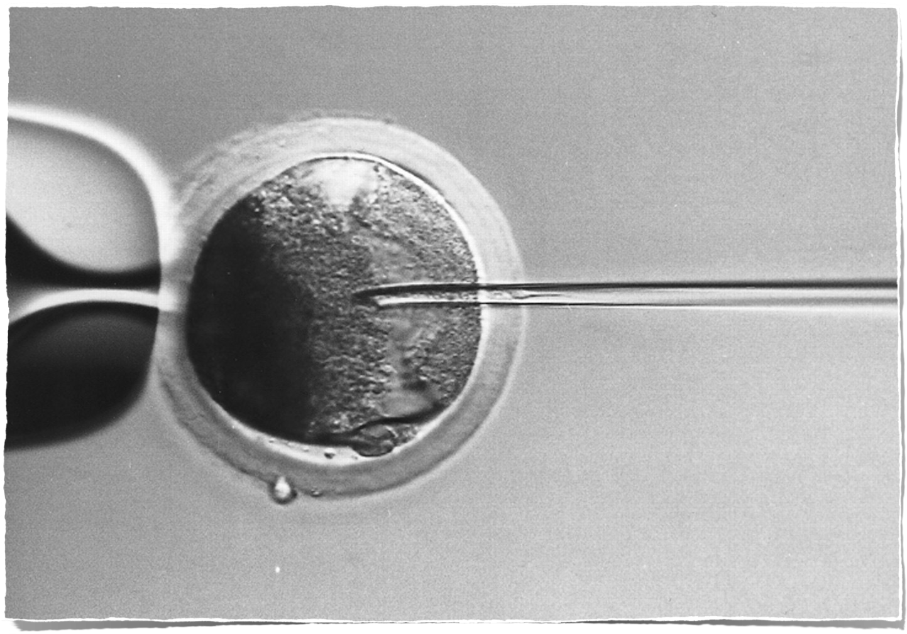
ICSI
Genetik olarak değerli hayvanlar
Notes:
16 Intracytoplasmic sperm injection ICSI
Intracytoplasmic sperm injection (ICSI) is another technique for producing in vitro embryos, consisting of the microinjection of a single sperm across the membrane of a oocyte leading to fertilization. This technique bypasses the normal sperm selection and oocyte–sperm interaction during fertilization. Normally this procedure is only used for patients that have poor sperm quality and where we suspect that sperm may not be able to fertilize eggs on their own.
A major application of this technique for animal production includes use of genetically important male gametes for procreating wild and domestic animals. There are only a few studies on ICSI as a method of fertilization in goats and there is only one report of live offspring.

