Slide 1
COMMON POLICIES OF THE EUROPEAN UNION

Slide 2
The EU's Common Policies focus on agriculture, competition, regional, commerce, transportation, tax, environment, consumer, fisheries, industry, telecommunications, social, energy &research and science.
I. Common Agricultural Policy
The Common Agricultural Policy (CAP) of the European Union has particular importance, as both agriculture is directly linked to nutrition, which is an extremely vital function, and that the largest part of the EU budget is allocated to CAP. Today, the EU is conducting a comprehensive CAP reform, both in order to ensure that the policy in question becomes increasingly complex, losing its manageability and meeting the new needs arising from enlargement.

Slide 3
AIM OF THE CAP (Common Agricultural Policy)
Support farmers and improve agricultural productivity, ensuring a stable supply of affordable food
Safeguard European Union farmers to make a reasonable living
Help tackle climate change and sustainable management of natural resources
Maintain rural areas and landscapes across the EU
Keep the rural economy alive by promoting jobs in farming, agri-foods industries and associated sectors

Slide 4
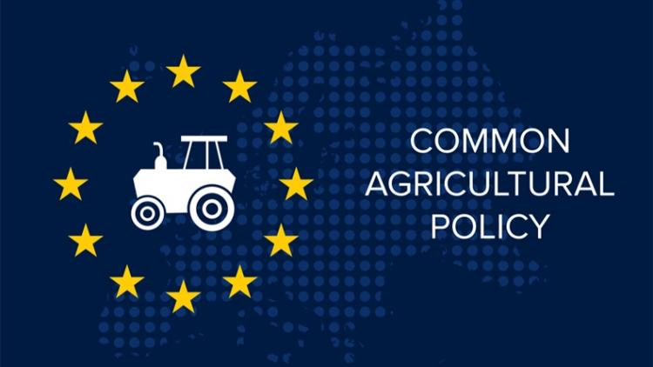
The CAP is a common policy for all EU countries. It is managed and funded at European level from the resources of the EU’s budget.

Slide 6
The CAP in practice
Farming is unlike most other businesses, as the following special considerations apply;
despite the importance of food production, farmers’ income is around 40% lower compared to non-agricultural income
agriculture depends more on the weather and the climate than many other sectors
there is an inevitable time gap between consumer demand and farmers being able to supply – growing more wheat or producing more milk inevitably takes time

Slide 7
The CAP takes action with
Income Support: through direct payments ensures income stability, and remunerates farmers for environmentally friendly farming and delivering public goods not normally paid for by the markets, such as taking care of the countryside.
Market Measures: to deal with difficult market situations such as a sudden drop in demand due to a health scare, or a fall in prices as a result of a temporary oversupply on the market.
Rural Development Measures: with national and regional programmes to address the specific needs and challenges facing rural areas.

Slide 8
CAP Financing

Slide 9
CAP Financing

Slide 11
CAP Financing
The CAP is financed through two funds as part of the EU budget;
The European Agricultural Fund (EAGF) provides direct support and funds market measures,
The European Agricultural Fund for Rural Development (EAFRD) finances rural development
Payments are managed at the national level by each European Union country!

Slide 12
The benefits of the CAP
Produce food!
there are around 10 million farms in the EU and 22 million people work regularly in the sector. They provide an impressive variety of abundant, affordable, safe and good quality products.
the EU is known throughout the world for its food and culinary traditions and is one of the world’s leading producers and net exporter of agri-food products. Due to its exceptional agricultural resources the EU could and should play a key role in ensuring food security of the world at large.

Slide 13
The benefits of the CAP
Rural community development!
There are many jobs linked to farming. Farmers need machinery, buildings, fuel, fertilisers and healthcare for their animals, also known as ‘upstream’ sectors.
Other people are busy in ‘downstream’ operations – such as preparing, processing, and packaging food, as well as in food storage, transport and retailing. The farming and food sectors together provide nearly 40 million jobs in the EU.
to operate efficiently and remain modern and productive, farmers, upstream and downstream sectors need ready access to the latest information on agricultural issues, farming methods and market developments.

Slide 14
The benefits of the CAP
Environmentally sustainable farming!
farmers have a double challenge – to produce food whilst simultaneously protecting nature and safeguarding biodiversity. Using natural resources prudently is essential for our food production and for our quality of life – today, tomorrow and for future generations.

