Slide 1
Pharmacy KAAN

Slide 2
FEVER
Hyperthermia
Hyperpyrexia (BT>106°F)

Slide 3
Inflammatory or not here I come
Malignancies,
Tissue damage??
Antigen-antibody interactions ??
Dehydration,
Heat stroke,
CNS inflammation,
Metabolic disorders??

Slide 4
drug-induced hyperthermia, %10
? ?
Homework:
1. Name at least 6 drugs that induce hyperthermia
2. Name one indicator of drug-induced hyperthermia

Slide 5
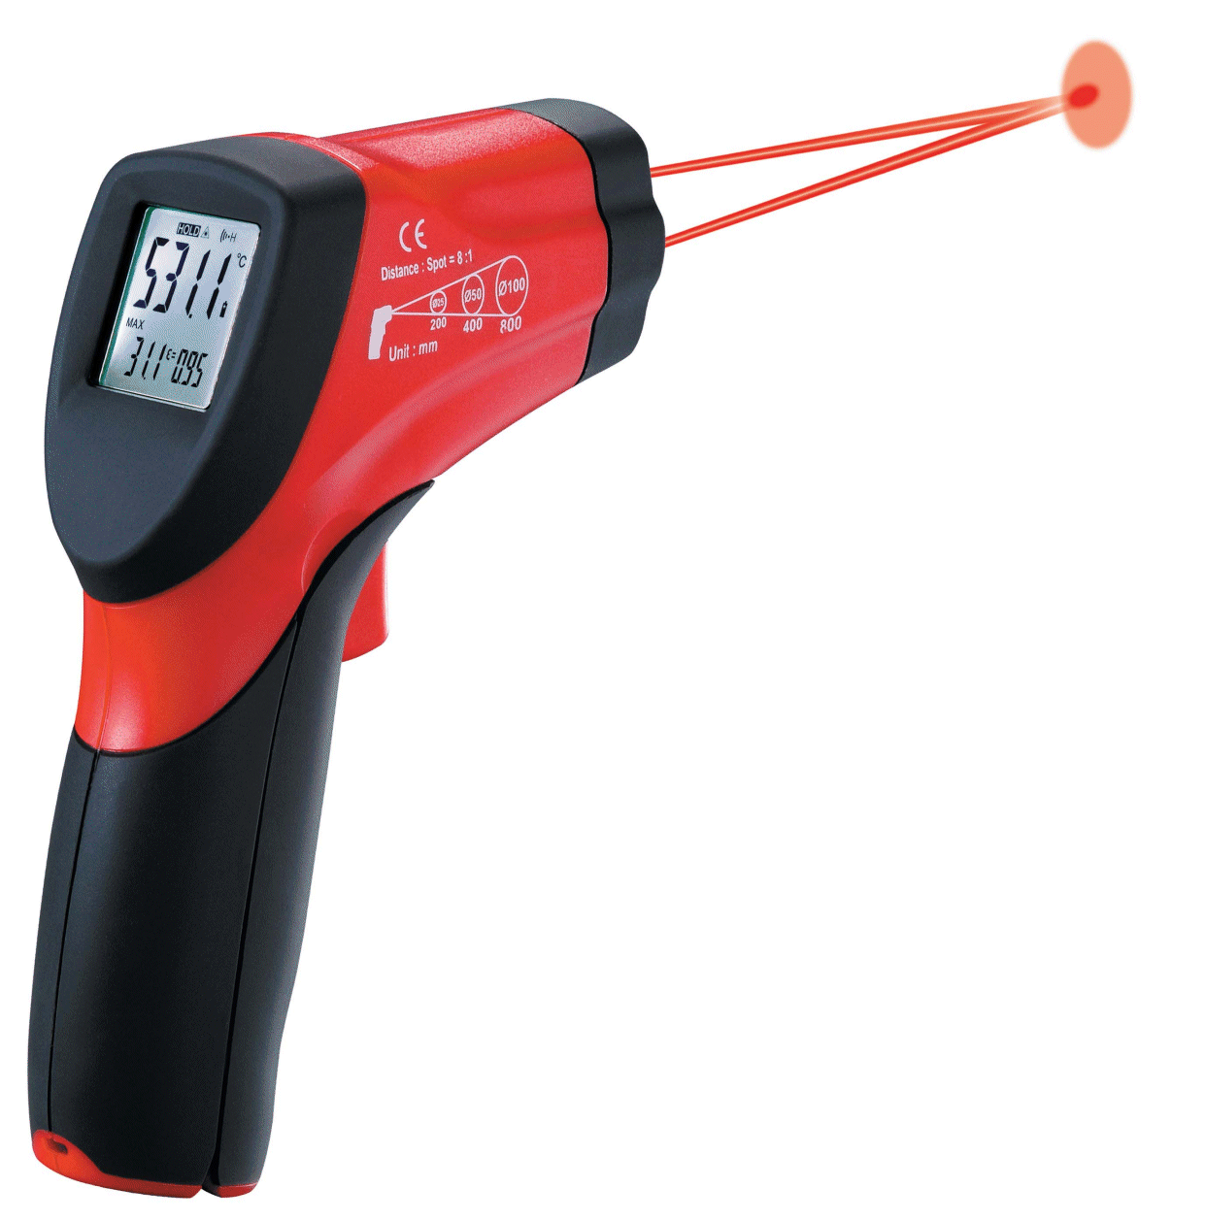
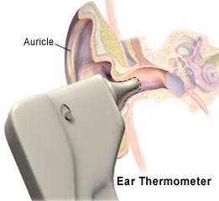
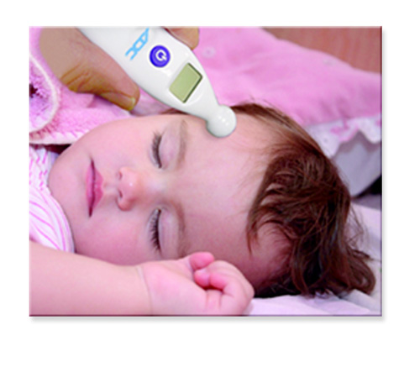
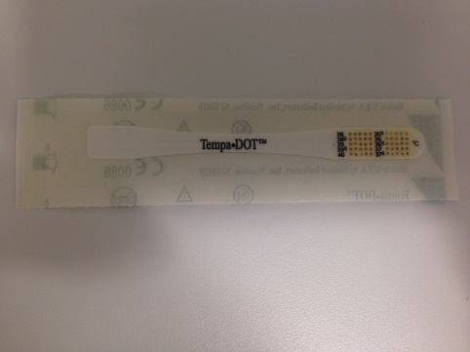
Tympanic thermometer
Non-contact infrared thermometer
3M™ Tempa•DOT™ Single use thermometer
Temporal termometre

Slide 6
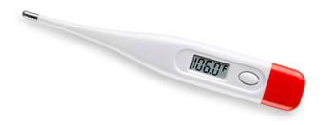
Digital thermometer
OTC DRUGS, AOB

Slide 7
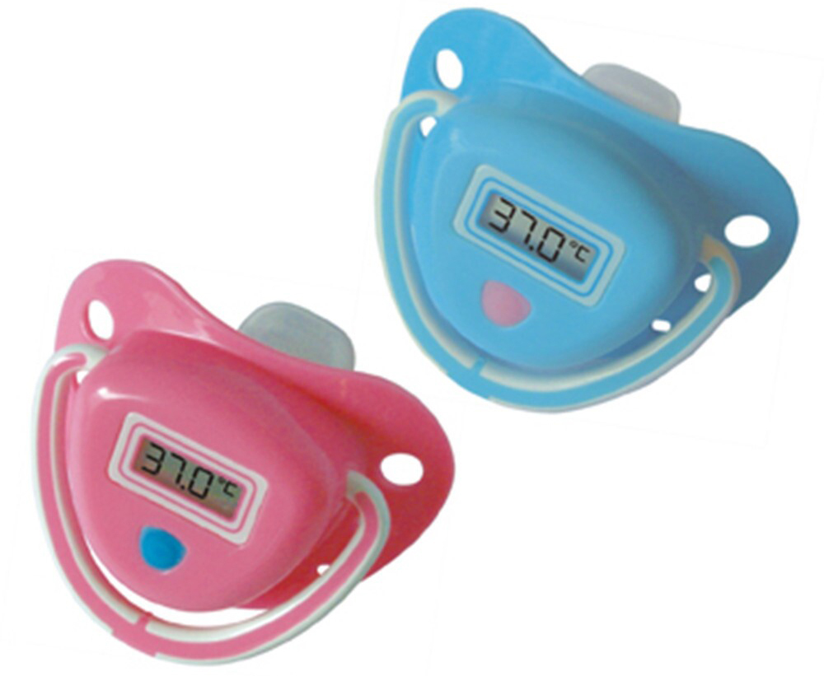
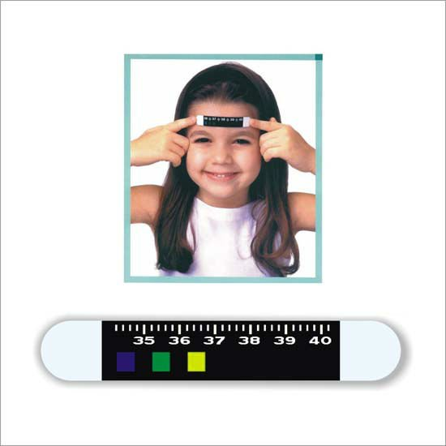

Slide 8
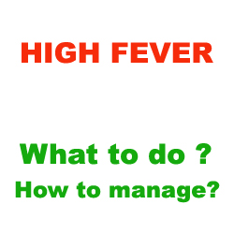
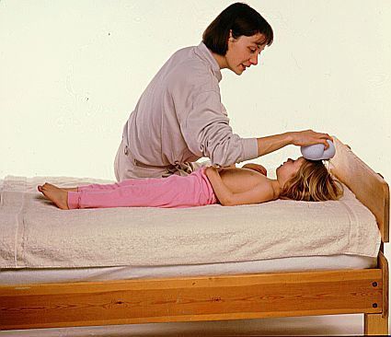
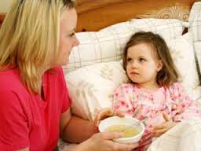
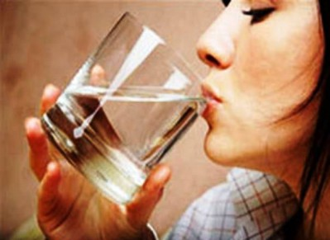
OTC DRUGS, AOB

Slide 9
Exclusions for self-treatment
? ?
OTC DRUGS, AOB

Slide 10
IBUPROFEN
Approved for patients > 6 months

Slide 11
IBUPROFEN
COX inhibitor
Advantegous to other NSAID, in dismenorhhea
Less GI issues and much less effect in platelets compared to Aspirin
Similar to otherNSAID other then Aspirin, increases the risk for MI and stroke
Rarely, Stevens Johnson Syndrome
t_{1/2} 1-2 hrs, metabolism in liver
OTC DRUGS, AOB

Slide 12
Rare, serious disorder of the skin and mucous membranes
Usually a reaction to medication that starts with flu-like symptoms, followed by a painful rash that spreads and blisters
Then the top layer of affected skin dies, sheds and begins to heal after several days

Slide 13
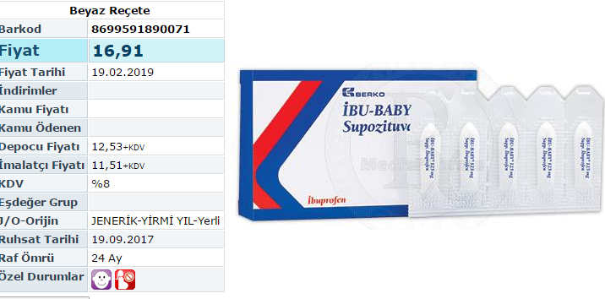
İbuprofen Posology and Apps
Pediatric suspensions in Turkey 100mg/5ml
Suppositories 60-125 mg/sup

Slide 14
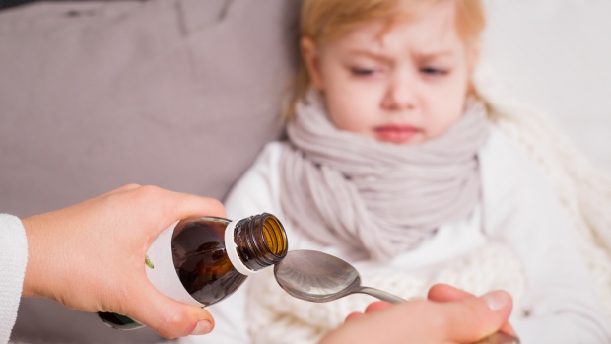
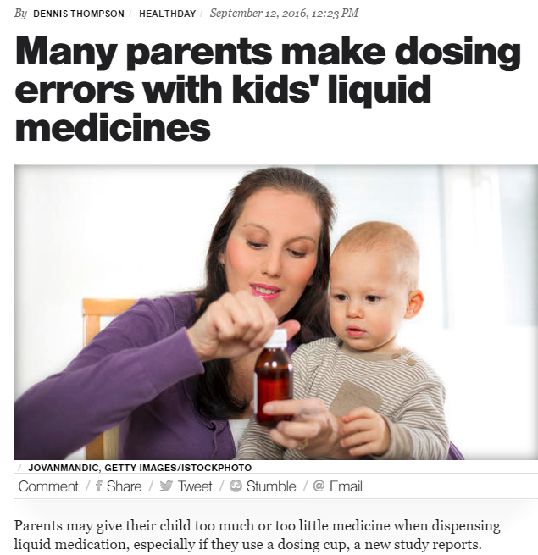
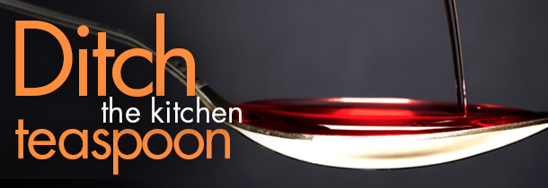
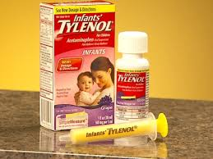

Slide 15
Metabolism in liver, elimination through kidneys
paracetamol
Non-toxic metabolites
induced by alcohol
P450
toxic
metabolite
glutathion
Non-toxic metabolite
Exhausted by alcohol and paracetamol high dose
Paracetamol Hepatotoxicity (usually > 7g)
Nausea, dizziness, confusion, abdominal pain (not always!)
Typical onset after 24 hours
Complications | Liver failure, kidney failure, pancreatitis, low blood sugar, lactic acidosis.
OTC DRUGS, AOB

Slide 16
Mechanism of action
Reduction of PG synthesis in CNS
periferal effects << central effects
Not (that) antiinflammatory
No GI advers effects
No effect on kidneys or platelets
Pharmacokinetics
Fast absorption & distribution w oral app
Rectal bioavailability 50-60%
Effective in 30’ after oral app; 4 hours
OTC DRUGS, AOB

Slide 17
Advantages
NO gastric ulceration
NO effect on kidneys
NO REYE Syndrome
Interaction with alcohol
Chronic alcohol use increases the risk for liver failure through
Induction of P450 (remember why?)
Less glutathion in alcohol abusers
3. Liver is already damaged in chronic alcohol users
Paracetamol is safe at regular doses, risky in high doses
OTC DRUGS, AOB

Slide 18
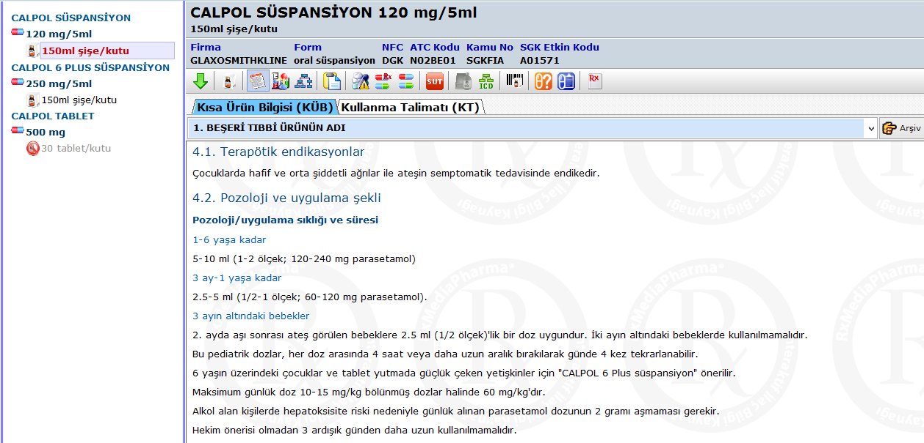
60mg for 0-3 months

Slide 19
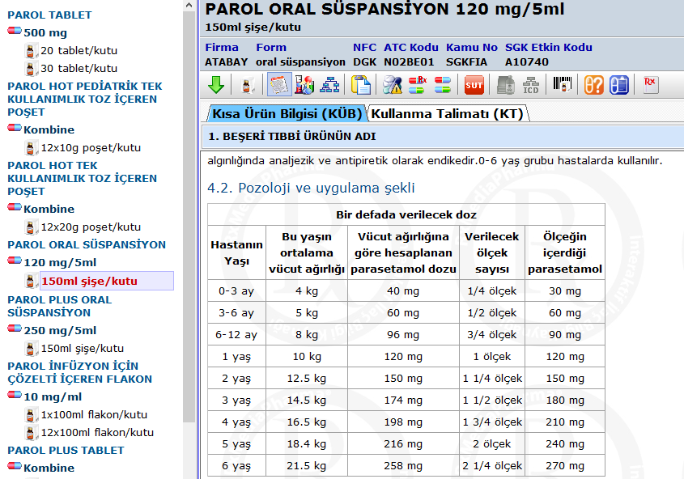
40mg for 0-3 months

Slide 20
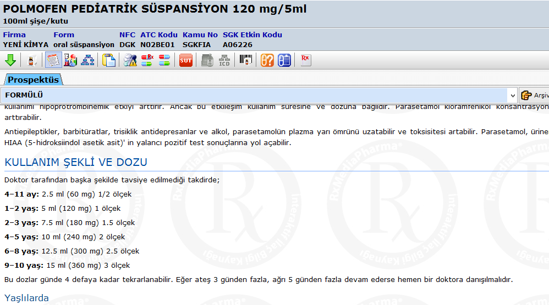
No suggestion for 0-3 ay months
What if the baby is 2?
Should I give
1 or 1.5?

Slide 21
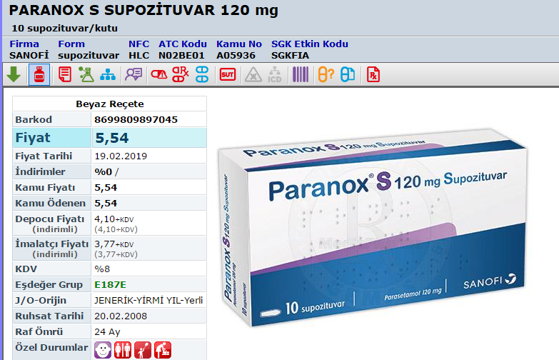

Slide 22
Paracetamol Posology and App
Age of baby | Amount of paracetamol | Number of tablets/volume

Slide 23
Alcohol warning: If you consume 3 or more alcoholic drinks every day, ask your doctor whether you should take acetaminophen or other pain relievers or fever reducers. Acetaminophen may cause liver damage.
Similar warnings in preparations in Turkey
Interaction with Warfarin
Paracetamol+warfarin increases risk for bleeding
We thought that paracetamol DOES NOT affect platelet aggregation
How come?
OTC DRUGS, AOB

Slide 24
Paracetamol inhibits the metabolism of warfarin
This keeps the blood levels of warfarin high

Slide 25
Therapeutic use
For fever and pain
Not associated with Reye Syndrome, safer in children with fever
Safer in patients with peptic ulcer
Not effective in arthritis or rhomatic fever
Reye’s Syndrome:
Reye's (Reye) syndrome is a rare but serious condition that causes swelling in the liver and brain
Reye's syndrome most often affects children and teenagers recovering from a viral infection, most commonly the flu or chickenpox
OTC DRUGS, AOB

Slide 26
Treatment:
Acetylcysteine (mucolytic), replaces glutathion and reduces the
amount of toxic intermediate metabolite
Application within the 8-10 hrs (up to 24 hrs according to some references)
is effective
Oral or iv
OTC DRUGS, AOB

Slide 27
HAAA very interesting eczacı hanım☺!!
My grandpa had an eye surgery last week and the eye drop he was prescribed included this acetylcycteine compound
What is the connection?

Slide 28
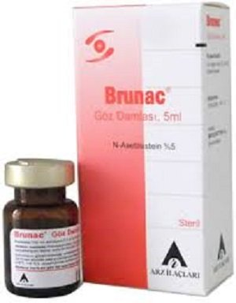
Acetylcysteine

Slide 29
Alternate different antipyretics for fever reduction

Slide 30
Cyclooxygenase (COX)
OTC DRUGS, AOB

Slide 31
COX- 1, Good COX
House-keeping:
protect gastric mucosa
support kidney function
mediate platelet aggregation
COX-2, Bad COX
Where is tissue damage there is COX-2
inflammation
pain
fever
Kidney function needs both COX-1 and COX-2
products
OTC DRUGS, AOB

Slide 32
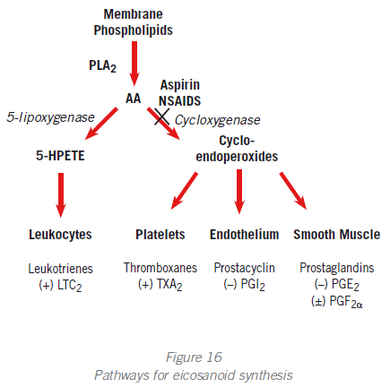
PGE₂
www.heartandmetabolism.org/dictionnary_pr.asp
OTC DRUGS, AOB

Slide 33
Antipyretic before or after vaccination?

Slide 34
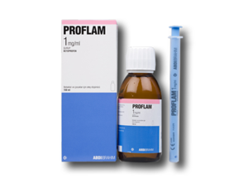
Ketoprofen
NO LONGER OTC

Slide 35
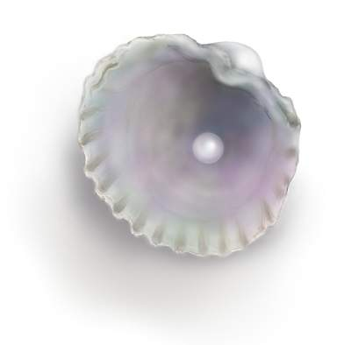
Fever – Clinical Pearls
Most common antipyretics: Paracetamol and ibuprofen
Also, naproxen and aspirin for adults
At regular dose, an antipyretic MUST reduce fever within 2 hrs
Issue with absorption with paracetamol rectal suppositories
Most common advers rxs with NSAID:
-- even at doses for pediatric preps-
dyspepsia, nausea, iştahsızlık, upset stomach
OTC DRUGS, AOB

Slide 36
Fever– Clinical Pearls
May be taken with food, milk, antacids
GI ulceration not common, but may happen (Age > 60, preexisting GI issues..)
Connection between NSAID use and MI:
Patients with CV diseases should avoid NSAIDs (naproxen appear to be asafer than ibuprofen)
NSAIDs reduce kidney perfusion

Slide 37
Fever – Clinical Pearls
Paracetamol is safe at pregnancy (Category B)
NSAIDs are contraindicated at 3rd trimester (Category D); Naproxen is Category C throughout
Paracetamol, ibuprofen and naproxen may be used during lactation
No salicylates when hyperuricemia
OTC DRUGS, AOB
OTC DRUGS, AOB

