Slide 1
CUPID AND PSYCHE
Dr. Funda HAY KILIÇ
fhay@ankara.edu.tr

Slide 2
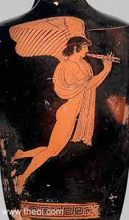
EROS (CUPID)
From the website Theoi Greek Mythology

Slide 3
Cupid and Psyche
From the website Wikimedia Commons

Slide 4
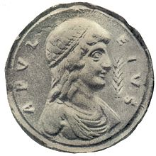
Apuleius, a Roman author of the second century A.D., in his novel Metamorphoses, or The Golden Ass (4.28-6. 24) tells the story.
From the website Wikipedia

Slide 5
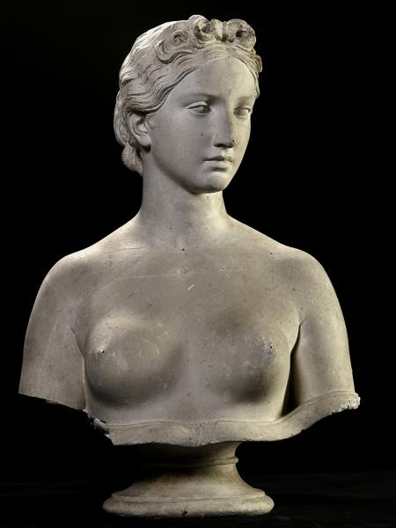
Psyche was by far the fairest daughter whom Cupid himself fell in love with.
From the website Smithsonian American Art Museum

Slide 6
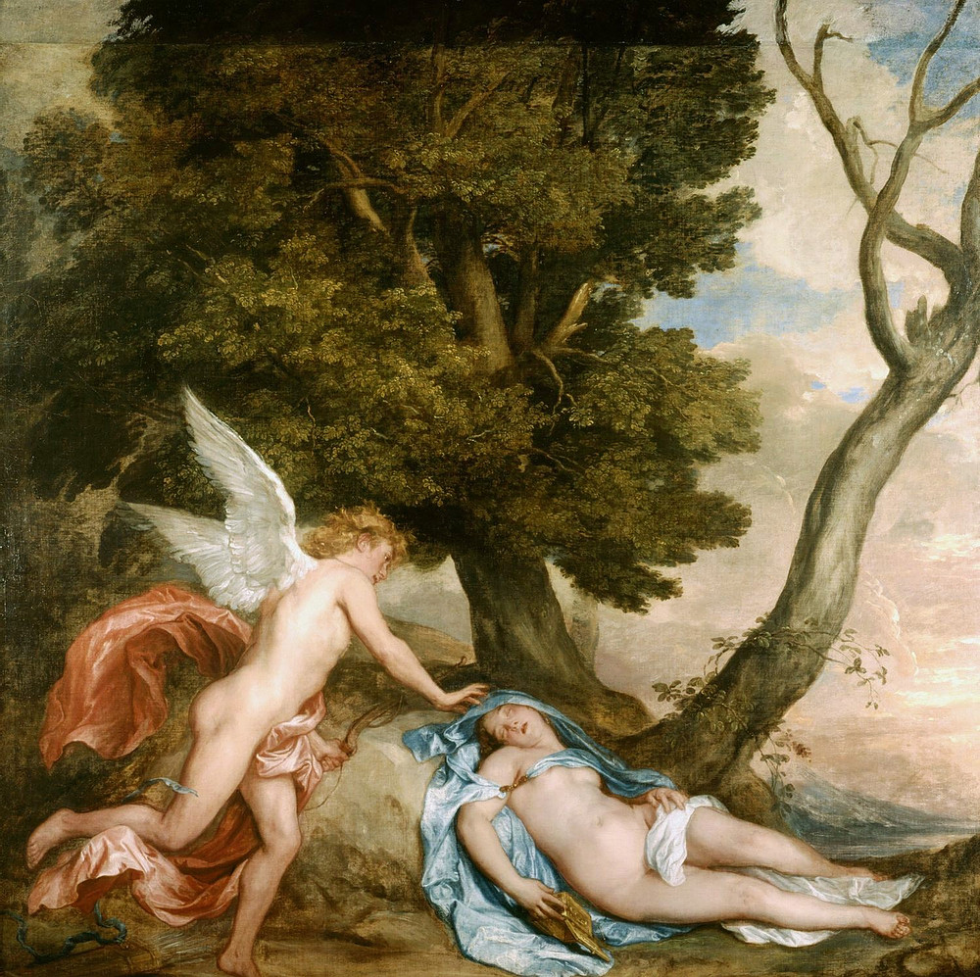
From the website Makrokozmoz Astroloji

Slide 7
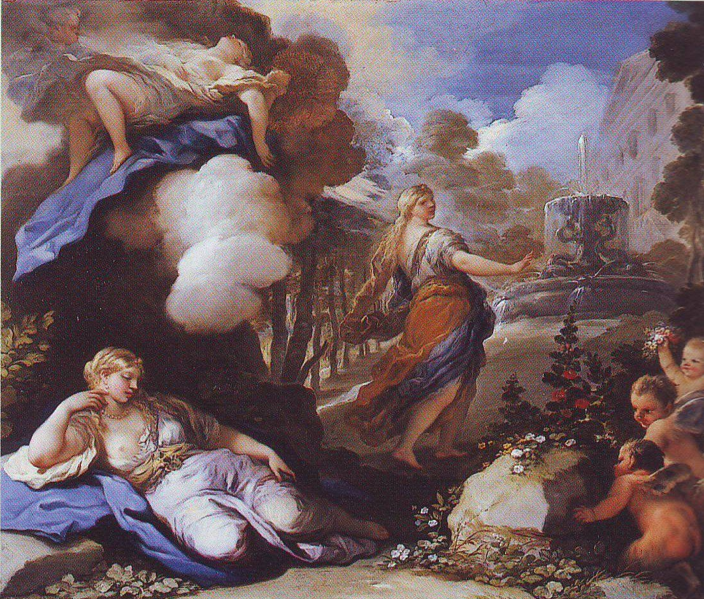
From the website Pinteresti

Slide 8
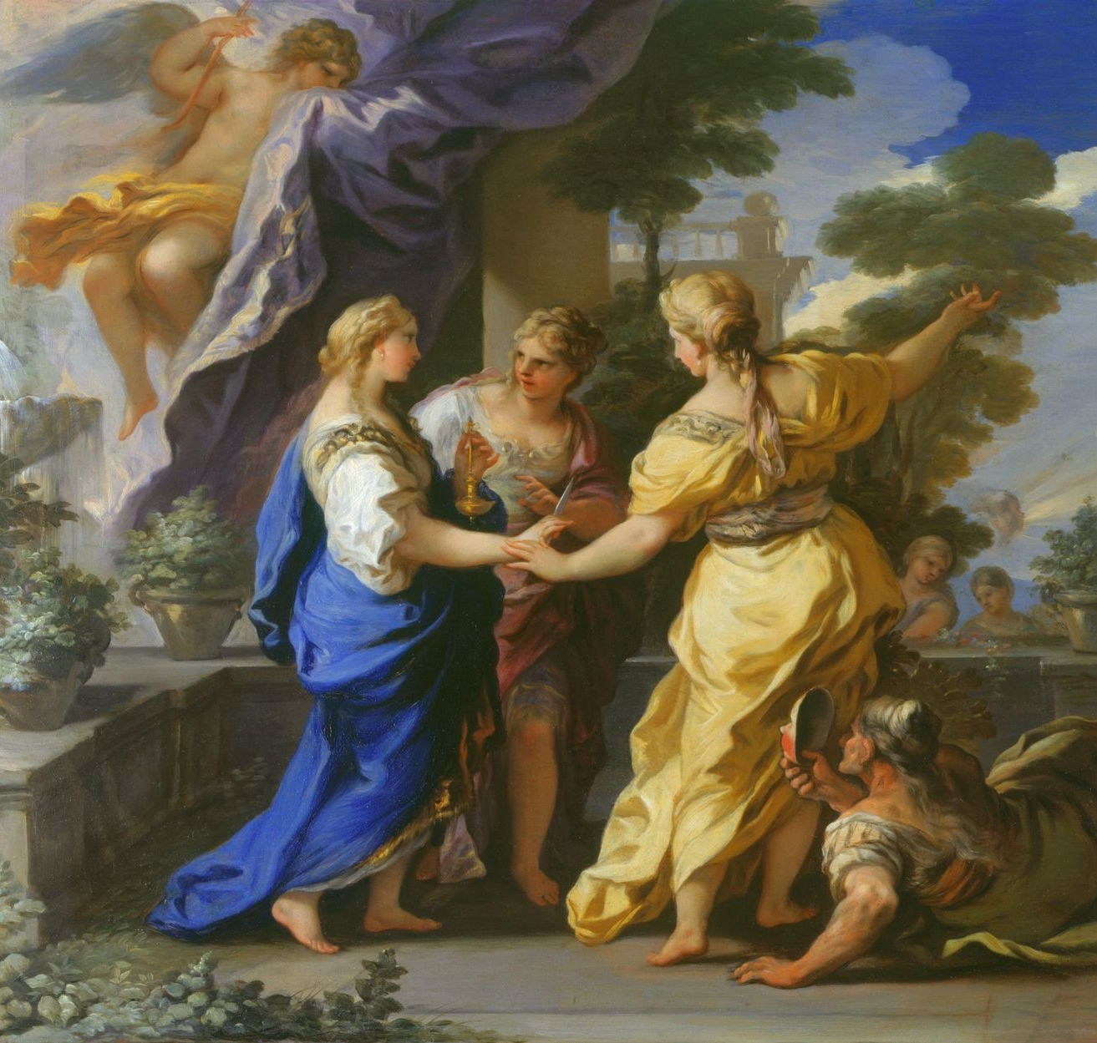
From the website Royal Collection Trust

Slide 9
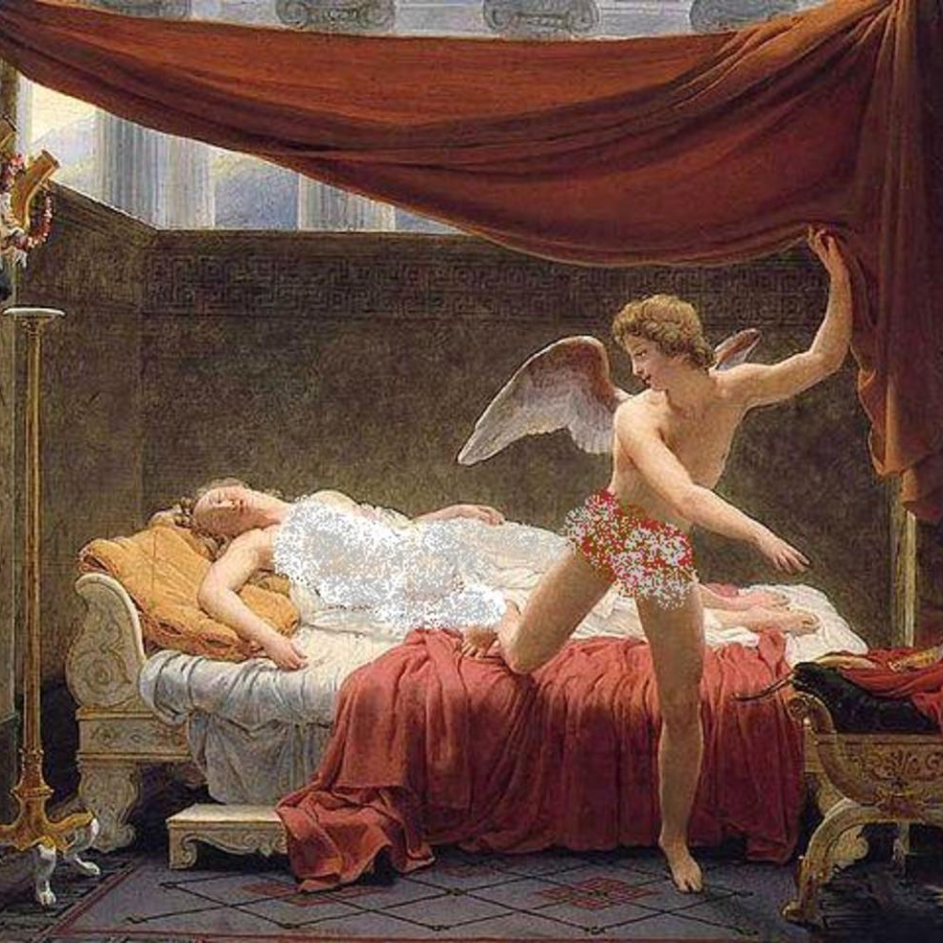
From the website Owlcation

Slide 10
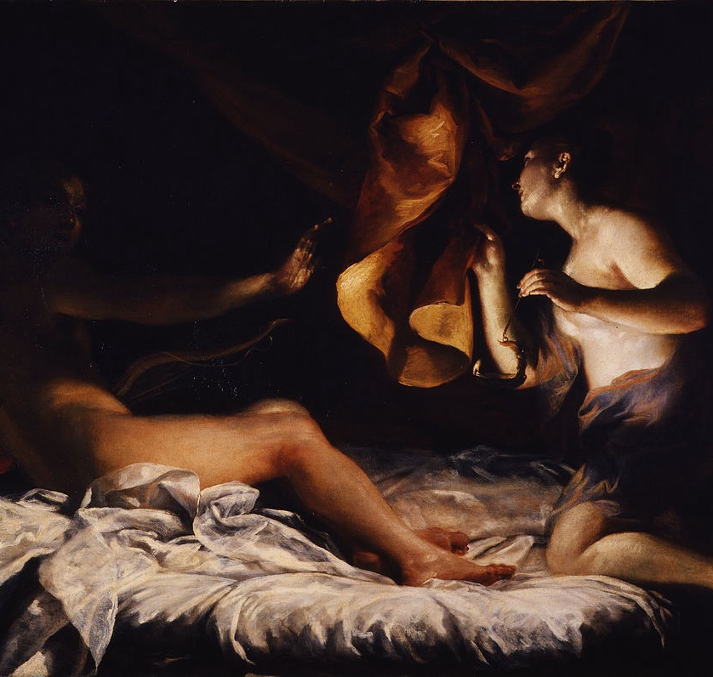
From the website Medium

Slide 11
From the website Wikimedia Commons

Slide 12
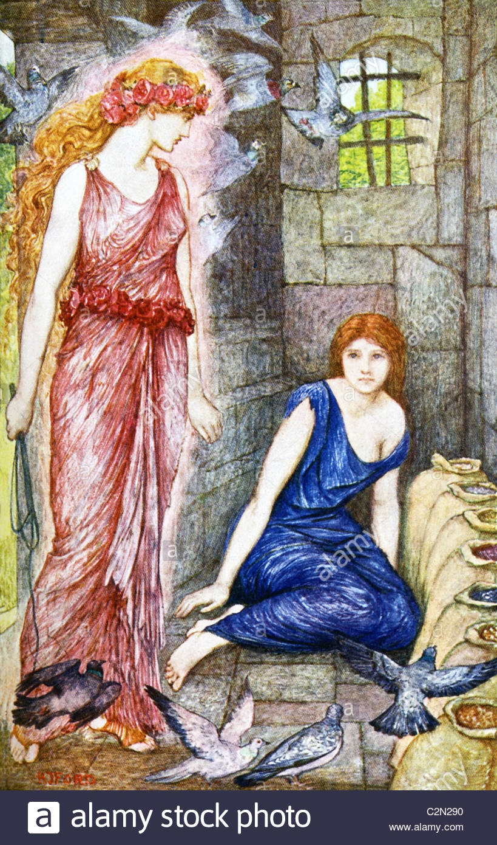
From the website Alamy

Slide 13
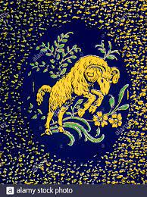
From the website Alamy

Slide 14
From the website Wikimedia Commons

Slide 15
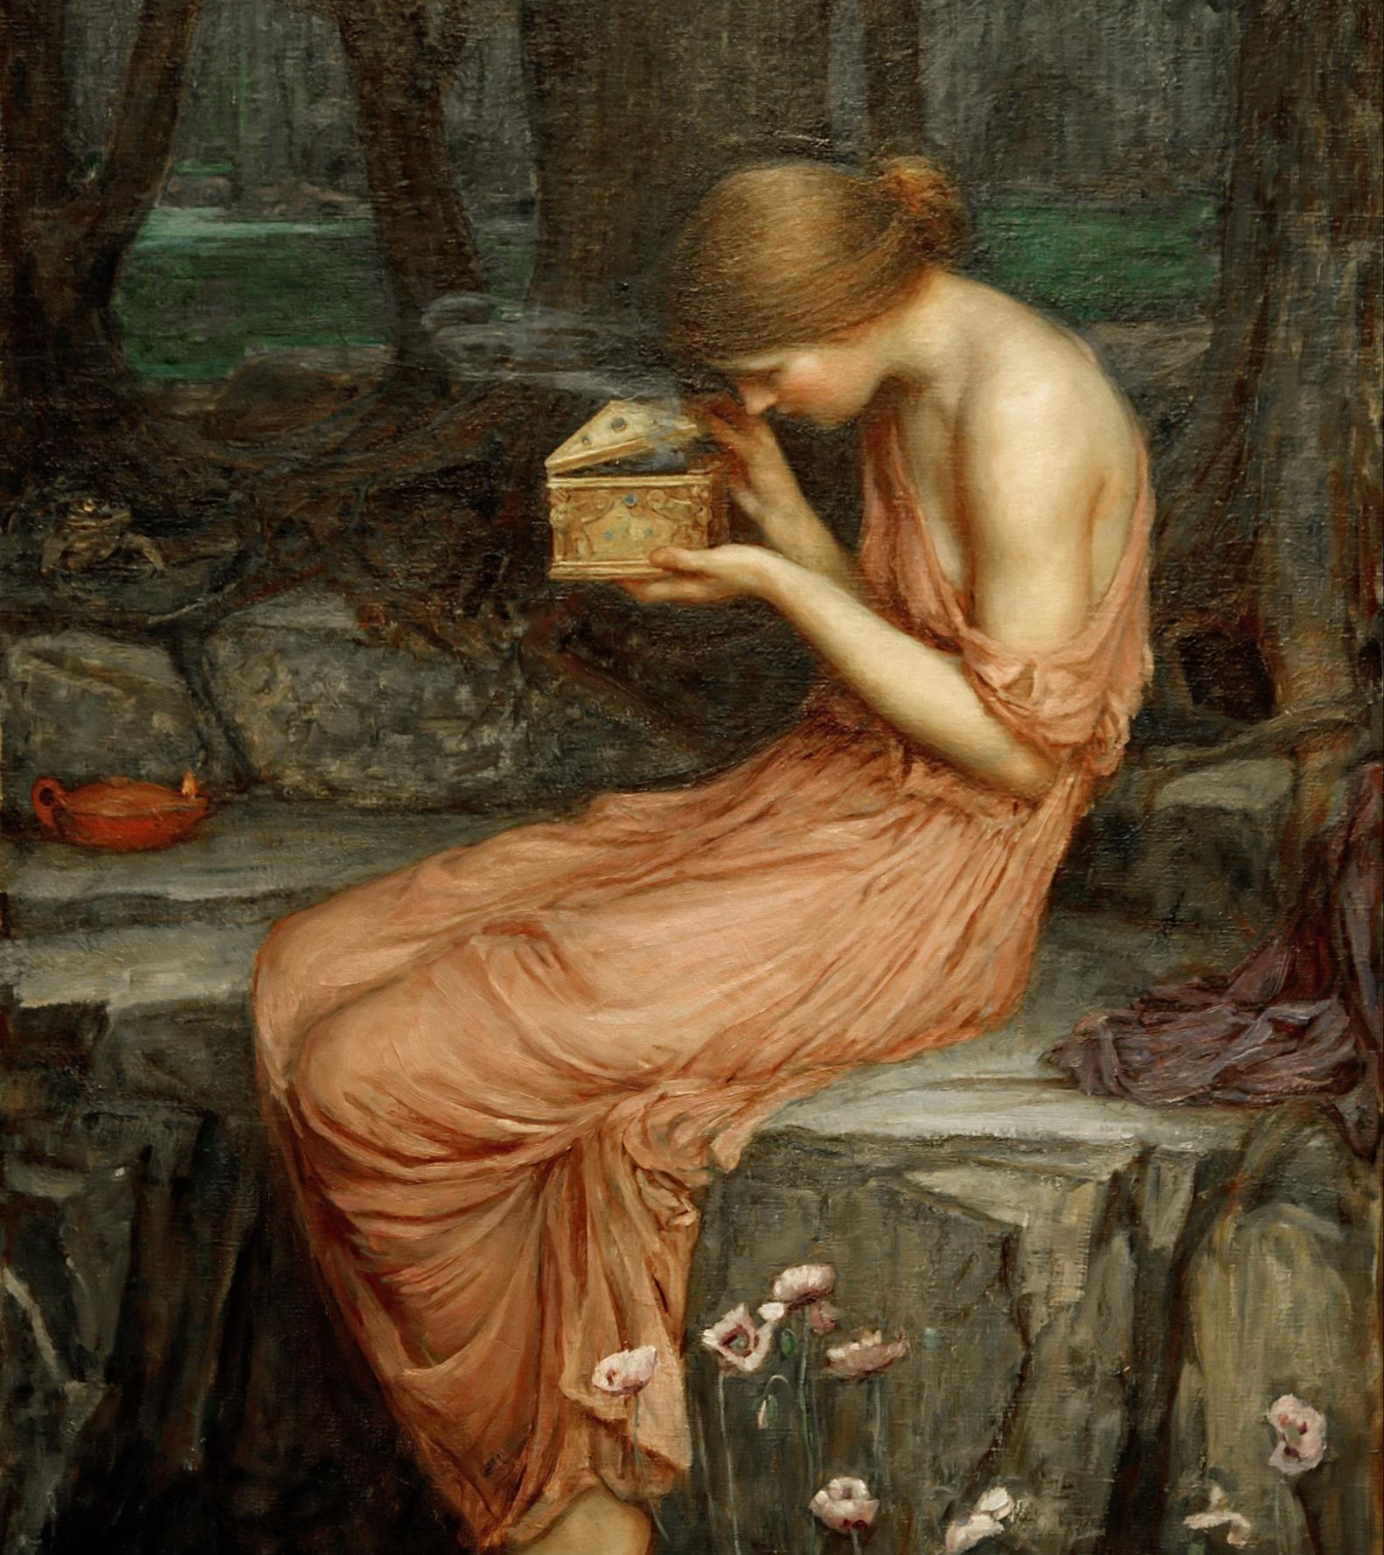
From the website Vikipedi

Slide 16
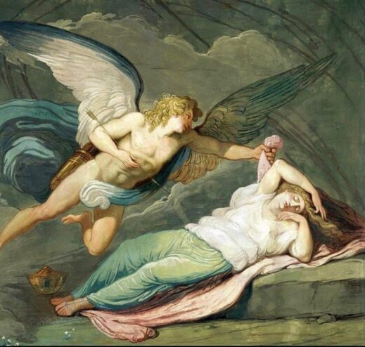
From the website Gossive

Slide 17
From the website Kunstkopie

Slide 18
Here is Apuleius' description of the final scene of Psyche's story:
Immediately a wedding feast appeared. The bridegroom took the highest place, embracing Psyche. So Jupiter with his own Juno took his place and then, in order, the other gods. Then Jupiter's cupbearer, the shepherd boy Ganymede, brought him a cup of nectar, the wine of the gods, and Bacchus gave nectar to the others. Vulcan cooked the feast; the Hours decorated everything with roses and other flowers. The Graces sprinkled the scent of balsam, and the Muses played and sang. Apollo sang to the cithara and Venus danced in all her beauty to the music; the tableau was so fitting for her that the Muses accompanied her with choral odes or played upon the tibia; a satyr and Pan played the pipes. So, with all due ceremony, Psyche was married to Cupid and, in due time, a daughter was born to them, whom we call Pleasure (Voluptas).

Slide 19
OTHER LOVE MYTHS AND ZEUS
From the website All That's Interesting

Slide 20
Here they are—all 7 of his immortal lovers:
1. Metis [cousin]—mother of Athena. Murdered by swallowing.
2. Themis [aunt]—mother of Dike, the Horae and the Morai. She built the Oracle at Delphi.
3. Eurynome [elder Oceanid]—mother of the 3 “Charites” (“graces”).
4. Demeter [older sister]—mother of Persephone, the future queen of the underworld.
5. Mnemosyne [first generation Titanide]—mother of the 9 muses.
6. Leto [cousin, Titanide]—mother of Artemis and Apollo.
7.Hera [older sister]—mother of Ares (war), Hebe (cupbearer), Eileithyia (childbirth), Eris (discord) and Hephaestus (fire and metallurgy).

Slide 21
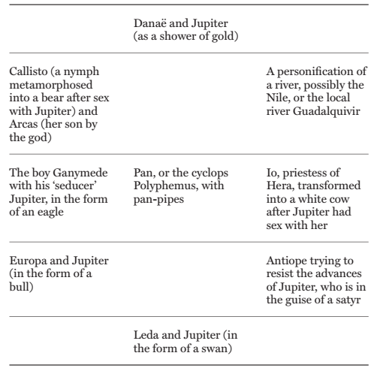
Alkmenê in the form of her husband, Amphitryon
From the book Classical Mythology

Slide 22
Bibliography
Clayton, Matt. Mythology A Captivating Guide to Greek Mythology, Egyptian Mythology, Norse Mythology, Celtic Mythology and Roman Mythology. E-book, 2017.
Hard, Robin. The Routledge Handbook of Greek Mythology. Routledge, 2004.
Morales, Helen. Classical Mythology: A Very Short Introduction. Oxford UP, 2007.
Morford, Mark, P. O., and Robert J. Lenardon. Classical Mythology. Longman, 1985.
Shelburne, Walter A. Mythos and Logos in the Thought of Carl Jung: The Theory of the Collective Unconscious in Scientific Perspective. University of New York Press, 1988.

