Slide 1
Lecture 1: Overview of Public Health
Res. Assist. Dr. Bahar Onaran

Slide 2
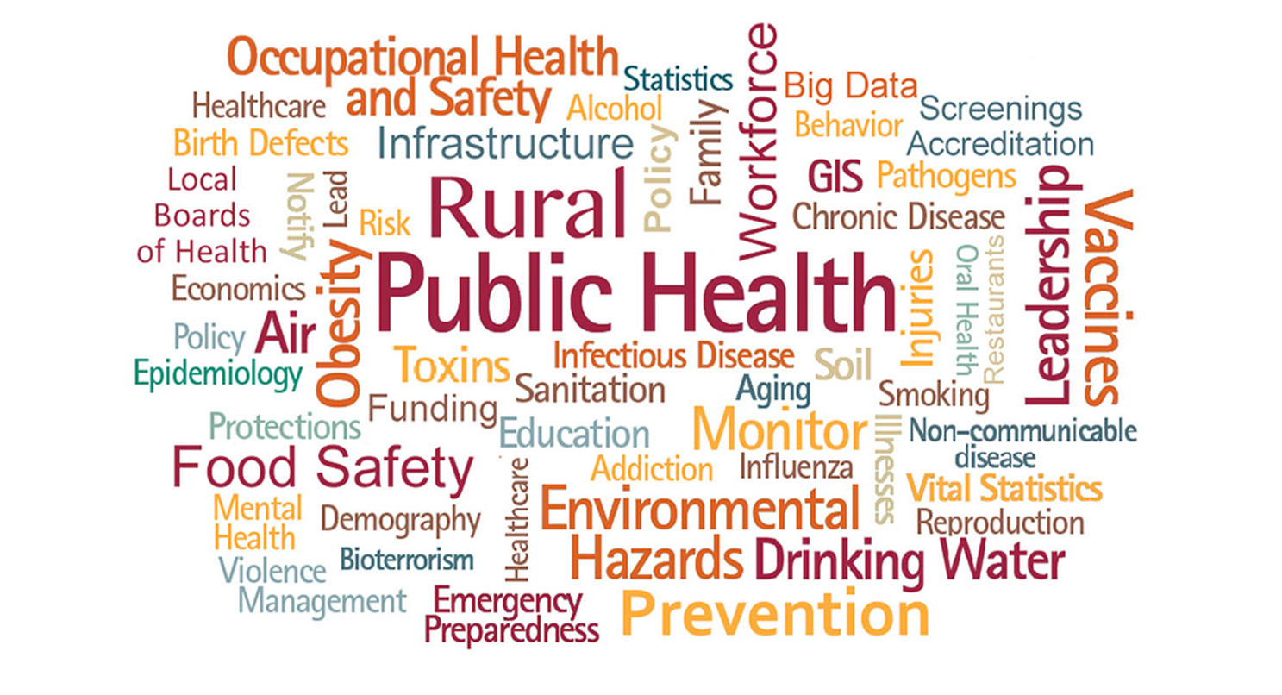

Slide 3
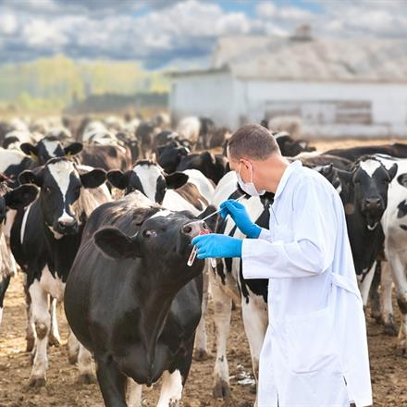
Although only a minority of veterinarians report primary public health employment, practically all veterinarians contribute to the overall public health effort.

Slide 4
According to the World Health Organization;
Health →
a state of complete physical, mental and social well-being and not only the absence of disease or deficiency.

Slide 5
Public Health;
can be defined as the totality of all evidence-based public and private efforts that preserve and promote health and prevent…
→disease, disability, and death.

Slide 6
What is 'One Health'?
'One Health' is an approach to designing and implementing programmes, policies, legislation and research in which multiple sectors communicate and work together to achieve better public health outcomes.

Slide 7
The concept of One Health;
is the collaborative effort of multiple health science professions, together with their related disciplines and institutions
—working locally, nationally, and globally
—to provide optimal health for people, domestic animals, wildlife, plants, and our environment.

Slide 8
Human health
Animal health
Environment health
One
health
One Health Approach
Traditional Perspective
of Public Health

Slide 9
Healthy people:
Enabling people everywhere to live and thrive.
Human
health
Animal
Health
Healthy animals:
→Healthy animals are well cared for, minimizing pain, stres and suffering, resulting in increased milk, meat and egg production from less sources.
→Helping pets live longer and healthier lives.
Environment
health
Healthy planet:
Conserving resource use helps sustain a growing population.

Slide 10
Power of one health:
Preserve efficiency of tools used in humans and animal medicine
Limit desease spread
Lessen livestock mortality and improve productivity
Improve human nutrition
Ensure people have food choices
Conserve resources
Boost economies and livelihoods
Combat diseases like obesity and diabetes with proper nutrition
Pets help improve health
decreasing anxiety, blood pressure and stress
→social skills and development in kids
One
health

Slide 11
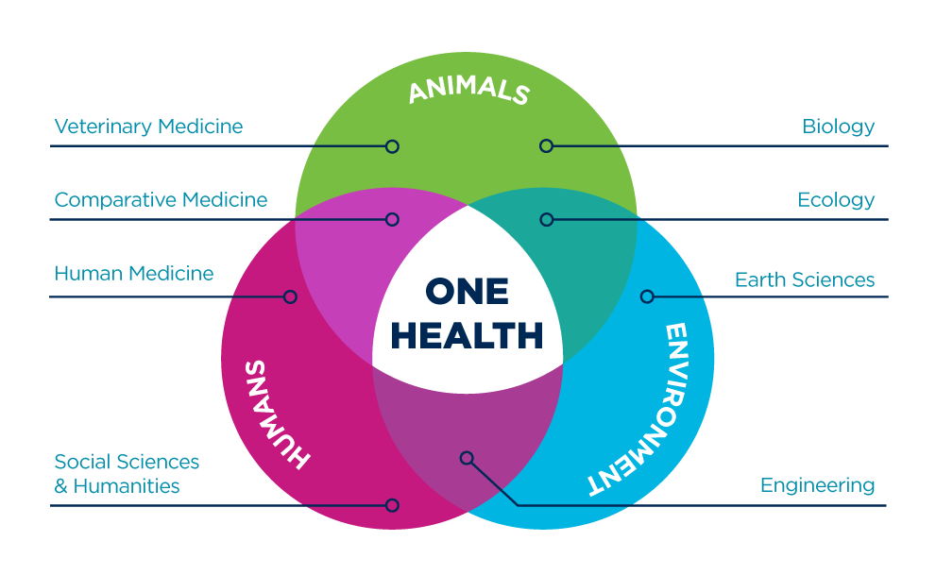
One health approach

Slide 12
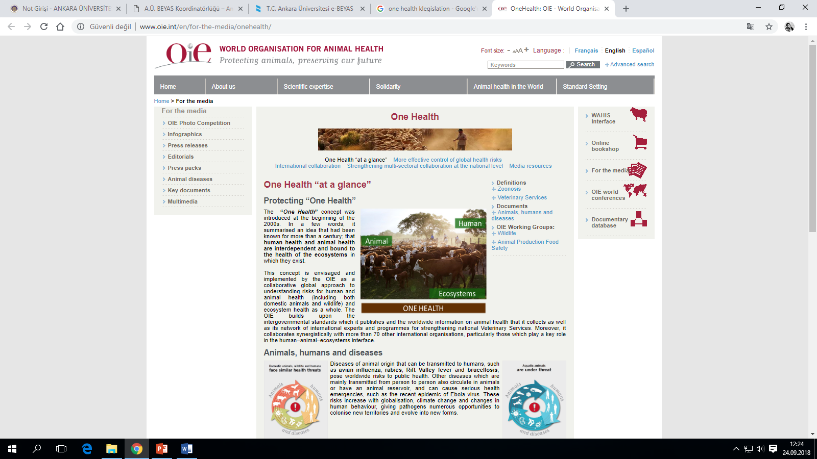

Slide 13
The areas of work in which a One Health approach is particularly relevant include;
food safety,
the control of zoonoses (diseases that can spread between animals and humans, such as flu, rabies and Rift Valley Fever),
and combatting antibiotic resistance (when bacteria change after being exposed to antibiotics and become more difficult to treat).

Slide 14
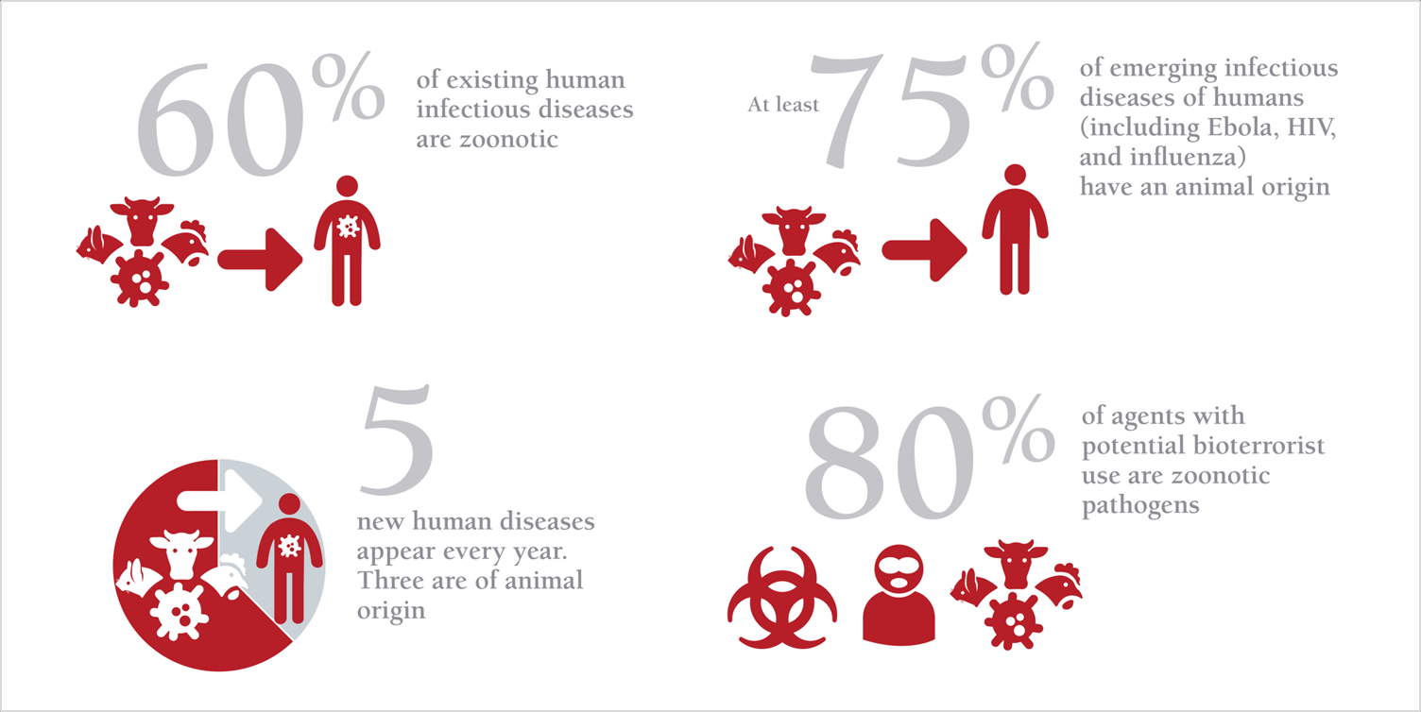

Slide 15
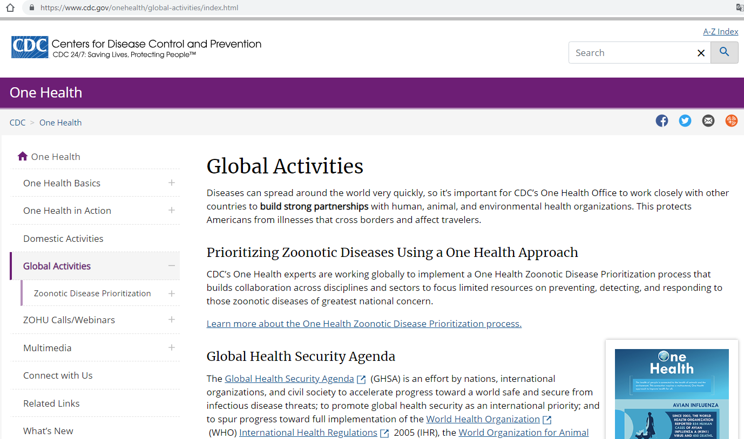

Slide 16
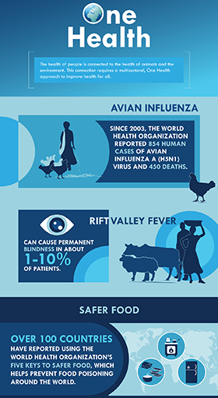
The health of people is connected to the health of animals and the environment.
This connection requires a multisectoral, One Health approach to improve health for all.
WHO: Five keys to safer food.
Video link: https://www.youtube.com/watch?v=ONkKy68HEIM

Slide 18
Why do we need a One Health approach?
Many of the same microbes infect animals and humans, as they share the eco-systems they live in.
Efforts by just one sector cannot prevent or eliminate the problem.
→For instance, rabies in humans can be effectively prevented only by targeting the animal source of the virus (for example, by vaccinating dogs).

Slide 19
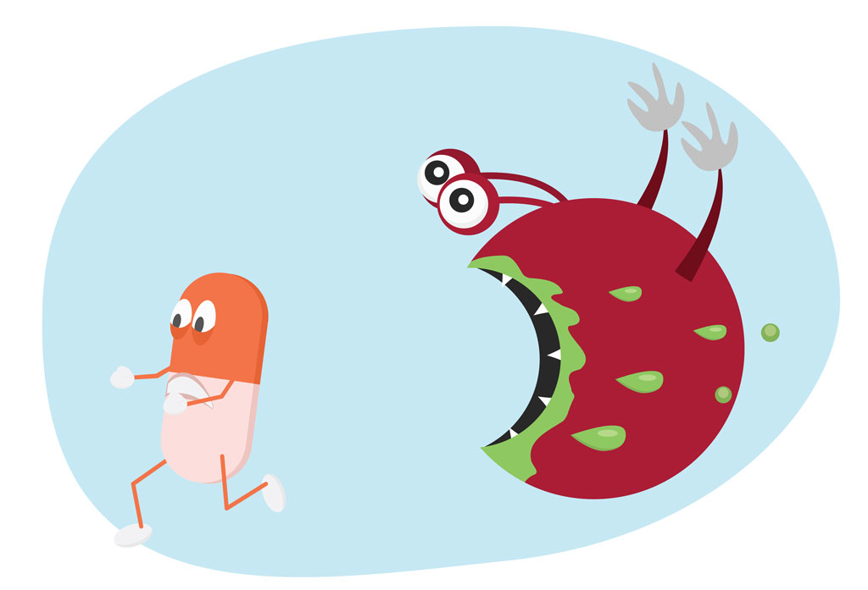
Information on influenza viruses circulating in animals is crucial to the selection of viruses for human vaccines for potential influenza pandemics.
Drug-resistant microbes can be transmitted between animals and humans through direct contact between animals and humans or through contaminated food
→ to effectively contain it, a well-coordinated approach in humans and in animals is required.

Slide 20
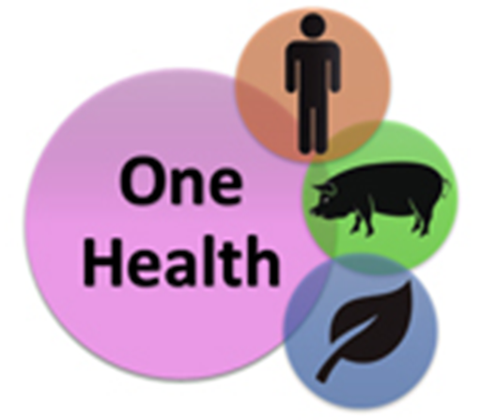
Who makes the One Health approach work?
Many professionals with a range of expertise who are active in different sectors,
→such as public health, animal health, plant health and the environment, should join forces to support One Health approaches.

Slide 21
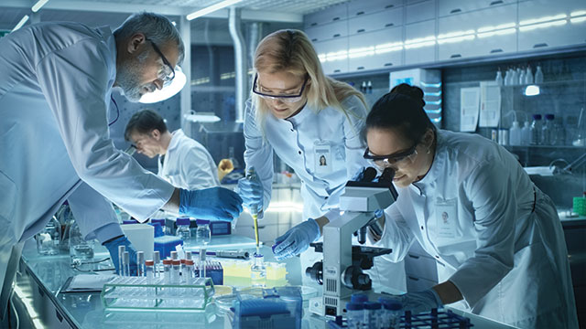
Who makes the One Health approach work?
To effectively detect, respond to, and prevent outbreaks of zoonoses and food safety problems
→ epidemiological data and laboratory information should be shared across sectors.
Government officials, researchers and workers across sectors at the local, national, regional and global levels should implement joint responses to health threats.

Slide 22
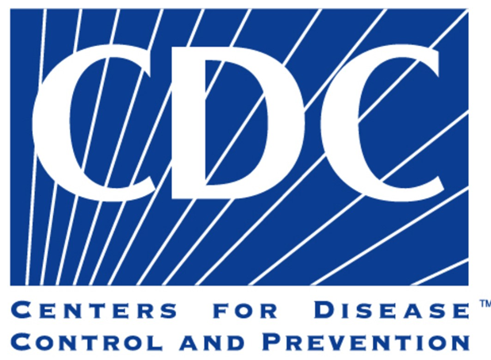
Who makes the One Health approach work?
WHO works closely with the Food and Agriculture Organization of the United Nations (FAO) and the World Organisation for Animal Health (OIE) to promote multi-sectoral responses to
→food safety hazards, risks from zoonoses, and other public health threats at the human-animal-ecosystem interface and provide guidance on how to reduce these risks.

Slide 23
Who makes the One Health approach work?
→CDC uses a One Health approach by working with physicians, veterinarians, ecologists, and many others to monitor and control public health threats and to learn about how diseases spread among people, animals, and the environment.

Slide 24
One Health can be thought of as having three major subcomponents:
→basic sciences, clinical medicine, and public health.
Major components of public health include;
population health,
community health,
mental health,
environmental/ecological health,
occupational/recreational health.
Basic science
Public health
Clinical medicine

Slide 25
The differentiating variables among these components are the dynamics of the population(s), changing social/health behaviors, and perhaps most importantly, the selection of the population to study/surveil.

Slide 26
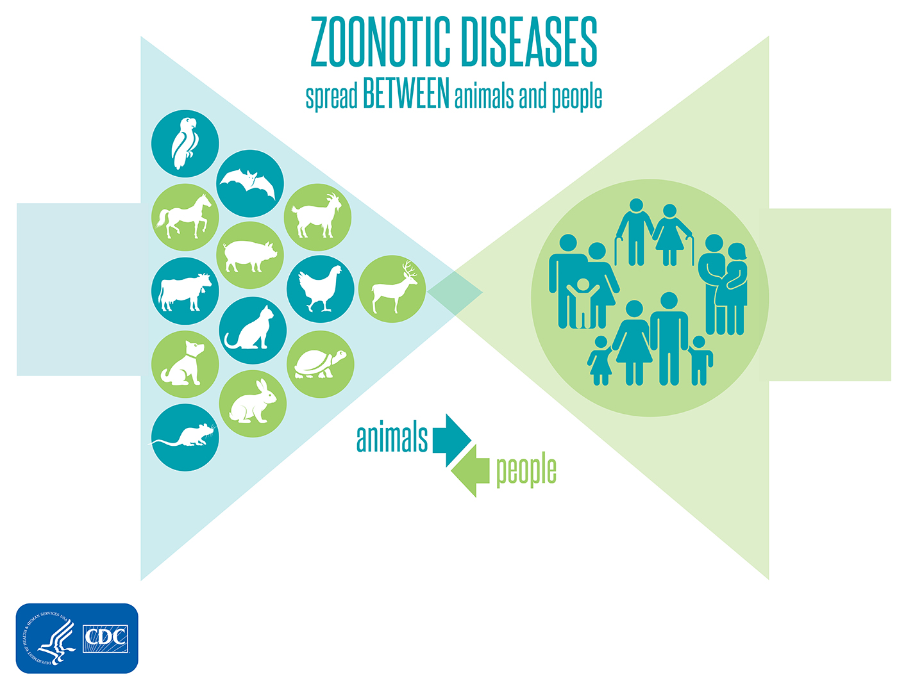
There are many examples that show how the health of people is related to the health of animals and the environment.
For instance, some diseases can be shared between animals and people.
These diseases are known as zoonotic diseases.
Examples include:
→Rabies
→Salmonella infection
→West Nile virus fever
→Q Fever (Coxiella burnetti)…

Slide 28
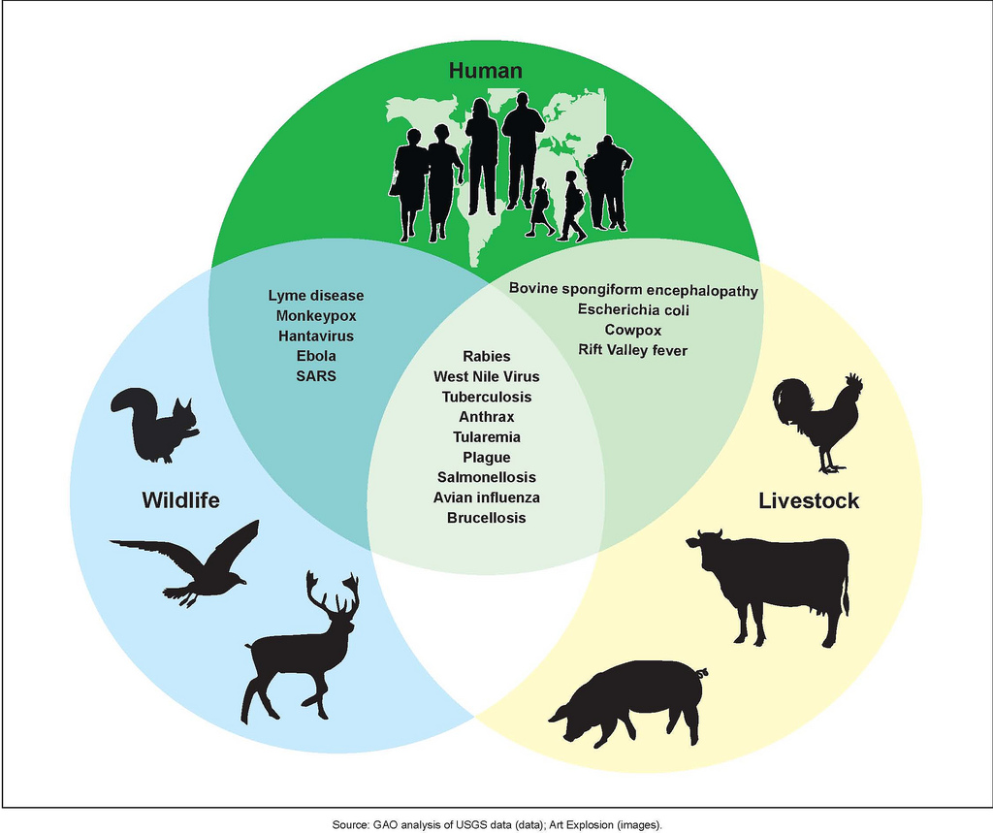

Slide 29
Video: One health: From Concept to Action. Video link: https://www.cdc.gov/onehealth/basics/index.html
What are the factors and their effects that we have difficulties to provide public health?
Factor (Cause) | Change (Effect)
Human populations are growing and expanding into new geographic areas. | As a result, more people live in close contact with wild and domestic animals. Close contact provides more opportunities for diseases to pass between animals and people.
The earth has experienced changes in climate and land use, such as deforestation and intensive farming practices. | Disruptions in environmental conditions and habitats provide new opportunities for diseases to pass to animals.
International travel and trade have increased. | As a result, diseases can spread quickly across the globe.

Slide 30
Endemic: regularly found disease among particular people or in a certain area.
Sporadic: happening sometimes; not regular or continuous.
Epidemic: is the rapid spread of infectious disease to a large number of people in a given population within a short period of time, usually two weeks or less.
Pandemic:
→an epidemic infectious disease that has spread across a large region; for instance multiple continents, or even worldwide.
→Epidemic occurring on a scale which crosses international boundaries, usually affecting a large number of people.

Slide 31
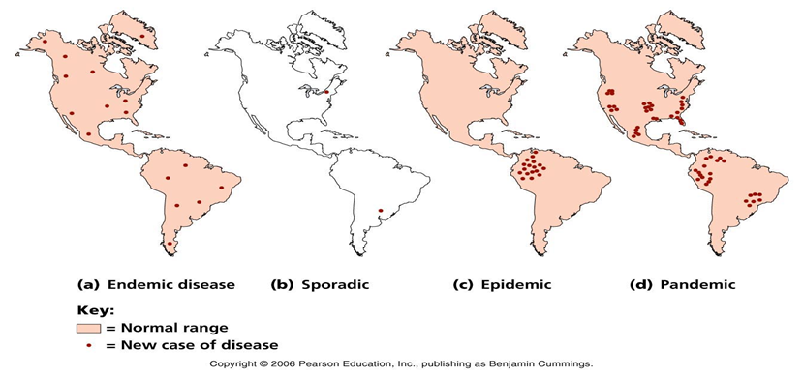
Throughout history, there have been a number of pandemics, such as smallpox and tuberculosis.
One of the most devastating pandemics was the Black death, which killed over 75 million people in 1350.
The most recent pandemics include the HIV pandemic as well as the 1918 and 2009 H1N1 pandemics.

