Slide 1
Yapay Zeka 802600715151
Doç. Dr. Mehmet Serdar GÜZEL
Slides are mainly adapted from the following course page:
at http://ai.berkeley.edu created by Dan Klein and Pieter Abbeel for CS188

Slide 2
Lecturer
Instructor: Assoc. Prof Dr. Mehmet S Güzel
Office hours: Tuesday, 1:30-2:30pm
Open door policy – don’t hesitate to stop by!
Watch the course website
Assignments, lab tutorials, lecture notes

Slide 3
e
Markov Models
Notes:
Please retain proper attribution, including the reference to ai.berkeley.edu. Thanks!
Note: pretty short lecture, good one to present mini-contest results or anything else not exactly lecture.

Slide 4
e
Markov Models
In probability theory, a Markov model is a stochastic model used to model randomly changing systems. It is assumed that future states
depend only on the current state, not on the events that occurred before it (that is, it assumes the Markov property)
Notes:
Please retain proper attribution, including the reference to ai.berkeley.edu. Thanks!
Note: pretty short lecture, good one to present mini-contest results or anything else not exactly lecture.

Slide 5
Independence
Two variables are independent in a joint distribution if:
Says the joint distribution factors into a product of two simple ones
Usually variables aren’t independent!
Can use independence as a modeling assumption
Independence can be a simplifying assumption
Empirical joint distributions: at best “close” to independent
What could we assume for {Weather, Traffic, Cavity}?
Independence is like something from CSPs: what?

Slide 6
Example: Independence?
T | P
hot | 0.5
cold | 0.5
T | W | P
hot | sun | 0.4
hot | rain | 0.1
cold | sun | 0.2
cold | rain | 0.3
T | W | P
hot | sun | 0.3
hot | rain | 0.2
cold | sun | 0.3
cold | rain | 0.2
W | P
sun | 0.6
rain | 0.4

Slide 7
Example: Independence
N fair, independent coin flips:
H | 0.5
T | 0.5
H | 0.5
T | 0.5
H | 0.5
T | 0.5

Slide 8
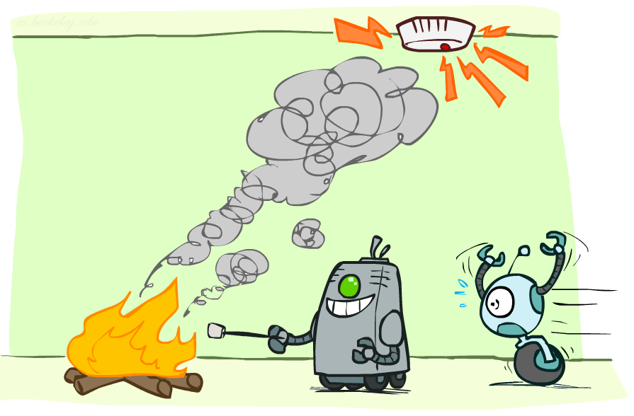
Conditional Independence

Slide 9
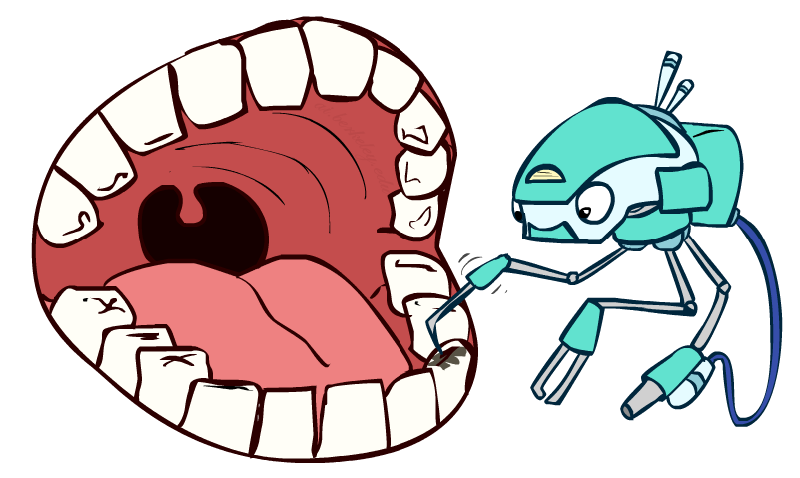
Conditional Independence
P(Toothache, Cavity, Catch)
If I have a cavity, the probability that the probe catches in it doesn't depend on whether I have a toothache:
P(+catch | +toothache, +cavity) = P(+catch | +cavity)
The same independence holds if I don’t have a cavity:
P(+catch | +toothache, -cavity) = P(+catch| -cavity)
Catch is conditionally independent of Toothache given Cavity:
P(Catch | Toothache, Cavity) = P(Catch | Cavity)
Equivalent statements:
P(Toothache | Catch , Cavity) = P(Toothache | Cavity)
P(Toothache, Catch | Cavity) = P(Toothache | Cavity) P(Catch | Cavity)
One can be derived from the other easily

Slide 10
Conditional Independence
Unconditional (absolute) independence very rare (why?)
Conditional independence is our most basic and robust form of knowledge about uncertain environments.
X is conditionally independent of Y given Z
if and only if:
or, equivalently, if and only if

Slide 11
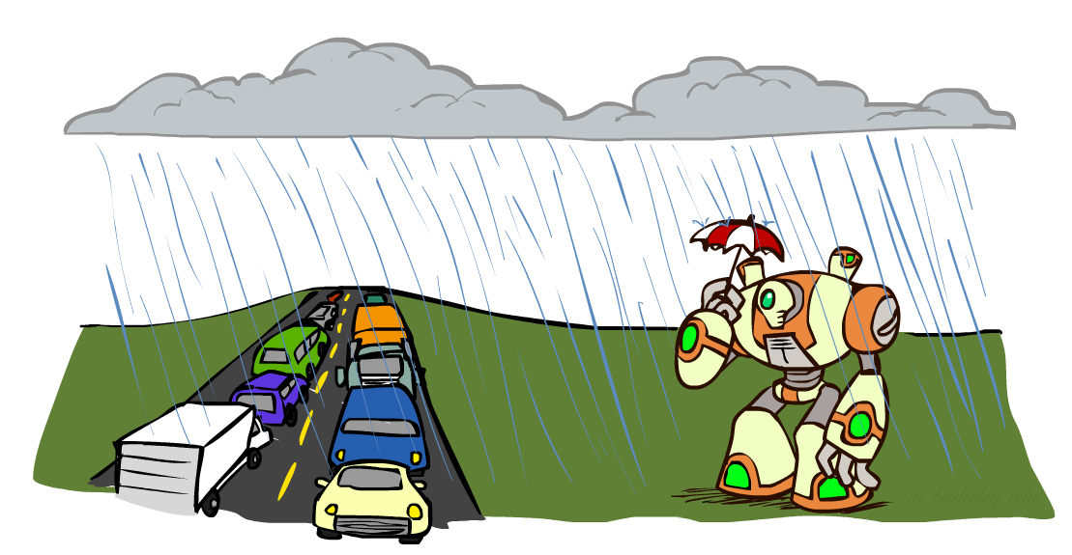
Conditional Independence
What about this domain:
Traffic
Umbrella
Raining

Slide 12
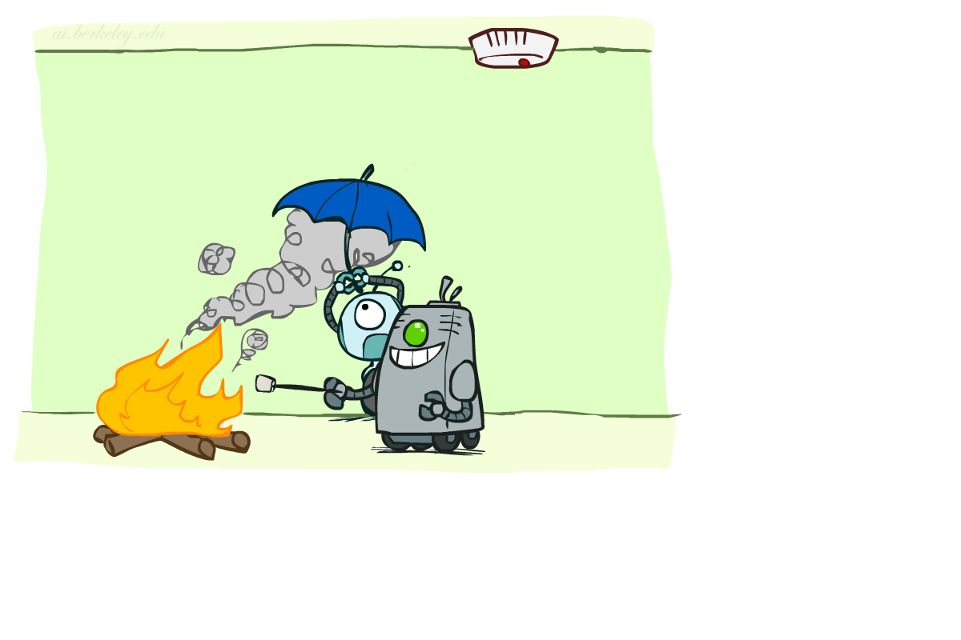
Conditional Independence
What about this domain:
Fire
Smoke
Alarm

Slide 13
Probability Recap
Conditional probability
Product rule
Chain rule
X, Y independent if and only if:
X and Y are conditionally independent given Z if and only if:

