Slide 1
Expansion
AKE 117 AMERICAN HISTORY I
Dr. GAMZE KATI GUMUS

Slide 2
Incoming IMMigration waves
Who and why?
What did they do?
Irish famine due to the fail of potato crop (1845-1852)
Unemployed farmers and artisans in Germany and Scandinavia emigrated as a result of displacement by technology
Political refugees escaping the European revolutions of 1830 and 1848
Jews and other religiously discriminated groups
Promise of jobs and land in America due to the expansion to the West and the demand for labor in construction and manufacturing.
The Germans, who had the means, purchased farms and moved westward.
The Irish, mainly unskilled laborers with no means, crowded the urban centers of the US. They worked at construction jobs, factories and domestic service.

Slide 3
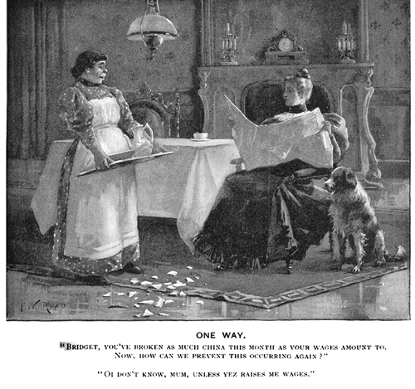
Life, Front Cover. March 19, 1896.
Notes:
http://thegibsonhousemuseum.blogspot.com/2015/02/domestic-servants-part-i.html

Slide 4
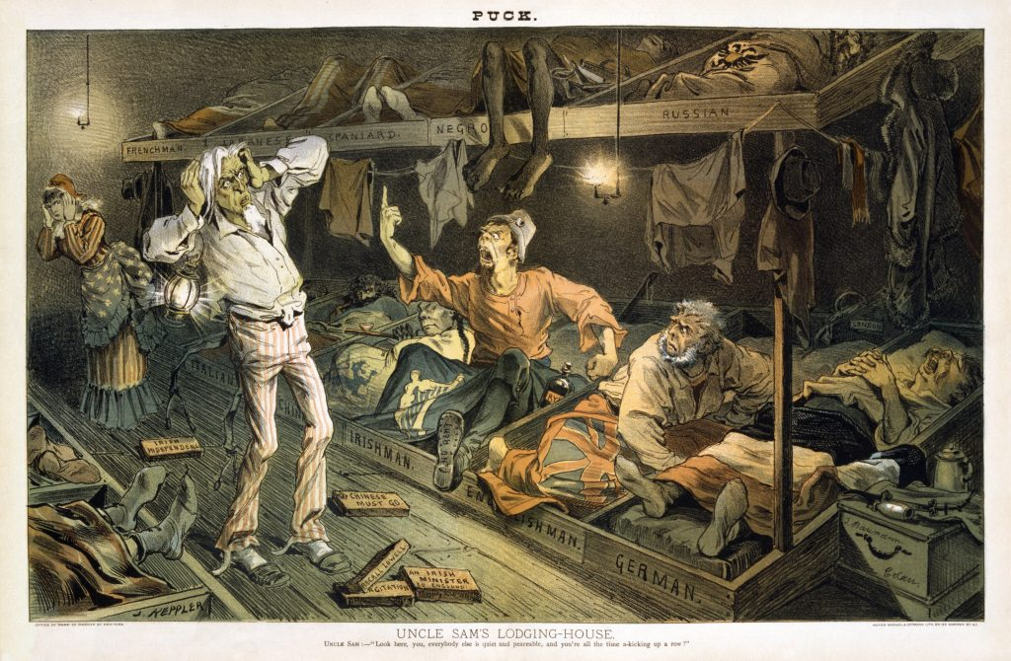
1882
Notes:
https://www.pri.org/stories/2018-12-19/trump-administration-s-public-charge-provision-has-roots-colonial-us

Slide 5
Agriculture
The United States was urbanized by 1850s due to technological developments. People worked at nonagricultural jobs.
And yet, the westward expansion also highlighted the importance of the rural and agricultural life for the growing domestic and foreign markets.
The federal government sold Western lands at public auctions to the highest bidder, the rest was sold at the minimum price of $1.25 per acre.
People received bank loans to purchase land, and speculators also helped the buyers and squatters alike financially.
Canals were built to lower the transportation price of agricultural goods.

Slide 6
INDUSTRIALIZATION
Child laborers or families with children were employed at factories to lower the costs.
Immigrants, especially young immigrant women, preferred to work at the factories since they offered dormitories.
Farm girls of New England were another source of cheap labor.
American industry largely depended on water power, instead of steam power, still in 1860.

Slide 7
RAILROADS
The railroad boom of the 1840s and 50s provided speedy access to isolated farms and distant markets.
Immigrants formed a high proportion of railroad laborers, which led to a break up of immigrant families followed by a rising number of widowed immigrant women in search of jobs available at urban cities.

Slide 8
Population distribution and opportunity
Free and enslaved blacks as well as Native Americans were at the bottom of the income distribution. Free blacks, and is some cases slaves, were generally working at the same jobs with poor white immigrants.
By 1860, the upper 5 percent of families owned over half the nation’s wealth.
Slaveholders were richer than non-slaveholders.
It was, and is still, believed that any man can become rich if they are willing to join the competition for self-improvement (the concept of rags-to-riches). Therefore, inequalities were seen temporary.
The rich elite class of America, however, was mainly rich not because its members were self-made men but because they inherited family wealth and had a good education. Their milieu was socially distant than that of the poor.

Slide 9
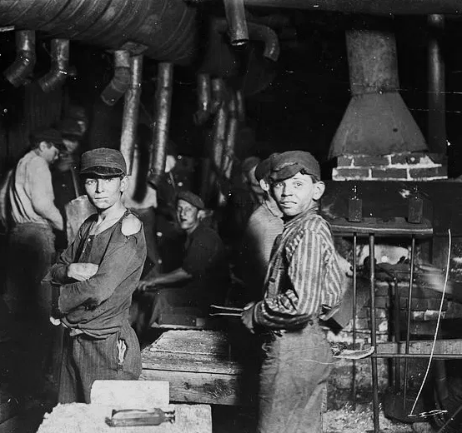
1918
Notes:
Socialwelfare.library.vcu.edu

Slide 10
5 year old shrimp-picker. 1911
Notes:
Socialwelfare.library.vcu.edu

Slide 11
Breaker boys working at mines,1911.
Notes:
Mashable.com

Slide 12
Children working in mines, 1843

Slide 13
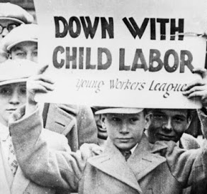
Notes:
Rememberingtherepublic.blogspot.com

Slide 14
THE POOR

Slide 15
THE POOR
Unskilled laborers worked at back-breaking jobs.
They lived in unsanitary conditions, usually crowded in the cheapest rented rooms or shacks.
Malnutrition was common; and sickness due to both poor hygiene and malnutrition prevailed among the poor.

Slide 16
SOCIAL MOBILITY
Children of manual workers would not rise to the level of clerical, managerial and professional employment because of their limited opportunities.
Sons of unskilled laborers would become semi-skilled laborers.

Slide 17
The cost of expansion: Native americans
Indian stereotypes
Reasons
Deceitful
Blood-thirsty savages
Weak
Childlike
Communal ownership of land
Mutual obligation
The higher status of women in different Native cultures

Slide 18
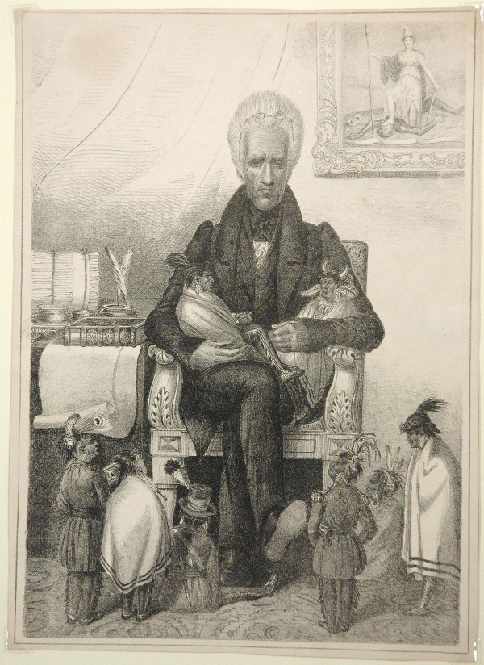
NATIVE AMERICAN POLICY
“Andrew Jackson As The Great Father” Harper’s Weekly, drawn by Thomas Nast in 1830.
The American government’s policy had four core and yet contradictory arguments:
Indian tribes were excepted as independent nations that possessed the land since they occupied it
White settlers had the right to claim the Indian land
The federal government had authority over Indian affairs
Indian culture-viewed as savagery-could not coexist with American civilization
Notes:
http://anthropology.msu.edu/anp336-us13/2013/07/06/the-great-white-father/

Slide 19
NATIVE AMERICAN POLICY
The Southern Indian tribes occupied Western Georgia, Nort Carolina as well as major portions of Tennessee, Florida, Alabama and Mississippi; the lands that would become to be known as the Cotton Kingdom.
The government decided that Indians should be removed to the west of the Mississippi River—in order to save them from extinction at the hands of white settlers.
Notes:
https://historycontext.wordpress.com/2017/02/21/the-trouble-with-andrew-jackson/
“A political cartoon depicting the forcible relocation of the Cherokee”

Slide 20
The trail of tears
Disrespecting the Indian culture on the issue of ancestral land, the white population forced the Native population out of their rightful land.
President Andrew Jackson believed that many Indians would willingly emigrate to the West.
Even though the federal government resolved to purchase the Native land from tribes, the concept of treating land as a salable commodity was not easy to be acknowledged for Natives. Moreover, many tribes were tricked out of their land.
This forced removal led to the uprooting of southern Indians from their lands towards Oklahoma, then a vacant territory. This removal is referred to as the Trail of Tears.
It is estimated that approximately 3.000 Native Americans died en route because of disease, starvation and cold.
The American government further deprived the Natives from their claims on fertile land by limiting them to ”reservations,” which would later become sovereign ground for Natives under federal authority.

