Slide 1
Principles of Academic Writings Prof.Dr.Barbaros Özer

Slide 2
Language
You're not done writing your essay until you've polished your language by correcting the grammar, making sentences flow, incoporating rhythm, emphasis, adjusting the formality, giving it a level-headed tone, and making other intuitive edits.
Proof-read until it reads just how you want it to sound.
Writing an essay can be tedious, but you don't want to bungle the hours of conceptual work you've put into writing your essay by leaving a few slippy misppallings and pourly worded phrazies.

Slide 3
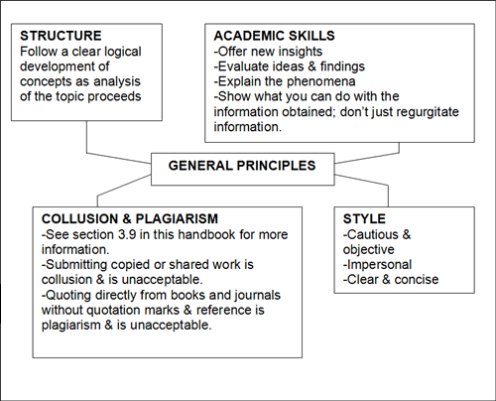

Slide 4
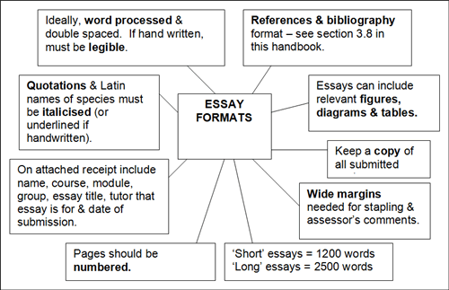

Slide 5
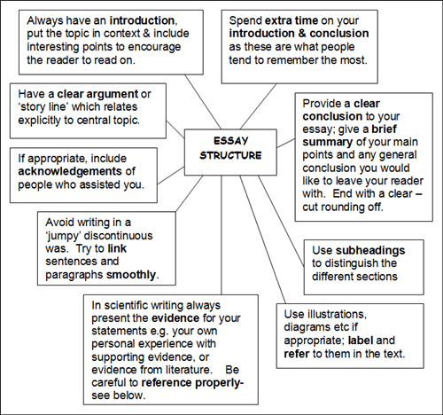

Slide 6
14 Top Tips on Writing Essays
Analyse the title – make sure you really understand what it is asking you to do – see table below on instruction words.
Read around – this is essential. Read the references plus others to supplement the list. Generate your own ideas from the reading.
Draft introduction – what do you aim to do in the essay?e.g. prove/disprove a theory etc
Use subheadings – this helps to distinguish sections.

Slide 7
Save – make sure you save your work on disk or USB stick just in case your computer crashes.
Draft the main bones of the essay – you can flesh it out later.
Show draft to someone else – it always helps having another opinion.
Check your spelling and grammar.
Vary sentence length – in general don’t use over long sentences, short sentences can be effective to. Try it.

Slide 8
Use paragraphs – Huge blocks of writing can be off putting read.
Avoid clichés – e.g. ‘very interesting’, ‘boils down to’, ‘getting down to it’, ‘sort of’ and many others!
Do not use abbreviations – In formal work it is not professional to use abbreviations and slang e.g. don’t, I’ve, we’ve etc.
Check your final version – read it out loud.
Save, file away and submit – Make sure you have plenty of time to print it out and get it in before the deadline.

Slide 9
