Slide 1
BASIC GENETIC TERMS-II

Slide 2
Since every living thing on earth wants to make copy of itself or pass on genes, genetics affects all living things.
Genes are the small DNA pieces, units of inheritance which controls everything like
looks, behaviour,
how species reproduce,
production traits.

Slide 3
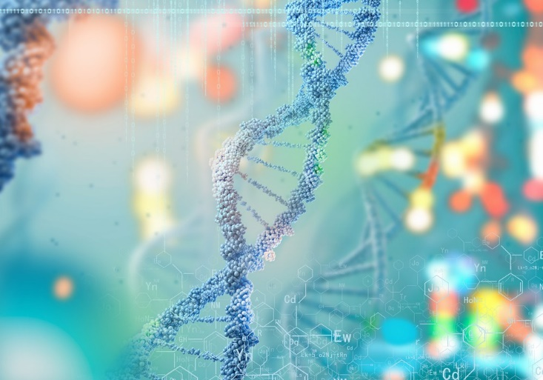
Genetics is the center of all biological subjects because biology depend on genes…
Plants, animals, human, bacteria, virus
https://www.coopergenomics.com/blog/disease-awareness/a-week-in-genetics/

Slide 4
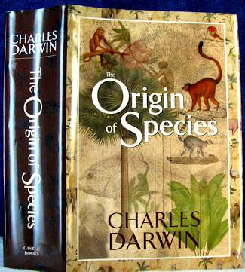
Brief History and Subdivisions
Genetics is relatively new department when we compare it with other divisions.
1859 →Discovery of Natural Selection by Charles Darwin.
1865 →Discovery of hereditary transmitted in units by Gregor Mendel

Slide 5
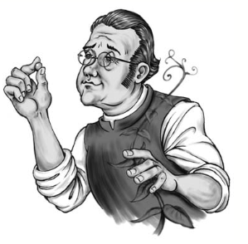
Brief History
1865 → Mendel, pea 7 characters plant hybrids
Science community didn’t take into account, HARD TO UNDERSTAND!
1875-1880 → Cell and nucleus role put forth
1883→ Roux-Weisman importance of chromosome in inheritance

Slide 6
Brief History and Subdivisions
1869→DNA isolated by Friedrich Miescher
1879→Mitosis described
1900→ Rediscovery of Mendel’s work by DeViries, Correns and von Tschermak

Slide 7
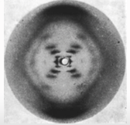
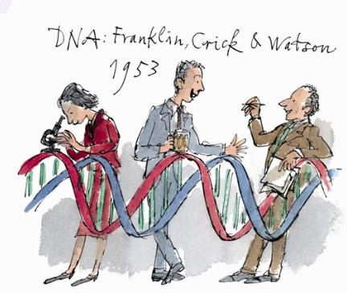
Genetik kavramının tanımı ve Tarihçe
1902→ discovery of chromosomes by Walter Sutton.
1911→ Morgoan and Sturtvent “Chromosomes carry genes”
1931→ McClintock recombination event
1953→ Structure of DNA???

Slide 8
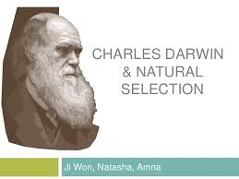
Discovery of Natural Selection by Charles Darwin
What is the basis of evolution?

Slide 9
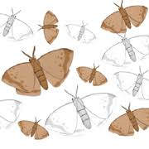
Discovery of Natural Selection by Charles Darwin
It is actually really simple;
ability to survive and reproduce.
How are we able to survive and have ability to adapt?
These abilities depend on genetic diversity.

Slide 10
Lets think, what would happen if genetic diversity doesn’t exist in species
Think

Slide 11
Famines→ extinction
Loss of biodiversity→ extinction
Defaunation→ extinction

Slide 12
Great Irish famine 1845–49
Great Famine, (Irish Potato Famine, Great Irish Famine, or Famine of 1845–49) occurred in Ireland
Phytophthora infestans infected potato crop causing a disease that destroys both the leaves and the edible roots, or tubers, of the potato plant.
The Irish famine was the worst to occur in Europe in the 19th century.
https://www.britannica.com/event/Great-Famine-Irish-history

Slide 13
Great Irish famine 1845–49
Potato valued as a great food supply.
But the heavy reliance on just one or two high-yielding types of potato greatly reduced the genetic variety that ordinarily prevents the decimation of an entire crop by disease,
thus the Irish became vulnerable to famine.
https://www.britannica.com/event/Great-Famine-Irish-history

Slide 14
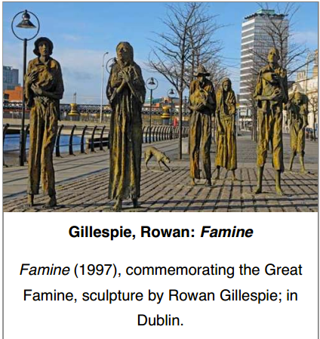
1 million people died of hunger
https://www.britannica.com/event/Great-Famine-Irish-history
Notes:
1million people died of hunger

Slide 15
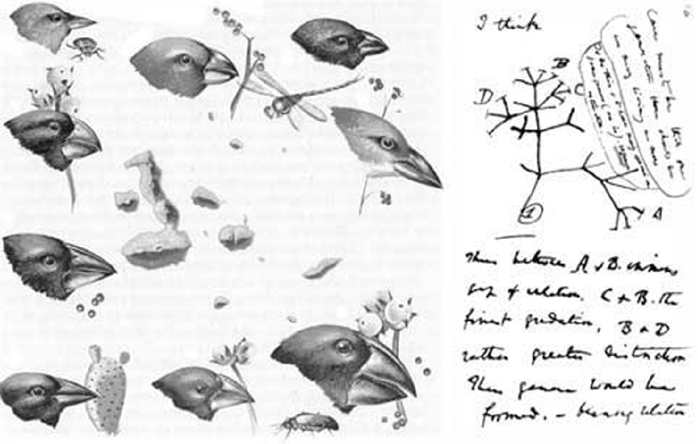
Discovery of Natural Selection by Charles Darwin
Darwin found several species of a bird species (finch) adapted to different environments.
They also differed in beak shape, food source, and how food was captured.
https://doi.org/10.1017/9781316771488.006

Slide 16
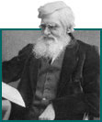
Darwin and Wallace developed similar theory on natural selection.
They presented their theory at the Linnaean Society in 1858.
Darwin published his book, Wallace returned to his studies on biogeography.

Slide 17
Brief History
Gregor MENDEL
In 1860s he defined biological factors which play an important role inheritance, and named them as “units”.

Slide 18
Genes are the main subject of genetics.
From this ground,
population genetics,
studies on evolution,
association work on genes and characters… and many other research areas

Slide 19
Brief History and Subdivisions
Genetics is generally divided into four major subdivisions:
✓ Classical, or Mendelian, genetics: A discipline that describes how physical characteristics (traits) are passed along from one generation to another.
✓ Molecular genetics: The study of the chemical and physical structures of DNA, its close cousin RNA, and proteins. Molecular genetics also covers how genes do their jobs.
✓ Population genetics: A division of genetics that looks at the genetic makeup of larger groups.
✓ Quantitative genetics: A highly mathematical field that examines the statistical relationships between genes and the traits they encode.

