Slide 1
Therapeutıc ultrasound
Dr. Pınar Can
pcan@ankara.edu.tr

Slide 2
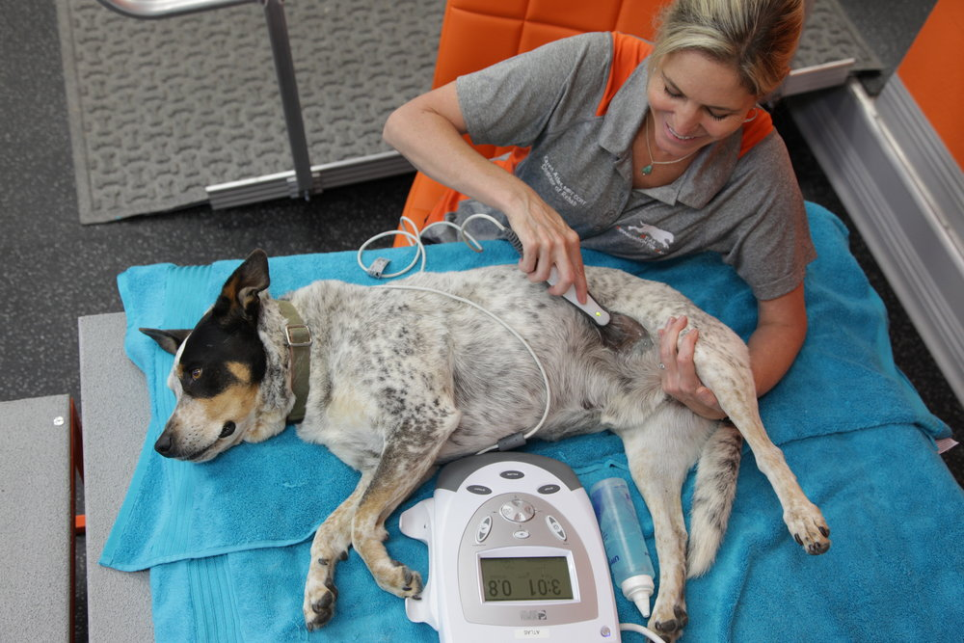
It is applying of high-frequency sound waves to the tissues with the help of a probe similar to the one used in diagnostic ultrasound (US).
Superficial heating agents penetrate soft tissues to a depth of approximately 1 cm.
Deep heating agents like as therapeutic US and diathermy can elevate tissue temperatures at depths of 2 cm or more.
https://images.squarespace-cdn.com/content/v1/59933811197aeaa6c78fa74d/1504829129407-8MJ9Y4XQEN0K0BW004KR/ke17ZwdGBToddI8pDm48kLkXF2pIyv_F2eUT9F60jBl7gQa3H78H3Y0txjaiv_0fDoOvxcdMmMKkDsyUqMSsMWxHk725yiiHCCLfrh8O1z4YTzHvnKhyp6Da-NYroOW3ZGjoBKy3azqku80C789l0iyqMbMesKd95J-X4EagrgU9L3Sa3U8cogeb0tjXbfawd0urKshkc5MgdBeJmALQKw/Therapeutic+Ultrasound.JPG

Slide 3
Physical principles
US is a high frequency sound wave (20,000 vibrations a second).
Sound waves are produced via the reverse piezoelectric effect (compression and expansion of a piezoelectric crystal).
Sound waves have the properties of reflection, scattering and absorbtion by the tissues.
Absorption is the transfer of energy from the sound beam to the tissues.
Absorption is high in tissues with high protein content and relatively low in adipose tissue
US energy is absorbed in tissues due to acoustic impedance and turns into heat energy.

Slide 4
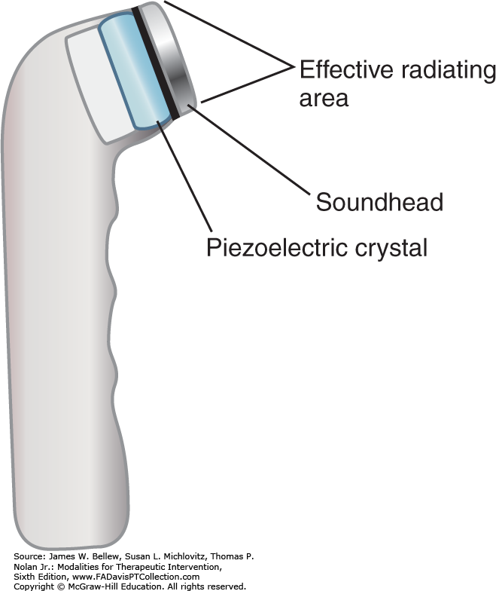
US has direct effect on cells and healing
US effect can be thermal or non-thermal,
It depens on the density, frequency, area treated, duration of treatment and speed of movement of the probe or the absorption rate of tissues.

Slide 5
Intensity is the amount of energy applied per unit area (watt / cm²).
The higher the intensity, the faster the tissue temperature increases.
Frequency defines the penetration depth (MHz).
Penetration decreases as the frequency of the US waves increases.
1 MHz ultrasound wave can heat 2-5 cm depth.

Slide 6
if the soft tissue thickness is low in the treated area or if the area is close to bone tissue >> Low intensity-high frequency.
Experimental studies have shown that 5-10 minutes of US therapy provides sufficient temperature increase in an area 2-3 times the probe surface.
Clip the area before applying and use gel for eliminating the air between skin and prob.

Slide 7
Effects of Therapeutic US
The most important effect of US is heating.
US waves are essentially mechanical pressure waves and, as they move through tissues, absorbed energy is converted into kinetic energy which increases the local temprature.
It creates compression and expansion movement on the surfaces of adjacent tissues, and increases regional blood supply with the effect of micromassage.
This causes a chain reaction of molecules vibrating and colliding into neighboring molecules.

Slide 8
Absorption is greatest in tissues with high protein content.
The absorption of ultrasound energy is optimal in the dense collagen-based tissues (tendon, ligament, fascia, joint capsule and established scar tissue),
It is most effective in tendons, ligaments, fascia, joint capsules and scar tissues.

Slide 9
The degree of warming depends on the acoustic impedance of the tissues.
Acoustic impedance is the resistance to the propagation of ultrasound waves through tissues.
Acoustic impedance Air < Fat < Muscle < Bone
Increased tissue temperatures may increase collagen extensibility, blood flow, pain threshold, and enzyme activity, as well as mild inflammatory reactions, and changes in nerve conduction velocity.

Slide 10
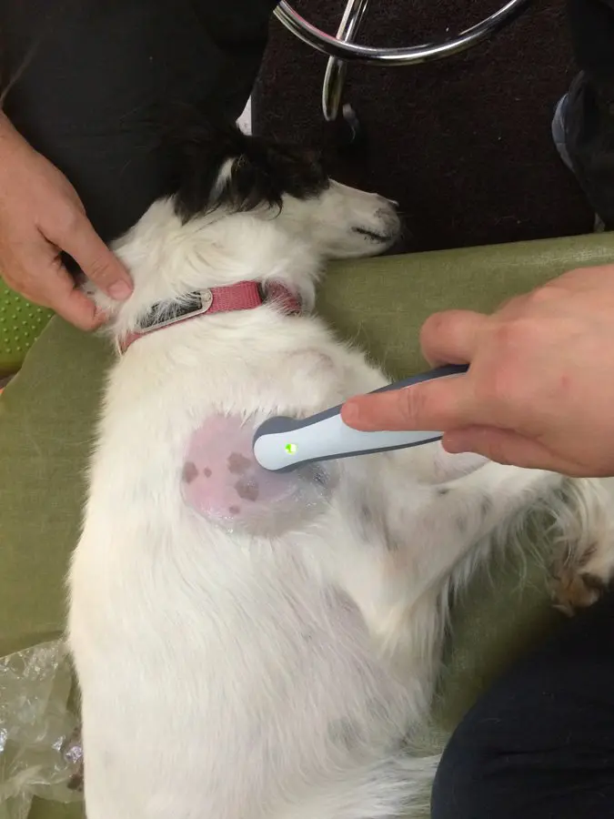
Heating is thought to alter the viscoelastic properties of collagen and collagen molecular bonding.
Heat can increase the endorphins by this way reduces pain.
Nerve tissue absorbs US energy more than muscles and warms up >>> analgesic and antispasmodic effect
https://healingartsanimalcare.com/wp-content/uploads/2014/11/IMG_5306.jpg.webp

Slide 11
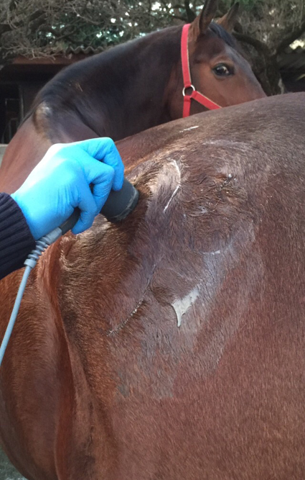
It has an inhibitory effect on sympathetic fibers.
Very high dose US application may cause pathological fractures.
Increasing circulation with vasodilation helps to remove metabolic wastes that stimulate pain from the area.
https://www.equltrasound.com/wp-content/uploads/2015/05/therapeutic-ultrasound-treatment.jpg

Slide 12
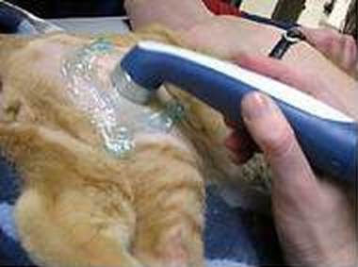
The nonthermal effects include cavitation and acoustic streaming
Microstreaming, or acoustic streaming, refers to small‐grade, unidirectional pressure waves created in the fluids around cells.
Cavitation is the compression and expansion of small gas bubbles in body fluids.
Both may modify cellular function and membrane permeability, thus assisting with tissue repair and swelling reduction.
https://cdn11.bigcommerce.com/s-13ttxa/images/stencil/400x400/uploaded_images/ultrasound-therapy-for-animals.jpg?t=1465409275

Slide 13
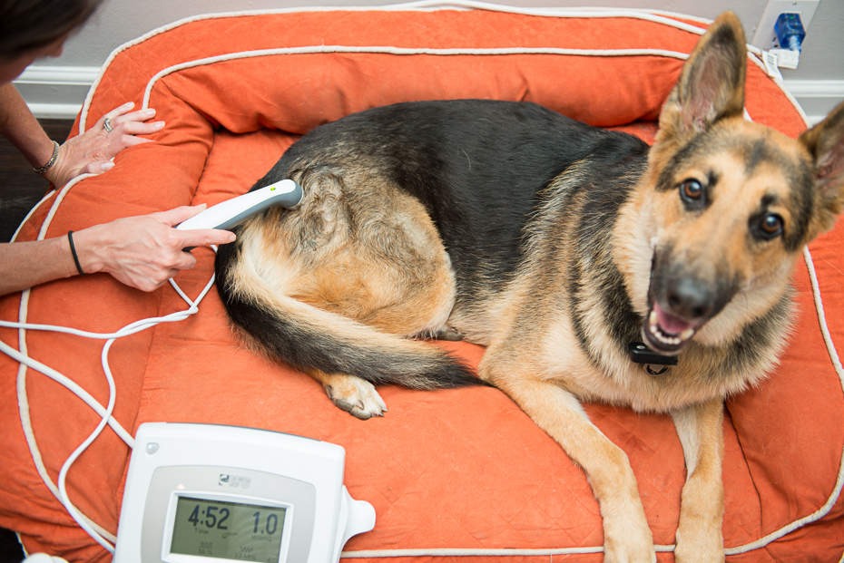
But cavitation can lead to hemolysis, bleeding, and tissue necrosis.
In order to prevent detrimental effects of cavitation, constant application should be avoided and unnecessarily high doses should not be applied.
Recomended application velocity is approximately 4 cm per second
http://www.heatheroxford.com/uploads/3/4/5/4/34547934/6616999_orig.jpg

Slide 14
1-4 ºC temperature increase can be provided in 2-5 cm or more deep tissues in regarding to the thermal effect of US.
Collagen fiber extensibility, regional blood circulation, enzyme activity and pain threshold increase.
In cases such as joint contracture, muscle spasm and pain, limited range of motion as a result of wound healing, US therapy can be effective.
Accelerates wound and fracture healing

Slide 15
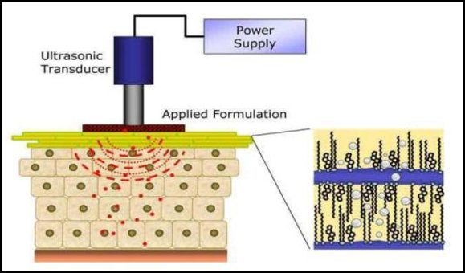
Phonophoresis
The use of US to enhance the delivery of topically applied medications through intact skin
The target for the drug may be local (antiinflammatory or analgesic) or systemic.
Phonophoresis enhances transdermal drug delivery by altering the stratum corneum, which is the major barrier to drug penetration.
https://www.researchgate.net/profile/Ritesh-Bathe/publication/311444050/figure/fig11/AS:436289792155662@1481031000775/The-basic-principle-of-phonophoresis-Ultrasound-pulses-are-passed-through-the-probe-into_W640.jpg

Slide 16
The possible action of mechanism is that US denatures the structural keratin proteins in the stratum corneum, strips or delaminates the cornified layers of the stratum corneum, changes cell permeability, or alters the lipid-enriched intercellular structures between the cells.
After the stratum corneum is crossed the pharmaceutical molecules penetrate the dermis, are absorbed into the tissues and capillaries, and travel throughout the circulatory system.

Slide 17
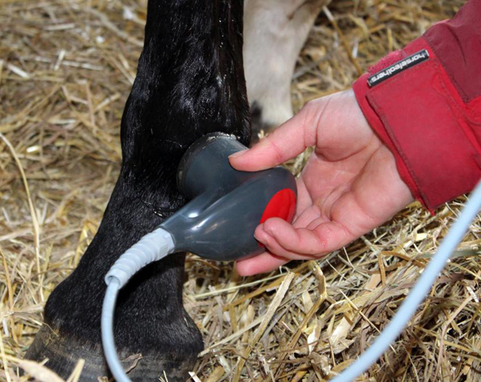
tendinitis, bursitis, osteoarthritis, and neuroma
Steroids such as hydrocortisone and dexamethasone sodium in the treatment of osteoarthritis
Lidocaine, one of the local anesthetics, to reduce pain
https://www.equltrasound.com/wp-content/uploads/2015/06/ultrasound-deep-heat-after-surgery.jpg

Slide 18
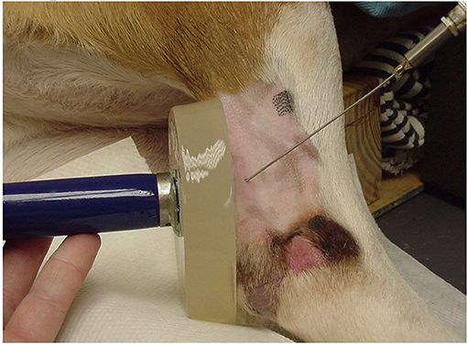
Indications
Main indications;
Soft tissue shortening (e.g., contracture, scarring)
Subacute and chronic inflammation
Pain (such as muscle guarding, trigger points)
Tendinitis and bursitis
Joint contracture and scar tissue
Pain and muscle spasm
https://www.frontiersin.org/files/Articles/446925/fvets-06-00185-HTML/image_m/fvets-06-00185-g001.jpg

Slide 19
Precautions and Contraindications
Local burns may occur if the intensity is too high, treatment times are too long, or the transducer is held stationary, thereby concentrating energy in a small area.
Avoid direct US exposure to;
Cardiac pacemakers
Carotid sinus or cervical ganglia
Eyes. Because blood supply to the lens is poor, heat is poorly dissipated and could result in cataracts. Retinal damage could also result.

Slide 20
Gravid uterus
Heart. Electrocardiographic changes have occurred in dogs.
Injured areas immediately after exercise
Malignancy
Spinal cord if a laminectomy has been performed
Wounds that are contaminated. Ultrasound could drive bacteria into the tissues
Recent incision sites. It is not recommended to treat incision sites with continuous US for the first 14 days to avoid dehiscence

Slide 21
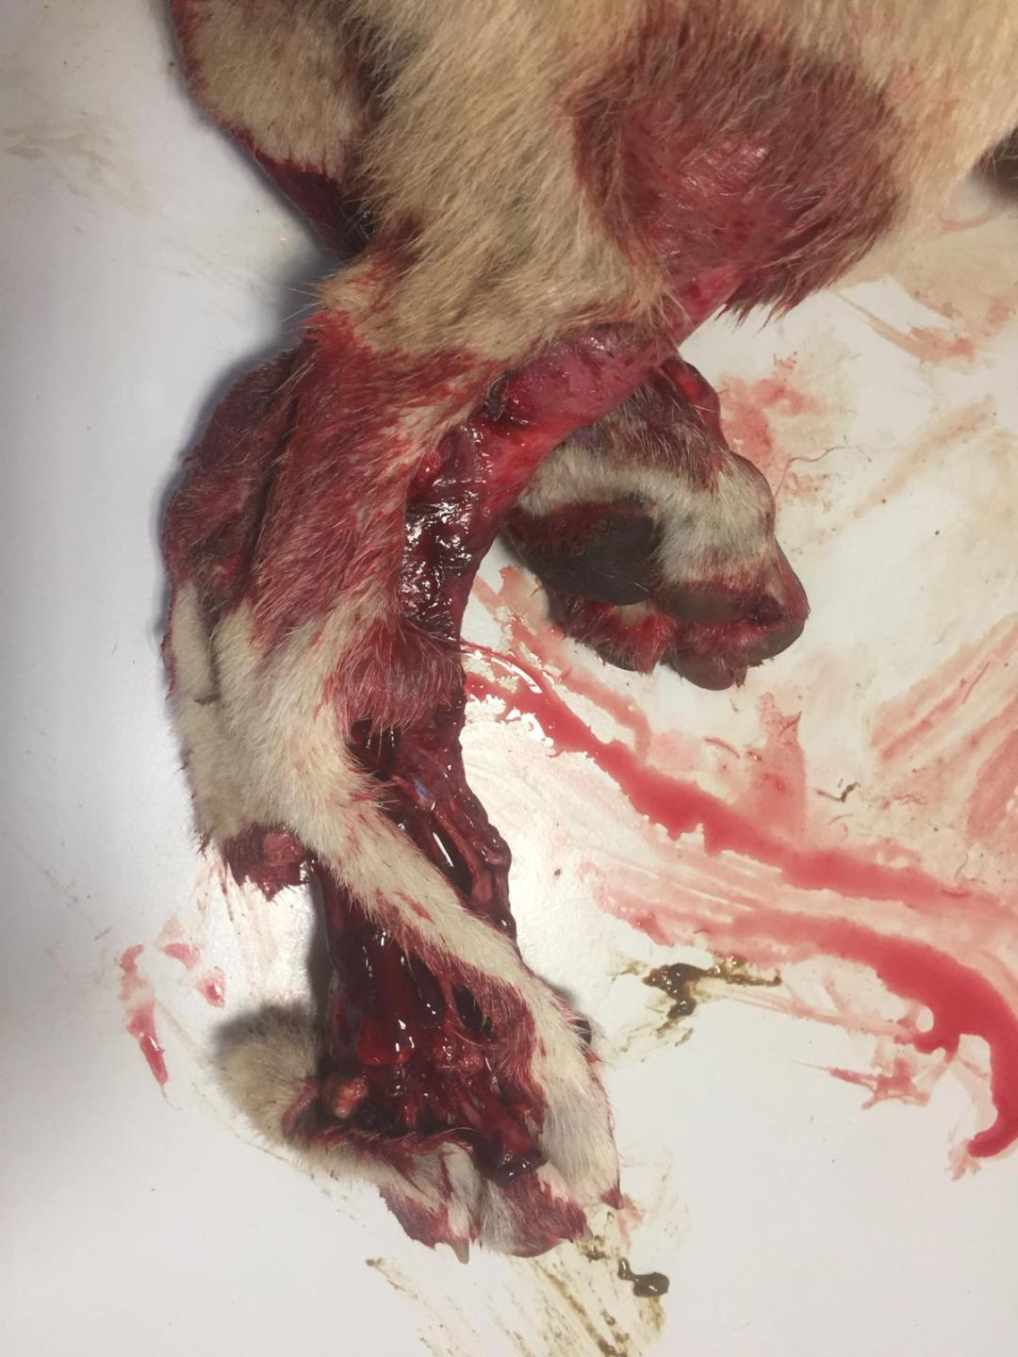

Slide 22
