Slide 1
Biomedical Uses of Lithium
Anti depressant antiviral anticancer effect

Slide 2
İNTRODUCTION
Recent studies on the biological effects of lithium have expanded the scope of their potential use to include major disease treatments. These are diseases such as neoplasms, retroviral infections and immunological disorders, and studies on lithium are ongoing.
In fact, lithium is mostly used for mood stabilization. Lithium, a small atom, can cause significant changes in biological systems. Obviously, regardless of the disease process, a strong possibility in molecular studies will shed some light on the disease itself.
HISTORICAL BACKGROUND
Primarily, Lithium is obtained in one way from rocks in North and South America, and in the form of salts in arid places that are volcanic active. Mostly used in the production of lithium light metal alloys, glass making, lubricating oils, and batteries that produce electricity Only less than 1% of total lithium is found in medicine as a drug.
Lithium is found naturally in biological tissues.It is commonly found in low concentrations of drinking water. Natural waters that contain higher concentrations of these and other metals are often referred to as "mineral waters" with so-called medicinal properties. Lithium was first used medicinally in the treatment of gout. Garrod (1859) previously described the medical use in detail and specifically talked about its use in brain gout disease.
Gout is a depressive illness that occurs as a result of excess uric acid in the blood. Lithium urate is the most soluble salt of uric acid and therefore facilitates the excretion of uric acid and modify gout symptoms.

Slide 3
The clinical value of lithium in psychiatry was discovered in 1949 by Cade (Australian psychiatrist). At that time, there was no effective treatment for any patient in major psychiatric diseases, and the effect of lithium had to be observed. So it has been surprising and exciting.
Since the mid-1960s, lithium use has increased until it is estimated that approximately 500,000 patients will receive worldwide.
Lack of great commercial exploitation potential limited lithium development compared to organic psychotherapeutic agents. However, it is used only by 60,000 patients in the UK..
Lithium carbonate is used specifically for prophylaxis or for the prevention of effective impairment for recurrent emotional changes in patients suffering from manic depressive psychosis. Limited use for other psychiatric conditions. Although it reduces the side effects, lithium is a safer drug according to experimental gains.
Lithium significantly improves mood and improves the patient's quality of life. This situation is undoubtedly good. Otherwise patients may be suicidal. This was expressed by their families.
Lithium is taken orally, usually in tablet form, as lithium carbonate. It is monitored by looking at the levels of lithium in the blood 12 hours after treatment.
Determination in the blood is traditionally done by Flame Emission Spectrometry or Atomic Absorption Spectroscopy, but lithium-ion selective electrodes are now commercially available and are the most effective way of determination in lithium-treated patients. It is useful both in clinical setting and in the dosage adjustment in relation to the patient's condition.
Serum lithium concentrations should be in the range of 0.4-0.8 mmol- '. High levels can cause side effects, including chills, dizziness, drowsiness, and diarrhea. Mood stability does not occur until a significant period of time in lithium treatment; there may be a delay.

Slide 4
It is referred to as the drug name LITHURIL.
LİTHURİL is available in glass bottle packaging containing 100 capsules.
contains an active substance called lithium carbonate. LiCO₃
İt is used in the diseases mentioned below;
Prevention and treatment of explosive disorder attacks and recurrent depression in the disease called:
“manic-depressive illness”,
- To decrease the incidence of cluster headache in seizures,
- Treatment of depression and other behavioral disorders,
- To decrease the frequency of infection in patients with low number of cells in the blood.
You should be sure that this medicine is safe for you. The doctor should be informed of the conditions listed below.
Respiratory Problems;
heart disease;
kidney disease;
thyroid disorder;
an abnormal electrocardiograph or ECG
fainting story; or
A family member who died before age 45.
It must be said whether it is.

Slide 5
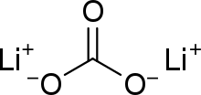
Alkali metals (Group 1A) easily lose an electron to yield a univalent cation. Alkali metal compounds are almost entirely ionic, although lithium has rather more tendency to form covalent compounds
Lithium carbonate
Lithium compounds, also known as lithium salts, are primarily used as a psychiatric medication. It is primarily used to treat bipolar disorder and treat major depressive disorder that does not improve following the use of antidepressants. In these disorders, it reduces the risk of suicide. Lithium is taken by orally.
Evidence suggests that patients with bipolar disorder have mitochondrial dysfunction. Oxidative stress and low levels of antioxidants (such as glutathione) lead to cell death. Lithium can protect against oxidative stress by regulating complex I and II of the mitochondrial electron transport chain upwards.

Slide 6
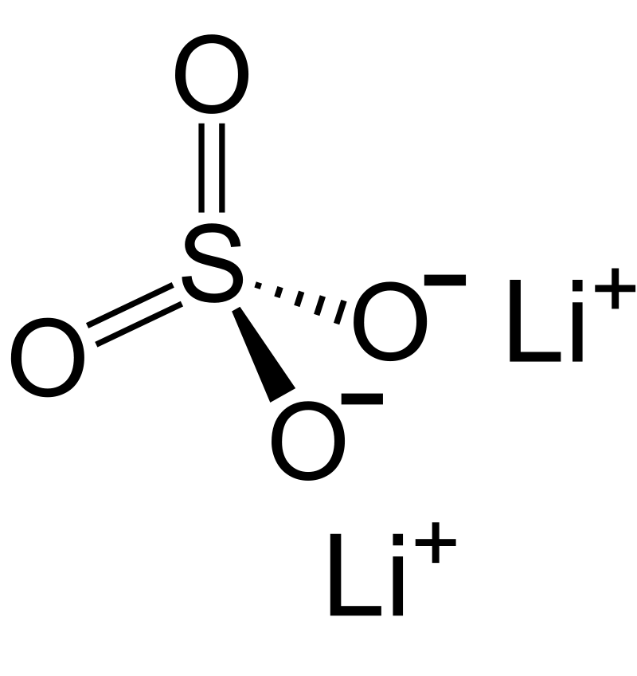
Lithium sulfate
Lithium (Li) is used in psychiatry for the treatment of mania, endogenous depression, and psychosis; and also for treatment of schizophrenia. Usually lithium carbonate (Li₂CO₃) is applied, but sometimes lithium citrate (Li₃C6H5O7), lithium sulfate or lithium oxybutyrate are used as alternatives.

Slide 7
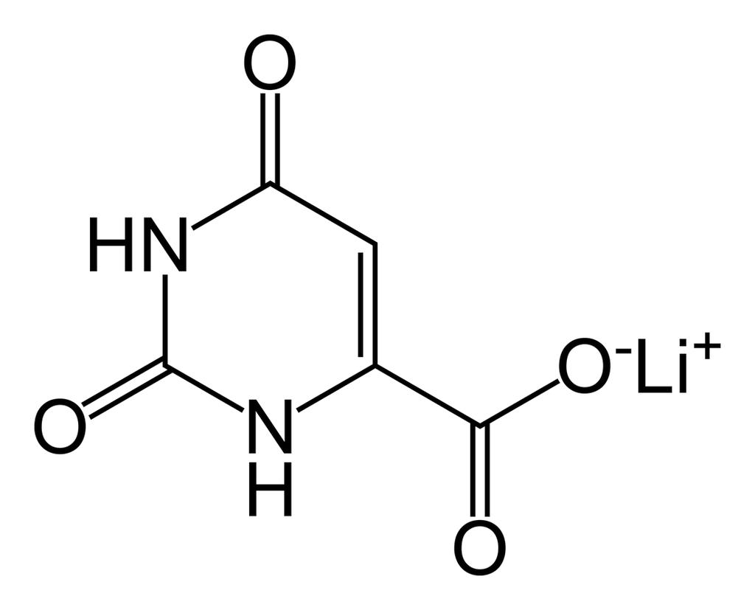
Lithium orotate
(C₅H₃LiN₂O₄), is a salt of orotic acid and lithium. It is available as the monohydrate, LiC₅H₃N₂O₄·H₂O.In this compound, lithium is non-covalently bound to an orotate ion, rather than to a carbonate or other ion, and like other salts, dissociates in solution to produce free lithium ions. It is marketed as a dietary supplement, though only barely researched between 1973–1986 to treat certain medical conditions, such as alcoholism and Alzheimer's disease.
While lithium orotate is capable of providing lithium to the body, like lithium carbonate and other lithium salts, there are no systematic reviews supporting the efficacy of lithium orotate and it is not approved by the U.S. Food and Drug Administration (FDA) for the treatment of any medical condition.

Slide 8
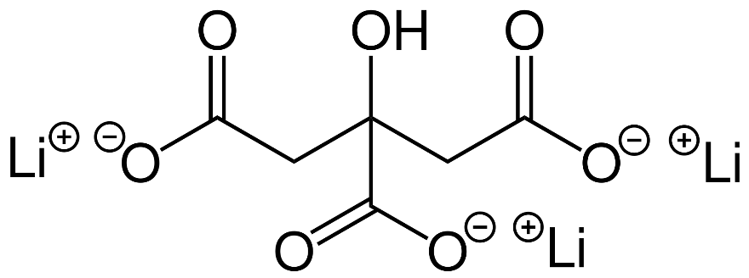
Lithium citrate
Used to treat bipolar disorder, mood stabilizers suppress shifts between mania and depression. Mood-stabilizing drugs are also used in schizoaffective disorder
A mood stabilizer is a psychiatric pharmaceutical drug used to treat mood disorders characterized by intense and sustained mood shifts, such as bipolar disorder type I or type II and schizoaffective disorder.
7 up (drink)
As with cocaine in Coca-Cola, lithium was widely marketed as one of a number of patent medicine products popular in the late-19th and early-20th centuries, and was the medicinal ingredient of a refreshment beverage. Charles Leiper Grigg, who launched his St. Louis-based company The Howdy Corporation, invented a formula for a lemon-lime soft drink in 1920. The product, originally named "Bib-Label Lithiated Lemon-Lime Soda", was launched two weeks before the Wall Street Crash of 1929. It contained the mood stabilizer lithium citrate, and was one of a number of patent medicine products popular in the late-19th and early-20th centuries. Its name was soon changed to 7 Up. All American beverage makers were forced to remove lithium in 1948. Despite the 1948 ban, in 1950 the Painesville Telegraph still carried an advertisement for a lithiated lemon beverage.

Slide 9
Mechanism of action
The specific biochemical mechanism of lithium action in stabilizing mood is unknown.
Upon ingestion, lithium becomes widely distributed in the central nervous system and interacts with a number of neurotransmitters and receptors, decreasing norepinephrine release and increasing serotonin synthesis.
Unlike many other psychoactive drugs, Li+
typically produces no obvious psychotropic effects (such as euphoria) in normal individuals at therapeutic concentrations. Lithium may also increase the release of serotonin by neurons in the brain. In vitro studies performed on serotonergic neurons from rat raphe nuclei have shown that when these neurons are treated with lithium, serotonin release is enhanced during a depolarization compared to no lithium treatment and the same depolarization.

Slide 10
Oxidative metabolism
Evidence suggests that mitochondrial dysfunction is present in patients with bipolar disorder. Oxidative stress and reduced levels of anti-oxidants (such as glutathione) lead to cell death. Lithium may protect against oxidative stress by up-regulating complex I and II of the mitochondrial electron transport chain.
Dopamine and G-protein coupling
During mania, there is an increase in neurotransmission of dopamine that causes a secondary homeostatic down-regulation, resulting in decreased neurotransmission of dopamine, which can cause depression. Additionally, the post-synaptic actions of dopamine are mediated through G-protein coupled receptors. Once dopamine is coupled to the G-protein receptors, it stimulates other secondary messenger systems that modulate neurotransmission. Studies found that in autopsies (which do not necessarily reflect living people), people with bipolar disorder had increased G-protein coupling compared to people without bipolar disorder. Lithium treatment alters the function of certain subunits of the dopamine associated G-protein, which may be part of its mechanism of action.
Glutamate and NMDA receptors
Glutamate levels are observed to be elevated during mania. Lithium is thought to provide long-term mood stabilization and have anti-manic properties by modulating glutamate levels. It is proposed that lithium competes with magnesium for binding to NMDA glutamate receptor, increasing the availability of glutamate in post-synaptic neurons. The NMDA receptor is also affected by other neurotransmitters such as serotonin and dopamine. Effects observed appear exclusive to lithium and have not been observed by other monovalent ions such as rubidium and caesium.

Slide 11
GABA receptors
GABA is an inhibitory neurotransmitter that plays an important role in regulating dopamine and glutamate neurotransmission. It was found that patients with bipolar disorder had lower GABA levels, which results in excitotoxicity and can cause apoptosis (cell loss). Lithium has been shown to increase the level of GABA in plasma and cerebral spinal fluid. Lithium counteracts these degrading processes by decreasing pro-apoptotic proteins and stimulating release of neuroprotective proteins. Lithium's regulation of both excitatory dopaminergic and glutamatergic systems through GABA may play a role in its mood stabilizing effects.
Cyclic AMP secondary messengers
Lithium's therapeutic effects are thought to be partially attributable to its interactions with several signal transduction mechanisms. The cyclic AMP secondary messenger system is shown to be modulated by lithium. Lithium was found to increase the basal levels of cyclic AMP but impair receptor coupled stimulation of cyclic AMP production. It is hypothesized that the dual effects of lithium are due to the inhibition of G-proteins that mediate cyclic AMP production.

Slide 12
Some medicines can interact with lithium and cause a serious condition called serotonin syndrome. Your doctor may also use stimulant medicine, opioid medicine (narcotic medicine), herbal products.
or make sure he knows whether to take medication to prevent depression, mental illness, Parkinson's disease, migraine headaches, serious infections, or nausea and vomiting.
The doctor should be consulted before making any changes in how or when you take the medication.
Lithium has been an FDA-approved and preferred drug for the treatment of mood disorders for many years, and cumulative evidence points to its potential use as an anti-cancer agent.
ANTIVIRAL EFFECT new investigates on lıhium compounds
The current rapid spread of the new coronavirus (2019-nCoV) from Wuhan, China, requires a prompt response from the research community. Lithium is commonly used to treat bipolar disorder, but has been shown to show antiviral activity. Studies on the subject of compilation are published,
It has taken a systematic approach to describe five in vitro studies reporting the effect of lithium on coronaviral infections.
In case of urgent need, it is recommended to investigate lithium as a potential treatment or prophylaxis for the new Wuhan coronavirus (2019-nCoV).

