Slide 1
Carbohydrates
Res. Asst. Aybüke ÇELİK
A.U. Faculty of Pharmacy, Department of Biochemistry
2. week

Slide 2
General Properties of Carbohydrates
They contain C,H, O.
They have potentially active aldehyde or ketone group.
They contain a large number of hydroxyl groups

Slide 3
Carbohydrates are compounds of tremendous biological importance:
– they provide energy through oxidation – they supply carbon for the synthesis of cell components
– they serve as a form of stored chemical energy
– they form part of the structures of some cells and tissues

Slide 4
Classification of Carbohydrates
Monosaccharides
Oligosaccharides
Polisaccharides

Slide 5
Aldose- Ketose
Aldose:
Carbonyl carbon is on the first carbon (Aldehyde)
Ketose:
Carbonyl group is
on the second
carbon (Ketone)

Slide 6
Hemiacetal & hemiketal formation
An aldehyde can react with alcohol to form hemiacetal
A ketone can react with alcohol to form hemiketal
aldehyde
alcohol
hemiacetal

Slide 7
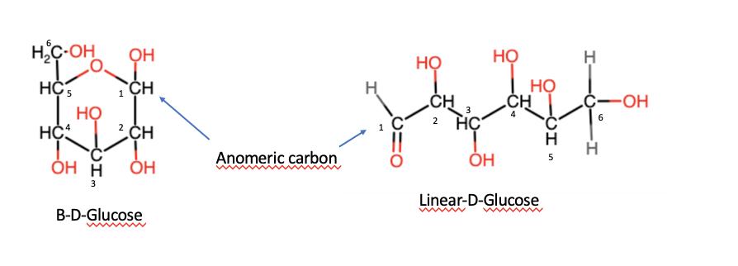
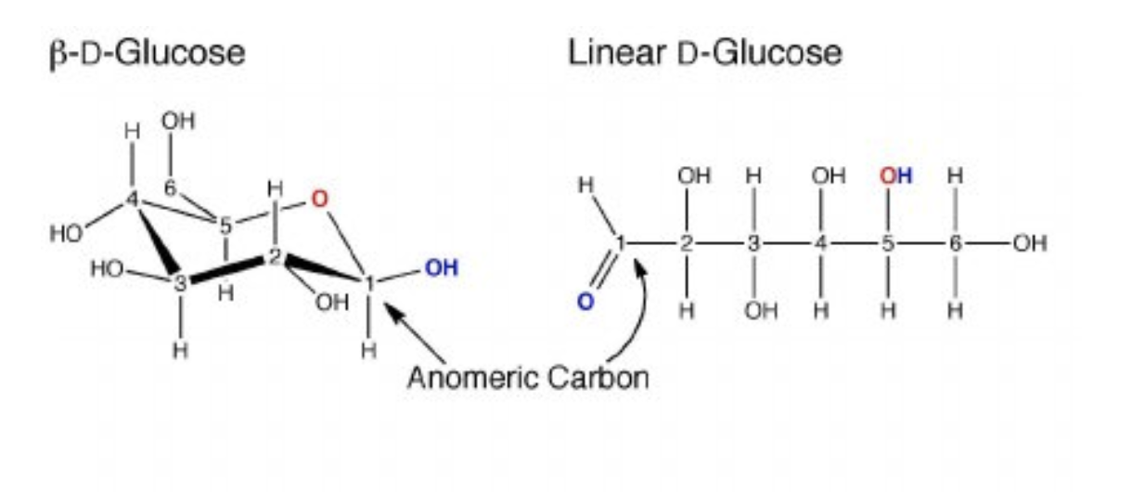
Cyclic form of Glucose

Slide 8
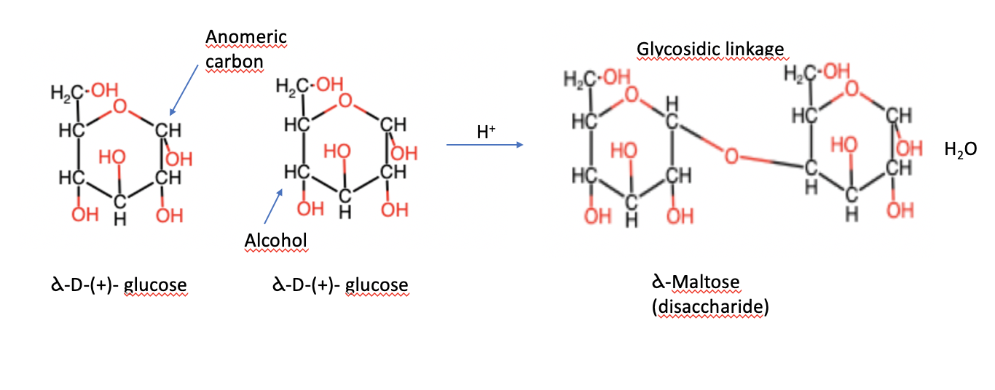
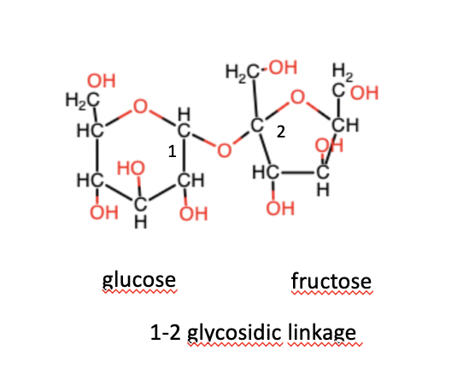
sucrose

Slide 9
Carbohydrates consist of hemiacetal bonds are reducing sugars.
Carbohydreates that includes only acetal group aren’t reducing sugars.

Slide 10
Reducing Features
Sucrose has D-glucose and D-fructose
Glycosidic bond :C1(glucose) with C2(Fructose)
Sucrose isn’t reducing sugar (Acetal bond)
Maltose and sellubiose are reducing sugars.
Sucrose does not show any reducing properties because its hemiacetal and hemiketal hydroxyls form an alpha (1,2) glycosidic linkage.

Slide 11
Reactions of Carbohydrates
1) Reducing feaures
Monosccaharides which have free hemiacetal or hemiketal hydroxyl groups are reducing sugars.

Slide 12
General Reactions of Carbohydrates
A carbohydrate bearing a reducing group reduce some of the ingredients given below. and it is oxidized.

Slide 13
2) The effect of alkalies on sugars
A yellow color is formed when the reducing sugar is heated by adding NaOH or KOH to the sugar solution. The resulting color turns into orange color and dark brown.
The color change is caused by the polymerization of the aldehydes liberated.

Slide 14
3) Effect of acids on sugars
Carbohydrates are generally cleaved by monosaccharides when boiled with dilute acids.
When monosaccharides are treated with concentrated acids, they form colored compounds.

Slide 15
Nylander Reaction
Principle: The sugars which have free reductor groups reduce the Bi³⁺ in the solution to metallic form when boiled in alkaline environment.

Slide 16
Nylander Reaction
1st Tube 2nd Tube 3rd Tube
+Nylander solution (0,25ml)
Glucose (2ml) fructose sucrose
Tubes are boiled in the water bath and color change is observed

Slide 17
Methylene Blue Reaction
Principle: The sugars are heated in alkaline environment and hydrogen ions which are separated from the molecules, are combined with the methylene blue and methylene blue turns into reducing form.

Slide 18
Methylene Blue Reaction
Distilled water (5ml) + methylene blue solution (10 drops) +2 N NaOH (2 drop)
+glucose (4 drop) Water bath

Slide 19
Moore Reaction
Moore assay is a special test for sugars with free aldehyde or ketone groups.
Principle: It is based on the principle that it comes in a yellow, orange color and a brown color with little addition of NaOH or KOH on the sugar solution.
The color reaction is the result of polymerization of the aldehydes which becomes free.

Slide 20
Moore Reaction
1st tube 2ndtube 3rd tube 4th tube
Sucrose Starch Glucose Fructose (2 ml)
10%NaOH (0,5 ml)
Water bath
Color change is observed

Slide 21
Molisch Reaction
Principle: The pentoses treated with concentrated sulfuric acid are converted to furfural and the hexoses are converted into hydroxymethyl furfural, which is based on the form of colored complexs between these compounds and alcoholic solution of alpha-naphthol.

Slide 22
Molisch Reaction
1.tube 2.tube 3.tube 4.tube
Glucose Fructose Sucrose Starch ( 2 ml)
+Molisch reactive (mixed) (1 ml)
+sulfuric acid (1,5 ml)
formation of violet-red color
acid is added by keeping the tube inclined

Slide 23
Hydrolysis of starch with salivary amlyase
Principle: is based on the color reaction of dextrins, maltose and glucose which formed during hydrolysis of starch with iodine.
Starch + Iodine-------------------Blue
Amilodextrin + Iodine- --------- Violet's
Erythrodextrin + Iodine- --------Onion skin
Acrodextrin + Iodine- ----------- Light yellowish
Maltose and Glucose + Iodine- ---------- Colorless

Slide 24
1 ml starch (mixed) + Iodine 1 ml……….Blue,
purple colour formation

Slide 25
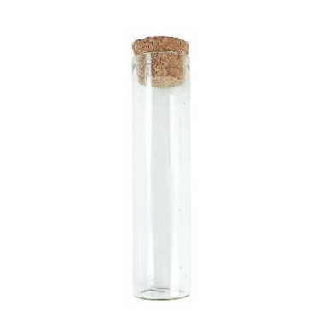
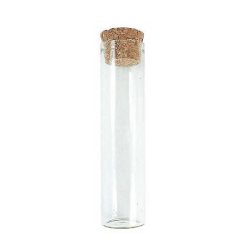
Hydrolysis of starch with salivary amlyase ( with bench)
1. TUBE
1 ml starch
+
1 ml iodine
Blue colour
Take from 2.tube + 2 drop iodine
3 ml starch
saliva
1 min later
1 min later
1 min later
1 min later
37 C 1 min inubation
Violet
Onion skin
Light yellow
No colour
2.TUBE
4.TUBE
5.TUBE
6.TUBE
3.TUBE

Slide 26
Hydrolysis of starch with salivary amlyase
3 ml starch (mixed)
Saliva
37°C 1 min incubation
37°C 1, 2, 3 min incubation
Take 0,5 ml, add Iodine
Colour formation

Slide 27
Hydrolysis of starch with salivary amlyase
Starch+Iodine solution (Purple color)
Starch+Amylase→Hydrolysis

Slide 28
Experiment Report:
Name-Family Name: Date:
No:
Experiment Name::
Prensibe of experiment:
Result of experiment:
Comments:

Slide 29
References
ANKARA UNIVERSITY FACULTY OF PHARMACY BIOCHEMISTRY PRACTICE BOOK – 2004
PRACTICAL BIOCHEMISTRY- (2015) ALJEBORY, A., AND ALSALMAN, A.
A LABORATORY TEXT BOOK OF BIOCHEMISTRY, MOLECULAR BIOLOGY AND MICROBIOLOGY-2014
LEHNINGER PRINCIPLES OF BIOCHEMISTRY- 5TH EDITION-2008

