Slide 1
B-309 BİYOKİMYA I
XIV.HAFTA

Slide 2
GLİKOJEN SENTAZ VE GLİKOJEN FOSFORİLAZ

Slide 3
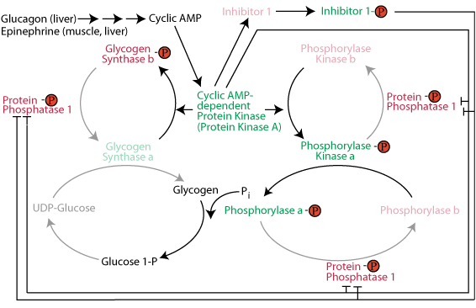
https://www.google.com/url?sa=i&url=http%3A%2F%2Feducation.med.nyu.edu%2Fmbm%2Fcarbohydrates%2Fglycogen.shtml&psig=AOvVaw3KYcroXwd0gCZSO7ZCanub&ust=1589403556879000&source=images&cd=vfe&ved=0CAIQjRxqFwoTCND0u-ubr-kCFQAAAAAdAAAAABAI

Slide 4
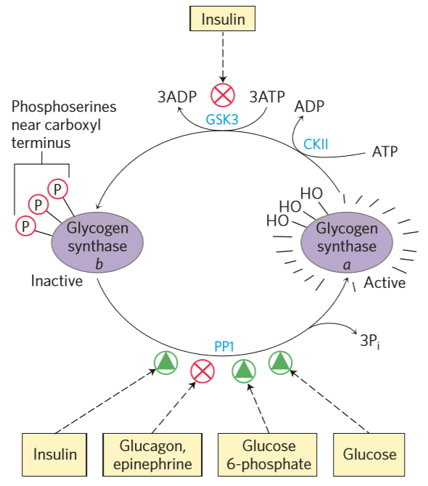
https://www.google.com/url?sa=i&url=https%3A%2F%2Fgreek.doctor%2Fbiochemistry-1%2Flectures%2Fregulation-of-glycogen-synthesis-and-degradation%2F&psig=AOvVaw3KYcroXwd0gCZSO7ZCanub&ust=1589403556879000&source=images&cd=vfe&ved=0CAIQjRxqFwoTCND0u-ubr-kCFQAAAAAdAAAAABAd

Slide 5
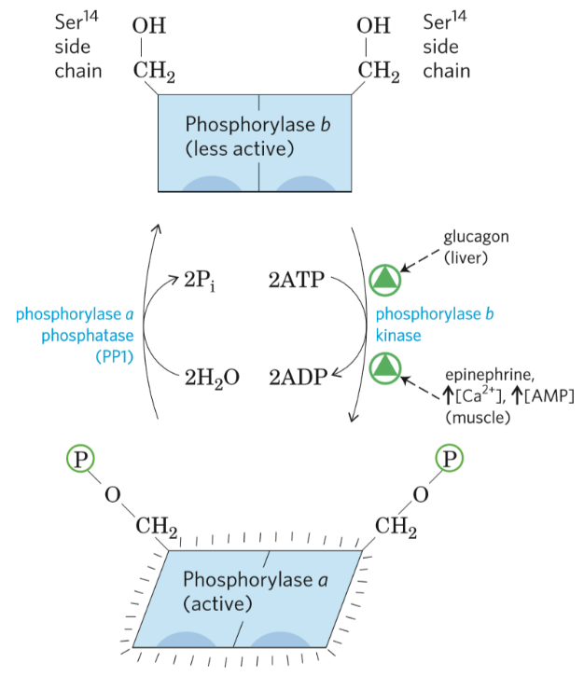
https://www.google.com/url?sa=i&url=https%3A%2F%2Fgreek.doctor%2Fbiochemistry-1%2Flectures%2Fregulation-of-glycogen-synthesis-and-degradation%2F&psig=AOvVaw3KYcroXwd0gCZSO7ZCanub&ust=1589403556879000&source=images&cd=vfe&ved=0CAIQjRxqFwoTCND0u-ubr-kCFQAAAAAdAAAAABAi

Slide 6
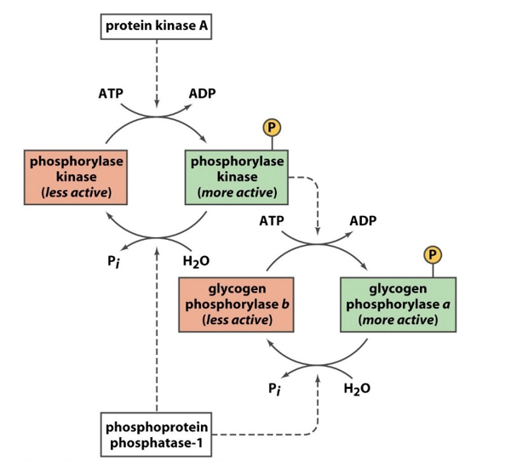
https://www.google.com/url?sa=i&url=https%3A%2F%2Fwww.chegg.com%2Fhomework-help%2Fquestions-and-answers%2Ffigure-describe-regulation-glycogen-phosphorylase-relevance-control-glycogen-metabolism-ti-q29298893&psig=AOvVaw3KYcroXwd0gCZSO7ZCanub&ust=1589403556879000&source=images&cd=vfe&ved=0CAIQjRxqFwoTCND0u-ubr-kCFQAAAAAdAAAAABAm

Slide 7
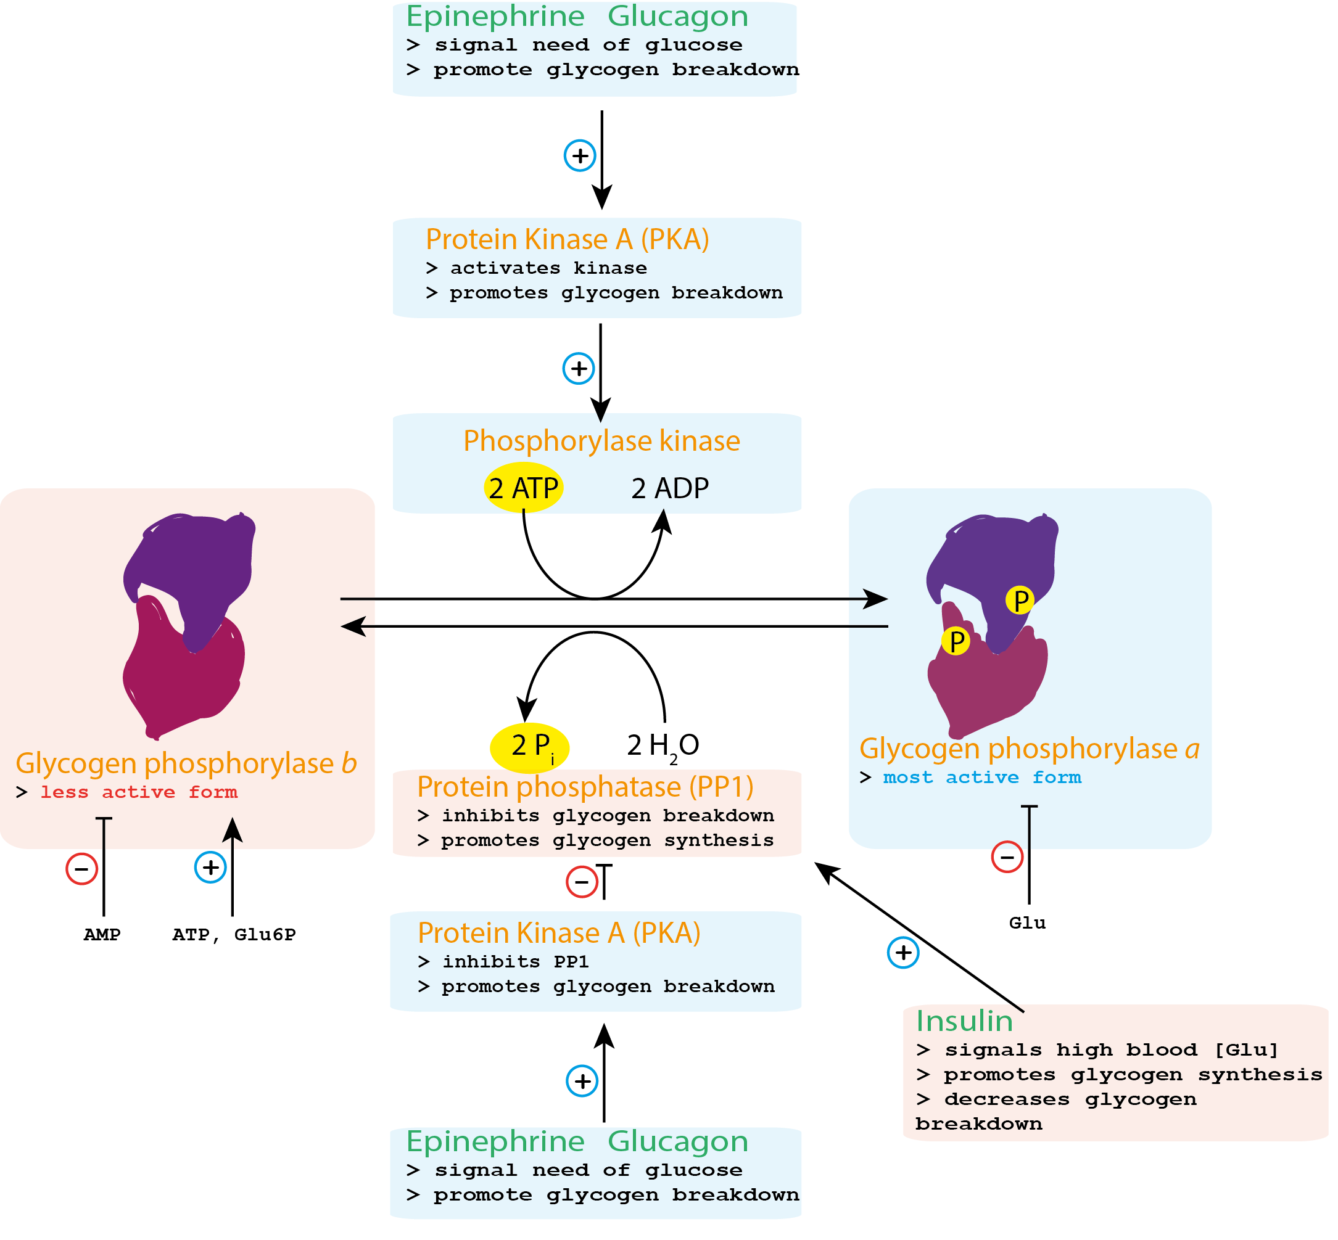
https://www.google.com/url?sa=i&url=https%3A%2F%2Fcommons.wikimedia.org%2Fwiki%2FFile%3AGlycogen_phosphorylase_kinase_control.png&psig=AOvVaw3KYcroXwd0gCZSO7ZCanub&ust=1589403556879000&source=images&cd=vfe&ved=0CAIQjRxqFwoTCND0u-ubr-kCFQAAAAAdAAAAABAr

Slide 8
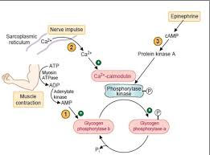
https://www.google.com/url?sa=i&url=http%3A%2F%2Fjumed15.weebly.com%2Fuploads%2F5%2F8%2F7%2F5%2F58753271%2Fsheet15.pdf&psig=AOvVaw3KYcroXwd0gCZSO7ZCanub&ust=1589403556879000&source=images&cd=vfe&ved=0CAIQjRxqFwoTCND0u-ubr-kCFQAAAAAdAAAAABAv

Slide 9
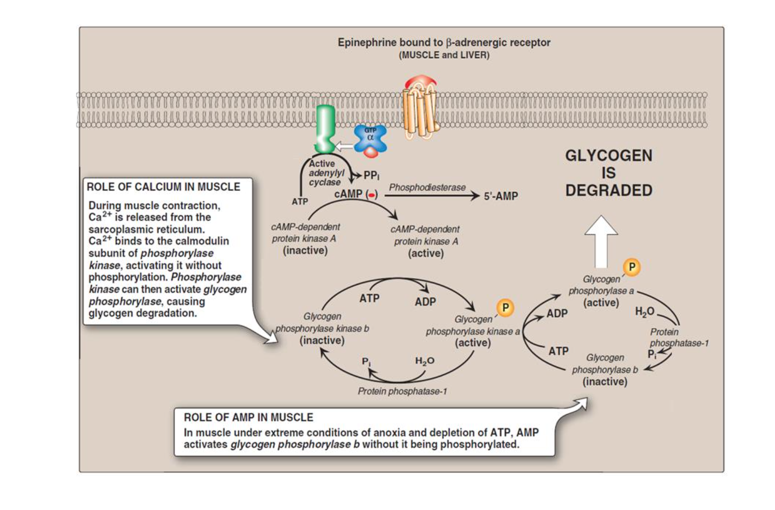
https://www.google.com/url?sa=i&url=https%3A%2F%2Fwww.memorangapp.com%2Fflashcards%2F91257%2FBiochemistry%2BL24%2BBiochemistry%2Bof%2BSkeletal%2Band%2BHeart%2BMuscle%2F&psig=AOvVaw3KYcroXwd0gCZSO7ZCanub&ust=1589403556879000&source=images&cd=vfe&ved=0CAIQjRxqFwoTCND0u-ubr-kCFQAAAAAdAAAAABA0

Slide 10
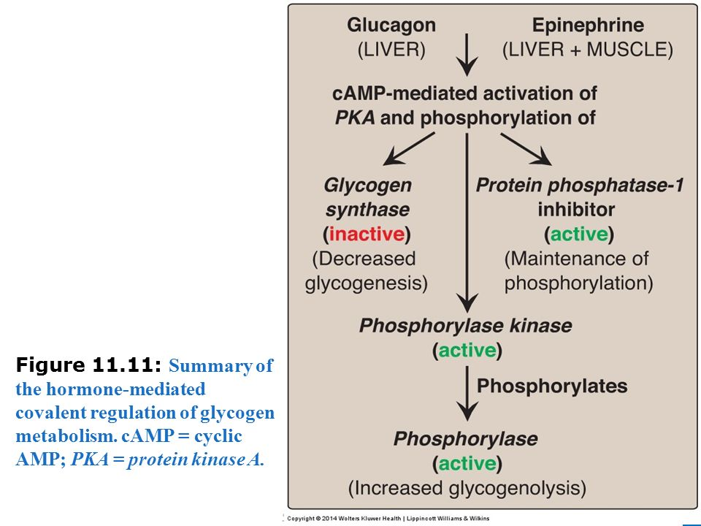
https://www.google.com/url?sa=i&url=https%3A%2F%2Fslideplayer.com%2Fslide%2F11205193%2F&psig=AOvVaw3KYcroXwd0gCZSO7ZCanub&ust=1589403556879000&source=images&cd=vfe&ved=0CAIQjRxqFwoTCND0u-ubr-kCFQAAAAAdAAAAABBD

Slide 11
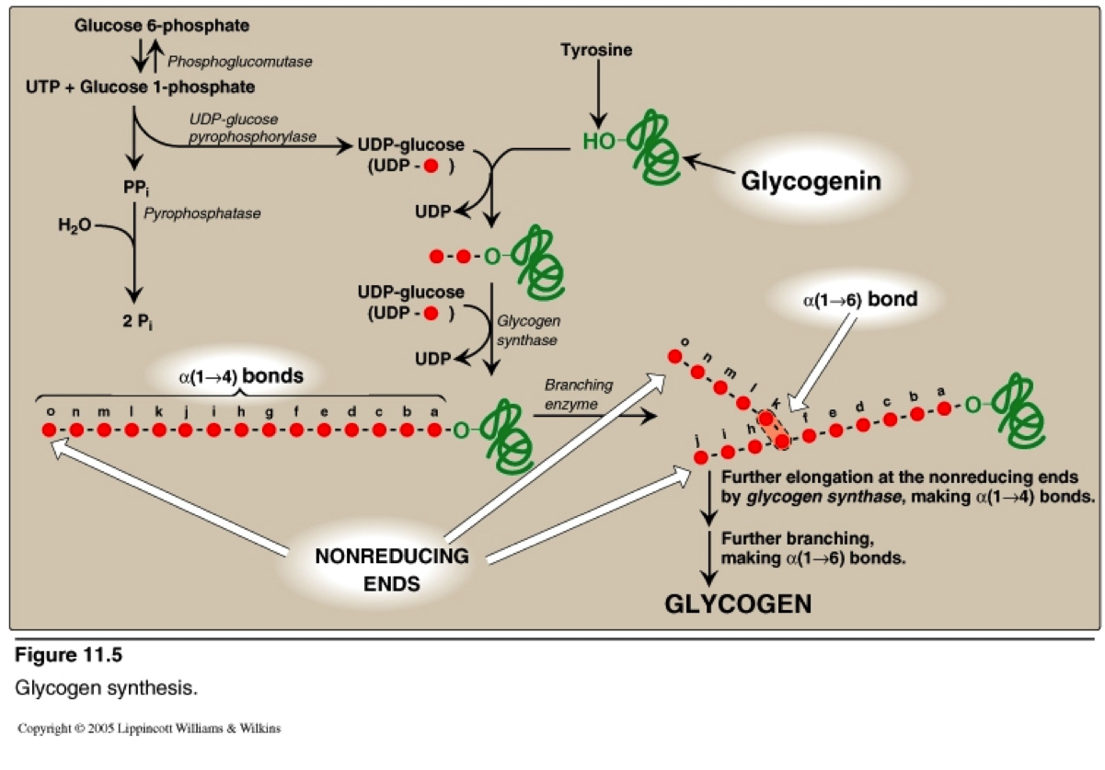
https://www.google.com/url?sa=i&url=http%3A%2F%2Fglycogen-1.blogspot.com%2F2016%2F11%2Fnew-glycogen-vs-glycogen.html&psig=AOvVaw3KYcroXwd0gCZSO7ZCanub&ust=1589403556879000&source=images&cd=vfe&ved=0CAIQjRxqFwoTCND0u-ubr-kCFQAAAAAdAAAAABBM

Slide 12
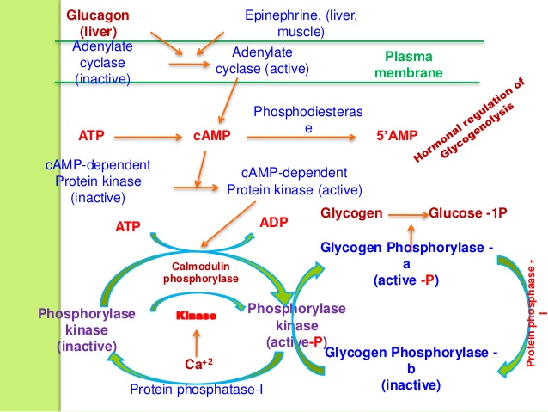
https://www.google.com/url?sa=i&url=https%3A%2F%2Fwww.slideshare.net%2FYESANNA%2Fglycogenolysis-42953316&psig=AOvVaw29OmdZanM12tzQ5YXjBSTR&ust=1589404546277000&source=images&cd=vfe&ved=0CAIQjRxqFwoTCIjmgb-fr-kCFQAAAAAdAAAAABAX

Slide 13
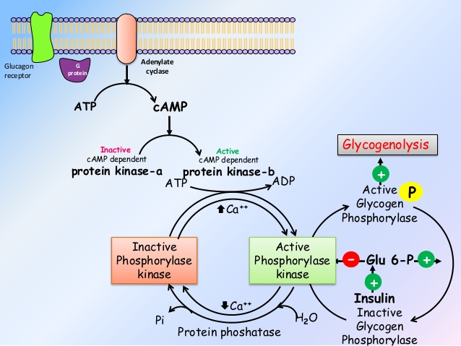
https://www.google.com/url?sa=i&url=https%3A%2F%2Fwww.slideshare.net%2Fashokktt%2Fmetabolism-of-glycogen&psig=AOvVaw29OmdZanM12tzQ5YXjBSTR&ust=1589404546277000&source=images&cd=vfe&ved=0CAIQjRxqFwoTCIjmgb-fr-kCFQAAAAAdAAAAABAi

Slide 14
KAYNAKÇA
Başlıca Kaynak: Lehnınger Biyokimyanın İlkeleri, Davıd L.Nelson, Mıchael M. Cox, Beşinci Baskıdan Çeviri, Çeviri Editörü; Y. Murat Elçin, Palme Yayıncılık, 2013.

Slide 15
Principles of Biochemistry, H. R. Horton, L. A. Moran, K. G. Scrimgeour, M. D. Perry, J. D. Rawn, Pearson Prentis Hall, 2006.
Color Atlas of Bıochemıstry, J. Koolman, K. H. Roehm, Georg Thıeme Verlag, 2005.

Slide 16
Harper’s Illustrated Bıochemıstry, R. K. Murray, D. K. Granner, P. A. Mayes, V. W. Rodwell, Lange Medıcal Books/McGraw-Hıll Medıcal Publıshıng Dıvısıon, 2003.
Basic Concepts in Biochemistry, A Student’s Survival Guide, H. F. Gilbert, McGraw-Hill Health Proffesions Division, 2000.

