Slide 2
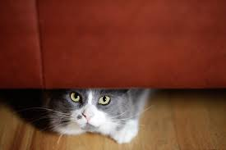
BEHAVIOURAL RESPONSES
Behavioural responses are a result of a complex interplay between many different factors including the emotional motivation of the animal and its previous learning experience.
In response to any given situation one can show a number of responses:
Avoidance
Repulsion
Inhibition
Appeasement

Slide 3
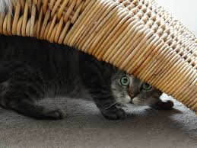
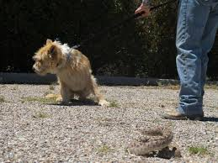
AVOIDANCE
Aims to remove the animal from the difficult situation and enable it to avoid a negative stimulus.
The response may be active and involve physically moving away or hiding but can also be more passive and involve turning a head away or even averting gaze.
It is important that if dogs/cats choose this response they are not prevented from avoiding, or forced to continue to interact with the stimulus or remain in the situation.
If this happens they may switch behavioural responses and choose a less desirable response, such as repulsion which could have more serious consequences.

Slide 4
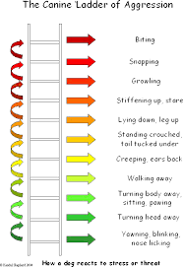
REPULSION
The aim is to remove an unwanted stimulus by making it go away.
It can take the form of growling, barking, air snapping and biting and will progress up the so called “ladder of aggression” if an animal is not achieving the desired effect i.e. the removal of the stimulus.
If repulsion behaviour is not succeeding, the emotion of frustration can also become activated and this will lead to acceleration and intensification of the repulsion response.
For example, if the dog is restrained on a lead and the person or other dog does not move away, or continues to advance.

Slide 5
REPULSION
When dogs communicate using repulsion responses the other dog will usually respond to the passive forms of the behaviour and work to reduce the potential for confrontation by adopting an avoidance or inhibition response themselves.
Sometimes they will select appeasement and this is more likely to occur in puppies and kittens, for example when an adult snarls at a puppy and it responds by trying to lick at the adult dog’s face.

Slide 6
INHIBITION
This is a response which aims to passively gather information about a potentially threatening situation or stimulus, while remaining non responsive to the situation.
It has been referred to as freeze in older literature.
Inhibition may be selected if the negative event or stimulus is overwhelming, in terms of its intensity or its proximity.
It may also be selected in situations where the negative event happens very quickly or unexpectedly.

Slide 7
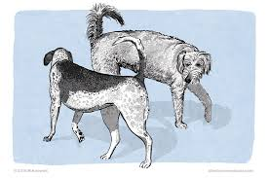
INHIBITION
It can be seen in interactions between dogs and may occur momentarily before the behaviour escalates to repulsion, as can be seen before a dog fight.
In some situations, where there is a mixture of positive and negative expectation animals will select inhibition to allow them time to gather information about the situation before making a decision as to whether to stay or not.
For obligate social mammals like dogs it is not uncommon for them to have an inherent positive motivation of seeking, related to the obtaining of social interaction, mixed with a negative motivation of anxiety due to uncertainty about the interaction.

Slide 8
INHIBITION
Inhibition is seen in interactions between dogs/cats and people in situations: in the veterinary surgery or at the groomers, where the animal appears to be very good but is in fact in a state of inhibition!!!!
Recognising inhibition is crucial since animals can switch responses very quickly
Inhibition can change to repulsion if inhibition does not enable the animal to protect itself from perceived threat.
Veterinary staff should be well aware of this response for their own safety and also for the welfare of the animal.

Slide 9
APPEASEMENT
The aim of this response is to actively exchange information, through both gathering and offering, in order to reduce the potential negative outcome of a situation.
These behaviours are indicative of a negative emotional state of fear-anxiety.
Gathering and offering information: via the sensory channels of visual, vocal, olfactory and tactile communication.
Olfactory appeasement behaviours include sniffing and licking, to increase the production of scent signals.

Slide 10
APPEASEMENT
They will engage in the same interactions when greeting people, especially after a period of separation or when there is any uncertainty about the interaction.
Tactile appeasement behaviours involve exchanging muscle tension information which informs dogs of whether the other animal is relaxed or tense.
Dogs will use tactile appeasement with people when they lean against either their owners or a stranger, or sit with their paws or head resting on the person’s feet or lap.

Slide 11
APPEASEMENT
Appeasement may be mediated through behavioural responses, such as offering a toy.
The toy is indicative of a positive emotional encounter and offers information to the other party that there is an intention that is positive.
Offering a toy can help to reduce tension in socially difficult situations.
As with any behavioural response it is important to interpret it within the context in which it occurs and in association with the accompanying body language. It is only by doing so that appeasement related toy offering can be distinguished from entirely positively motivated play.

Slide 12
APPEASEMENT
If a situation leads to an entirely negative emotional response the dog is most likely to select avoidance or repulsion which both aim to terminate the interaction with the stimulus or situation.
In situations where there is something for the dog to gain then it makes more sense to try and gather further information on the situation either actively, through appeasement, or passively, through inhibition.

Slide 13
APPEASEMENT
It is important to remember that all of these behavioural responses are perfectly normal when they occur in response to an emotional motivation that is justified by the context.
It is only when the emotion is not justified or is excessive that associated behavioural responses are problematic.
Human understanding of normal canine/feline behaviour and normal emotional responses is crucial if misunderstanding are to be avoided.

