Slide 1
EME 201 Materials Science
Atomic and Ionic Arrangements

Slide 2
Imperfections in the Atomic and Ionic Arrangements
Until now, it has been accepted that there is perfect order along the crystalline material at atomic scale.
But such an idealized solid structure is not available; they all contain numerous defects.
By the way, many of the materials are quite sensitive to deviations from the crystal perfection.
A defect in the crystal structure corresponds to a lattice disorder having one of the dimensions with one or more atomic diameters.
The classification of crystal defects is often done according to the geometry or size of the defects.

Slide 3
Point Defects
Point defects are localized in any other case perfect atomic or ionic arrangements inside the crystal shape.
These defects may be integrated through the movement of atoms or ions when heated, when the material is being processed, or while it's far energized with the aid of the advent of different atoms.
A point defect, generally, dislocations, grain boundaries, and so forth. It consists of an atom or ion or a pair of atoms or ions that differs from the prolonged defects.
An essential "factor" of point defects is the reality that the defects seem at one or locations, however their presence can be felt over much larger distances in the crystalline material.

Slide 4
Vacancies
When an atom or ion is missing from its normal position in the crystal structure, a gap or vacancy will be formed.
When atoms or ions are missing (that is, when there are gaps or vacancies), the overall randomness or entropy of the material grow up.
All the crystalline materials display vacancy type of point defects.
Gaps or vacancies can be incorporated into metals and alloys during solidification, at high temperatures, or as a result of radiation damage.
Gaps or vacancies illustrate an important role in determining the rate at which atoms or ions can travel or spread in a solid material.
The concentration of vacancy type of defect is small at around room temperature, but the concentration of vacancy type of defect grows up exponentially as the temperature increases.

Slide 5
Vacancies
The temperature depedency of vacancy type of defect is shown by the following Arrhenius equation:
Nv = N exp ( -Qv/RT)
where
-Nv = the number of vacancy type of defect per cm3
-N = the number of atoms per cm3
-Qv = the energy required to result one mol of vacancy type of defect (cal/mol)
-R = the gas constant (1.987 cal/mol.K)
-T = the temperature (K)

Slide 6
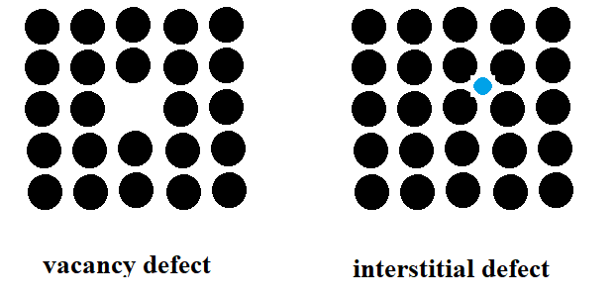
Interstitial Defects
An interstitial defect occurs when an extra atom or ion is normally introduced into the crystal structure in an unoccupied position.
Figure 1. Representations of vacancy type of defect and interstitial impurity atom.

Slide 7
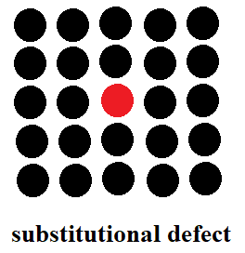
Substitutional Defects
When an atom or ion is replaced with a different atom or ion species, substitution defects occur.
Substitutional atoms or ions occupy normal lattice regions.
Substitutional atoms or ions may be larger than the normal atoms or ions in the crystal structure; in which case the surrounding interatomic spacings are decreased or the surrounding atoms have smaller interatomic spacings.
Also, the substitutional defect can be included as an impurity.
Figure 2. Schematic illustration of substitutional impurity atoms.

Slide 8
IMPURITIES IN SOLIDS
It is not possible to have a pure metal of only one type of atom; impure or foreign atoms are always present and some are found as crystal point defects.
Most of the known metals are not pure; On the contrary, these are alloys in which contaminating atoms are intentionally added to impart specific properties to the material.
It is normally used in metals to increase alloying, mechanical strength and corrosion resistance.
As an example, sterling silver is composed of 92.5% silver and the remaining copper.
Normally, pure silver is highly resistant to corrosion but at the same time very soft.
Copper alloying significantly increases mechanical strength without compromising corrosion resistance.

Slide 9
IMPURITIES IN SOLIDS
The addition of foreign atoms to a metal gives rise to the formation of a solid solution and/or a new second phase depending on the types, concentrations and temperature of the alloys.
With respect to alloys, the solute and the solvent are frequently used terms.
The solvent is the largest element or compound; Sometimes solvent atoms are called main atoms.
Solute is used to indicate an element or compound found in a small concentration.
A solid solution forms when, as the solute atoms are added to the host material, the crystal structure is maintained and no new structures are formed.
When dissolved atoms, foreign atoms, are added into the host material, a solid solution will be formed.
Within the solid solution, the crystal structure is preserved.

Slide 10
REFERENCES
William D. Callister, ‘Materials Science and Engineering: An Introduction’, Seventh edition, John Wiley & Sons, Inc., U.S.A.
Brian S. Mitchell, ‘AN INTRODUCTION TO MATERIALS ENGINEERING AND SCIENCE FOR CHEMICAL AND MATERIALS ENGINEERS’, John Wiley & Sons, Inc., U.S.A, 2004.
J. W. Martin, ‘Materials for Engineering’, Third Edition, WOODHEAD PUBLISHING LIMITED, Cambridge, England.
Donald R. Askeland & Pradeep P. Fulay, ‘Essentials of Materials Science and Engineering’, Second Edition, Cengage Learning, Toronto, Canada.
G. S. Brady, H. R. Clauser, J. A. Vaccari, ‘Materials Handbook’, Fifteenth Edition, McGraw-Hill Handbooks.

