Slide 1
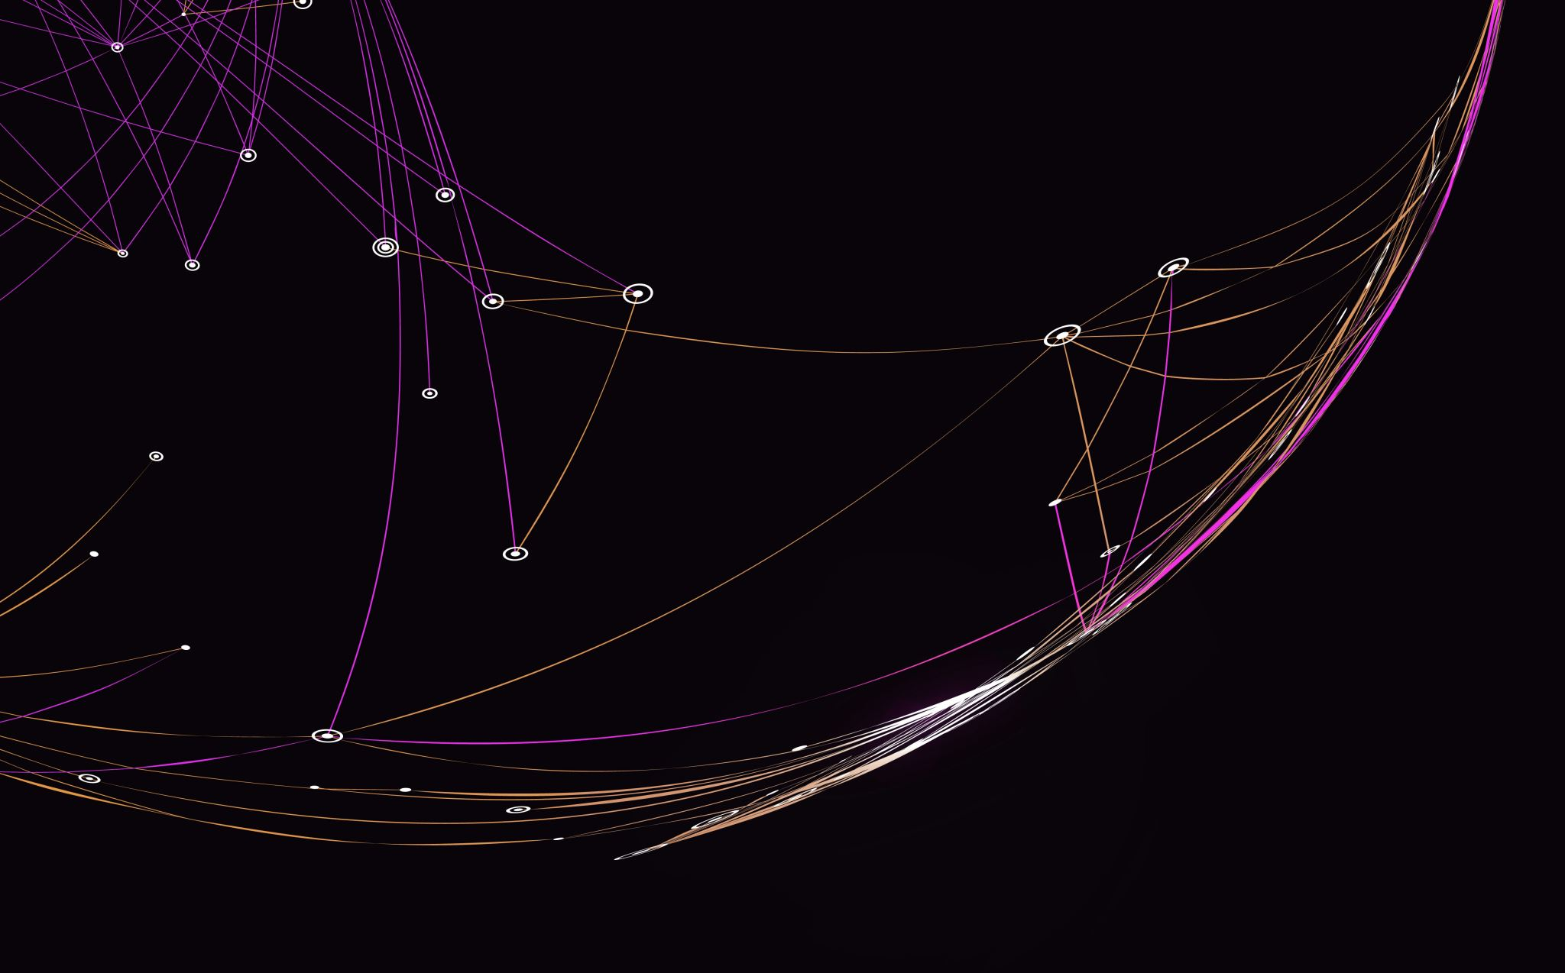
“The Men Who Murdered Mohammed”
by Alfred Bester

Slide 2
Time Travel Fiction & Films
Wells’s The Time Machine
Bradbury’s “A Sound of Thunder”
Vonnegut’s Slaughterhouse-Five
Back to the Future
Predestination
The Butterfly Effect
Interstellar
The Terminator

Slide 3
Tone and Style of the Story
Humour: parody of time travel fiction
Narrative accelerations
The mad scientist stereotype
Reference to real scientists and their work
Historical references
Intertextuality

Slide 4
Parody
Time travel fiction
The Grandfather Paradox
The Butterfly Effect
The mad scientist
Artificial Intelligence

