Slide 1
Vitamins

Slide 2
named "Vitamin" (vital amines).
By the time it was shown that not all vitamins were amines, the word was already ubiquitous.

Slide 3
An organic compound required as a nutrient in tiny amounts by an organisms

Slide 4
It cannot be synthesized in sufficient quantities by an organism, and must be obtained from the diet.
Vitamins have diverse biological function:
hormone-like functions as regulators of mineral metabolism (vit. D),
regulators of cell and tissue growth and differentiation (some forms of vit. A)
antioxidants (vit. E, C)
enzyme cofactors (tightly bound to enzyme as a part of prosthetic group, coenzymes

Slide 5
Lipid-soluble vitamins (A, D, E and K)
hydrophobic compounds, absorbed efficiently with lipids,
transport in the blood in lipoproteins or attached to specific binding proteins,
more likely to accumulate in the body,
more likely to lead to hypervitaminosis

Slide 6
Water-soluble vitamins - 8 B vitamins and vitamin C
Function: mainly as enzyme cofactors,
hydrophilic compounds dissolve easily in water,
not readily stored, excreted from the body,
their consistent daily intake is important.
Many types of water-soluble vitamins are synthesized by bacteria

Slide 7
Retinol
Biologically active forms - retinoids: retinol, retinal, retinoid acid.
Major vit. A precursors (provitamins) → plants carotenoids.
Food staf of animals origin contain most of vit. A in the form of esters (retinylpalmitates) – retinol and long fatty acid

Slide 8
Retinol esters → hydrolysis by pancreatic enzymes to retinol.
β-caroten is cleaved to retinal by β-carotene 15,15´ dioxygenase (cofactors iron and bile salts).
Intestinal cells → esterification of retinol → transported in chylomicrons.
Remnants of chylomicrons → liver→ esterification (if the concentration exceeds 100 mg, esters are stored ).
Transport of retinol to target organs tightly bound to retinol-binding protein, RBP.

Slide 9
Vit. A is necessary to form rhodopsin (in rodes, night vision) and iodopsins (photopsins, in cones – color vision) - visual pigment.
Retinaldehyd is a prosthetic group of light-sensitive opsin protein.
In the retina, all-trans-retinol is isomerized to 11-cis-retinol → oxidized to 11-cis-retinaldehyde, this reacts with opsin (Lys) → to form the holoprotein rhodopsin.
Absorption of light → conformation changes of opsin → photorhodopsin

Slide 10
The following is a series of izomerisation→ initiation of nerve impulse.
The final step is hydrolysis to release all-trans-retinaldehyde and opsin.
Deficiency of vit. A leads to night blindness.
Vitamin A is an important antioxidant

Slide 11
Transcription and cell differentiation
Retinoic acid regulates the transcription of genes - acts through nuclear receptors (steroid-like receptors).
By binding to various nuclear receptors, vit. A stimulates (RAR – retinoid acid receptor) or inhibits (RXR- retinoid „X“ receptor) transcription of genes transcription. All-trans-retinoic acid binds to RAR and 9-cis-retinoic acid binds to RXR.
Retinoic acid is necessary for the function and maintenance of epithelial tissues.

Slide 12
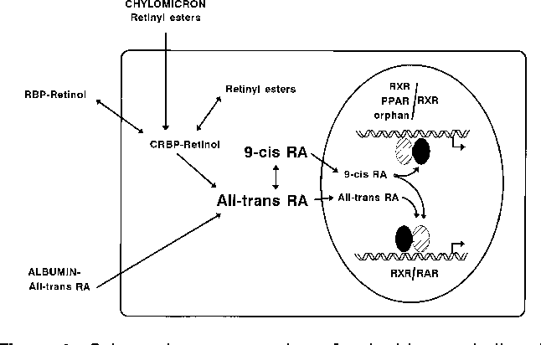

Slide 13
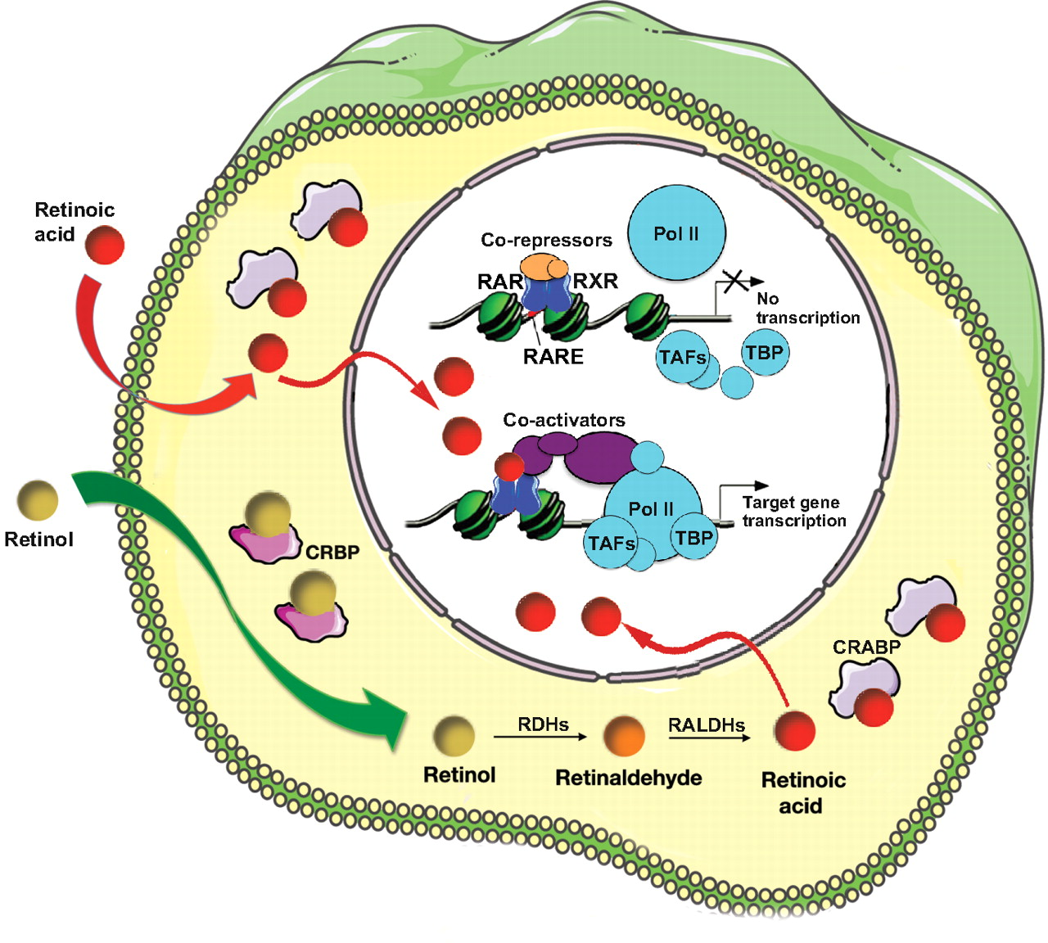

Slide 15
The early sign → a loss of sensitivity to green light,
prolonged deficiency → impairment to adapt to dim light
more prolonged deficiency leads to night blindness
Ever escalated deficiency leads to squamous metaplasia - columnar epithelia are transformed into heavily keratinized squamous epithelia.
The conjunctiva loses mucus-secreting cells → glykoprotein content of the tears is reduced → xeroftalmia ( „dry eyes“)
Often complication - bacterial or chlamidial infection which results in perforation of the cornea and blindness

Slide 16
transformation of respiratory epithelium – loss of protective airway function (antibacterial properties) → bronchitis.
Conversion of the urinary tract epithelium → higher frequency of urinary stone formation
Immunosuppression
Impairment of reproductive function (both in men and women).
Worldwide deficiency of vit. A
3 – 10 mil. children become xerophtalmic every year
250 000 to 500 000 go to blindness
1 million die from infections

Slide 17
Toxic dose:
single dose of more than 200 mg
more than 40 mg per day
Acute symptoms - headache, vomiting, impaired consciousness.
Chronic intoxication – weight loss, vomiting, pain in joints, muscles, blurred vision, hair loss, excessive bone growth.
Both vit. A excess and deficiency in pregnancy are teratogenic – retinoic acid is gene regulator during early fetal development
Carotenoids are non toxic - accumulation in tissues rich in lipids (the skin of babies overdosed with carrot juice may be orange).

Slide 18
Vitamin A
Vision
Gene transcription
Immune function
Embryonic development and reproduction
Bone metabolism
Haematopoieis
Skin health
Antioxidant activity

Slide 19
Sources of vit A
carrot
broccoli
spinach
papaya
apricots
cod liver oil
meat
egg
milk
dairy products

Slide 20
Vitamin D
Calciol, vitamin D₂ (cholecalciferol) → precursor of calcitriol, D₃ (1,25-dihydroxycalciferol).
Regulates with PTH calcium and phosphate level (absorption, reabsorption, excretion).
Synthesis in the skin (7-dehydrocholesterol) UV → further transformation in the liver and kidneys .

Slide 23
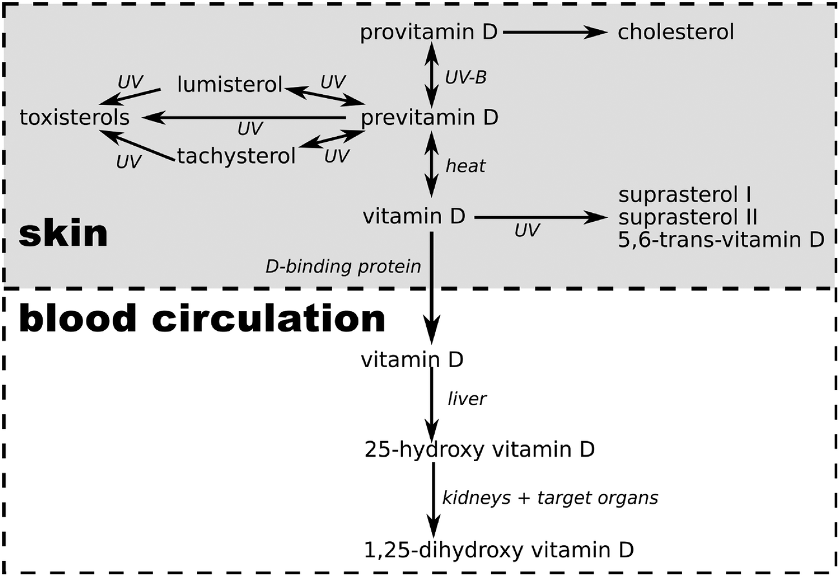

Slide 24
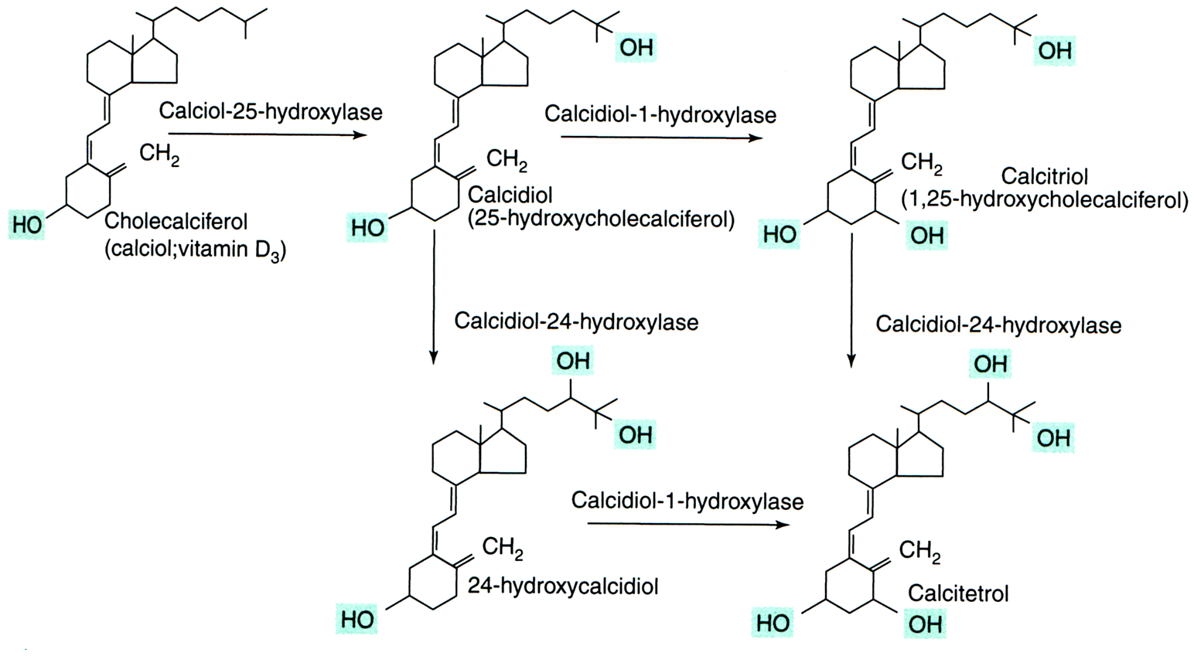

Slide 25
Transported in the blood on a carrier (vitamin-D binding protein, VDBP).
1,25(OH)₂D binds to intracellular receptors (intestine, bone, kidney).
The main function is to maintain plasma levels of calcium (essential for neuromuscular activity) and phosphate levels:
increase Ca absorption in the intestine,
reduce the excretion of calcium (stimulates parathyroid hormone-dependent Ca reabsorption in the distal tubule),
mobilizing bone mineral, together with parathyroid hormone

Slide 26
Failure of absorption in the intestine.
The lack of the liver and the renal hydroxylation of vit. D (congenital deficiency of 1-hydroxylase).
The lack of UV irradiation.
The main manifestation - impaired ossification of the newly created osteiod, abundance of non mineralized matrix.
Vit. D is necessary for the prevention of skeletal changes (rickets in growing individuals, osteomalacia in adults).

Slide 27
It increases the activity of natural killer cells (cytotoxic lymphocytes).
Increases the phagocytic ability of macrophages .
Reduces the risk of virus diseases (colds, flu).
Reduces the risk of many cancers (colon, breast and ovarian cancer).
Reduces the risk of cardiovascular disease → have a positive impact on the composition of plasma lipids

Slide 28
Sources of vitamin D
In addition to sunbathing:
various fish species (salmon, sardines and mackerel, tuna, catfish, eel), fish oil, cod liver
eggs, beef liver, mushrooms

Slide 29
Vitamin E
Vitamin E is a famil of α−, β−, γ−, δ− tocopherols and corresponding tocotrienols izomers.
They are formed from chroman ring and hydrofobic fytyl side chain.
The highest biological activity has α-tokoferol

Slide 30
Adsorbtion from the small intestine.
Its absorption is dependent on the presence of lipids in the diet.
Associated with plasma lipoproteins → liver uptake through receptors for apolipoprotein E.
α−tocopherol is bind to α-tocopherol transport protein (α-TTP) → transported to the target organs (the excess is stored in adipocytes, in muscle, liver).
β−, γ− a δ−tocopherols are transferred into the bile and degraded.

Slide 31
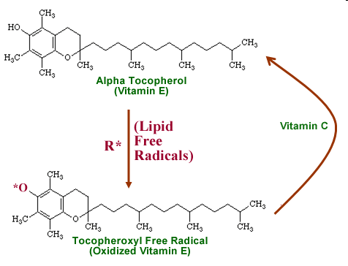
Stops free radical reactions (peroxyl radicals ROO• , oxygen radicals HO•, lipoperoxid radicals LOO•). Chroman ring with OH group → uptake radicals.

Slide 32
PUFA-H = polyunsaturated fatty acid
PUFA-OO• = peroxyl radical of polyunsaturated fatty acid
PUFA-OOH = hydroxyperoxy polyunsaturated fatty acid
PUFA-OH = hydroxy polyunsaturated fatty acid

Slide 33
Vitamin E as enzyme cofactor
α-tocopherol quinon generated by oxidation of α-tocopherol can acts as a cofactor of mitochondrial unsaturated fatty acids .
α-tocopherol quinon + cytochrom B₅ + NADH+H⁺ initiate formation of double bonds in FA – temporarily changes to α-tocopherol-hydroquinon (in the presence of O₂ changes back to α-tocopherol quinon).

Slide 34
The lack of α-tocopherol in plasma is often associated with impaired fat absorption or distribution (in patients with cystic fibrosis, in patients with intestine resection)
deficit of vit. E exhibit - neurological problems, impaired vision, eye muscle paralysis, platelet aggregation, impairment of fertility in men, impaired immunity.

Slide 35
Sources of vitamin E
fortified cereals
seeds and seed oils, like sunflower
nuts and nut oils, like almonds and hazelnuts
green leafy vegetables,
broccoli
cabbage
celery

Slide 36
Vitamin K is a group of lipophilic, hydrophobic vitamins.
They are needed for the postranslation modification of proteins required for blood coagulation,
They are involved in metabolism pathways, in bone mineralisation, cell growth, metabolism of blood vessel wall

Slide 37
Vitamin K
Vitamin K₁ (phylloquinon) – plant origin
Vitamin K₂ (menaquinon) – normally produced by bacteria in the large intestine
K₁ a K₂ are used differently in the body
K₁ – used mainly for blood clothing
K₂ – important in non-coagulation actions - as in metabolism and bone mineralization, in cell growth, metabolism of blood vessel walls cells.

Slide 39
Cofactor of liver microsomal carboxylase which carboxylates glutamate residues to γ-carboxyglutamate during synthesis of prothrombin and coagulation factors VII, IX a X (posttranslation reaction).
Carboxylated glutamate chelates Ca²⁺ ions, permitting the binding of blood clotting proteins to membranes.
Forms the binding site for Ca²⁺ also in other proteins – osteocalcin.

Slide 40
Deficiency is caused by fat malabsorption or by the liver failure.
Blood clotting disorders – dangerous in newborns, life-threatening bleeding (hemorrhagic disease of the newborn).
Osteoporosis due to failed carboxylation of osteokalcin and decreased activity of osteoblasts.
Under normal circumstances there is not a shortage, vit. K is abundant in the diet.

Slide 41
Sources of vitamin K
Green leafy vegetables
vegetable oil
broccoli
cereals

Slide 42
Water soluble vitamins
Vitamin B₁ (thiamine)
Vitamin B₂ (riboflavin)
Vitamin B₃ or Vitamin P or Vitamin PP (niacin)
Vitamin B₅ (panthotenic acid)
Vitamin B₆ (pyridoxine and pyridoxamine)
Vitamin B₇ or Vitamin H (biotin)
Vitamin B₉ or Vitamin M and Vitamin B-c (folic acid)
Vitamin B₁₂ (cobalamin)

Slide 43
Thiamin- B1
Thiamin has a central role in energy-yielding metabolism.
Composed of a substituted pyridine and thiazole ring.
Active form is thiamine diphosphate (thiamin pyrophosphate, TPP), a coenzyme for three multi-enzyme complex →
This complex catalyses oxidative decarboxylation of α-ketoacids →
pyruvate dehydrogenase in carbohydrate metabolism,
α-ketoglutarate dehydrogenase → cytric acid cycle,
Branched-chain keto-acid dehydrogenase .
TPP is coenzyme for transketolase – pentose phosphate pathway

Slide 44
Sources of B1
paddy grains, cereals meat yeast honey nuts

Slide 45
Mild deficiency – leads to gastrointestinal complients, weakness
Moderate deficiency - peripheral neuropathy, mental abnormalities, ataxia
Full-blown deficiency - beri-beri – characterized with severe muscle weakness, muscle wasting and delirium, paresis of the eye muscles, memory loss.
Degeneration of the cardiovascular system. .
Beri-beri causes long-term consumption of foods rich in carbohydrates but poor in thiamine - husked rice, white flour and refined sugar.

Slide 46
Vitamin B2- Riboflavin
Has a central role in energy-yielding metabolism.
Provides the reactive moieties of the coenzymes flavin mononucleotide (FMN) and flavin adenine dinucleotid (FAD).
Flavin coenzymes are electron carries in oxidoreduction reaction.

Slide 47
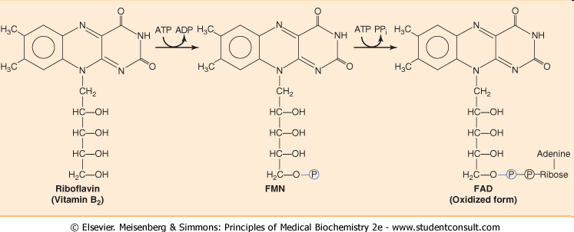
FMN → ATP-dependent phosphorylation of riboflavin
FAD → further reaction with ATP in which its AMP moiety is transferred to FMN.

Slide 48
FMN and FAD act as prosthetic groups of many oxidoreduction enzymes, flavoprotein:
oxydase of α-amino acids – degradation of amino acids
xantinoxidase – degradation of purines
aldehyde dehydrogenas
mitochondrial glycerol-3-phosphate dehydrogenase – transport of reducing unit (H⁺) from mitochondra to cytosol
succinate dehydrogenas – citric acid cycle
succinyl CoA-dehydrogenase – β-oxidation of FA
NADH-dehydrogenase – part of respiratory chain in mitochondria
coenzymes in hydrogen transfer – formation of reducing forms - FMNH₂ a FADH₂

Slide 49
Riboflavin is absorbed in the proximal intestine.
Riboflavin is stored mainly in the liver, kidney and heart in the form of FAD (70- 90%) or FMN.

Slide 50
Causes of vitamin B₂ deficiency
Lack of dietary vitamin B.
A result of conditions that affect absorption in the intestine.
The body not being able to use the vitamin.
An increase in the excretion of the vitamin from the body.

Slide 51
Vitamin B₂ – symptoms of deficiency
Cracked and red lips.
Inflammation of the lining of mouth and tongue.
Dry and scaling skin- keratitis, dermatitis and iron-deficiency anemia

Slide 52
Sources of vitamin B₂
foods of animal origin (liver, pork and beef, milk, dairy products, fish eggs)
cocoa,
nuts,
yeast,
of smaller quantities in cereals.

Slide 53
Vitamin B₃ - niacin
Active form – nikotinic acid and nikotinamid.
NAD a NADP → key components of the metabolic pathways of carbohydrates, lipids, amino acids.
Nicotinic acid prevents the release of fatty acids from adipose tissue, decreases lipoproteins VLDL, IDL a LDL.
High dose of niacin dilates blood vessels .

Slide 54
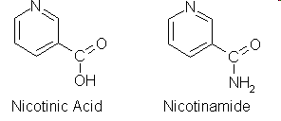

Slide 55
Absorption:
At low concentration by active transport.
At high concentration by passive diffusion.
Transportation:
Both nicotinic acid (NA) and nicotinamide (NAm) bind to plasma proteins for transportation.
Biosynthesis:
The liver can synthesize Niacin from the essential amino acid tryptophan, but the synthesis is extremely slow and requires vitamin B₆ (60 mg of Tryptophan= 1mg of niacin). Bacteria in the gut may also perform the conversion but are inefficient.

Slide 56
Deficiency
Pellagra: A serious deficiency of niacin.
The main results of pellagra can easily be remembered as "the four D's": diarrhea, dermatitis, dementia, and death.
Pelagra is very rare now, except in alcoholics, strict vegetarians, and people in areas of the world with very poor nutrition.
Milder deficiencies of niacin can cause dermatitis around the mouth and rashes, fatigue, irritability, poor appetite, indigestion, diarrhea, headache.

Slide 57
Sources of Vit B3
foods of animal origin
yeast
sunflower seeds, beans, peas
green leafy vegetable
broccoli, carrots

Slide 58
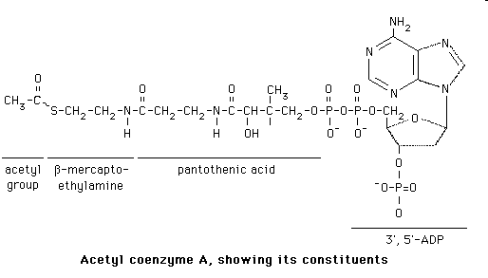
Vitamin B₅ – panthotenic acid

Slide 59
Co-enzyme A assists the following reactions:
formation of sterols (cholesterol and 7-dehydrocholesterol).
formation of fatty acids.
formation of keto acids such as pyruvic acid.
Other reactions are acylation, acetylation, signal transduction deamination

Slide 60
meat, foods of animal origin,
yeast,
wholemeal bread,
broccoli, avocado
royal gelly

Slide 61
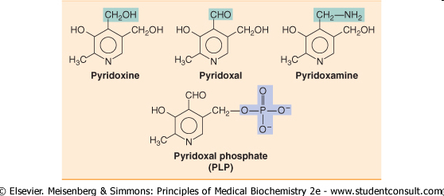
Vitamin 6 - Pyridoxine
Precursor of active coenzyme pyridoxalphosphate – PPL.

Slide 62
Vitamin B₆ is needed for more than 100 enzymes involved in protein metabolism.
It is also essential for red blood cell metabolism and hemoglobin formation.
The nervous and immune systems need vitamin B₆ to function efficiently.
It is also needed for the conversion of tryptophan to niacin (vitamin B₃).
Vitamin B₆ also helps maintain blood glucose within a normal range. When caloric intake is low, vitamin B₆ helps to convert stored carbohydrate or other nutrients to glucose to maintain normal blood sugar levels.

Slide 64
Signs of vitamin B₆ deficiency include:
Skin: dermatitis (skin inflammation), stomatitis (inflammation of the mucous lining of any of the structures in the mouth), glossitis (inflammation or infection of the tongue ).
Neurological abnormalities: Depression, confusion, and convulsions.
Vitamin B₆ deficiency also can cause anemia.

Slide 65
Sources of Vit B6
cereals,
beans,
meat,
liver,
fish,
yeast,
nuts and some fruits as banana
potatoes.
It is also produced by bacterial flora in the colon.

Slide 66
Vitamin B₇ - biotin
Prosthetic group of pyruvate carboxylase, acetyl-CoA carboxylase and other ATP-dependent carboxylases.

Slide 67
Sources of vit B7
liver
meat
kidney
yeast
egg yolk
mushrooms
milk and dairy products.

Slide 68
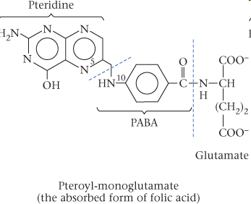
Vitamin B₉ – folic acid
Consist of pteroic acid - pteridine + paraaminobenzoic acid (PABA) + glutamic acid

Slide 69
Active metabolit of folic acid is tetrahydrofolate (THF) .
THF is coenzym of transferases carrying one carbon units.
This reaction participate in nucleotide and nucleic acid synthesis
N⁵,N¹⁰-THF carries one carbon units (methylen or methenyl).

Slide 71
Deficiency results in elevated levels of homocystein.
Deficiency in pregnant women can lead to birth defects

Slide 72
sources of animal origin
milk and milk products
yeast
greens

Slide 73
Chemically most complex vitamin
Complex of organic compounds atom within the molecule is Co, similar to the heme.
In man there are two metabolically active forms: methylcobalamin and adenosylcobalamin.

Slide 74
Cobalamin catalyses two reactions
Cytoplasmic methylation of homocystein to methionin.
Mitochondrial methylmalonyl-CoA mutase (methylmalonyl-CoA → sukcynyl-CoA) needs deoxy adenosylkobalamin.

Slide 76
Essential for the maturation of erythrocytes.
Protects against pernicious anemia.
Essential for cell growth and reproduction.
Essential for the formation of myelin and nucleoproteins.

Slide 77
Vitamin B₁₂ in food is bound to the protein.
Hydrochloric acid in the stomach releases free vitamin B₁₂.
Once released vitamin B₁₂ combines with a substance called intrinsic factor (IF). This complex can then be absorbed by the intestinal tract.

Slide 81
fish and shellfish,
meat (especially liver),
poultry,
eggs,
milk, and
milk products
while lacto-ovo vegetarians usually get enough B₁₂ through consuming dairy products, although vegan will lack B₁₂

Slide 82
Vitamin C is a water-soluble vitamin.
Almost all animals and plants synthesize their own vitamin C, not man.
Vitamin C was first isolated in 1928 and in 1932 it was proved to be the agent which prevents scurvy.

Slide 83
Vitamin C is a weak acid, called ascorbic acid or its salts “ascorbates”.
It is the L-enantiomer of ascorbic acid.
The D-enantiomer shows no biological activity.

Slide 84
Cofactor in the synthesis of norepinephrine from dopamine.
Involved in a variety of metabolic processes (oxidation-reduction reactions and cellular respiration, carbohydrate metabolism, synthesis of lipids and proteins).
antioxidant and free radical scavenger → maintain proper immune system.

Slide 85
T-lymphocyte activity, phagocyte function, leukocyte mobility, and possibly antibody and interferon production seem to be increased by vitamin C.
Involved in the synthesis of collagen, the major component of ligaments, tendons, cartilages and skin.
Involved in tyrosine metabolism

Slide 86
Deficiency symptoms
Fatigue, personality changes, decline in psychomotor performance and motivation.
Vitamin C deficiency over 3-5 months results in symptomatic scurvy.
Scurvy leads to the formation of liver spots on the skin, spongy gums, and bleeding from all mucous membranes.
In advanced scurvy there are open, suppurating wounds and loss of teeth. Severe scurvy may progress to neuritis, jaundice, fever, dyspnea, and death.

Slide 88
Vitamin C as pro-oxidant
Ascorbic acid reduces transition metals - Cu²⁺, to Cu⁺, and Fe³⁺ to Fe²⁺ during conversion from ascorbate to dehydroascorbate. This reaction can generate superoxide and other ROS:
Fenton´s reaction:
(1) Fe²⁺ + H₂O₂ → Fe³⁺ + OH· + OH⁻
(2) Fe³⁺ + H₂O₂ → Fe²⁺ + OOH· + H⁺
2 Fe²⁺ + 2 H₂O₂ → 2 Fe³⁺ + 2 OH· + 2 OH⁻
2 Fe³⁺ + ascorbate → 2 Fe²⁺ + dehydroascorbate

