Slide 1
Pre-Civil War African American Slavery
AKE 117: American History
Dr. Gamze Katı Gümüş

Slide 2
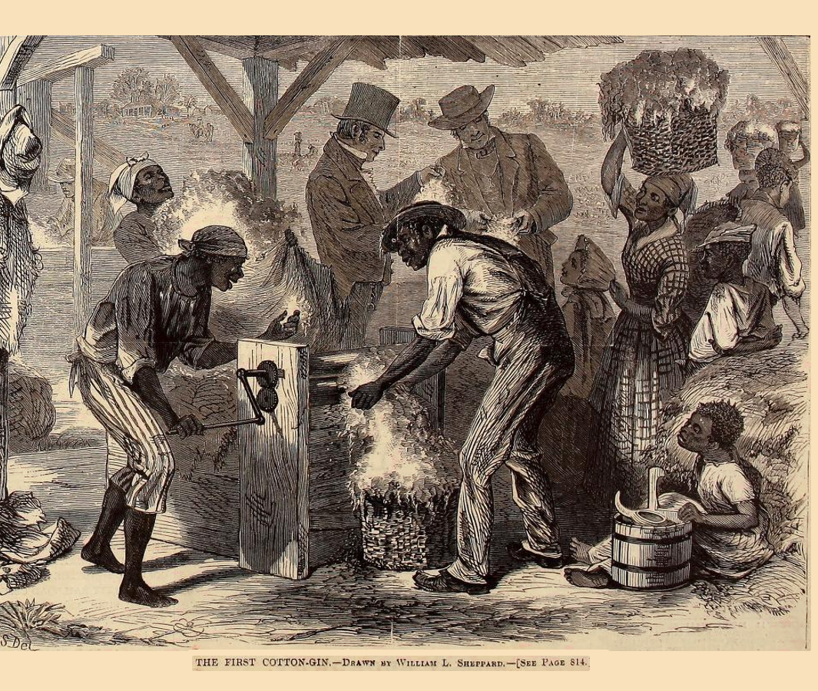
Rise of the Cotton Kingdom
The Southern soil and climate was suitable for growing cotton, and the use of the cotton gin (engine--patented by Eli Whitney in 1794) provided the Southerners an easy way to extract cotton from the plant.
The Industrial Revolution led to a high demand of cotton.
Steamboats lowered the transportation coasts and helped with the navigation of Mississippi and other Southern rivers.
The slave population, which increased from 1.5 million in 1820 to nearly 4 million in 1860, offered free and self-reproducing labor force.
This Photo by Unknown Author is licensed under CC BY-SA

Slide 3
Shortage of laborers
In the North, European immigrant population was high, offering a solution to the shortage of laborers.
The South, on the other hand, depended mostly on slave labor.

Slide 4
The Irony
Slaves were protected by state laws (generally unenforceable) that protected them from mutilation and murder.
Masters had to provide food, clothing and shelter.
Masters could not teach their slaves how to read or write. Slaves were not allowed to carry firearms or roam about the countryside.
Slaves were the property of their masters.
They could be sold, rented, mortgaged, and inherited.
They were not given the rights to marry, to hold property or to testify in court.

Slide 5
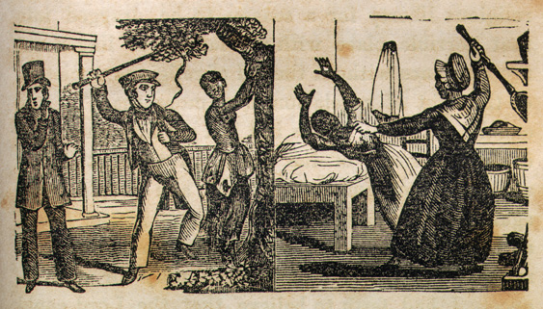
The Benevolent Master
Expected Gratitude
Provided medical care
Offered monetary rewards for extra productivity
Granted a week or more of Christmas vacation (remember religion played an important part on the justification of slavery)
Generally used Christian paternalism
Notes:
https://docsouth.unc.edu/neh/bibb/ill11.html illustrations from Henry Bibb’s narrative, who was a slave

Slide 6
Some planters and men of religion argued that religious instruction would make slaves more obedient, industrious, and faithful. They would accept their assigned position in this world, awaiting their reward in the heaven.
The ideal Christian master, on the other hand, would treat his slaves with charity and understanding.

Slide 7
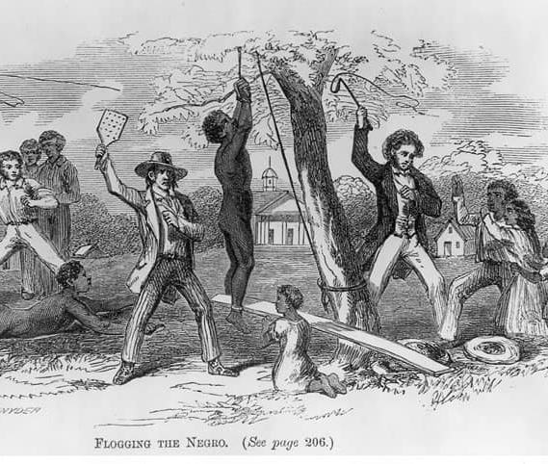
Discipline
Slaves were subjected to physical punishment for insuffiient labor, disorderly conduct, or refusal to accept the authority of a superior.
Notes:
http://interactives.dallasnews.com/2016/slavery-modern-media/

Slide 8
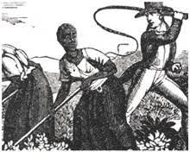
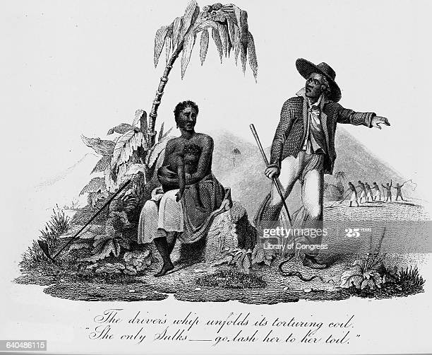
The Hierarchy
White overseers vs.
Black drivers
Notes:
Overseer image: https://web-clear.unt.edu/course_projects/HIST2610/content/04_Unit_Four/13_lesson_thirteen/03_southern_soc.htm
Driver image: https://www.gettyimages.com/photos/slave-driver?mediatype=photography&phrase=slave%20driver&sort=mostpopular

Slide 9
The creation and transmission of the Afro-American culture
Oral traditions, folklore, songs, dances, language, etc.
Black preachers= Christianity+African religions
Kinship patterns

Slide 10
Even though kinship was an important aspect of the slave culture, their families were susceptible to separation at the owner’s will or for the payment of his debts.
Slaves from different plantations could be married.
Interracial sexual relations were not seen as acceptable, and yet many slaveowners fathered black children.

Slide 11
FYI
Every Passover, Jews retell the story about the Hebrews' flight from slavery in Egypt and their miraculous escape across the Red Sea, giving birth to the nation of Israel.*
The stories told in the Hebrew Bible say that after the Israelites escaped from Egypt they fought a series of wars against the Canaanites (and other groups), which led to the Israelites taking over most of the Canaanites' land. The stories say that those Canaanites who survived had to do forced labor.**
The Year of Jubilee, which came every 50th year was a year full of releasing people from their debts, releasing all slaves, and returning property to who owned it (Leviticus 25:1-13). This year was also dedicated to rest.***
Notes:
https://www.haaretz.com/archaeology/.premium-were-hebrews-ever-slaves-in-ancient-egypt-yes-1.5429843
** https://www.livescience.com/56016-canaanites.html
*** https://www.christianity.com/wiki/bible/what-was-the-year-of-jubilee.html

Slide 12
Go Down Mo ses
Go down Moses way down in Egypt land Tell old Pharaoh to let My people go When Israel was in Egypt land Let my people go Oppressed so hard they could not stand Let My people go So the God sayeth, “Go down, Moses way down in Egypt land Tell old Pharaoh to let My people go” So Moses went to Egypt land Let My people go He made old Pharaoh understand Let My people go Yes The Lord said, “Go down, Moses way down in Egypt land Tell old Pharaoh to let My people go” Thus spoke the Lord, bold Moses said Let My people go “If not I'll smite your firstborns dead” Let My people go God, The Lord said, “Go down, Moses way down in Egypt land Tell old Pharaoh to let My people go”
Notes:
https://genius.com/Louis-armstrong-go-down-moses-lyrics

Slide 13
South as a Slave Society
The South became a slave society dominated politically and ideologically by a plantation-owned elite, since slaveholding was one of main sources of wealth and status.

Slide 14
Scientific Racism
Notes:
https://commons.wikimedia.org/wiki/File:Scientific_racism_irish.jpg

Slide 15
Proslavery argument
Southerners believed slavery was a “positive good,” but some Southerners viewed it as a duty and burden.
Some Southern writers created romantic representations of the plantation as a feudal manor blessed with human warmth, mutual duties, knightly virtues, and loyalty to blood and soil.
White Southerners feared emancipation would be a calamity both for the black and white populations.

Slide 16
Notes:
https://cadelllast.com/2012/12/24/what-is-more-of-a-threat-to-science-scientific-racism-or-unscientific-creationism/

Slide 17
Southern Free Blacks
After the Revolution, they reached a population of 100,000 in the southern states.
They owned property, found African churches and schools, etc.
New laws made by white legislators, who were afraid of the growing population of free blacks, changed their status. These laws:
Regulated their movement
Forbade them to associate with slaves
Subjected them to surveillance and discipline by whites
Denied them the right to testify in court against whites
Required them to work at approved jobs
Threatened them with penal labor

Slide 18
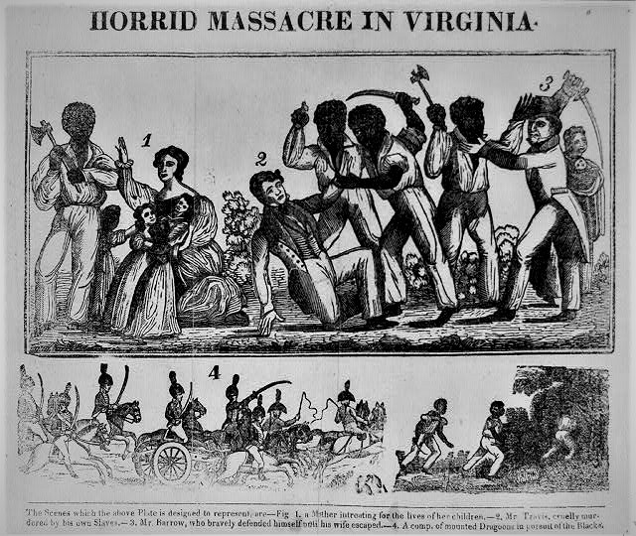
Nat Turner’s slave rebellion
Nat Turner led the bloodiest slave revolt in Virginia in 1831.
He and fellow slaves killed his new owner Joseph Travis, and his family. As they marched for rebellion, they killed the whites and freed slaves. At the end, 60 whites were dead, more than 70 slaves were freed. He and others were killed by the local militia, and many slaves who had nothing to do with the rebellion were killed as the result of the following hysteria.
Notes:
Image from https://constitutingamerica.org/august-21-1831-the-nat-turner-slave-rebellion-begins-guest-essayist-daniel-a-cotter/

Slide 19
Abolition efforts
Some reformers sent Africans to Liberia, a West African colony, the American Colonization Society had established as a refuge for American blacks.
Mormons and white abolitionists such as Theodore Dwight Weld, William Lloyd Garrison, and the Tappan Brothers fought for the freedom and the equality of the enslaved blacks.
The Anti-Slavery Society as well as the abolitionist press were also working hard for the emancipation of blacks.
Yet, many blacks resented the racial hypocrisy in the North and the patronizing attitudes of white abolitionists.

Slide 20
Black abolitionists
Frederick Douglass, Sojourner Truth, Henry Bibb, Harriet Tubman, Solomon Northup, Charles Lenox Remond, and others helped to change the Northern idea that blacks were treated kindly in the South. These Black abolitionists also helped to improve the image of the black man that was associated with racial inferiority.

Slide 21
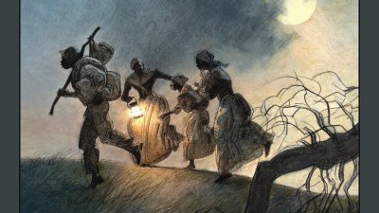
The Underground Railroad
According to the Fugitive Slave Laws, a runaway slave could be seized and taken back to his owner even within the borders of the free states. Therefore, many run-aways aimed to reach Canada in order to avoid U.S. jurisdiction.
As they were en route, they used the undergorund railroad, a network of black and white abolitionists who helped shelter, food, and aid to the runaway slaves.
This Photo by Unknown Author is licensed under CC BY-NC-ND
Notes:
https://www.history.com/topics/black-history/fugitive-slave-acts#section_2
https://www.history.com/topics/black-history/underground-railroad#section_2

Slide 22
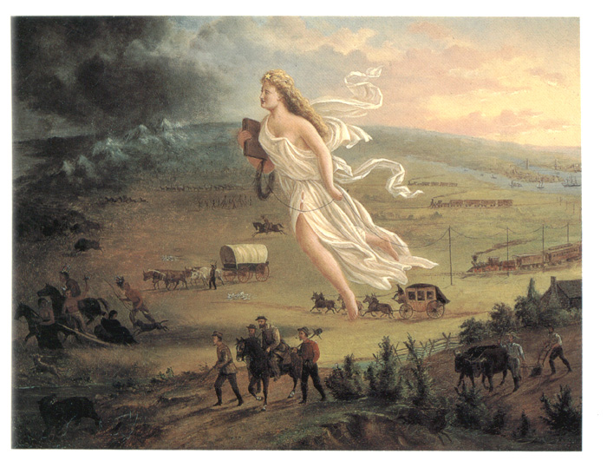
Manifest Destiny
Manifest Destiny, a phrase coined in 1845, is the idea that the United States is destined—by God—to expand its dominion and spread democracy and capitalism across the entire North American continent.
Painting by John Gast, “American Progress” (1872)
This Photo by Unknown Author is licensed under CC BY-NC-ND
Notes:
https://www.history.com/topics/westward-expansion/manifest-destiny
http://randomthoughtsonhistory.blogspot.com/2010/02/manifest-destiny-in-art.html

