Slide 1
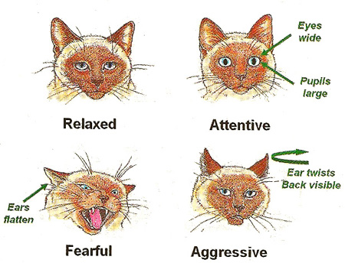
BODY LANGUAGE OF CATS
Assoc. Prof. Dr. Yasemin SALGIRLI DEMIRBAS

Slide 2
SIGNS OF EMOTIONAL STATE

Slide 3
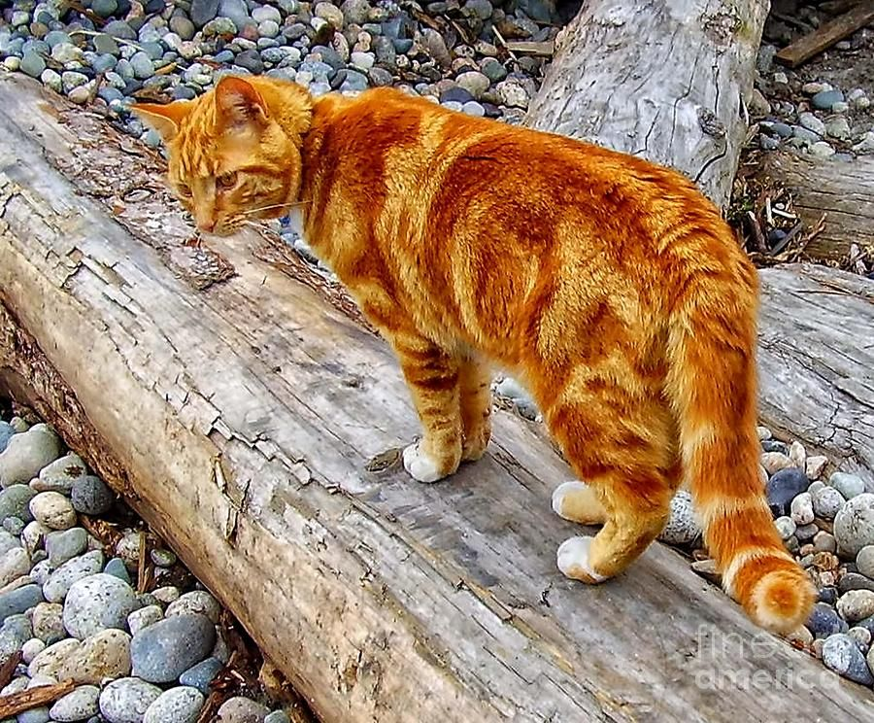
POSITIVE EMOTIONAL STATE

Slide 4
POSITIVE EMOTIONAL STATE

Slide 5
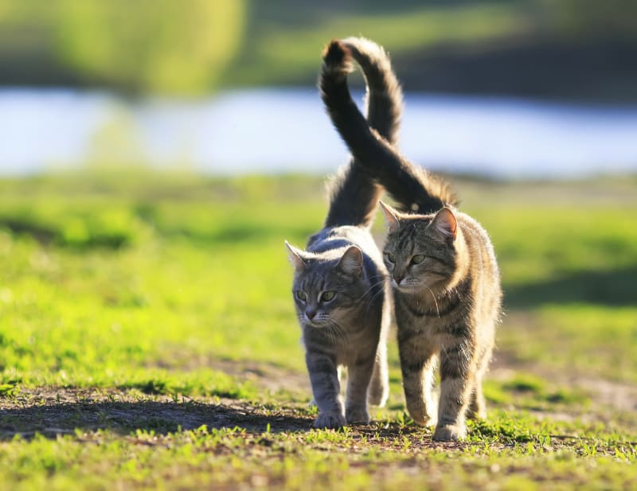
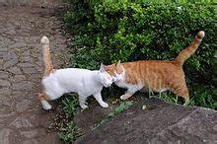
GREETING

Slide 6
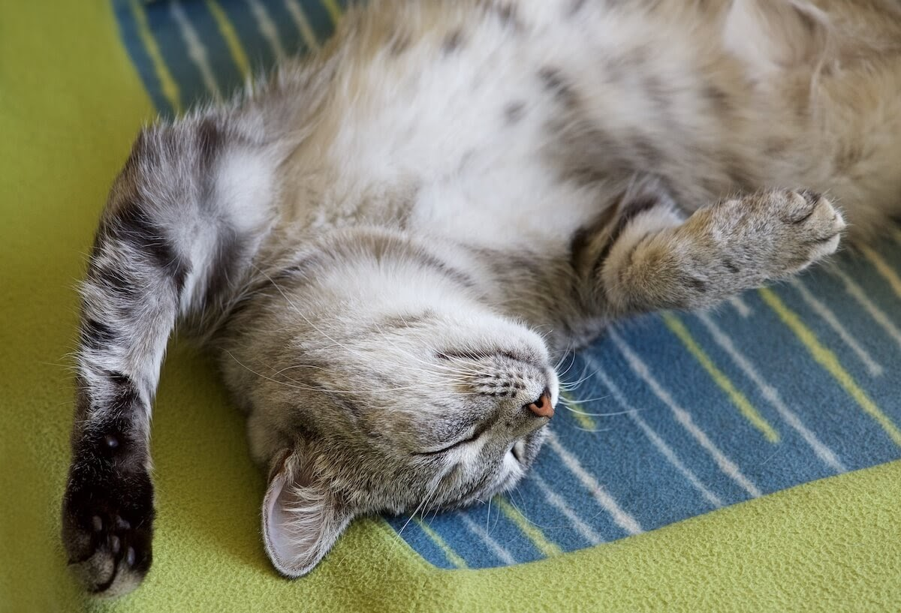
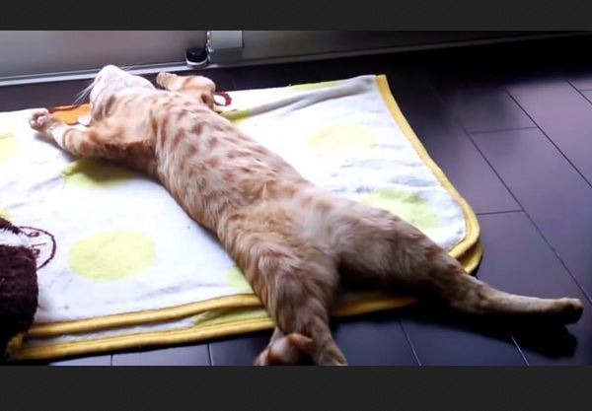
RELAXED CAT

Slide 7
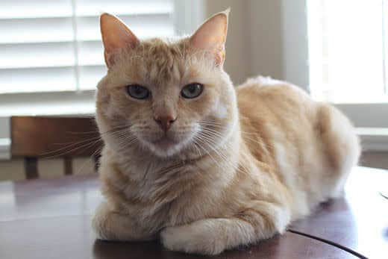
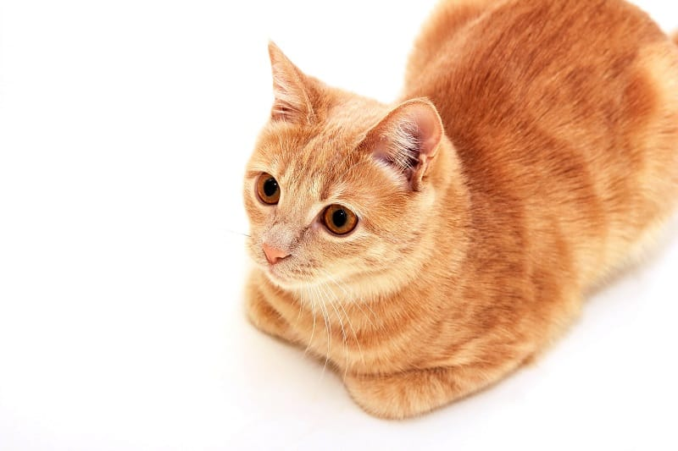
CAT LOAF

Slide 8
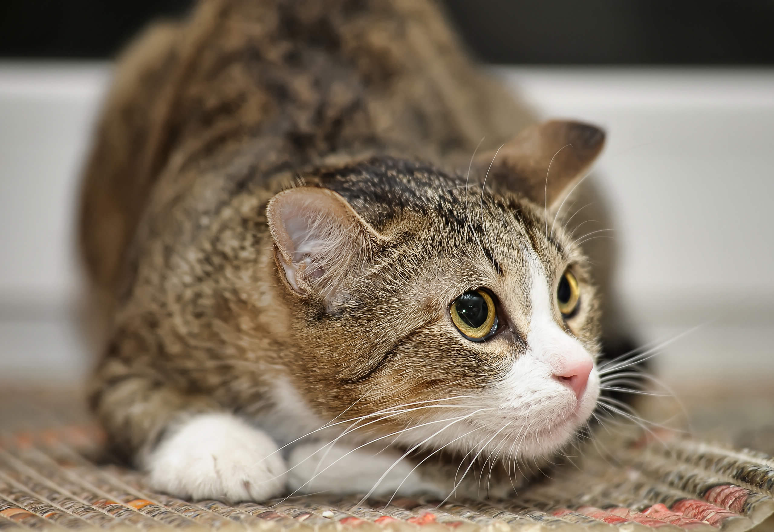
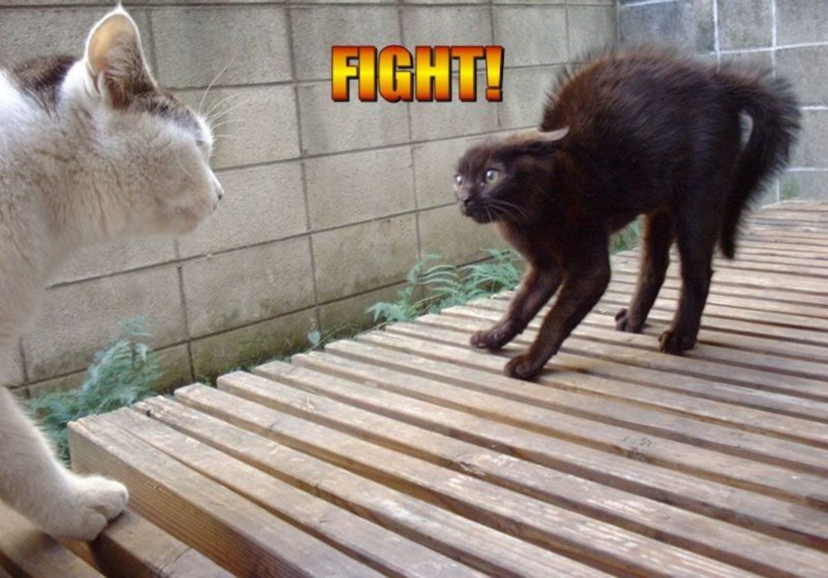
NEGATIVE EMOTIONAL STATE
DEFENSIVE BODY POSTURE

Slide 9
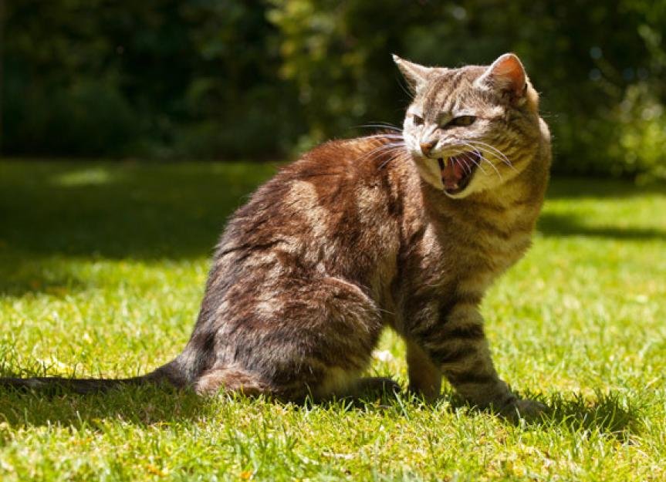
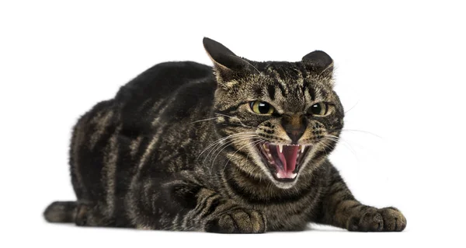
REPULSION

Slide 10
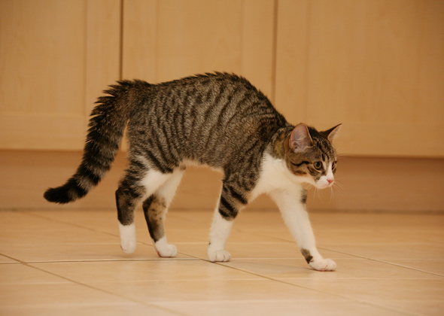
EMOTIONAL AROUSAL

Slide 12
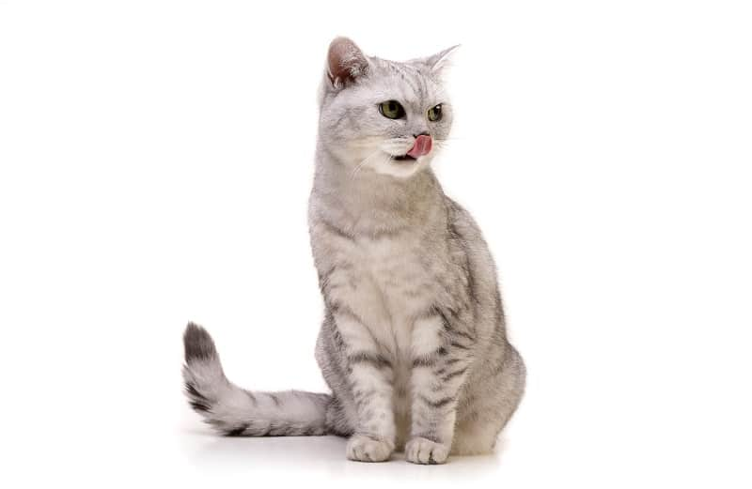
DISPLACEMENT BEHAVIORS
Normal behaviors displayed out of context

Slide 13
Your turn !

Slide 14
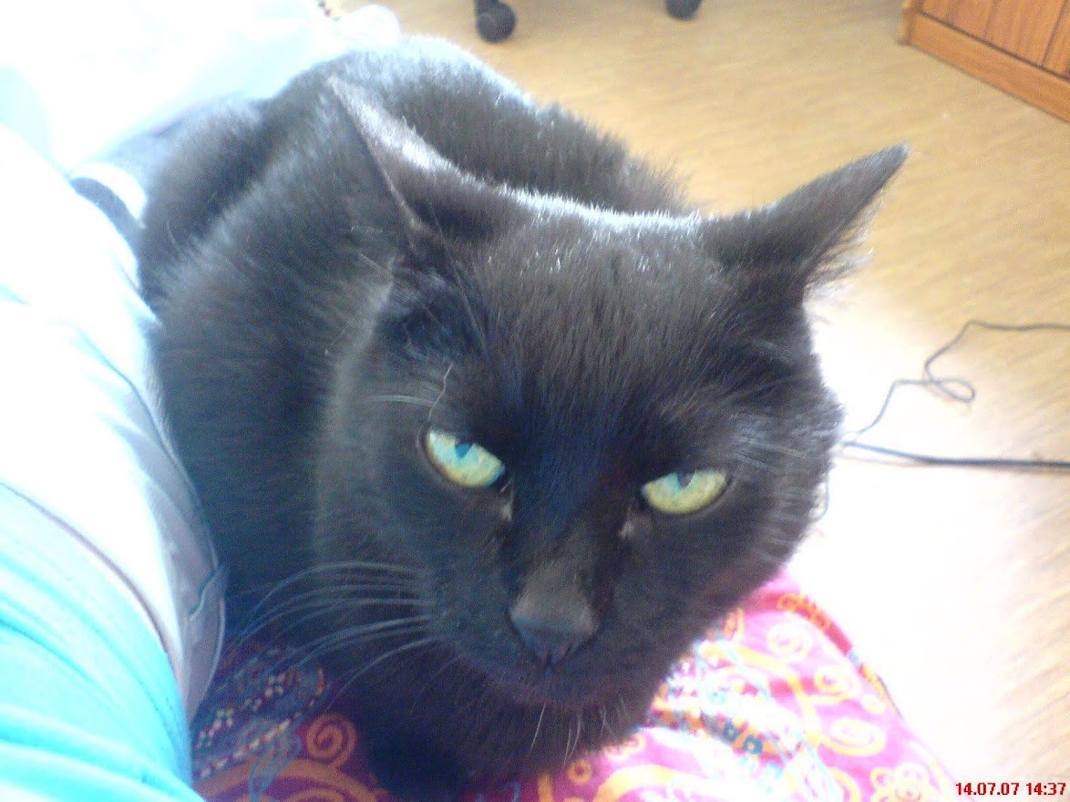
Your turn !

