Slide 1
ANKARA UNIVERSITY DEPARTMENT OF ENERGY ENGINEERING NUMERICAL METHODS
INSTRUCTOR
DR. ÖZGÜR SELİMOĞLU

Slide 2
CONTENTS
Numerical Integration
a) Romberg and Gaussian Integration

Slide 3
ROMBERG AND GAUSSIAN INTEGRATION
Romberg Integration
Romberg integration combines the trapezoidal rule with Richardson extrapolation. Let us first introduce the Richardson extrapolation
Richardson’s Extrapolation
Used iterative refinement to improve the solution of a set of simultaneous linear equations. Error-correction techniques are also available to improve the results of numerical integration on the basis of the integral estimates themselves. Generally called Richardson’s extrapolation, these methods use two estimates of an integral to compute a third, more accurate approximation.
The estimate and error associated with a multiple-application trapezoidal rule can be represented generally as
where I = the exact value of the integral, I(h) = the approximation from an n-segment application of the trapezoidal rule with step size h = (b − a)/n, and E(h) = the truncation error. If we make two separate estimates using step sizes of h₁ and h₂ and have exact values for the error,
(17)
Now recall that the error of the multiple-application trapezoidal rule can be represented approximately by Eq.
(18)

Slide 4
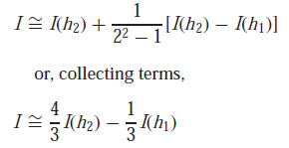
If it is assumed that $\overline{f} ′′$is constant regardless of step size, Eq. (18) can be used to determine that the ratio of the two errors will be
(19)
This calculation has the important effect of removing the term $\overline{f} ′′$from the computation. In so doing, we have made it possible to utilize the information embodied by Eq. (18) without prior knowledge of the function’s second derivative. To do this, we rearrange Eq. (19) to give
(20)
which can be substituted into Eq. (17):
which can be solved for
Thus, we have developed an estimate of the truncation error in terms of the integral estimates and their step sizes. This estimate can then be substituted into
to yield an improved estimate of the integral:
(21)
It can be shown that the error of this estimate is O(h⁴). Thus, we have combined two trapezoidal rule estimates of O(h²) to yield a new estimate of O(h⁴). For the special case where the interval is halved (h₂ = h₁/2), this equation becomes

Slide 5
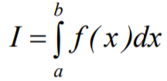
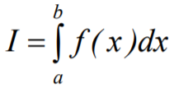
Combines the composite trapezoidal Rule with Richardson extrapolation to improve the accuracy of integration
Error in the approximation:
The accuracy of an estimated integral can be improved by using Richardson extrapolation, in which two numerical estimates are combined to obtain a third, more accurate value.
Romberg Integration is an extrapolation formula of the Trapezoidal Rule for integration. It provides a better approximation of the integral by reducing the True Error.
The truncation error in a multi-segment Trapezoidal Rule with n segments for an integral
Is given by
If I₁(h₁) is the approximate value of the integral from trapezoidal rule, and E₁(h₁) is the truncation error with a step size h₁ we can write the following
(i)
Similarly if we take another step h₂ we can write:
(ii)

Slide 6
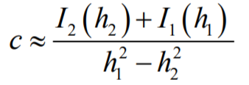
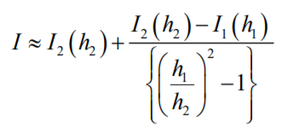
Combining (i) and (ii) we can solve for c
(iii)
Substituting (iii) into (ii) we obtain an improved estimate of the integral as:
(iv)
Can be shown that the error of this estimate is now O(h⁴) compared to O(h²) for regular trapezoidal rule.
For the special case where the interval is halved, h₂=h₁/2
(v)
Each successive application of the Richardson extrapolation to Trapezoidal Rule eliminates the leading terms in the error estimate.
Thus, if the first application of Richardson produces an error of order O(h⁴) , the next application will produce an error of order O(h⁶) , and so on.
The general formulation of this procedure on trapezoidal rule is known as the Romberg Integration.

Slide 7
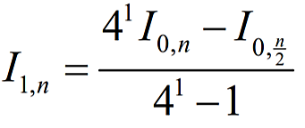
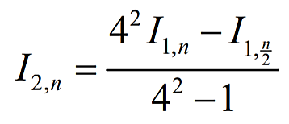
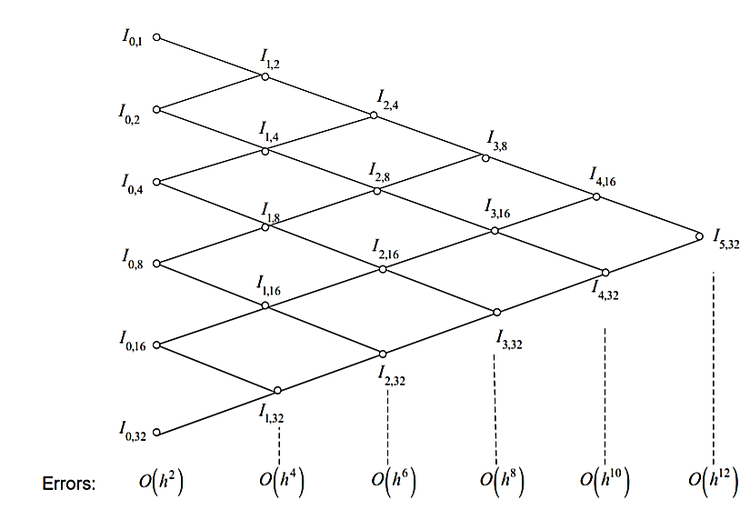
If I _{0,n} and I _{0,n/2} indicate the values of the integral computed by the trapezoidal rule with n and n/2 segments
Then the improved value of the integral given by Richardson’s extrapolation is
If the extrapolation is applied the second time
When the extrapolation process is repeated k times, we can generalize the formula as:
By applying a proper number of Richardson’s extrapolations, any desired accuracy may be obtained
Romberg Integration procedure:

Slide 8
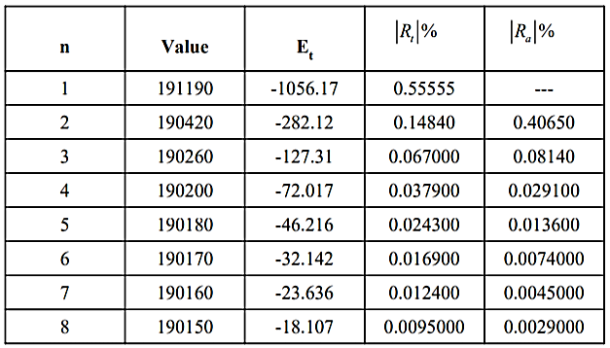
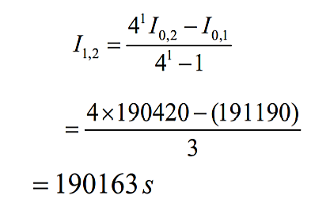
Example: Table shows the results obtained for the integral using multi-segment Trapezoidal rule for the time required 50% consumption of a reactant in an experiment . Use Romberg’s rule to find the time required for 50% of consumption. Use the 1, 2, 4, and 8-segment Trapezoidal rule results as given in the Table .
Solution: From Table, the needed values from original Trapezoidal rule are
where the above four values correspond to using 1, 2, 4 and 8 segment Trapezoidal rule, respectively.
To get the first order extrapolation values,

Slide 9
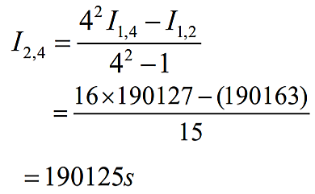
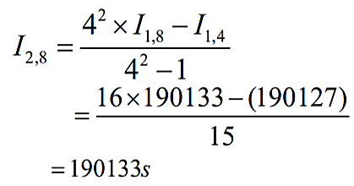
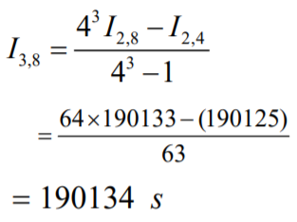
Similarly,
For the second order extrapolation values,
Similarly,
For the third order extrapolation values

Slide 10
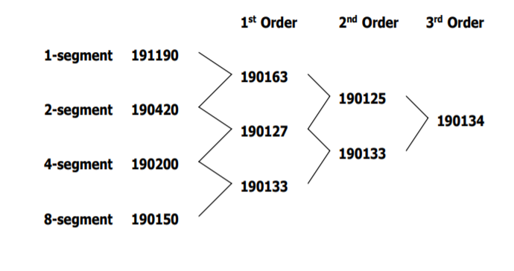
Table_{new} shows these increased correct values in a tree graph.
Table_{new} : Improved estimates of the integral value using Romberg Integration

Slide 11
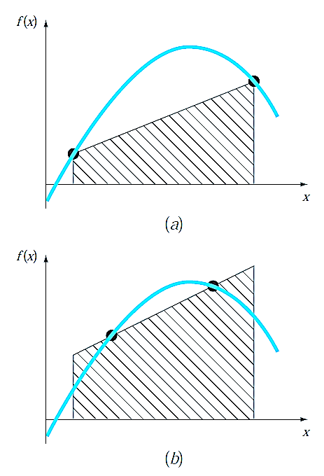
Gaussian Integration
Gauss Quadrature
Studied the group of numerical integration or quadrature formulas known as the Newton-Cotes equations. A characteristic of these formulas was that the integral estimate was based on evenly spaced function values. Consequently, the location of the base points used in these equations was predetermined or fixed.
As depicted in Fig. 9a, the trapezoidal rule is based on taking the area under the straight line connecting the function values at the ends of the integration interval. The formula that is used to compute this area is
(22)
where a and b = the limits of integration and b − a = the width of the integration interval. Because the trapezoidal rule must pass through the end points, there are cases such as Fig. 9a where the formula results in a large error.
Now, suppose that the constraint of fixed base points was removed and we were free to evaluate the area under a straight line joining any two points on the curve. By positioning these points wisely, we could define a straight line that would balance the positive and negative errors. Hence, as in Fig. 9b, we would arrive at an improved estimate of the integral.
Gauss quadrature is the name for one class of techniques to implement such a strategy. The particular Gauss quadrature formulas described in this section are called Gauss- Legendre formulas. Before describing the approach, we will show how numerical integration formulas such as the trapezoidal rule can be derived using the method of undetermined coefficients. This method will then be employed to develop the Gauss-Legendre formulas.
Figure 9: (a) Graphical depiction of the trapezoidal rule as the area under the straight line joining fixed end points. (b) An improved integral estimate obtained by taking the area under the straight line passing through two intermediate points.

Slide 12
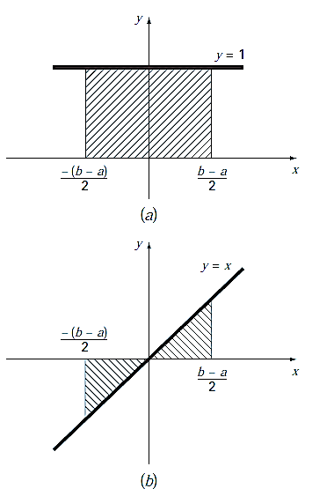
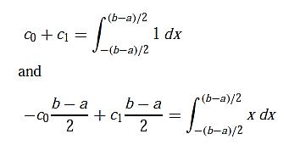
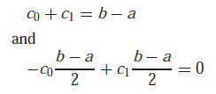
Derived the trapezoidal rule by integrating a linear interpolating polynomial and by geometrical reasoning. The method of undetermined coefficients offers a third approach that also has utility in deriving other integration techniques such as Gauss quadrature.
To illustrate the approach, Eq. (22) is expressed as
(23)
where the c’s = constants. Now realize that the trapezoidal rule should yield exact results when the function being integrated is a constant or a straight line. Two simple equations that represent these cases are y = 1 and y = x. Both are illustrated in Fig. 10. Thus, the following equalities should hold:
or, evaluating the integrals,
These are two equations with two unknowns that can be solved for
which, when substituted back into Eq. (23), gives
which is equivalent to the trapezoidal rule.
Figure 10: Two integrals that should be evaluated exactly by the trapezoidal rule: (a) a constant and (b) a straight line.

Slide 13
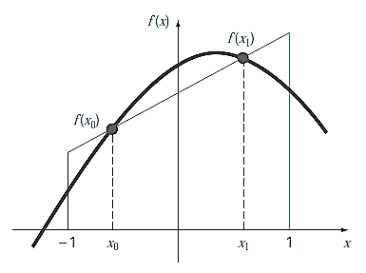
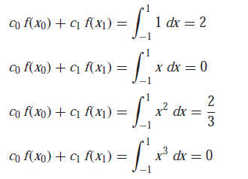
Derivation of the Two-Point Gauss-Legendre Formula
Just as was the case for the above derivation of the trapezoidal rule, the object of Gauss quadrature is to determine the coefficients of an equation of the form
(24)
where the c’s = the unknown coefficients. However, in contrast to the trapezoidal rule that used fixed end points a and b, the function arguments x₀ and x₁ are not fixed at the end points, but are unknowns (Fig. 11). Thus, we now have a total of four unknowns that must be evaluated, and consequently, we require four conditions to determine them exactly.
Just as for the trapezoidal rule, we can obtain two of these conditions by assuming that Eq. (24) fits the integral of a constant and a linear function exactly. Then, to arrive at the other two conditions, we merely extend this reasoning by assuming that it also fits the integral of a parabolic (y = x²) and a cubic (y = x³) function. By doing this, we determine all four unknowns and in the bargain derive a linear two-point integration formula that is exact for cubics. The four equations to be solved are
(25)
(26)
(27)
(28)
Figure 11: Graphical depiction of the unknown variables x₀ and x₁ for integration by Gauss quadrature

Slide 14
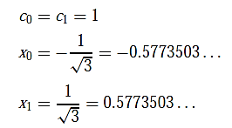
Equations (25) through (28) can be solved simultaneously for
which can be substituted into Eq. (24) to yield the two-point Gauss-Legendre formula
(29)
Thus, we arrive at the result that the simple addition of the function values at x = 1/ $\sqrt{3}$and −1/ $\sqrt{3}$ yields an integral estimate that is third-order accurate.
Notice that the integration limits in Eqs. (19) through (22) are from −1 to 1. This was done to simplify the mathematics and to make the formulation as general as possible. A simple change of variable can be used to translate other limits of integration into this form. This is accomplished by assuming that a new variable x_{d} is related to the original variable x in a linear fashion, as in
(30)
If the lower limit, x = a, corresponds to x_{d} =−1, these values can be substituted into Eq. (30) to yield
(31)
Similarly, the upper limit, x = b, corresponds to x_{d} = 1, to give
(32)

Slide 15
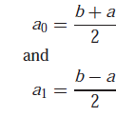
Equations (31) and (32) can be solved simultaneously for
(33)
(34)
which can be substituted into Eq. (30) to yield
(35)
This equation can be differentiated to give
(36)
Equations (35) and (36) can be substituted for x and dx, respectively, in the equation to be integrated. These substitutions effectively transform the integration interval without changing the value of the integral. The following example illustrates how this is done in practice.

Slide 16
Example 2: Use Eq. to evaluate the integral of
between the limits x = 0 to 0.8. The exact value of the integral is 1.640533.
Solution: Before integrating the function, we must perform a change of variable so that the limits are from −1 to +1. To do this, we substitute a = 0 and b = 0.8 into Eq. to yield
The derivative of this relationship is [Eq. (36)]
Both of these can be substituted into the original equation to yield
Therefore, the right-hand side is in the form that is suitable for evaluation using Gauss quadrature. The transformed function can be evaluated at −1/ $\sqrt{3 }$to be equal to 0.516741 and at 1/$\sqrt{3 }$to be equal to 1.305837. Therefore, the integral according to Eq. İs
which represents a percent relative error of −11.1 percent.

Slide 17
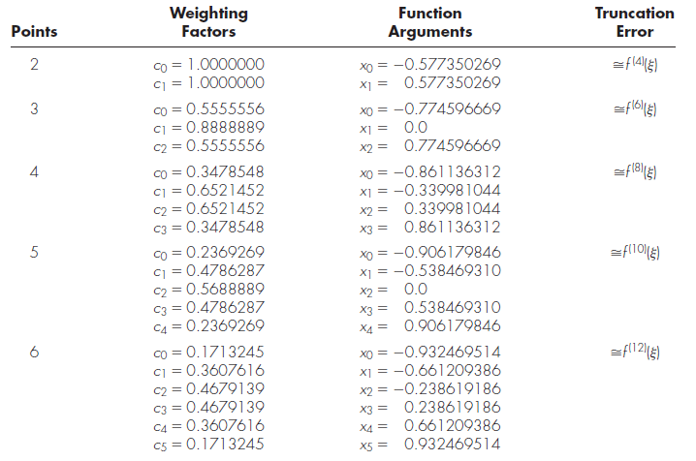
Higher-Point Formulas
Beyond the two-point formula described in the previous section, higher-point versions can be developed in the general form
(37)
where n = the number of points. Values for c’s and x’s for up to and including the six-point formula are summarized in Table 1.
Table 1 : Weighting factors c and function arguments x used in Gauss-Legendre formulas.

Slide 18
Example 3: Use the three-point formula from Table 1 to estimate the integral for the function.
Solution: According to Table, the three-point formula is
Because Gauss quadrature requires function evaluations at non-uniformly spaced points within the integration interval, it is not appropriate for cases where the function is unknown. Thus, it is not suited for engineering problems that deal with tabulated data. However, where the function is known, its efficiency can be a decided advantage. This is particularly true when numerous integral evaluations must be performed.

Slide 19
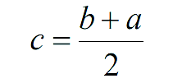
Error Analysis for Gauss Quadrature
The error for the Gauss-Legendre formulas is specified generally by
(38)
where n = the number of points minus one and f ^{(2n+2)} (ξ) = the (2n + 2) th derivative of the function after the change of variable with ξ located somewhere on the interval from −1 to 1.
Arguments and Weighing Factors for n-point Gauss Quadrature Formulas
Then Hence
Substituting our values of x, and dx into the integral gives us

Slide 20
Example 4: Calculate the Gaussian Qudrature on $\int_{0.2}^{1.5}{3x dx}$ with n=2. The exact value of the integral is 3.315.
Solution:
Step 1:
What we are doing in this step is converting the domain from [a,b] to [-1,1]. In doing so we gain several benefits, one important one is that the weights will be standardized. Meaning we can look them up, which greatly improve computation speed.
Step 2: Find the weights given n= 2 (or 3 point) , which we will use to estimate the integral.
Step 3: We use the following equation
Step 4: This is just for comparison purposes:

Slide 21
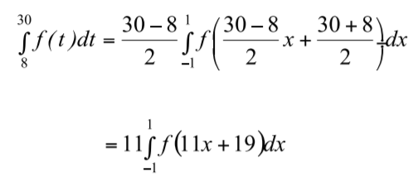
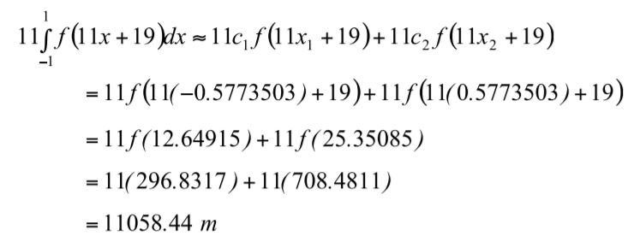
Example 5:
a) Use two-point Gauss Quadrature Rule to approximate the distance covered by a rocket from t=8 to t=30 as given by
b) Find the true error, E_{t} for part (a). (True Value= 11061.34 )
c) Also, find the absolute relative true error, $\left|Et\right|$ for part (a).
Solution: First, change the limits of integration from [8,30] to [-1,1] by previous relations as follows
Next, get weighting factors and function argument values from Table for the two point rule,
Now we can use the Gauss Quadrature formula

Slide 22
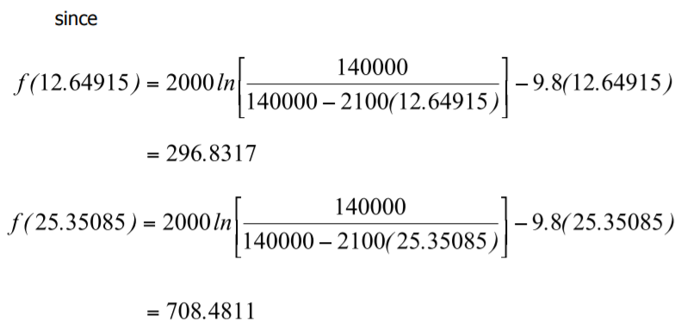
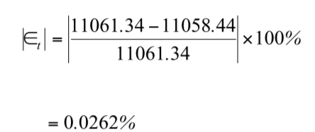
b) The true error, E_{t} is
c) The absolute relative true error,$\left|Et\right|$ , is (Exact value = 11061.34m)

Slide 23
REFERENCES
Jaan Kiusalaas, “Numerical Methods in Engineering with Python 3”,3rd Edition, Cambridge, NY, 2013
S.C. Chapra and R.P. Canale, “Numerical Methods for Engineers”, 6th ed., McGraw-Hill,, NY, 2010

