Slide 1
pH and total acidity
Assoc Prof. ÖZGE ŞAKIYAN DEMİRKOL
22.03.2021

Slide 2
There are two interrelated concepts in food analysis that deal with acidity: pH and titratable acidity.
Titratable acidity (also called total acidity) measures the total acid concentration in a food.
This quantity is determined by exhaustive titration of intrinsic acids with a standard base. Titratable acidity is a better predictor of acid’s impact on flavor than pH.

Slide 3
However, total acidity does not give all relevant information on a food. For instance, the ability of a microorganism to grow in a specific food is more dependent on the concentration of free hydronium ions, H3O+, than titratable acidity.
pH is defined as the negative log (base 10) of the hydrogen ion concentration and can span a range of 14 orders of magnitudes. In foods, it is not only a function of the type and concentrations of acids present, but also of the concentration of ionized acid counterparts (their conjugated bases).

Slide 4
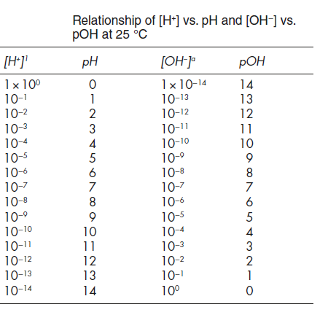

Slide 5
DETERMINATION OF TOTAL ACIDITY
Total acid concentration of a food material can be determined by titration with a base.
The amount of base (the point where the titration should be stopped) can be determined by various methods;
-colorimetric methods
-electrometric methods
-potentiometric methods

Slide 6
Sample preparatıon for total acıdıty
-grinding and extraction with water and alcohol
-decolorization →dilution
→usage of active coal
→usage of wool
-getting rid of CO₂

Slide 7
DETERMINATION OF pH
-Colorimetric methods
-Electrometric methods
-pH indicator papers
SAMPLE PREPARATION FOR pH
-getting rid of CO₂
-homogenization

Slide 8
Why pH is important?
They are effective on microorganism control
Heat treatment conditions
Optimum and minimum pH ranges for bacterias, molds and yeasts
Treatment and production of pectins and proteins
Settling of fruit juices

Slide 9
Thanks!!!!
osakiyan@ankara.edu.tr

