Slide 1
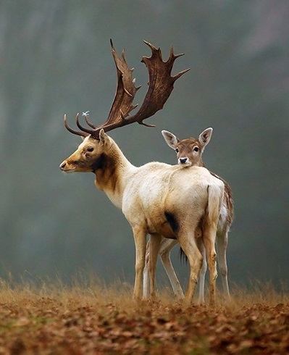
Life Principles
Dr. Arzu GÜRSOY ERGEN
Fen Fakültesi Biyoloji Bölümü
“I think the biggest innovations of the 21st century will be at the intersection of biology and technology.” ----Steve Jobs

Slide 2
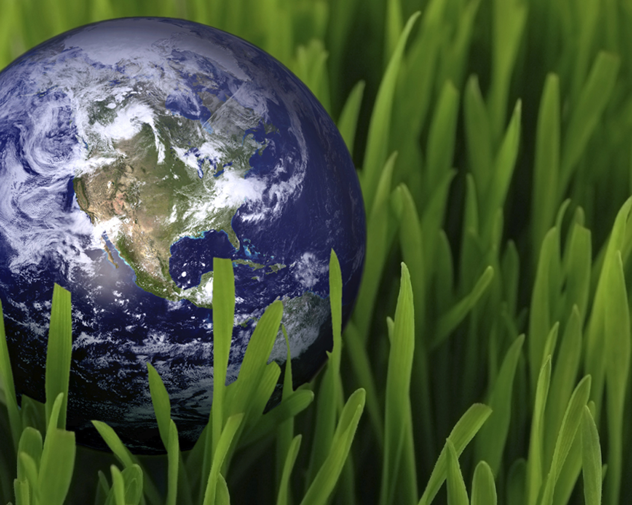
9 bacis principles of biomimicry
1. Nature runs on sunlight
2. Nature uses only the energy it needs
3. Nature fits form to function
4. Nature recycles everything
5. Nature rewards cooperation
6. Nature banks on diversity
7. Nature demands local expertise
8. Nature curbs excesses from within
9. Nature taps the power of limits.

Slide 3
1. Nature runs on sunlight
Nature is powered by the renewable energy of the sun.
The sun warms our earth, powering the water cycle, climate and weather.
In the presence of sunlight, green plants produce their own food through photosynthesis, and this in turn fuels the web of life.
Humans are mimicking how plants process sunlight in order to one day split water into clean-burning fuels.
This helps eliminate the problem of pollution-causing energy production.
If we were to consistently mimic the ways of nature, we would rely solely on renewable power.

Slide 4
2. Nature uses only the energy it needs
Nature uses only the energy it needs and relies on freely available energy.
Freely available energy includes sources such as electrons from sunlight used by plants for photosynthesis, rising air currents, wind, dissolved minerals from deep sea vents, decomposing organic materials, and nutrients from plants and animals that organisms feed upon.
Two major energy expenditures for organisms are obtaining the energy (e.g., through photosynthesis or finding and capturing food) and growing materials that make up their bodies and homes.
Organisms use low-energy processes to reduce the amount of energy they need.
Those processes usually involve self-assembly, building from the bottom-up (small elements to large), using modular or nested structures, building at ambient temperatures and pressures, and making use of multi-functional design.

Slide 5
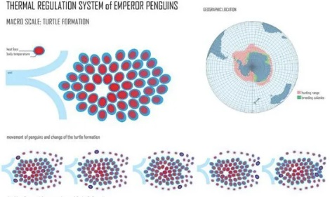
Biology Examples Emperor Penguin
Emperor penguins have many bodily structures that help them maintain body heat, such as special feathers that provide a lot of insulation.
However, in their Antarctic home they need extra help staying warm, and they get that from each other by huddling together to maintain their body heat.
Given this huddling arrangement, the outermost penguins in the huddle will inevitably get cold.
Thus, they take turns entering the center so that everyone can have a chance to stay warm.
Thermoregulation of penguin colony

