Slide 1
Evolution of Woody and Seed Plants

Slide 4
Secondary growth from lateral meristems: vascular cambium & cork cambium.

Slide 6
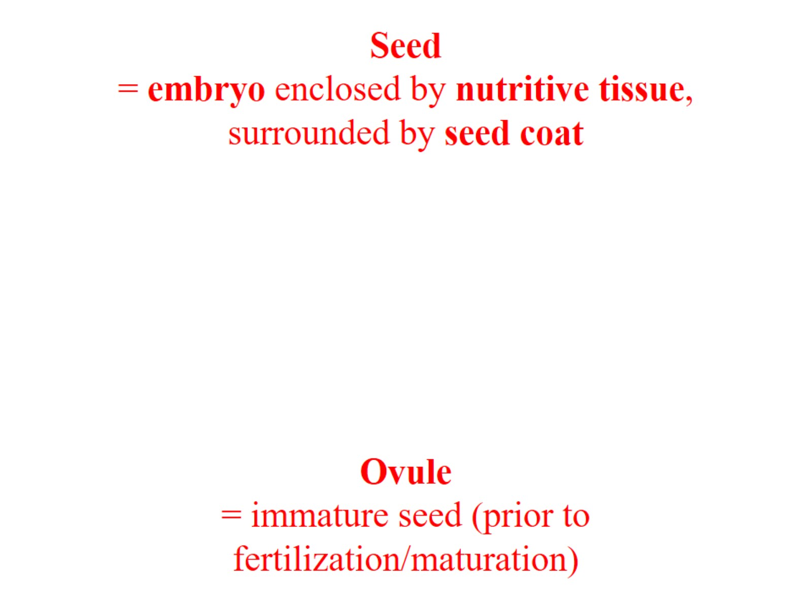
Seed = embryo enclosed by nutritive tissue, surrounded by seed coat

Slide 7
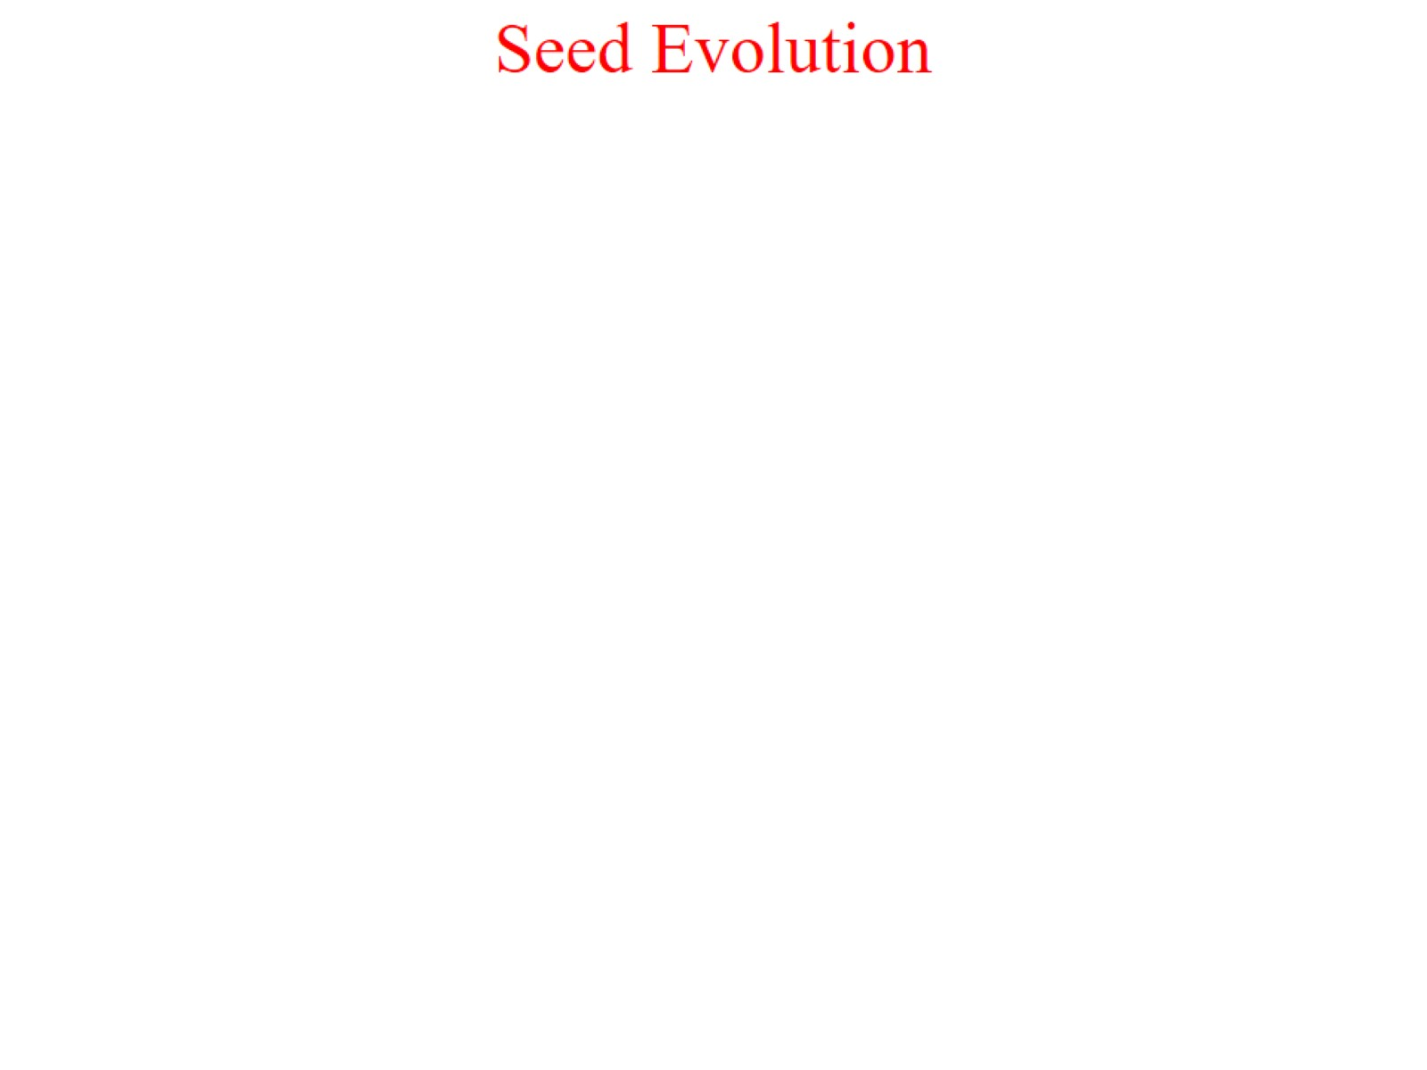
Seed Evolution

Slide 8
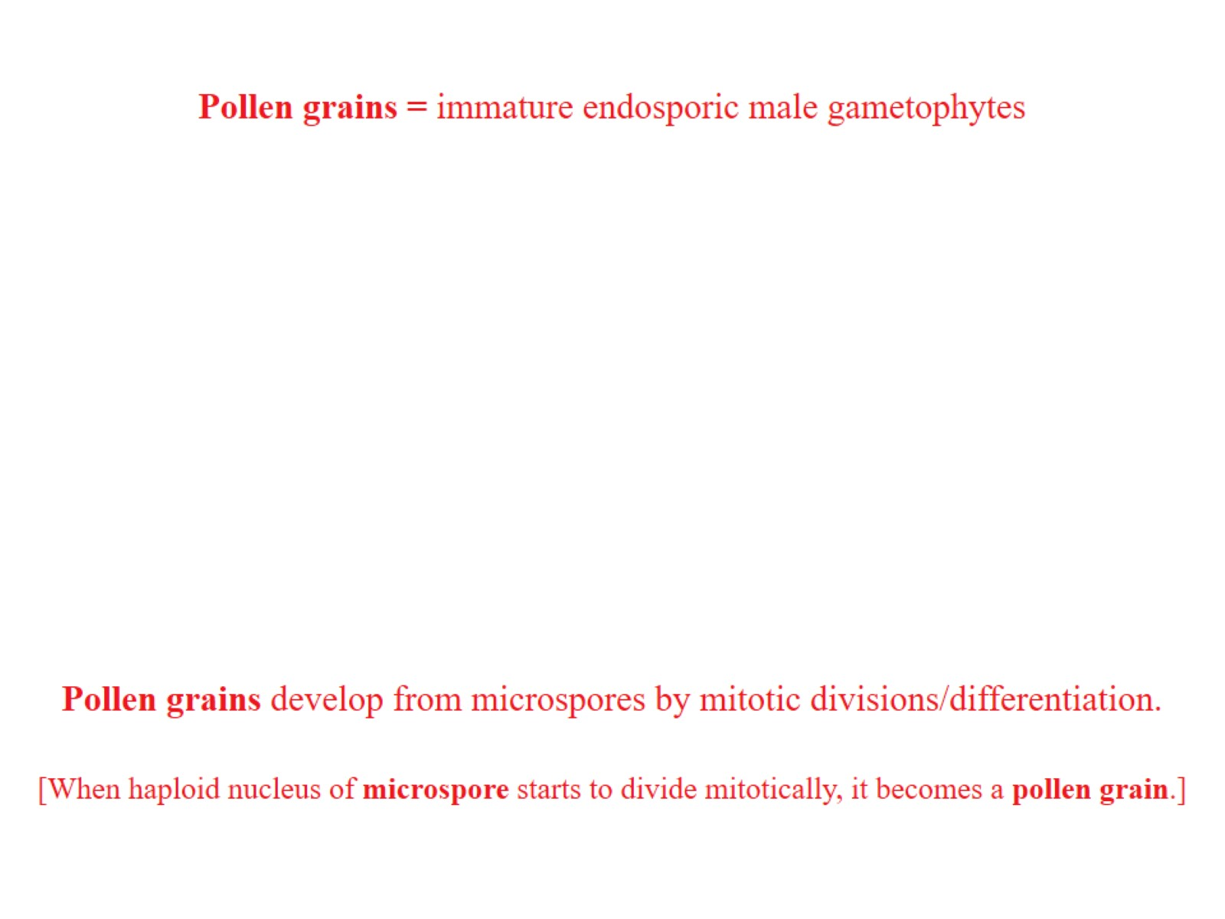

Slide 14
Adaptive significance of seeds

Slide 15
eustele – single ring of vascular bundles

Slide 16
ARCHEOPTERIS

Slide 17
“PTERIDOSPERMS” — “SEED FERNS”

Slide 18
Medullosa

Slide 20
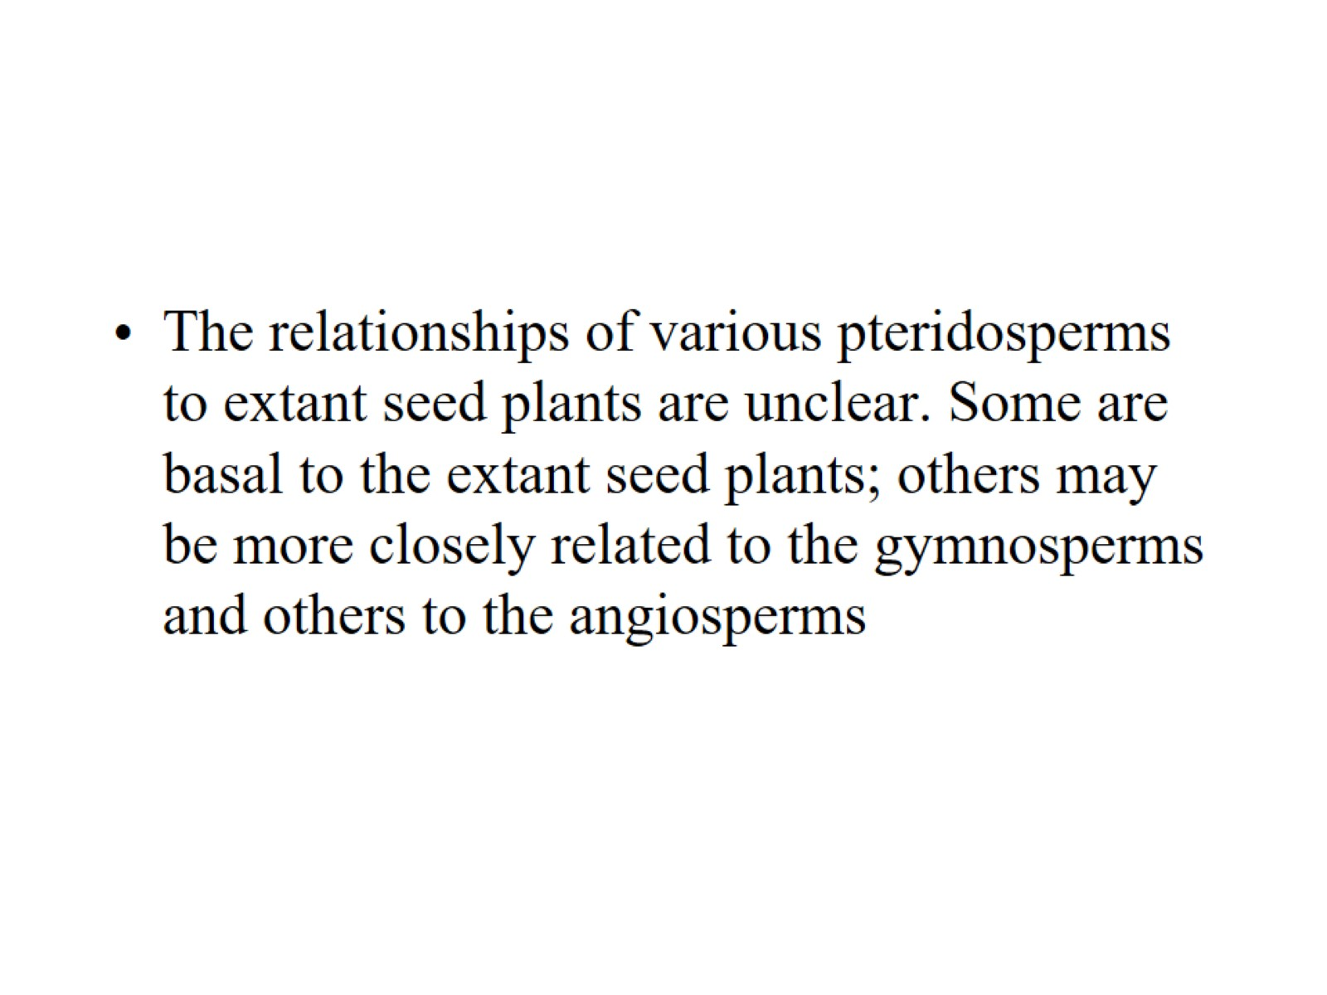

Slide 21
Cycadophyta – Cycads

Slide 22
Extant Cycads

Slide 23
Ginkgophyta—Ginkgo

Slide 24
Ginkgo

Slide 25
Seed Plants

Slide 26
Coniferophyta—Conifers

Slide 27
Coniferophyta—Conifers

Slide 28
Coniferophyta—Conifers

Slide 29
Coniferophyta—Conifers

Slide 30
Coniferophyta—Conifers

Slide 31
Coniferophyta—Conifers

Slide 32
Coniferophyta—Conifers

Slide 33
Coniferophyta—Conifers

Slide 34
Coniferophyta—Conifers

Slide 35
Coniferophyta—Conifers

Slide 36
Coniferophyta—Conifers

Slide 37
Coniferophyta—Conifers

Slide 39
Pinaceae

Slide 40
Pinus

Slide 41
Cedrus

Slide 42
Abies

Slide 43
Picea

Slide 47
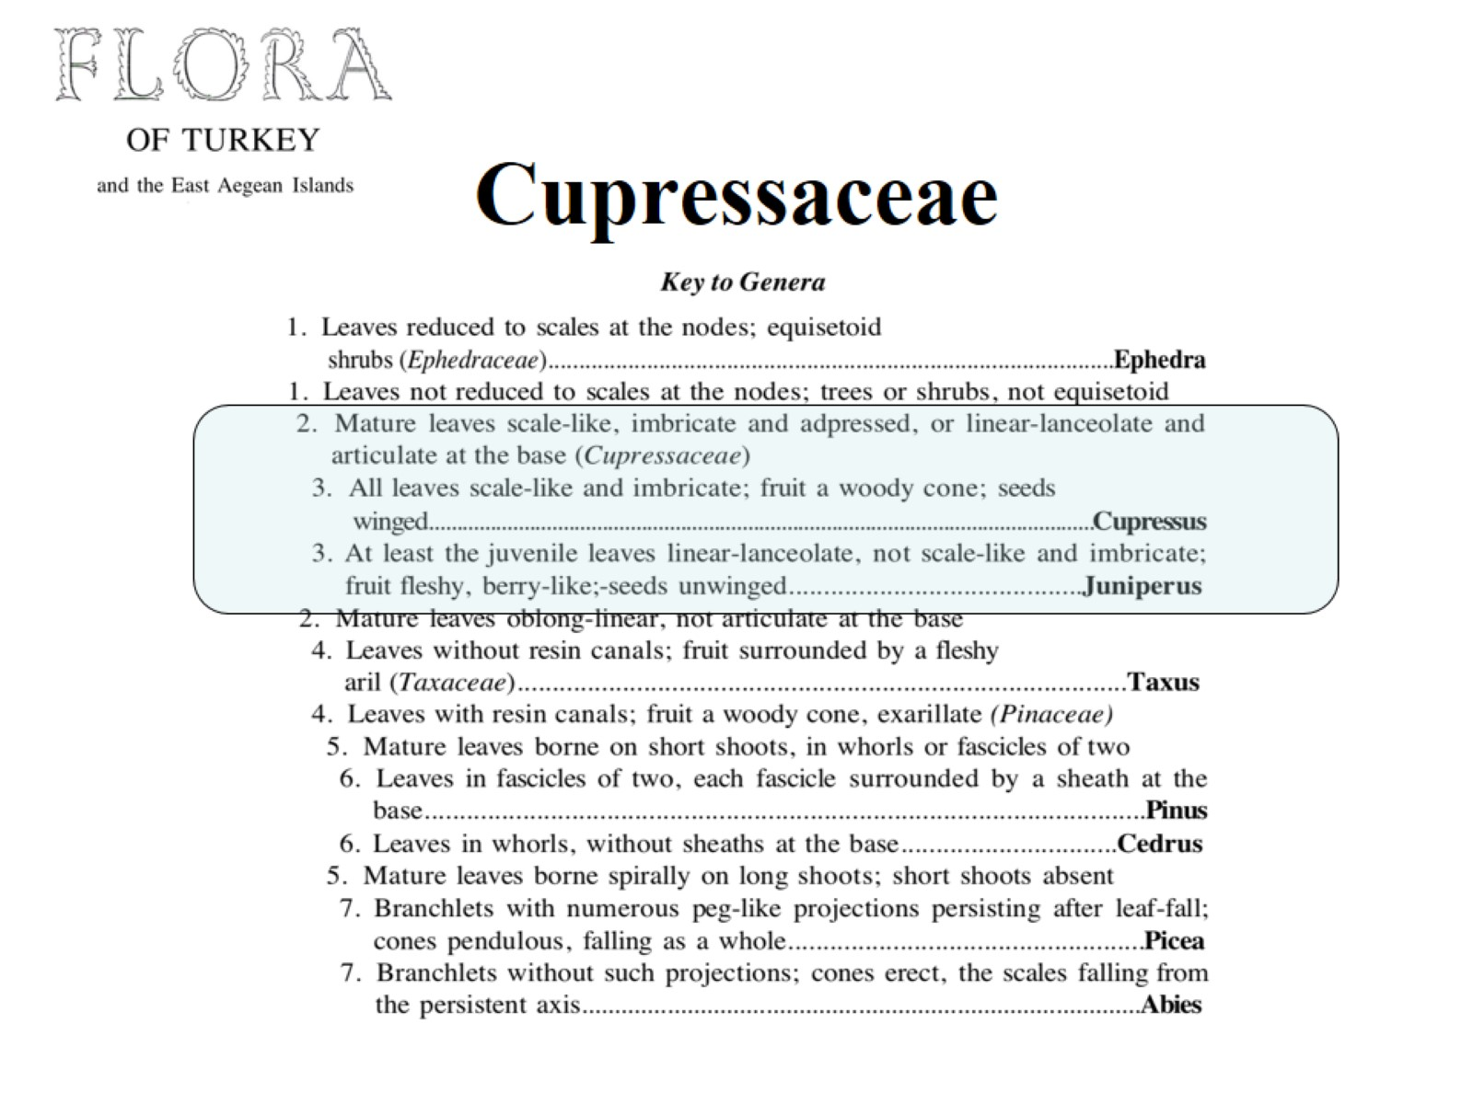
Cupressaceae

Slide 48
Cupressus

Slide 49
Juniperus

Slide 50
Thuja

Slide 53
Taxaceae

Slide 54
Taxus baccata

Slide 55
Coniferae – conifers

Slide 57
Gnetales Ephedraceae One genus: Ephedra (35-45 spp.) Morman Tea E. sinica: ma-huang – Chinese herbal medicine ephedrine – alkaloid weight loss, stimulant now banned.

Slide 58
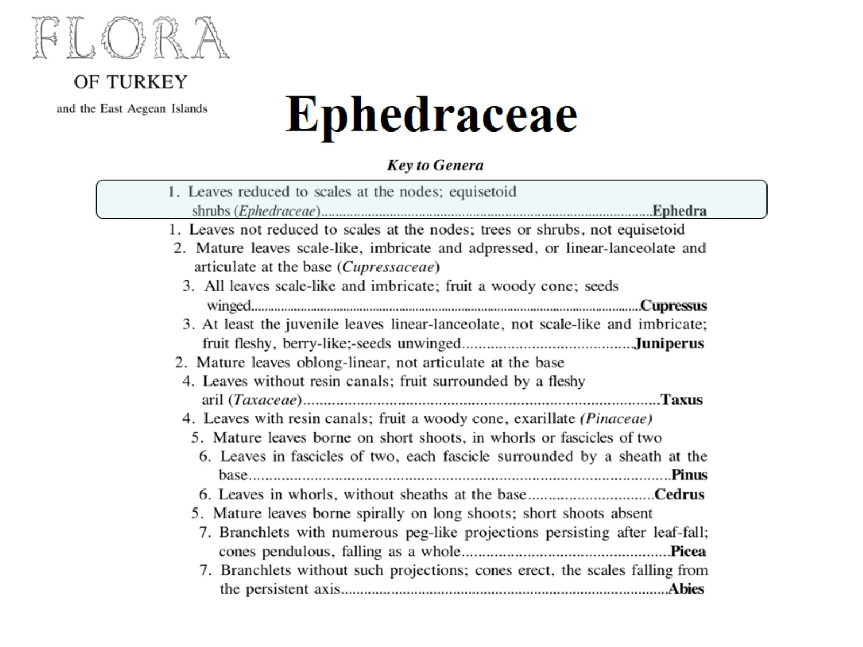
Ephedraceae

