Slide 1
BRAIN STORMING
Differences in visual communication between cats and dogs?
Which one do you think use their body language more effectively?
Why?

Slide 2
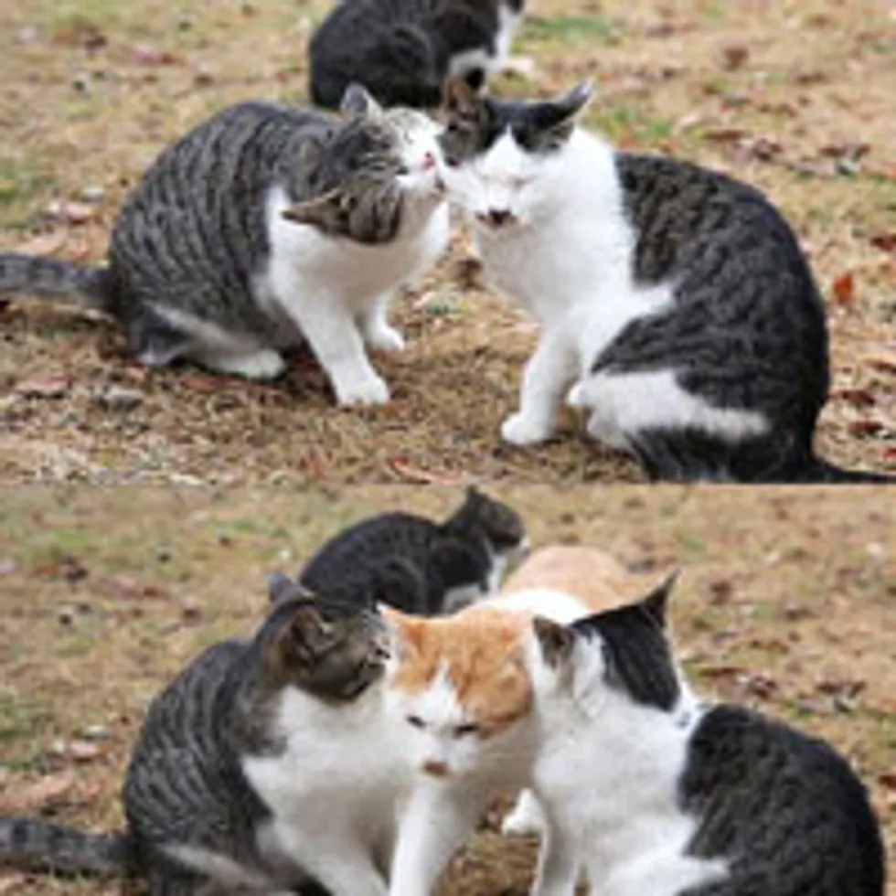
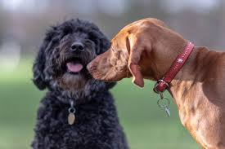
Social vs Solitary
Domestic Cat
Domestic Dog

Slide 3
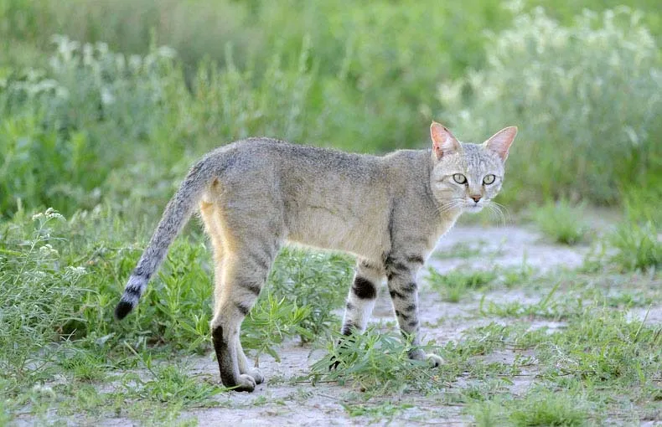
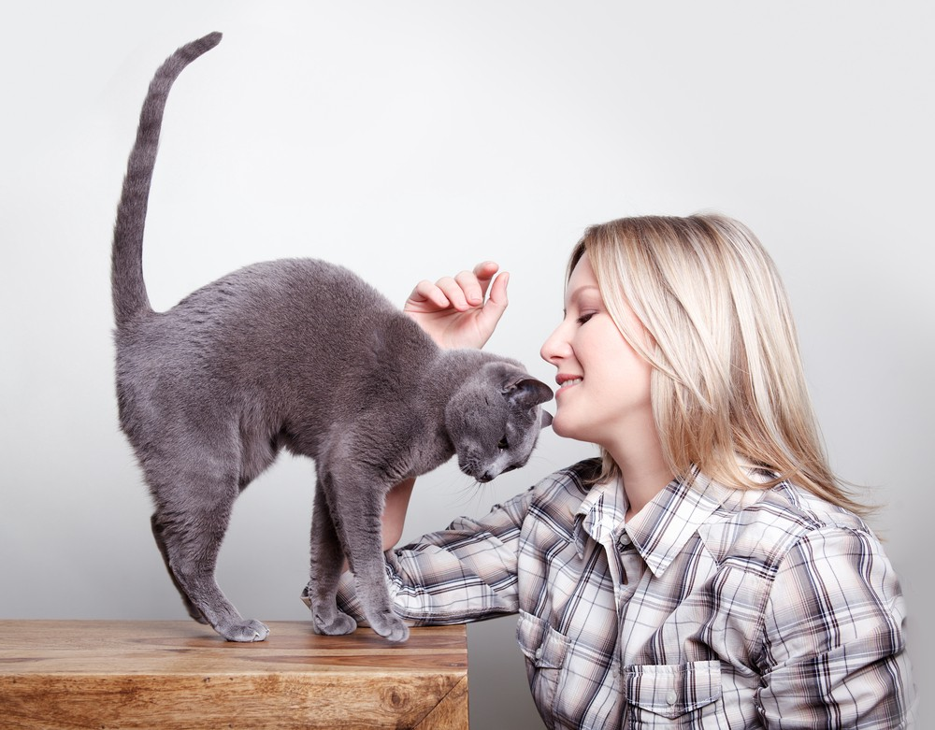
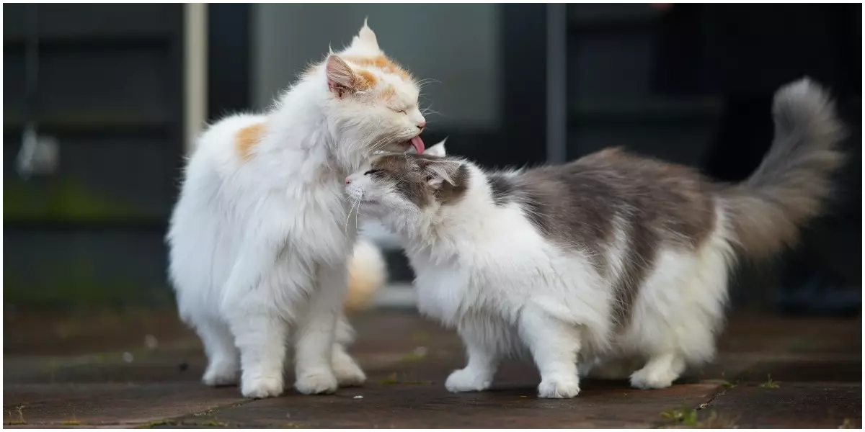
Domestic Cat
Solitary ancestor (African Wild cat)
Unique in terms of social relationships
Not socially obligate

Slide 4
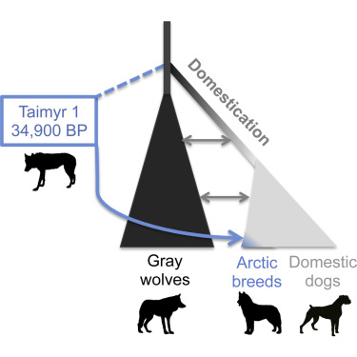
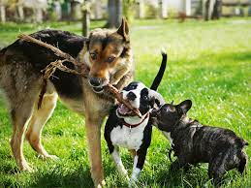
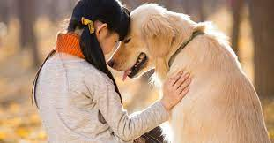
Domestic Dog
Socially obligate
Limited intraspecies cooperation
High cooperation ability with humans

Slide 5
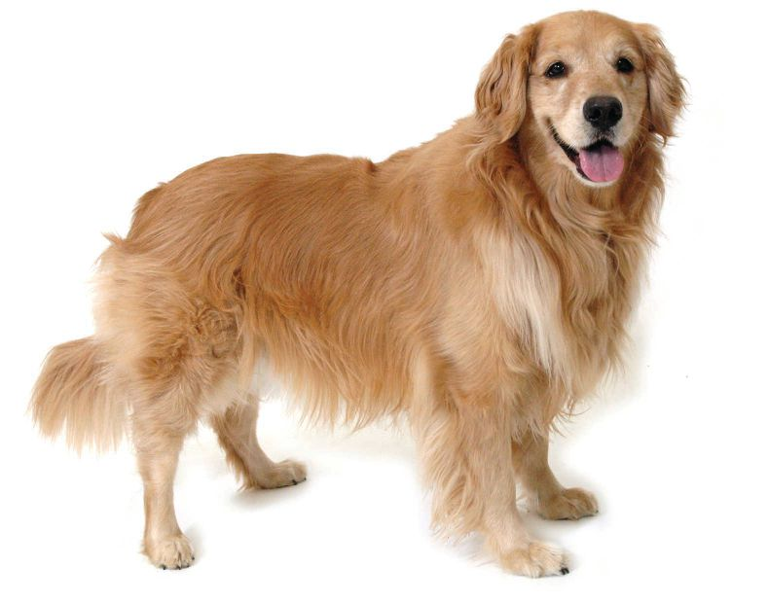
READING DOG BODY LANGUAGE
Ear position
Head position
Gaze direction
Facial muscles
Lips (tension)
Tail posture

Slide 6
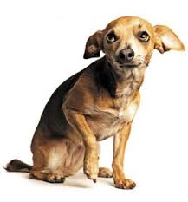
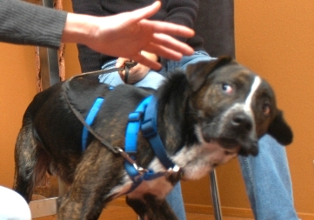
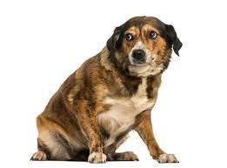
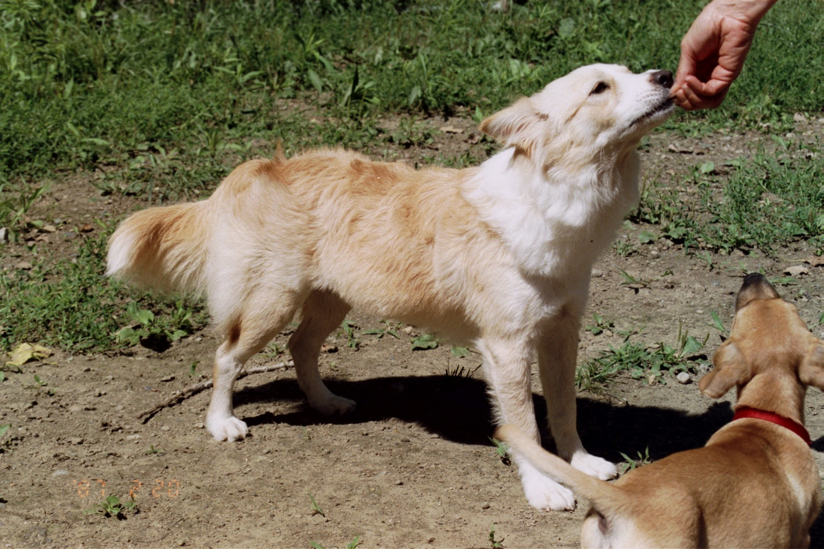
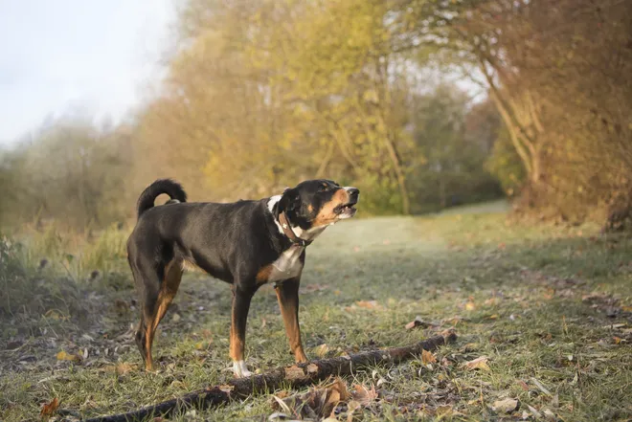
READING DOG BODY LANGUAGE

Slide 7
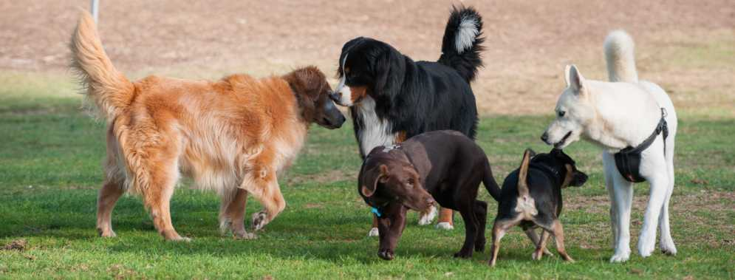
READING DOG BODY LANGUAGE

Slide 8
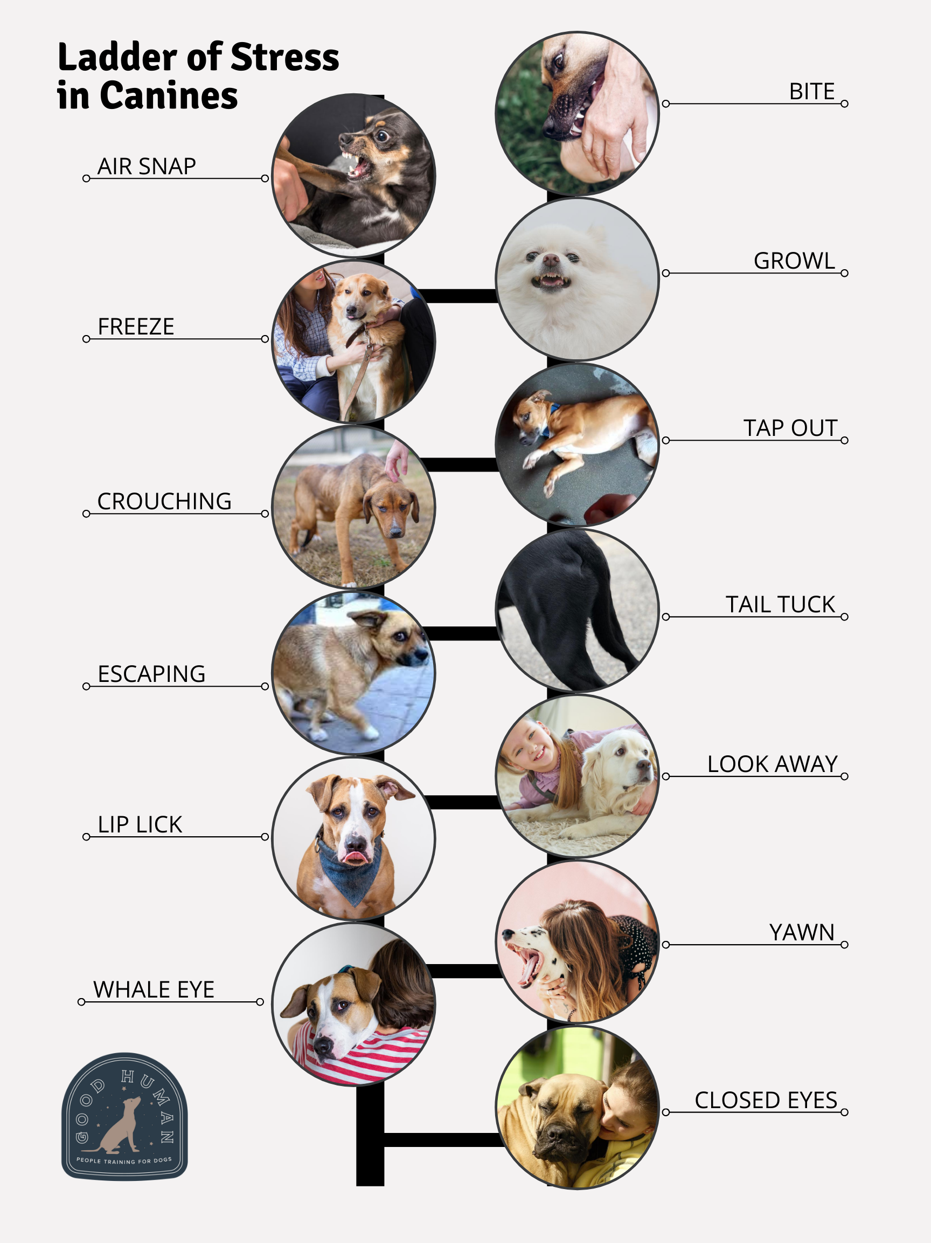
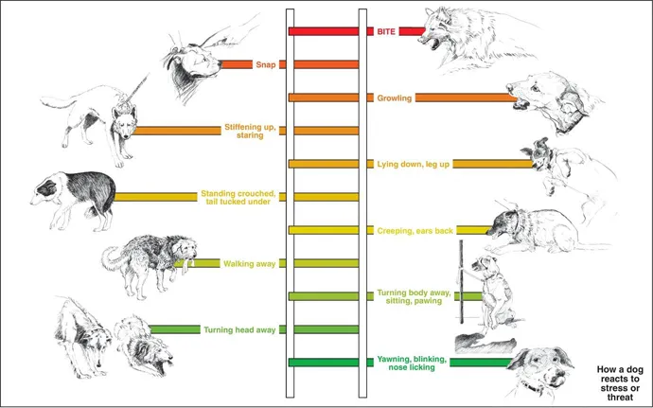
LADDER OF STRESS

Slide 9
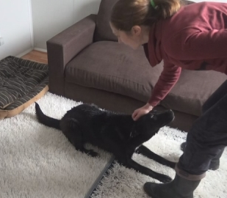
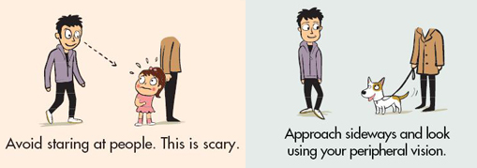
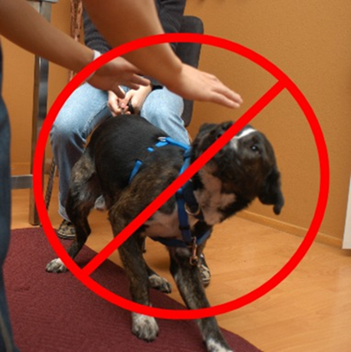
GREETING A DOG
Ask permission
Avoid staring at the dog
Approach sideways

Slide 10
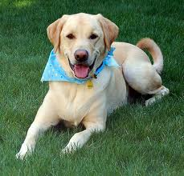
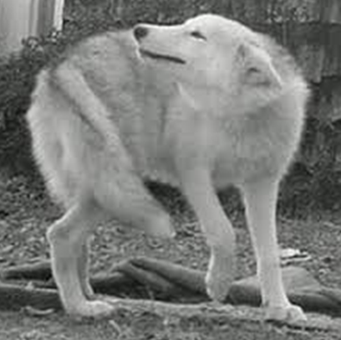
Respects subtle stress signs
Wait for dog’s approach

Slide 12
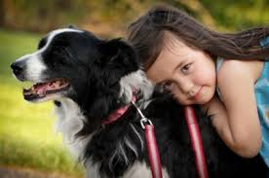
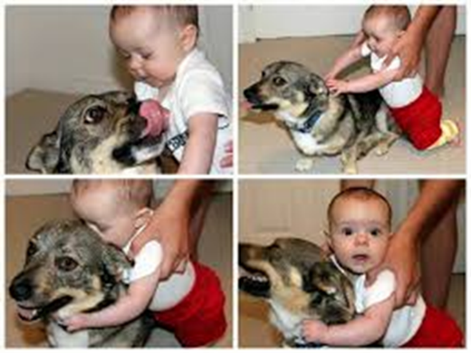
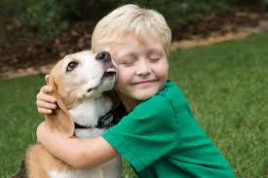
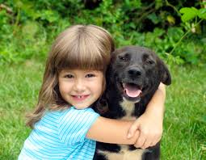
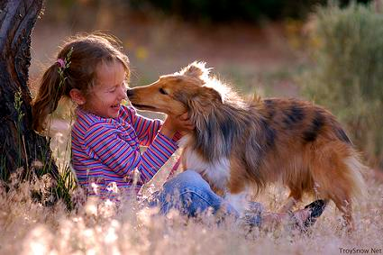
1
2
3
4
5

Slide 13
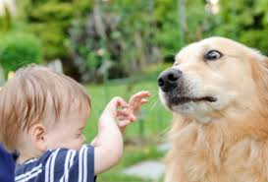
OTHER RULES
Stay calm-do not run/shout etc.
Dogs love chasing runners
Sudden movements may frighten the dog

Slide 14
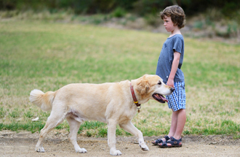
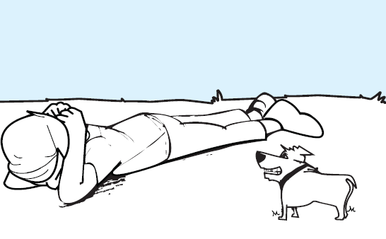
If an unfamiliar dog is approaching…

