Slide 1
GLASS packagIng MATERIALS
Instructor
Assist. Prof. Dr. Eda Demirok Soncu
E-mail: edemirok@eng.ankara.edu.tr
Phone: +90312 203 3300 (3639 ext.)
Office: 2nd floor #212
Fde 216 food packagıng

Slide 2
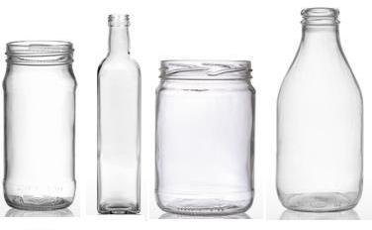
Glass packaging in food industry
Glass is defined as a mineral product obtained by melting
In the food industry, the two main types of glass containers are used for packaging
Bottles: They have narrow necks
Jars and pots: They have wide openings

Slide 3
Common composition of glass
Common glasses can have different chemical composition leading to their own color, thermal or mechanical resistance
The major components of glass material are
silica (SiO2), which is obtained from high purity sand
lime (CaO) from limestone (calcium carbonate)
soda (Na2O), which is provided from soda ash
alumina (Al2O3)
magnesia (MgO)
potash (K2O)
cullet which is a recycled broken glass

Slide 4
The functions of compounds used in glass materials
INGREDIENTS FUNCTIONS

Slide 5
Composition of glass with different color
 | INGREDIENTS
 | Silica (SiO₂) | Lime (CaO) | Soda (Na2O) | Iron oxide (Fe2O3) | Chromium oxide (Cr2O3) | Carbon | Cobalt
White flint (clear glass) | (+) 72% | (+) 12% | (+) 12%
Pale green (half white) | (+) | (+) | (+) | (+)
Dark green | (+) | (+) | (+) | (+) | (+)
Amber | (+) | (+) | (+) | (+) |  | (+)
Blue | (+) | (+) | (+) | (+) |  |  | (+)

Slide 6
Advantages of glass packaging materials (regarding food quality and safety)
Heat processable: Glass is thermally stable, which makes it suitable for the hot-filling (e.g. canned vegetables) and the in-container heat sterilization and pasteurization of food products (e.g. canned fruits, canned pickles)
Glass has great thermal strenght which means glass bottles or jars is the capability to withstand sudden thermal changes during process (e.g. immediate cooling just after pasteurization/sterilization). The presence of boron and aluminum oxides in the glass composition increases thermal strenght

Slide 7
Advantages of glass packaging materials (regarding food quality and safety)
UV-protection: Dark colored glass materials (especially amber) are used to protect of light sensitive food products from UV-light
Chemical integrity: Glass is chemically resistant to all food products, both liquid and solid. In other words, it is possible to note that glass is inert. Additionally, it is odourless
Hygiene: Glass surfaces are easily wetted and dried during washing and cleaning prior to filling

Slide 8
Advantages of glass packaging materials (other functional properties)
Quality image: Consumers want to buy glass packaged products and they are ready to pay a premium for them, for specific products such as spirits and liqueurs
Transparency: It provides an opportunity for the consumers to be able to see the product
Color: This properties provide different look at first sight
Design potential: Characteristic shapes are often used to enhance product and brand recognition

Slide 9
Advantages of glass packaging materials (other functional properties)
Microwaveable: Glass is open to microwave penetration and food can be reheated in the container
Strenght: Although glass is a brittle and heavy material, its strenght properties make it easy to handle during filling and distribution
Environmental benefits: Glass containers are returnable, reusable and recyclable

Slide 10
Production stages of glass material
1) Melting
2) Container forming
3) Surface treatments
3.1) Hot end treatment
3.2) Cold end treatment
3.3) Container inspection and
quality

Slide 11
Step 1) MELTING
After materials, which are silica, lime and soda, are mixed, this composition is melted in a furnace at temperatures of around 1350°C
Then, the molten glass is allowed to flow through a temperature controlled channel to the forming machine

Slide 12
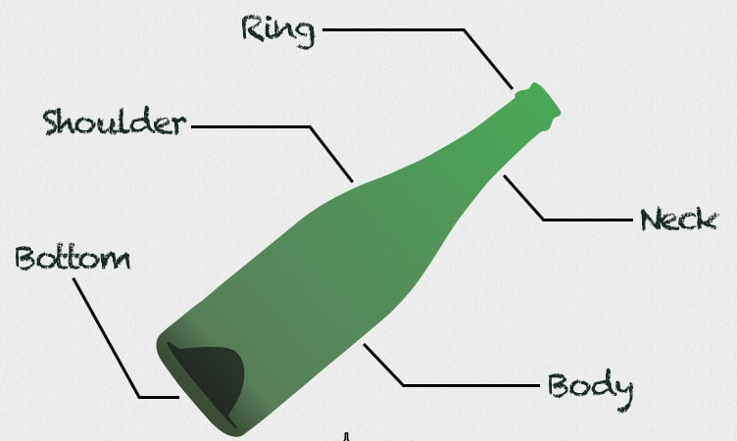
Parts of the glass bottle
Tilt angle

Slide 13
Step 2) CONTAINER FORMING
In the feeder, the molten glass is extruded through an orifice of known diameter at a predetermined rate
Then, it is cropped into a solid cylindrical shape (This cylinder of glass is known in the trade as a gob)
The gob is allowed to free-fall into the forming machine, where it enters the parison
The parison comprises a neck finish mould and a parison mould

Slide 14
Step 2) CONTAINER FORMING
The parison is formed by either pressing or blowing the gob to the shape of the parison mould
Then, the parison is inverted and placed into the final mould and blown out to the shape of the final mould

Slide 15
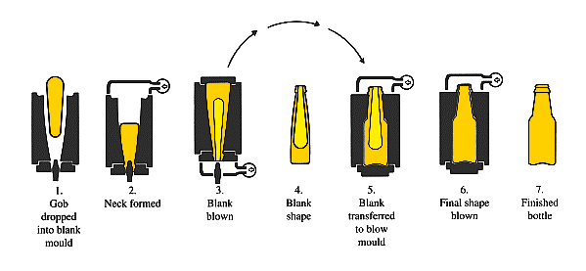
Forming of glass bottle

Slide 16
Step 2) CONTAINER FORMING
There is two different way to produce glass material
press and blow process, which is generally used for jars with a neck finish size of ≥35 mm
blow and blow process or narrow neck press and blow process, which is usually used for bottles with a neck finish size of ≤35mm

Slide 17
Step 2) CONTAINER FORMING
Additionally, during forming process, arrangement of tilt angle is another crucial step for the stability degree of glass materials
Tilt angle should be ≥22° for a wide-mouthed jar
Tilt angle should be ≥16° for a bottle

Slide 18
Step 3) SURFACE TREATMENTS
After forming process is completed, three following stages are applied to the glass container
Hot end treatment
Cold end treatment
Container inspection and quality

Slide 19
Step 3.1) HOT END TREATMENT
The purpose of hot end surface treatment is to prevent surface damage whilst the bottle is still hot and to help maintain the strength of the container
The most common coating material deposited is tin oxide
Sometimes, derivatives of titanium are also used; although, it tends to generate more high friction surfaces. In this condition, lubricant (a greasy compound) is added in order to overcome this problem

Slide 20
Step 3.2) COLD END TREATMENT
Cold end treatment process applied by spray or vapour of lubricants into the container
The most commonly lubricants are derivatives of polyester waxes or polyethylene
This process has two crucial purposes
The first purpose is to create a lubricated surface that does not break down under the influence of pressure or water
The second one is to help the flow of containers through a high speed filling line

Slide 21
Step 3.3) CONTAINER INSPECTION AND QUALITY
Quality assurance is needed to ensure that consumer safety, brand owner’s needs and efficiency in handling, packing, distribution and purchasing stages
The techniques to quality control are defined in one of three categories
Chemical techniques
Physical techniques
Visual techniques

Slide 22
Chemical quality control techniques
Chemical testing by spectrophotometry, flame photometry and X-ray fluorescence is used to check raw materials and the finished glass
Small changes in the proportions of glass compounds and purity of raw materials can have a significant effect on processing conditions and physical properties (such as fragility)

Slide 23
Physical quality control techniques
Physical tests include checking dimensional tolerances, tests for color, impact strength, thermal shock resistance and internal pressure strength

Slide 24
Visual quality control techniques
Visual tests check for defects that can be seen with neck eyes
These defects are detected by automatic monitoring system with multiple cameras
Visual defects comprise various types of cracks, foreign bodies, material contamination from the process environment and mis-shapes

Slide 25
Visual quality control techniques
Visual defects are classified as follow
Critical defects which endanger the consumer or prevent use in packaging
Major defects which seriously affect efficiency in packing
Minor defects that relate to appearance even though the container is functionally satisfactory

Slide 26
Closure selection
Closures for glass packaging containers are usually metal or plastic, though cork is still widely used for wines and spirits
Effective sealing is achieved either by a tight fitting plug, a screw threaded cap applied with torque in one of several ways or a metal cap applied with pressure

Slide 27
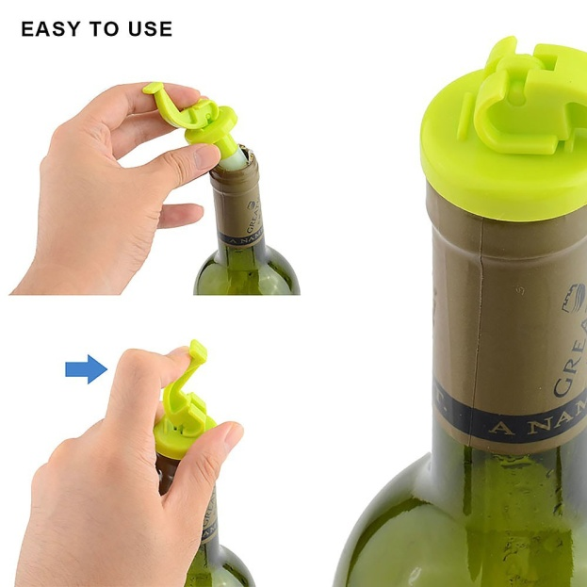
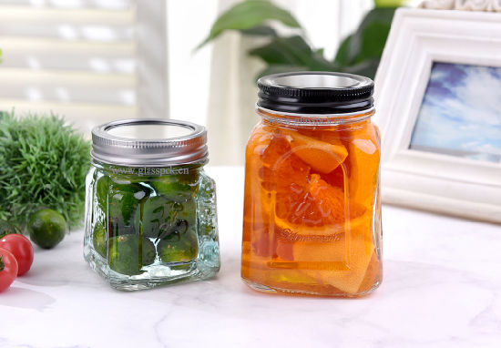
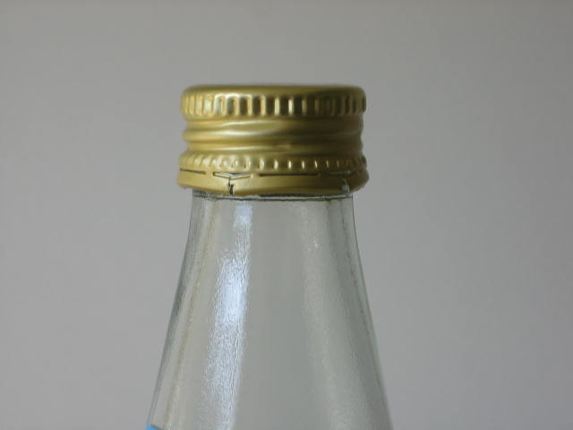
Different types of closures
Air-tight fitting plug
Metal caps
Screw caps

Slide 28
Closure selection
Careful choice of closure is essential. Too large closure can create leakage, while too small closure may not fit with glass material
Three types of closure are used in the food industry today
Normal seal
Vacuum seal
Pressure seal

Slide 29
Normal, vacuum or pressure seals
Normal seals are applied to non-vacuum/non-pressure filled products such as coffee, milk powders, milk, yoghurts, peanut butter or chocolate spreads
Metal closures are used for vacuum seals. They can be pressed or twisted on glass while vacuum is created by flushing the headspace air with steam. Vacuum seal is used during in-bottle pasteurization and sterilization
Pressure seals can be metal or plastic lid, which is pressed or twisted on glass

Slide 30
Production process of glass
Youtube link: https://www.youtube.com/watch?v=Us2Ahku3Xws

Slide 31
References
Coles R. et al. (2003). Food Packaging Technology. Blackwell Publishing and CRC Press. (in Chapter 6 pages 152-173)
Piergiovanni, L. & Limbo, S. (2016). Food Packaging Materials. Springer. (in Chapter 2 pages 6-10)

