Slide 1
Evrim, Kurumlar ve İktisat Kuramı: Thorstein Veblen
Altug Yalcintas
Ankara University
altug.yalcintas@politics.ankara.edu.tr

Slide 2
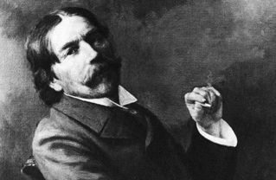
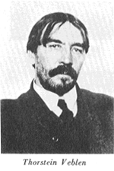
Thorstein B. Veblen (1857-1929)

Slide 3
Thorstein B. Veblen (1857-1929)
A Norwegian-American
PhD, Yale University
PhD thesis on Kant (lost!)
Lecturer at Cornell, Stanford, Missouri, Chicago, and Newschool
Never become a full professor
Known for his personal affairs with women
Known as an influential social critic
Editor of the Journal of Political Economy
Rejected the presidency of the American Economic Association (1924)

Slide 4
Thorstein B. Veblen (1857-1929)
Veblen as a social critic
Iconoclastic assaults on captains of industry and leisure class in the American society
Veblen as an economist
Powerful attacks of Marx, marginalism in economics
Veblen as a sociologist
Determinants of social change and social intertia
Veblen as the first-ever evolutionary social theorist
Significance of habits and instincts in his social analyses

Slide 5
Thorstein B. Veblen (1857-1929)
Influences:
Marx: class conflict
Spencer and Darwin: evolutionary theory, «survival of the fittest», critique of teleology,
American pragmatists and psychologists: C. Sanders Peirce, John Dewey, and William James

Slide 6
Thorstein B. Veblen (1857-1929)
What is it that survives in the society and the economy?
(«unit of selection»)
Biology | Economics
Species | Institutions

Slide 7
Thorstein B. Veblen (1857-1929)
Biology | Economics
Species | Institutions
On the Origin of Species
Evolution in natural life
On the Origin of Institutions
Evolution in social and economic life

Slide 8
Thorstein B. Veblen (1857-1929)
What is an institution?*
Families, universities, religion, sciences, bureaucracy, law, business firms, for-profit organizations, non-profit organizations, nations, conventions, routines, ideologies,
* Formal definitions are postponed in this class
to a later stage for practical purposes

Slide 9
Thorstein B. Veblen (1857-1929)
How do institutions operate?
Interaction and hierarchy among institutions
Business firms
Employing people
Law
Signing contracts
Bureaucracy
Papers and documents
Nation State
International Law
Military
…
…
…

Slide 10
Thorstein B. Veblen (1857-1929)
How do institutions operate?
Interaction and hierarchy among institutions
Business firms
Employing people
Law
Signing contracts
Bureaucracy
Papers and documents
Nation State
International Law
Military
…
…
…

Slide 11
Thorstein B. Veblen (1857-1929)
How do institutions operate?
Interaction and hierarchy among institutions
Business firms
Employing people
Law
Signing contracts
Bureaucracy
Papers and documents
Nation State
International Law
Military
…
…
…

Slide 12
Thorstein B. Veblen (1857-1929)
How do institutions operate?
Interaction and hierarchy among institutions
This interaction and hierarchy is:
Complex, multi-directional, and cumulative (or circular)

Slide 13
Thorstein B. Veblen (1857-1929)
What are institutions made of?
HABITS and INSTINCTS

Slide 14
Thorstein B. Veblen (1857-1929)
Habits: washing your teeth before going to bed, turning on your TV as you arrive home, checking your emails as you arrive at your office, congratulating friends on anniversaries, calling your friends at their birthdays, going to the same bank, drawing the same amoung of Money from the ATMs, using Internet Explorer or Google Chrome, sitting in the same chair in the classroom etc.
Instincts: parenthood, workmanship, and idle curiosity

Slide 15
Thorstein B. Veblen (1857-1929)
Habits: washing your teeth before going to bed, turning on your TV as you arrive home, checking your emails as you arrive at your office, congratulating friends on anniversaries, calling your friends at their birthdays, going to the same bank, drawing the same amoung of Money from the ATMs, using Internet Explorer or Google Chrome, sitting in the same chair in the classroom etc.
Instincts: parenthood, workmanship, and idle curiosity

Slide 16
Thorstein B. Veblen (1857-1929)
How do instincts and habits operate?
Habits
Institutions
Instincts

Slide 17
Thorstein B. Veblen (1857-1929)
Institutions
Habits
Instincts
INDIVIDUAL and SOCIAL BEHAVIOUR

Slide 18
Thorstein B. Veblen (1857-1929)
What is the significance of individual and social behaviour
which is a product of institutions, habits, and instincts?
Consequences cannot always be designed
Or the issue of spontaneity
No direction of change
Or the issue of non-teleology
Often, conservative in nature
Or the issue of inertia

Slide 19
Thorstein B. Veblen (1857-1929)
What is the significance of individual and social behaviour
which is a product of institutions, habits, and instincts?
Markets are dependent on the ways in which institutions, habits, and instincts operate and interact
Individuals and societies are not always rational.
Consequences of individual and social behaviour are not always efficient and optimal

Slide 20
Thorstein B. Veblen (1857-1929)
Consumption as an institution
An orthodox definition of economics: the science of the allocation of «limited resources» among «unlimited needs.»
Is it always needs that really matter when we consume commodities?
Or, do wants and desires matter, too?

Slide 21
Thorstein B. Veblen (1857-1929)
Consumption as an institution
When wants and desires matter,
Consumption is not only consumption.
Individuals consume for conspicuous purposes, too!

Slide 22
Thorstein B. Veblen (1857-1929)
What is conspicuous consumption?
Spending money on luxury
goods for purposes of social display
Emulation as an evolutionary
mechanism (or instinct-?)
Desire for status, provoking envy
Fashion, make-up, alcohol,
drug, sports, higher education,
Leisure Class

Slide 23
Thorstein B. Veblen (1857-1929)
What (who) is leisure class?
An elite social strata in which individuals can afford not to work
Useless practices of consumerism or conspicuous consumption
Hedonistic behaviour: Seeking pleasure at all times.

Slide 24
Thorstein B. Veblen (1857-1929)
What (who) is leisure class?
An elite social strata in which individuals can afford not to work
Useless practices of consumerism or conspicuous consumption
Hedonistic behaviour: Seeking pleasure at all times.
Check out Slide 19, bulletins 5 and 6:
«Irrationality» and «inefficiency»

Slide 25
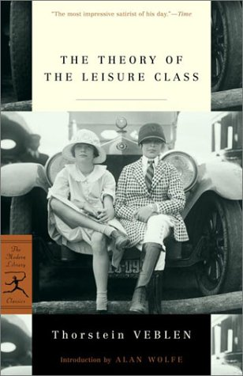
Thorstein B. Veblen (1857-1929)
What (who) is leisure class?
Cover pages of Veblen’s The Theory
of Leisure Class (1899)

Slide 26
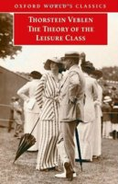
Thorstein B. Veblen (1857-1929)
What (who) is leisure class?
Cover pages of Veblen’s The Theory
of Leisure Class (1899)

Slide 27
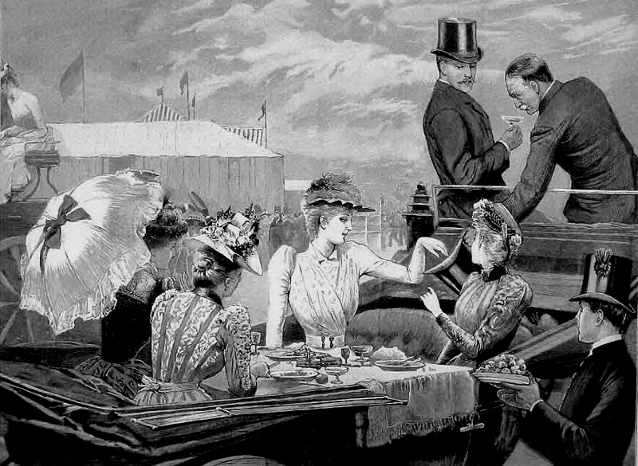
Thorstein B. Veblen (1857-1929)
What (who) is leisure class?
Further representations

Slide 28
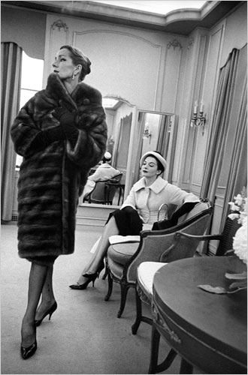
Thorstein B. Veblen (1857-1929)
What (who) is leisure class?
Further representations

Slide 29
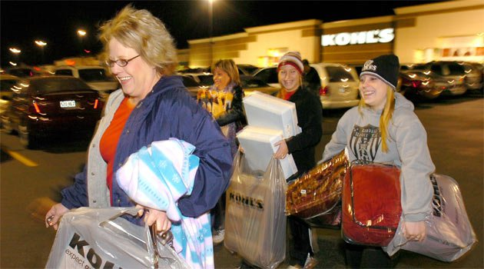
Thorstein B. Veblen (1857-1929)
What (who) is leisure class?
Further representations

Slide 30
Thorstein B. Veblen (1857-1929)
What (who) is leisure class?
Further representations

Slide 31
Thorstein B. Veblen (1857-1929)
Shopping Malls
Alışveriş Merkezleri (AVMs)
Centres of consumerism

Slide 32
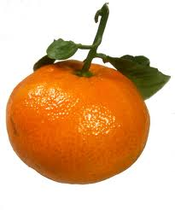
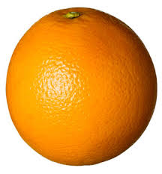
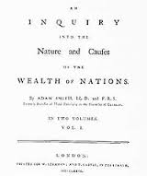
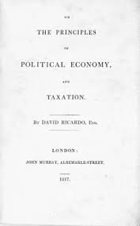
Question 1: Where are the transitional species?
Question 2: How come that two different species exist simultanously?

