Slide 1
CULTURAL POETICS
OR
NEW HISTORICISM

Slide 2
NEW CRITICISM
During the 1940s, 1950s, and 1960s, New Criticism was the dominant approach to literary analysis.
New Criticism regards a literary text as an artifact with an existence of its own, independent of and not necessarily related to its author, its readers, the historical time it depicts, or the historical period in which it was written.
A text's meaning emerges when readers scrutinize the text alone.

Slide 3
For the New Critics, a literary text is highly structured and con­tains its meaning within itself.
Such an analysis, say the New Critics, is particularly rewarding because literature offers us a unique kind of knowledge and presents us with the deepest truths related to humanity, truths that science is unable to disclose.

Slide 4
What New Criticism did not provide for Greenblatt and other critics was an attempt to understand literature from a historical perspective. In a New Critical analysis, the text was what mattered, not its historical context.
In addition, Greenblatt believed that questions concerning the nature and definition of literature were not encouraged.

Slide 5
OLD HISTORICISM
* This view assumes that historians can write objectively about any given historical time period, person, event, or text and are able definitively to state the objective truth about that person, era, occurrence, or text.

Slide 6
NEW HISTORICISM
That historians can articulate a unified and internally consistent worldview of any given people, country, or era and can reconstruct an accurate and objective picture of any historical event are key assumptions that Cultural Poetics or New Historicism challenges.

Slide 7
Appearing as an alternate approach to textual interpretation in the 1970s and early 1980s, Cultural Poetics—often called New Historicism in America and Cultural Materialism in Great Britain—declares that all history is subjective, written by people whose per­sonal biases affect their interpretation of the past.

Slide 8
Edward Hallet Carr ,‘’Tarihin olguları hiçtir, yorum ise her şeydir’’ diyerek bu konudaki görüşünü ortaya koyar. Carr’a göre; bir tarih eserini ele alınca, ilk ilgilenmemiz gereken şey içindeki olgular değil, onu yazan tarihçi olmalıdır. Olguları incelemeden önce tarihçiyi incelemeyi elzem bulur.

Slide 9
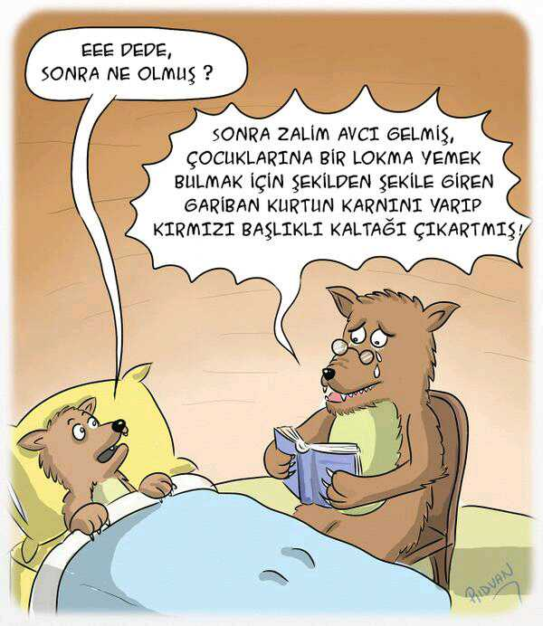

Slide 10
*Cultural Poetics asserts, history can never provide us with the objective truth of or give us a totally accurate picture of past events, persons, or eras nor the worldview of a group of people.
*Disavowing the old historicism's autonomous view of his­tory, Cultural Poetics declares that history is one of many discourses, or ways of seeing and thinking about the world.

Slide 11
Cultural Poetics claims that it provides its adherents with a practice of literary analysis that:
Highlights the interrelatedness of all human activities.
Admits its own prejudices.
Gives a more complete understanding of a text than does the old Historicism and other interpretative approaches.

Slide 12
HISTORICAL DEVELOPLMENT
In the inaugural issue, D.A. Miller, a leading New Historicist, published his essay "Discipline in Different Voices: Bureaucracy, Police, Family and Bleak House" In this essay, he declares two of New Historicism's major tenets: Literary texts are embedded in social and politi­cal discourses, and all literary texts are vehicles of power. In the next issue of Representations, another leading New Historicist, Louis Montrose, published his essay "Shaping Fantasies," reiterating and expanding upon Miller's declaration that literary texts are seats of power. The same year Representations was issued,- another major New Historical text, James I and the Politics of Literature, authored by Jonathan Goldberg, asserted that different historical eras develop different "modes of power," with each epoch viewing reality differently, including conflicting concepts of truth.

Slide 13
New Historicists claim, literature should be read in relation to culture, his­tory, society, and other factors that help determine a text's meaning.

Slide 14
In his article «Towards a Poetics of Culture.(1987)» Greenblatt asserts that art and society are interrelated, but no scholar can use just one theoretical stance (or school of criticism) to discover this complex web of interrelationships. New Historicism should therefore be viewed as a reading practice, says Greenblatt, not a school of criticism, because when texts and their relationship to society are investi­gated, an array of often conflicting social and literary patterns evolves that
demonstrate how art affects society and how society affects art.

Slide 15
* How literature was formed, whose interest it serves, and what the term literature really means. Do contemporary issues and the cultural milieu (environment) of the times operate together to create literature, they wondered, or is literature an art form that will always be with us?

Slide 16
Deconstruction, Marxism, Fem­inism, and Lacanian psychoanalysis began to challenge the assumptions of New Criticism. Rejecting New Criticism's claim that the meaning of a text can be found mainly in the text, poststructural theorists had been developing a variety of theoretical positions about the nature of the reading process, the part the reader plays in that process, and the definition of a text or the actual work of art. Among these multitude voices, Cultural Poetics arose.

Slide 17
From the Marxist scholars—Georg Lukacs, Walter Benjamin, Raymond Williams, and others—they learned that history is shaped by the people who live it, and they accepted the Marxist idea of the interconnected­ness of all life. They also believed that what we do with our hands and how we make our money do affect how and what we think.

Slide 18
Unlike many of the poststructuralist theories—especially deconstruction—Cultural Poetics struggled to find a way out of
undecidability, or aporia, about the nature of reality and the interpretation
of a text. Although not denying that many factors affect the writing, the
production, and the publication of texts, New Historicists sought to move
beyond undecidability rather than simply asserting that a text has many
possible meanings. In doing so, they challenged the assumptions of the old
historicism, which presupposed historians could actually write an objective
history of any situation. In addition, they redefined the meaning of a text
and asserted that all critics must acknowledge and openly declare their
own biases.

Slide 19
Throughout the 1980s and 1990s, critics such as Catherine Gallagher, Jonathan Dollimore, Jerome McGann, Stephen Greenblatt, to name a few, voiced their concerns that the study of literature and its relationship to history has been too narrow.
Viewing a text as culture in action, these critics blur the distinction between an artistic production and any other kind of social production or event.

Slide 20
Cultural Poetics:
Cultural Materialism.
2) New Historicism.

Slide 21
Cultural Materialism New Historicism
* Call for a reawakening of our historical consciousness.
* Declare that history and literature must be seen as disciplines to be analyzed together.
* Place all texts in their appropriate contexts.
* Believe that while we are researching and learning about different societies that provide the historical context for various texts, we are simultaneously learning about ourselves, our own habits, and our own beliefs.

Slide 22
CULTURAL MATERIALISM
Marxist in its theories and political and cultural in its aims.
Believing that literature can serve as an agent of change, cultural materialists declare that a culture's hegemony is unstable.

Slide 23
NEW HISTORICISM
New Historicism is the name given to the American branch of Cultural Poetics.
One of its originating voices, Greenblatt, along with a host of other scholars, believes that one's culture permeates both texts and critics.

Slide 24
Because all critics are influenced by their culture, New Historicists believe that none of us can escape public and private cultural influences.

Slide 25
Like other poststructuralist practices, Cultural Poetics begins by challenging the long-held belief that a text is an autonomous work of art that contains all elements necessary to arrive at a supposedly correct interpretation.

Slide 26
Unlike the old historicism, this New Historicism, or Cultural Poetics, asserts that an intricate connection exists between an aesthetic object—a text or any work of art—and society, while denying that a text can be evaluated in isolation from its cultural context.

Slide 27
We must know, it declares, the societal concerns of the author, of the historical times evidenced in the work, and of other cultural elements exhibited in the text before we can devise a valid interpretation.

Slide 28
Michel Foucault
Unlike many past historians, Foucault declares that history is not linear (i.e. it does not have a definite beginning, a middle, and an end) nor is it necessarily teleological (i.e., purposefully going forward toward some known end).

Slide 29
History cannot be explained as a series of causes and effects controlled by some mysterious destiny or an all-powerful deity.

Slide 30
For Foucault, history is the complex interrelationship of a variety of discourses, the various ways—artistic, social, political, and so on—that people think and talk about their world.

Slide 31
How these discourses interact in any given historical period is not random. Rather, the interaction is dependent on a unifying principle (or pattern) Foucault calls the episteme—that is, through language and thought, each period in history develops its own perceptions concerning the nature of real­ity (or what it defines as truth), sets up its own acceptable and unacceptable standards of behavior; establishes its own criteria for judging what it deems good or bad; and certifies what group of people develop, articulate, protect, and defend the yardstick whereby all established truths, values, and actions will be deemed acceptable.

Slide 32
To unearth the episteme of any given historical period, Foucault borrows techniques and terminology from archaeology. Just as an archaeologist must slowly and meticulously dig through various layers of earth to uncover the symbolic treasures of the past, historians must expose each layer of discourse that comes together to shape people's episteme.

Slide 33
As an archaeolo­gist must date each finding and then piece together the artifacts that define and help explain that culture, so must the historian piece together the various discourses and their interconnections among themselves and with nondiscursive practices—any cultural institution such as a form of government, for example—that will assist in articulating the episteme under investigation.

Slide 34
From this point of view, history is a form of power. Because each era or people develop their own episteme, the episteme actually controls how that era or group of people views reality. History, then, becomes the study and unearthing of a vast, complex web of interconnecting forces that ultimately determines what takes place in each culture or society.

Slide 35
Foucault asserts that the abrupt and often radical changes that cause breaks from one episteme to another are neither good nor bad, valid nor invalid. Similar to the discourses that help produce them, different epistemes exist in their own right; they are neither moral nor immoral, but amoral.

Slide 36
According to Foucault, historians must realize that they are influenced and prejudiced by the episteme(s) in which they live. Because their thoughts, customs, habits, and other actions are colored by their epistemes, historians can never be totally objective about their own or any other historical period.

Slide 37
To be a historian, Foucault asserts, means one must confront and articulate one's own set of biases before examining the various discourses or the mate­rial evidence of past events that comprise an episteme of any given period.

Slide 38
Such an archaeological examination of the various discourses, Foucault believes, will not unearth a monological view of an episteme (i.e., one that presupposes a single, overarching, political vision or design); instead, this kind of examination will reveal a set of inconsistent, irregular, and often con­tradictory discourses that will explain the development of that episteme, including which elements were accepted, changed, or rejected to form the "truth" and to set the acceptable standards for that era.

Slide 39
Clifford Geertz
There exists "no human nature independent
of culture," culture being defined by Geertz as "a set of control mechanisms— plans, recipes, rules, instructions," for governing behavior.

Slide 40
Each person must be viewed as a cultural artifact.

Slide 41
How each person views society is always unique because there exists what Geertz calls an "information gap" between what our body tells us and what we have to know in order to function in society. This gap also exists in society because society cannot know everything that happens among all its people.

Slide 42
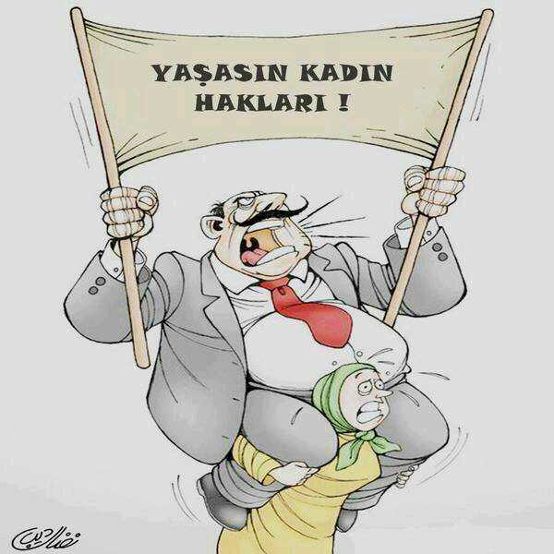

Slide 43
Cultural Poetics also adapts Geertz's anthropological methodology for describing culture, thick description.

Slide 44
Thick description describes the seemingly insignificant details present in any cultural practice. By focusing on these details, one can then reveal the inherent contradictory forces at work within a culture.

Slide 45
Texts, History, and Interpretation
Because texts are simply one of many elements that help shape a culture, Cultural Poetics critics believe that all texts are really social documents that reflect but also, and more importantly, respond to their historical situation.

Slide 46
Since any historical situation is an intricate web of often competing discourses, Cultural Poetics scholars center history, declaring that any interpretation of a text would be incomplete if we do not consider the text's relationship to the discourses that helped fashion it and to which the text is a response.

Slide 47
From this point of view, a text becomes a battleground of compet­ing ideas among the author, society, customs, institutions, and social prac­tices that are all eventually negotiated by the author and the reader and influenced by each contributor's episteme.

Slide 48
For a Cultural Poetics critic, everything we do is interrelated to and within a network of practices embedded in our culture. No act is insignificant; everything is important.

Slide 49
In our search to attach meaning to our actions,
Cultural Poetics critics believe that we can never be fully objective because we are all biased by cultural forces.

Slide 50
Cultural Poetics critics maintain that we will discover not only the social world of the text but also the present-day social forces working upon us as we negotiate meaning with printed mater­ial. Like history itself, our interaction with a text is a dynamic, ongoing pro­cess that will always be somewhat incomplete.

Slide 51
WHAT CULTURAL POETICS REJECTS
Monological interpretations of a given culture, people, or historical era can accu­rately demonstrate that culture's beliefs and values.
A historian can establish the "norms" and the "truth" of any social order.
A writer or a historian can be totally objective.
Autonomous artifacts, including literary texts, can or do exist.

Slide 52
Literature is shaped only by historic moments, and that history serves as merely a background for literary study.
Only one correct interpretation of a text exists.

Slide 53
WHAT CULTURAL POETICS DOES AND ACCEPTS
It intentionally smudges the line between history and literature, believing that text (literature) and context (history) are the same and that literature has no his­tory of its own but is ensconced in cultural history.
It admits that definitive interpretations of a text are unattainable because relevant material is too far spread to gather exhaustively; we can never recover the original meaning of anything because we cannot hear all the voices that contributed to the event.

Slide 54
It recognizes that power affects literature as deeply as it does history.
It believes that texts, like all forms of discourse, help shape and are shaped by social forces.
It looks to single moments in history that may have influenced or been influenced by a literary text produced at the time, relying heavily on historical documents to discover these significant moments; by so doing, history can no longer be con­sidered simply "background" information for textual analysis but instead is an essential element in the interpretive process.

Slide 55
Literature is shaped by historical moments while also shaping the individual reader or listener to these texts.
One of the most important elements in textual analysis is discov­ering how a text was formed…
Writers, like texts, are subjected to social biases, cultural influences, and political agendas; hence, no writer or critic can ever be entirely objective.

Slide 56
METHODOLOGY
No matter their methodology, Cultural Poetics scholars begin by assuming that language shapes and is shaped by the culture that uses it.

Slide 57
By language, Cultural Poetics critics mean much more than spoken words.
Included in this definition of language is history. Like literature, writing, or other relationships that involve either a transfer or a relationship of power, history becomes a narrative discourse.

Slide 58
From this perspective, history and literature
are nearly synonymous, both being narrative discourses that interact with their historical situations, their authors, their readers, and their present-day cultures. Neither can claim a complete or an objective understanding of its
content or historical situation because both are ongoing conversations with their creators, readers, and cultures.

Slide 59
Meaning evolves from the interaction of the vari­ously interwoven social discourses, no hierarchy of discourses can exist; all discourses are necessary and must be investigated in the process of textual analysis.
The interpretative process must also include questions about the methodological assumptions for discerning meaning for each discourse and for every practitioner because no single discourse, method, or critic can reveal the one single truth about any social production in isolation from other discourses.

Slide 60
A text's meaning as perceived through the lens of Cultural Poetics resides in the cultural system composed of the interlocking discourses of its author, the text, and its reader.

Slide 61
To begin to understand a text's significance and to realize the complex social structure of which it is a part, Cultural Poetics critics declare that all three areas of concern must be investigated. If one area is ignored, the risk of returning to the old historicism, with its lack of understanding about a text as a social production, is unavoidable.

Slide 62
Anecdotes are well-preserved messages that most often come to us in their original state, unaltered by the ideologies of publishers or other institutions of preservation. As soon as they are gathered together, a collection of anecdotes reveals "counter-histories" or alternative perspectives of an incident or era presented by voices that usually go unheard in a monolithic interpretation of history.

Slide 63
Because Cultural Poetics views history and literature as social discourses and therefore battlegrounds for conflicting beliefs, actions, and customs, a text becomes "culture in action."

Slide 64
Cultural Poetics scholars believe that an investigation into these and similar happenings demonstrates the complex relationships that exist among all dis­courses and shows how narrative discourses such as history, literature, and other social productions interact with, define, and are, in turn, shaped by their culture. What we will learn by applying these principles and methodologies is that there is not one voice but many voices to be heard interpreting texts and our culture: our own voice, the voices of others, the voices of the past, the voices of the present, and the voices that will be in the future.

Slide 65
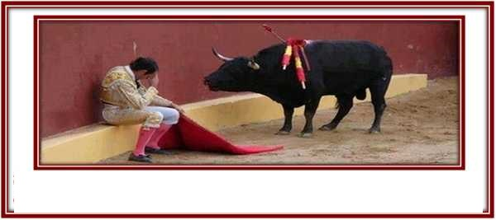

Slide 66
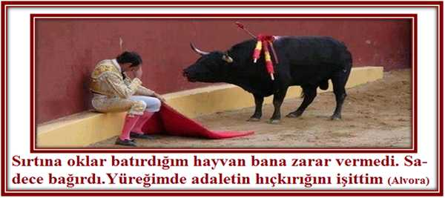

Slide 67
Dulce et Decorum Est
BY WILFRED OWEN
Bent double, like old beggars under sacks,
Knock-kneed, coughing like hags, we cursed through sludge,
Till on the haunting flares we turned our backs,
And towards our distant rest began to trudge.
Men marched asleep. Many had lost their boots,
But limped on, blood-shod. All went lame; all blind;
Drunk with fatigue; deaf even to the hoots
Of gas-shells dropping softly behind.
Gas! GAS! Quick, boys!—An ecstasy of fumbling
Fitting the clumsy helmets just in time,
But someone still was yelling out and stumbling
And flound’ring like a man in fire or lime.—
Dim through the misty panes and thick green light,
As under a green sea, I saw him drowning.

Slide 68
In all my dreams before my helpless sight,
He plunges at me, guttering, choking, drowning.
If in some smothering dreams, you too could pace
Behind the wagon that we flung him in,
And watch the white eyes writhing in his face,
His hanging face, like a devil’s sick of sin;
If you could hear, at every jolt, the blood
Come gargling from the froth-corrupted lungs,
Obscene as cancer, bitter as the cud
Of vile, incurable sores on innocent tongues,—
My friend, you would not tell with such high zest
To children ardent for some desperate glory,
The old Lie: Dulce et decorum est
Pro patria mori.
NOTES: Latin phrase is from the Roman poet Horace: “It is sweet and honorable to die for one’s country.”

Slide 69
From a New Historicist point of view, Owen's "Dulce et Decorum Est" both reveals and shapes its culture and is a no less authoritative account of the War than is a history textbook.
The dying soldier in Owen's "Dulce" is universal He is the everyman, the nameless recruit whose carefully studied face represents the tormented spirits of all those fated to see the hellish affairs of war.

Slide 70
Owen's poem stands as an example of a subversive voice that survived the powerful cultural forces that might have silenced its message of resistance.
War gores the spirit as well as the body, Owen insisted. The content of "Dulce et Decorum Est" was clearly implicated in its cultural milieu as it responds powerfully to the dominating rhetoric of the time.
Owen has changed us—and the world—with his words.

