Slide 1
IMMIGRATION INTO THE US
AKE 118
DR. GAMZE KATI GUMUS

Slide 2
Terminology
Migration: Moving
Immigration: Moving across national frontier
Xenophobia: dislike of or prejudice against people from other countries*
Nativism: the policy of protecting the interests of native-born or established inhabitants against those of immigrants*
Native
Native-born (native-born)
Naturalization: the admittance of a foreigner to the citizenship of a country*
Notes:
* Oxford Dictionaries

Slide 3
Why did Europeans migrate to the New World?
Faith
Empire
Economic gain

Slide 4
Push and Pull Theory in Immigration
Push : It refers to those forces existing in the place of origin that encourage or impel people to emigrate.
Irish potato famine, earthquakes, political (Nazis), economic pressures, growing population
Pull : It refers to those attractive forces emanating from the migrants’ goal that draw migrants.
Promises of political and religious freedom, economic gain
Means: It refers to the ability to migrate
Affordable transportation
The lack of restraints on mobility in the place of origin
The absence of effective barriers at the destination

Slide 5
Immigration Myths Believed by Most Americans

Slide 6
The Plymouth Rock
Most immigrants come for religious or political liberty

Slide 7
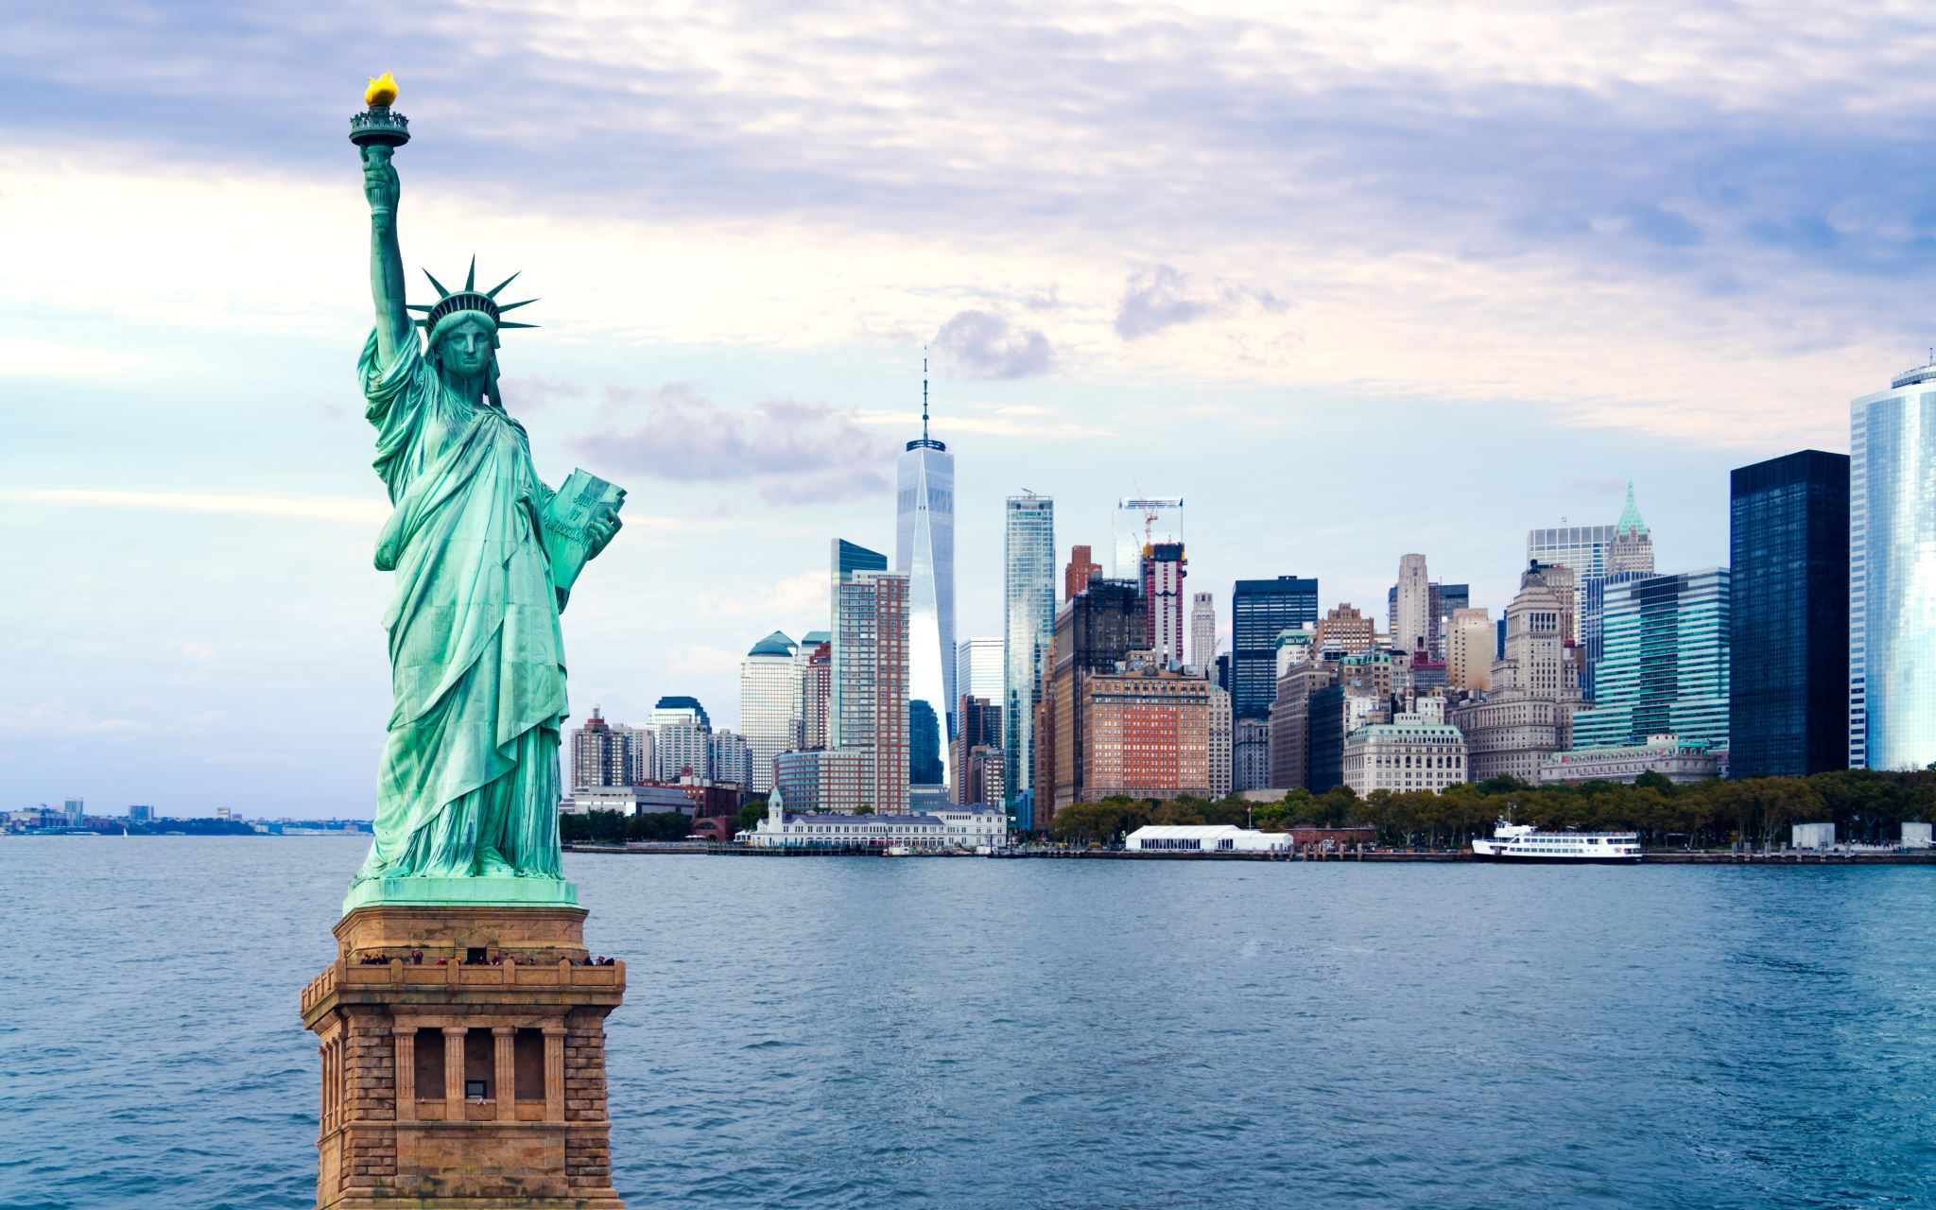
The Statue of Liberty
Most immigrants are extremely poor

Slide 8
The Melting Pot
In which nationalities and ethnic groups (but not races) would fuse into one.

Slide 9
Ravenstein’s Laws of Migration
Ernst Georg Ravenstein was a 19th century British social scientist

Slide 10
Ravenstein’s Laws of Migration
Migration is selective
Pull migrants tend to be positively selected whereas push migrants are negatively selected.
Pull migrants: conditions at home are not intolerable
Push migrants: would not have left home if they were not pushed out

Slide 11
Ravenstein’s Laws of Migration
People migrate at certain stages of the life cycle
Young people are more likely to migrate
E.g. Brain Drain

Slide 12
Ravenstein’s Laws of Migration
Migration follows precise patterns
Particular region , city, village sends migrants to particular regions

Slide 13
Ravenstein’s Laws of Migration
Migration has a counter-stream
Some immigrants return back to their place of origin

Slide 14
What is an American?

Slide 15
Crèvecoeur vs. Ravage

Slide 16
Transformation
British American
American

Slide 17
Race relations
Between the English and the Indians
Ethnocide: cultural suicide
Between whites and blacks
Slaves
Free blacks (codes, curfew, forbidden interracial marriage or sexual intercourse, etc.)

Slide 18
Ethnic Relations (What mattered?)
Race
Religion
Ethnicity
Social status

Slide 19
Observations Concerning the Increase of Mankind, Peopling of Countries, etc. By Benjamin Franklin (1751)
And since Detachments of English from Britain sent to America, will have their Places at Home so soon supply'd an increase so largely here; why should the Palatine Boors be suffered to swarm into our Settlements, and by herding together establish their Language and Manners to the Exclusion f ours? Why should Pennsylvania, founded by the English, become a Colony of Aliens, who will shortly be so numerous as to Germanize us instead of our Anglifying them, and will never adopt our Language or Customs, any more than they can acquire our Complexion. Which leads me to add one Remark: That the Number of purely white People in the World is proportionably very small. All Africa is black or tawny. Asia chiefly tawny. America (exclusive of the new Comers) wholly so. And in Europe, the Spaniards, Italians, French, Russians and Swedes, are generally of what we call a swarthy Complexion; as are the Germans also, the Saxons only excepted, who with the English, make the principal Body of White People on the Face of the Earth. I could wish their Numbers were increased. And while we are, as I may call it, Scouring our Planet, by clearing America of Woods, and so making this Side of our Globe reflect a brighter Light to the Eyes of Inhabitants in Mars or Venus, why should we in the Sight of Superior Beings, darken its People? why increase the Sons of Africa, by Planting them in America, where we have so fair an Opportunity, by excluding all Blacks and Tawneys, of increasing the lovely White and Red? But perhaps I am partial to the Complexion of my Country, for such Kind of Partiality is natural to Mankind.

Slide 20
Changing Standards of Naturalization
1790
Free whites “of good character,” who had been in the United States for at least two years could be naturalized in any American court
1795
Five years of residency
1798
(Alien and Sedition Acts): File a declaration of intention to become a citizen at least five years before becoming a citizen, fourteen years of residency, etc.
1801
Restored the requirements of 1795 Naturalization Act, five years of residency

Slide 21
Why naturalization mattered?
Without citizenship nonwhite residents could not
vote
own property
testify in court

Slide 22
US Immigration Timeline**
1819: The United States demands demographic information from captains under the Steerage Act
1820: Between 1820 and 1860, the Irish—many of them Catholic—account for an estimated one-third of all immigrants to the United States. Some 5 million German immigrants also come to the U.S., many of them making their way to the Midwest to buy farms or settle in cities
1849: The Know-Nothing Party was formed in opposition to the rising numbers of Irish and German immigrants
1880: As America begins a rapid period of industrialization and urbanization, a second immigration boom begins. Between 1880 and 1920, more than 20 million immigrants arrive. The majority are from Southern, Eastern and Central Europe, including 4 million Italians and 2 million Jews. Many of them settle in major U.S. cities and work in factories.
1882: The Chinese Exclusion Act passes, which bars Chinese immigrants from entering the U.S. Beginning in the 1850s, a steady flow of Chinese workers had immigrated to America. They worked in the gold mines, and garment factories, built railroads, and took agricultural jobs. The 1882 Act is the first in American history to place broad restrictions on certain immigrant groups.
1891: The Immigration Act of 1891 further excludes who can enter the United States, barring the immigration of polygamists, people convicted of certain crimes, and the sick or diseased.
Notes:
From History https://www.history.com/topics/immigration/immigration-united-states-timeline

Slide 23
US Immigration Timeline**
1892: Ellis Island opens
1907: Amid prejudices in California that an influx of Japanese workers would cost white workers farming jobs and depress wages, the United States and Japan sign the Gentlemen’s Agreement. Japan agrees to limit Japanese emigration to the United States to certain categories of business and professional men. In return, President Theodore Roosevelt urges San Francisco to end the segregation of Japanese students from white students in San Francisco schools.
1917: Xenophobia reaches new highs on the eve of American involvement in World War I. The Immigration Act of 1917 establishes a literacy requirement for immigrants entering the country and halts immigration from most Asian countries.
1924: The Immigration Act of 1924 limits the number of immigrants allowed into the United States yearly through nationality quotas. Under the new quota system, the United States issues immigration visas to 2 percent of the total number of people of each nationality in the United States at the 1890 census. The law favors immigration from Northern and Western European countries.
Notes:
From History https://www.history.com/topics/immigration/immigration-united-states-timeline

Slide 24
US Immigration Timeline**
1924: In the wake of the numerical limits established by the 1924 law, illegal immigration to the United States increases. The U.S. Border Patrol is established to crack down on illegal immigrants crossing the Mexican and Canadian borders into the United States. Many of these early border crossers were Chinese and other Asian immigrants, who had been barred from entering legally.
1942: Labor shortages during World War II prompt the United States and Mexico to form the Bracero Program, which allows Mexican agricultural workers to enter the United States temporarily.
1952: The McCarran-Walter Act formally ends the exclusion of Asian immigrants to the United States.
1965: The Immigration and Nationality Act overhauls the American immigration system. The Act ends the national origin quotas enacted in the 1920s which favored some racial and ethnic groups over others.
Notes:
From History https://www.history.com/topics/immigration/immigration-united-states-timeline

Slide 25
US Immigration Timeline**
2017: President Donald Trump issues two executive orders—both titled “Protecting the Nation from Foreign Terrorist Entry into the United States”—aimed at curtailing travel and immigration from six majority Muslim countries (Chad, Iran, Libya, Syria, Yemen, Somalia) as well as North Korea and Venezuela. Both of these travel bans are challenged in state and federal courts.
2018: In April 2018, the travel restrictions on Chad are lifted. In June 2018, the U.S. Supreme Court uphold a third version of the ban on the remaining seven countries.
Notes:
From History https://www.history.com/topics/immigration/immigration-united-states-timeline

Slide 26
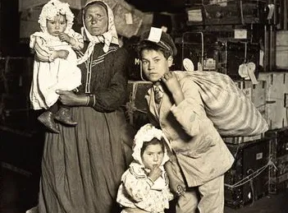
Notes:
Italian family arrives at Ellis Island-lost baggage, Lewis Hine Collection

