Slide 1
Evrim, Kurumlar ve İktisat Kuramı: Sıçramalı Denge Kuramı
Altug Yalcintas
Ankara University
altug.yalcintas@politics.ankara.edu.tr

Slide 2
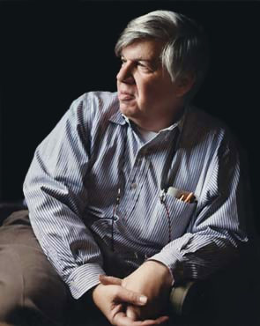
Stephan J. Gould
1941-2002
American paleontologist (a scholar who investigates into fossils) and popular science writer
Professor at Harvard U, New York U, and the American Museum of Hatural History
Punctuated equilibirum, life’s tape, exaptation, anti-progressivism etc.

Slide 3
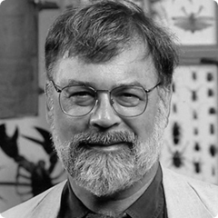
Niles Eldredge
Paleontologist
Curator of the American Museum of Natural History
Punctuated equilibirum

Slide 4
Replaying life’s tape Thought experiment Contingency Unpredictability Overdetermination

Slide 5
Exaptation: a shift of function, cooptation of a function for a new use Bird’s feather original function: temperature regulation → present function: display, flight Panda’s thumb Original function: a bone similar to human thumb → peel off bamboo leaves Penguin’s wing Original function: flight → present function: swim Duck’s feet Original function:

Slide 6
Theory of punctuated equilibirum + Punctuation: rare suddent shifts + Evolution does not always mean change + Evolution also means stasis + Stasis → equilibrium: no or little change in long periods of time

Slide 7
Theory of punctuated equilibirum Pace of evolution: + Natural selection: several millions of years. + During punctuation: less than 100,000 years. + After punctuation: several millions of years, again.

Slide 8
Theory of punctuated equilibirum + a large amount of change in a short time + gradualism vs. sudden bursts / rapid changes / sharp jumps + contingencies in nature: earth quakes, lakes forming, sea level rising, meteors hitting the surface of the earth etc. which leads to

Slide 9
Theory of punctuated equilibirum + isolation: new environment for a small part of the population, new selection processes + absence of transitional forms

Slide 10
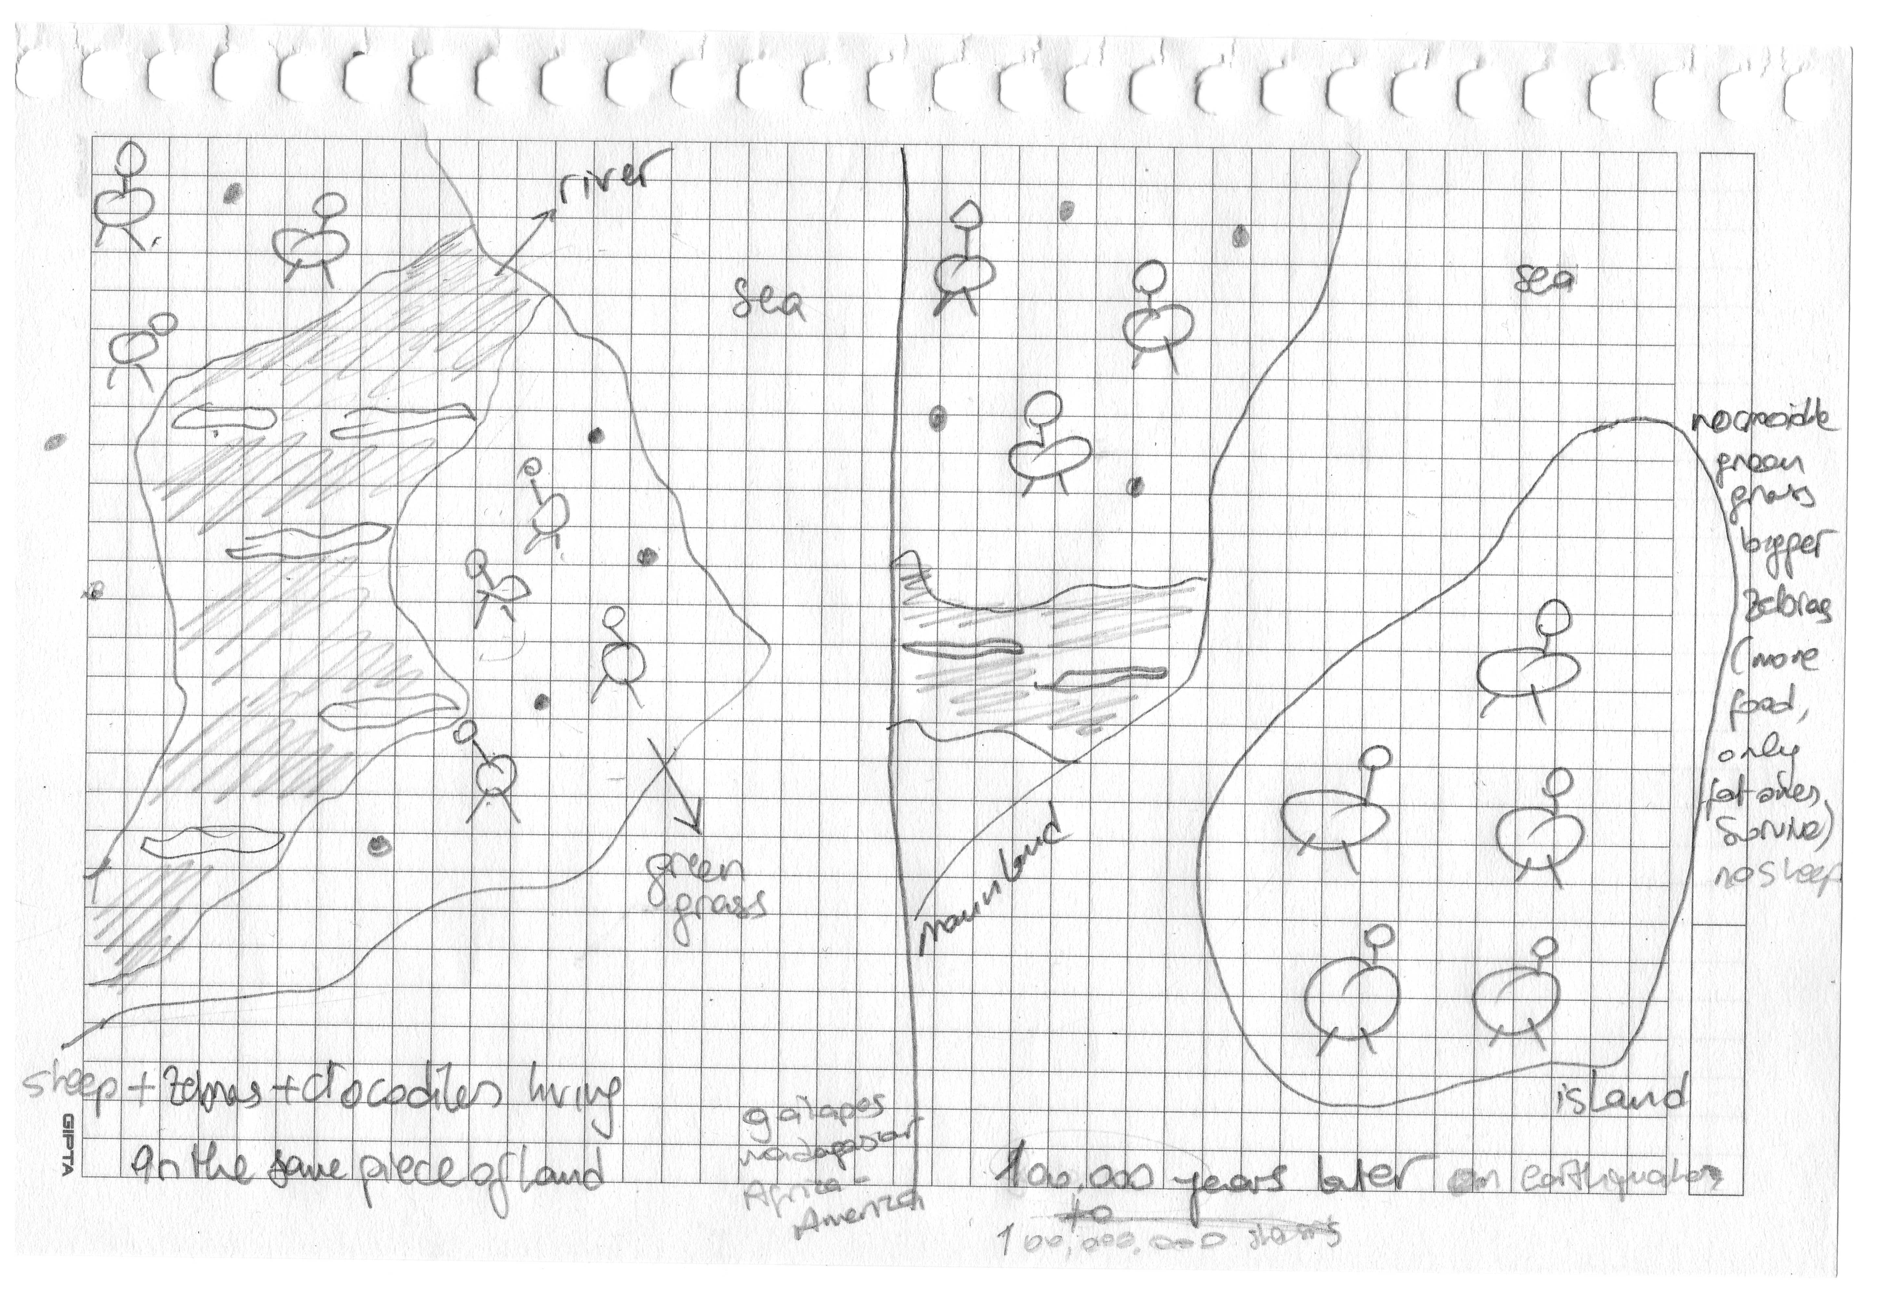

Slide 11
Specie 1
Time
Punctuation
Contingent Event
Equilibrium or stasis 1’: Different set of selection pressures on the isolated population
Equilibrium or stasis 1
Specie 1
Specie 1’
Macro evolution or speciation or variation amongst species

Slide 12
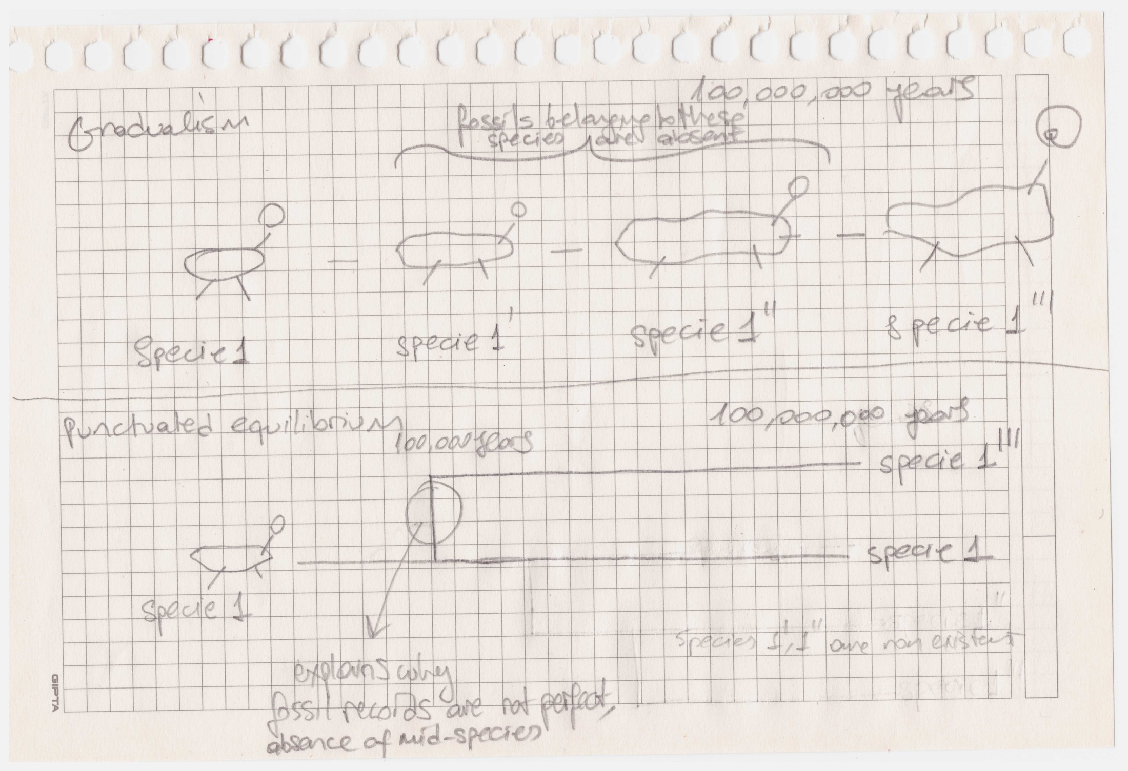

Slide 13
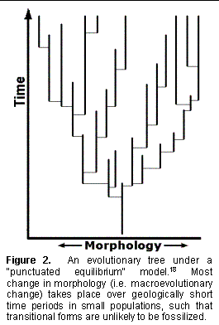
Source: Punctuated Equilibrium and Patterns from the Fossil Record
http://www.ideacenter.org/contentmgr/showdetails.php/id/1232 (November 2013)

Slide 14
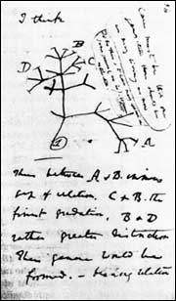
Original drawing from one of Darwin’s notebooks.

Slide 15
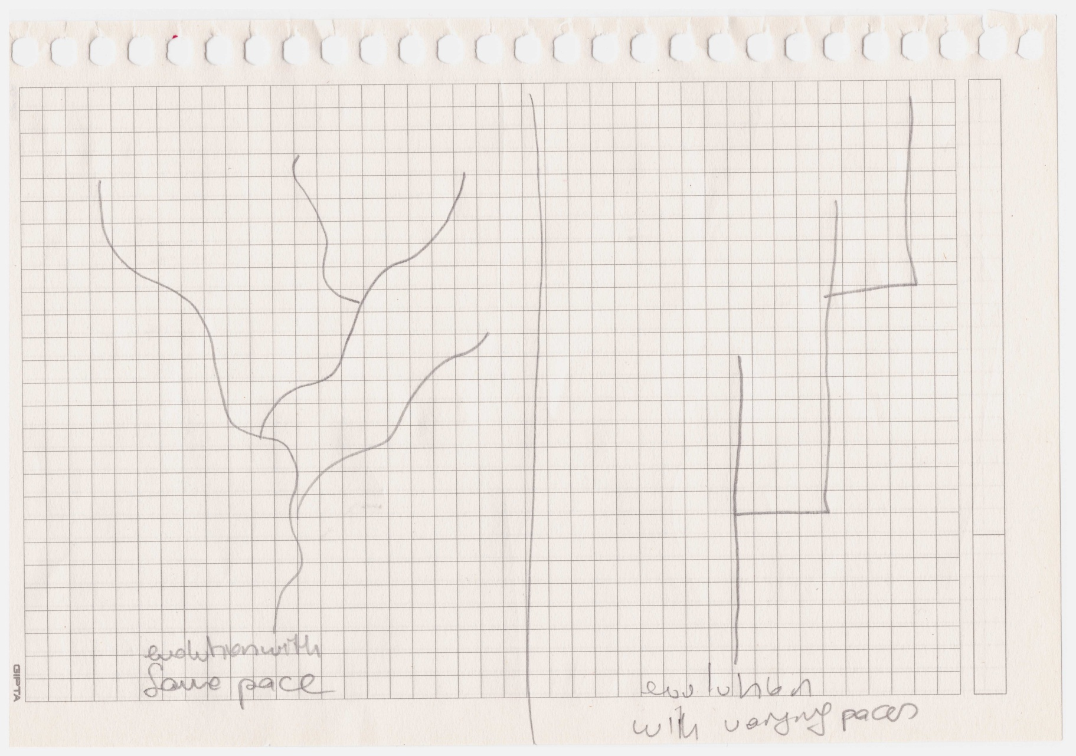

Slide 16
So what is the point? + Evolution means change and stasis at the same time. + Variation of species + How about variation of theories? + What does variation replace?

Slide 17
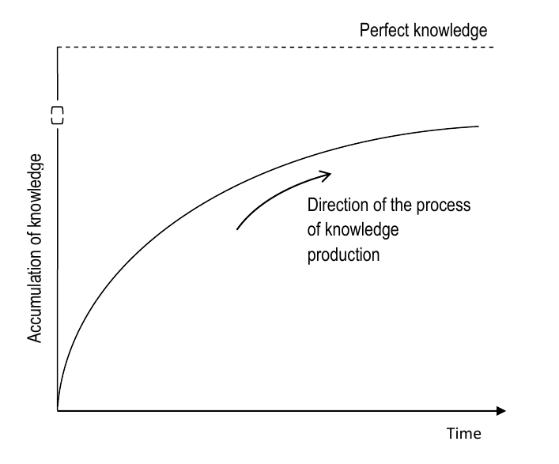
How should we understand progression?

Slide 18
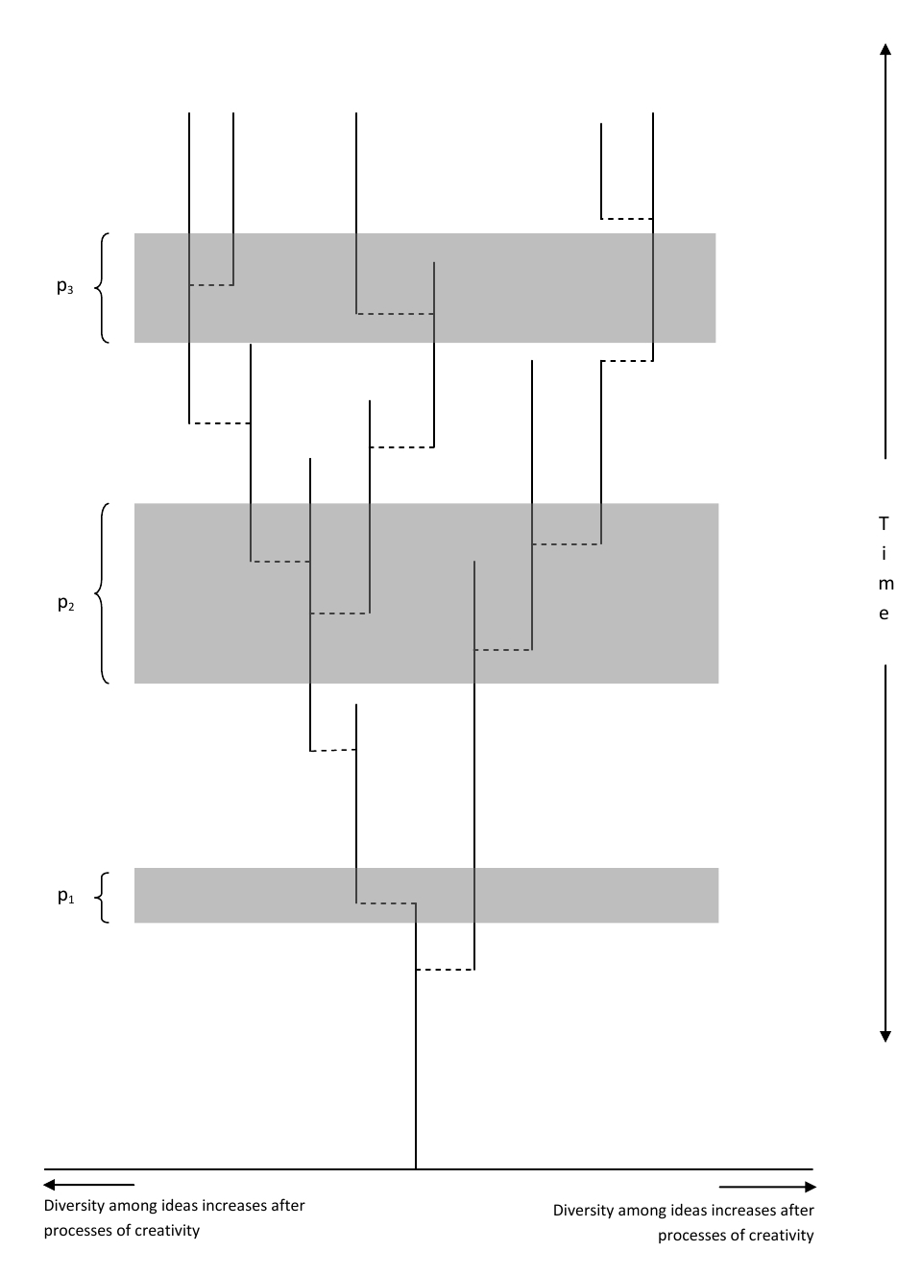
An alternative:

Slide 19
Implications of the theory of punctuated equilibirum for the evolution of ideas + There is progress + However, progress is discontinued + There is certainly no perfection + Instead, there is variation amongst ideas

