Slide 1
AGRICULTURAL STRUCTURES
SUBJECT 1
CLASSIFICATION OF STRUCTURES

Slide 2
INTRODUCTION
The main objective of agricultural enterprises is to increase the quantity and quality of production, to reduce production costs and thus to maximize the income of the farmer.
Ensuring the continuity of agricultural activities can be achieved by establishing sufficient infrastructure in enterprises. this is generally referred to as rural infrastructure services.

Slide 3
Rural infrastructure services can be listed as follows:
all structures and facilities in agricultural enterprises
supply of drinking, utility and irrigation water and storage, transmission, distribution of water
Drainage and land reclamation
Waste management
Land consolidation
Rural roads
Establishment of new residential areas
Rural electricity, communications systems

Slide 4
Rural Infrastructure
All kinds of planning, projecting and construction phases related to these services constitute the engineering phases of rural infrastructure.
Planning and project work requires engineering knowledge.
The design of agricultural structures is an engineering work that requires expertise.
Agricultural structures should be planned and projected in the most economical, most suitable and robust way according to the type of production.
After all, the purpose of using agricultural structures is to get the highest income.

Slide 5
AGRICULTURAL STRUCTURES
Livestock production facilities (cattle, sheep, goat, poultry breeding structures)
Plant production facilities (greenhouse, mushroom production facilities)
Product storage structures (fruit-vegetable, grain, feed)
Product packaging, processing, marketing structures
Tool and machine protection structures
Waste Management, manure storage structures
Other facilities (drinking and irrigation water systems, in-house roads, electricity, communication systems)

Slide 6
WHAT IS THE STRUCTURE?
Buildings and facilities constructed in accordance with various materials and construction methods in order to meet a specific requirement are called structures.
The most important functions expected from a structure are:
It should carry the loads in a balanced way,
It must be sufficiently strong and durable,
It should be economical,
It must be aesthetic,
It should be environmentally friendly,
It must be fit for purpose.

Slide 7
Classification of structures according to their purpose of construction
Houses
cultural buildings
health buildings
social structures
commercial buildings
religious buildings
accommodation structures
agricultural structures

Slide 8
Classification according to the systems that make up the building
Load Bearing Systems: These are the load-bearing elements that form the basis of a building. Foundations, walls, columns, beams, floors, stairs and roofs…
Supplementary systems: These are the elements that cover the surfaces of the load bearing elements and beautify the appearance. Door and window joinery, flooring, stairs, wall coverings, stair balcony railings, insulation, paint-whitewash…
Installations: water, electricity, communications, sewage, ventilation, heating systems, etc..

Slide 9
Classification according to the static state of the carrier elements
Masonry structures: The structures in which the loads from the horizontal load-bearing elements such as the roof and floor in the building are carried by the external and internal walls and transmitted to the foundation are called masonry structures. In masonry structures, the walls carry the loads. For this reason, removing any wall and opening door and window spaces on the wall disrupts the static balance of the structure.

Slide 10
Classification according to the static state of the carrier elements
Skeletal structures: The structure has a skeleton consisting of columns and beams. Floor and roof loads are carried by this skeleton. The beams transfer the loads on themselves to the columns. Columns carry these loads and transmit them to the foundations. In carcass structures, the function of the walls is as a partition or filling element and they do not carry loads. Therefore, the walls can be removed or all kinds of changes can be made. If the column or beams are damaged, only then will the stability of the structure be disturbed. Frame structures can be made of wood, reinforced concrete or steel.

Slide 11
Classification according to the static state of the carrier elements
Prefabricated buildings: In this type of building systems, the building elements are fabricated one by one and buildings are constructed by assembly. After the foundation system is built in accordance with the project, the superstructure elements are ready for construction, placed in accordance with their position and combined.

Slide 12
Classification according to the type of material used
Masonry structures: structures built with materials that do not catch fire. Stone, Earth materials.
Reinforced concrete structures: load-bearing elements are made of reinforced concrete. column, beam, foundation, ladder
Wooden structures
Steel structures: The carrier system is the structures built from various steel profiles.

Slide 13
ClassIfIcatIon by buIld level
underground structures
aboveground structures

Slide 14
Classification according to the continuity of the structure

Slide 15
Construction types of agricultural structures
Structures are made up of different elements attached to each other. In order for the entire structure to remain in balance, each element that makes up the structure must remain in static balance under the influence of the loads, including its own weight.
Masonry structures: In this type of structures, the roof load is carried by the walls and transferred to the foundation. These structures can be made in two different constructions. It is the most common form to use truss systems to carry the roof load and transfer it to the walls. Lattice systems transfer the load from the support points where they sit on the walls. It is used in buildings with building width up to 12 m.

Slide 17
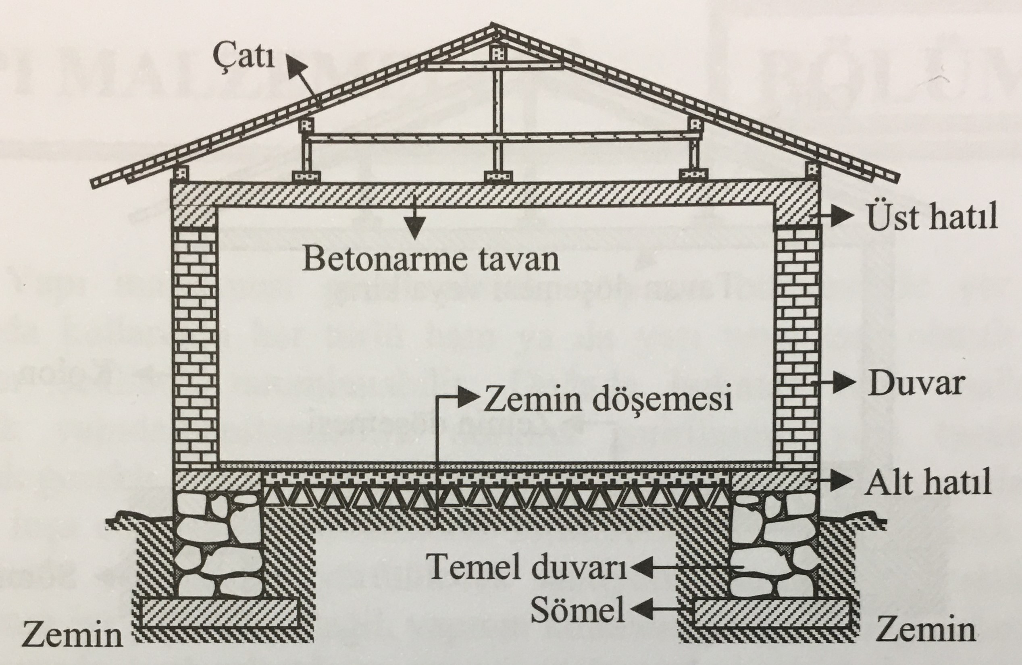
Construction types of agricultural structures
Masonry structures: In this type of structures, the roof load is carried by the walls and transferred to the footings. These structures can be made in two different constructions. It is the most common form to use truss systems to carry the roof load and transfer it to the walls. Lattice systems transfer the load from the support points where they sit on the walls. It is used in buildings with building width up to 12 m.

Slide 18
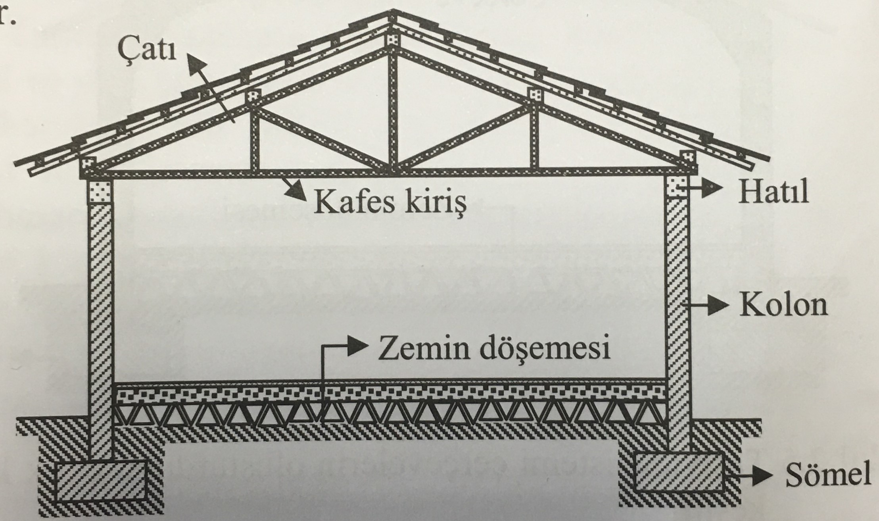
Construction types of agricultural structures
Masonry structures: Another transmit method is to use ceiling systems to transfer the roof load to the walls. The load is first transmitted to the ceiling with the snap roof and then to the walls with the help of the ceiling. However, ceiling construction in agricultural buildings is not always a preferred practice.

Slide 19
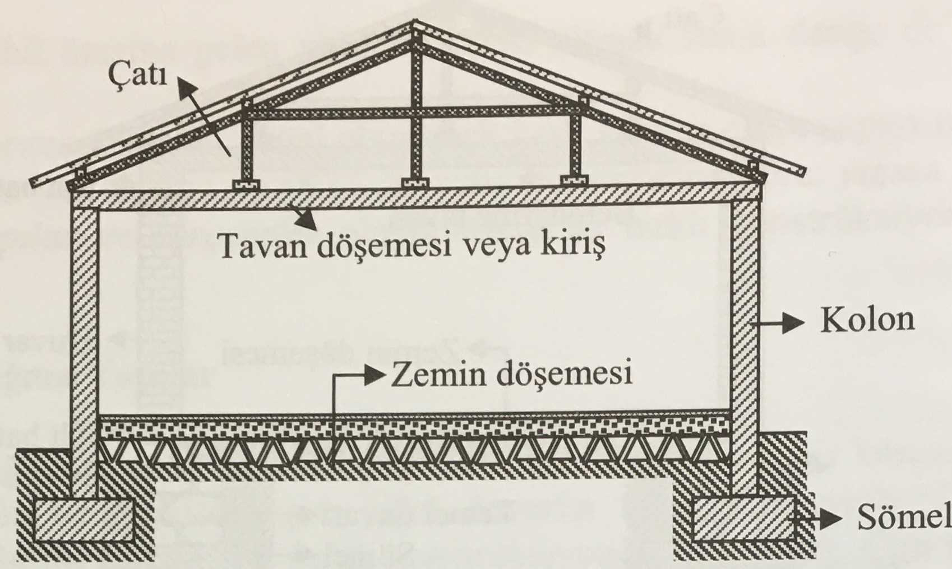
TYPES OF BUILDING
Skeletal Structures: Today, we mainly build agricultural structures in the form of frame (carcass) structures. In this type of structures, the roof load is carried by the columns and beams. The walls serve only as partitions. Such structures can be made in two different ways. The most common is the truss and column combination. The roof load is carried by the truss beam and transmitted to the columns at the support points. Columns transmit this load to the ground through footings. Another type of construction is the seated roof-ceiling-column combination. however, this type of construction is not suitable for agricultural structures.

Slide 20
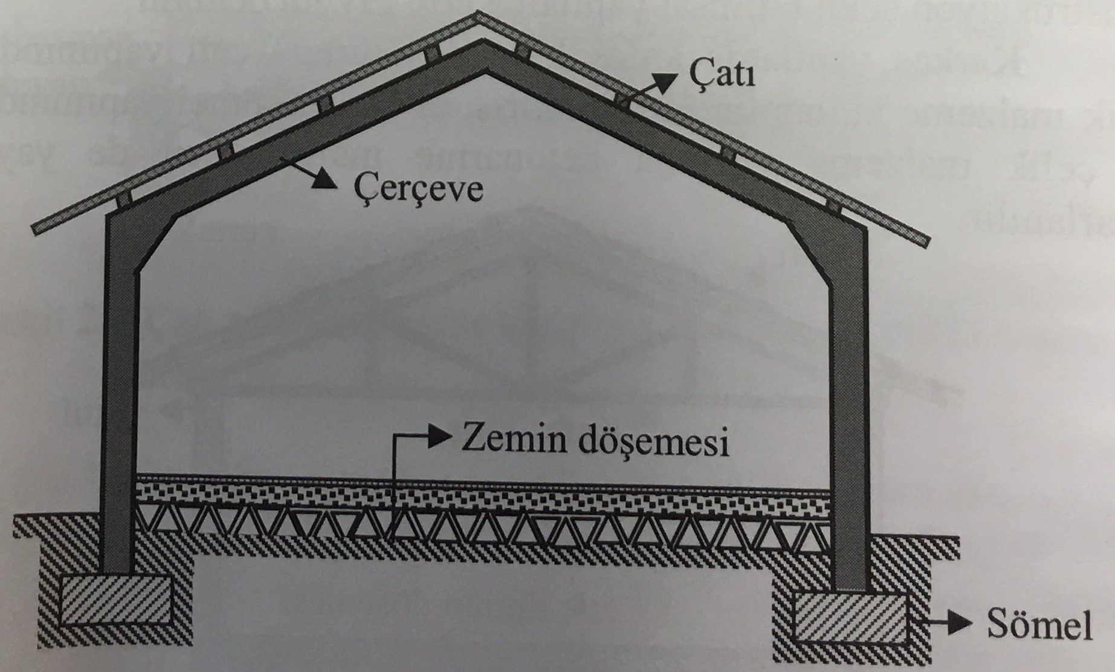
TYPES OF BUILDING
Frames: t is a form of construction that has been widely used in agricultural structures in recent years. In this system, the roof and the column are built to form a rigid frame. thus, the carrier system works as a whole against the acting loads. The biggest advantage of frames is that they allow wide openings to be built without the need for intermediate columns. They are made of steel, reinforced concrete materials.

