Slide 1
Chirality and its Biological Role

Slide 2
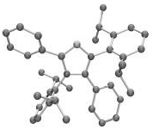
1. Introduction
Stereochemistry is a discipline of Chemistry which studies the arrangement of atoms in space. This discipline of Chemistry started its development by Louis Pasteur in the 19th century, who was observing salts of Tartaric Acid, he noticed that they rotate the plan of polarized light. This optical activity was managed to be explained by Jacobus van't Hoff and Joseff Le Bel with four different substituents model that are bonded to a Carbon atom, which has tetrahedral orientation (sp³ hybridisation) and the ordering of the four substituents can be done in two ways.
The shape of molecule is as a result of hybridisation and geometry of atoms bonds in the molecule.
A basic concept of Organic Chemistry says that molecule's structure is determiner of its properties.
Isomers are compounds that consists of same molecular formula, but have different chemical structure. Isomers can be Constitutional Isomers and Stereoisomers.

Slide 3
Constitutional Isomers can be: chain isomers, positional isomers and functional isomers (at constitutional isomers ordering of atoms is changed - sequence of bonds).
C₅H₁₂
n- pentane
isopentane
neopentane
C₅H₁₄N
3-pentanamine
2-pentanamine
C₃H₈O
propanol-1
methoxyethane

Slide 4
2. Stereoisomers have same ordering of atoms - same sequence of bonds, but only placement of atoms in molecule might be changed. Stereoisomers can be:
a) Conformational Stereoisomers (when passing from one stereoisomer to another, sigma bond must be rotated).
b) Configurational Stereoisomers (when passing from one stereoisomer to another, chemical bonds must be detached and placement of atoms in space must be in appropriate way).
Configurational Stereoisomers can be: Enantiomers and Diastereomers.
a)
b)

Slide 5
Geometric Isomery - is as a result of free rotation impossibility of molecule parts around double-bonded C=C.
Cis Isomers (Z)
Trans Isomers(E)
E-Z nomenclature according to priority rule
trans-2-butene
cis-2-butene
trans
cis
Cyclic compounds
1-chloro-2-methylcyclopentane

Slide 6
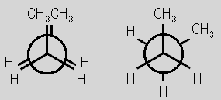
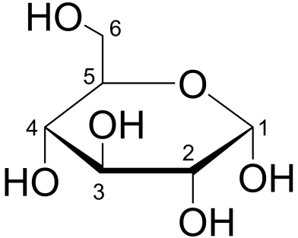
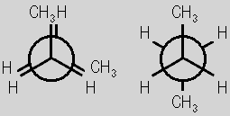
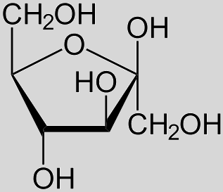
2. Types of projections
Projections with lines and wedges
Fischer’s projections
Tartaric acid
Newman’s projections
Haworth’s projections
α - Glucose
β - Fructose
Butane

Slide 7
Sawhorse projection
Chair and Boat projections
H
H
1. Syn
H
H
H
H
H
H
2. Gauche
H
H
H
H
3. Ecliptic
H
H
H
H
4. Anti
H
H
H
H
H
H
H
H
Butane
Cyclohexane

Slide 8
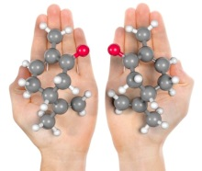
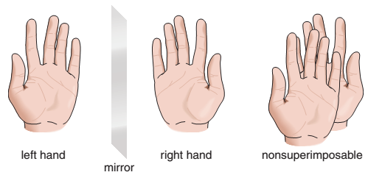
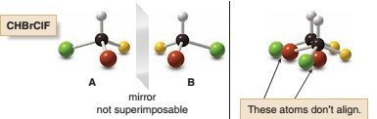
3. 1. Chirality - Stereocenter
Chirality - is a definition that refers to the molecule that cannot be superimposed on its mirror image. A simple example of chirality is "hand model", one hand is the mirror image of the other hand, and they cannot be superimposed. The word chirality is derived from the Greek (kheir - hand).
Most cases, molecule chirality is as a result of space orientation of four different substituents that are bonded to sp³ hybridisation C atom, and with IUPAC recommendation (1996) it is called as Chiral Center or Stereocenter.

Slide 9
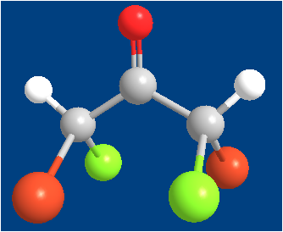
3. 2. Chiral and achiral molecule
Molecular chirality for the first time has been reported in 1815 by Jean Baptist Biot, who discovered rotation of polarized light plane during the passing of polarized light through sugar solution (optical activity).
A molecule can be chiral when:
1. Does not superpose with its mirror image 2. It has Stereocenter (it is not necessary) 3. It must not have any symmetric elements (plane, center and axis).
180º
.
(2S,5R)
meso form
Plane of symmetry
(Reflection)
Center of symmetry (Inversion)
(1S,3S)-1,3-dibromo-1,3-dichloropropan-2-one
Axis of symmetry
(Rotation)

Slide 10
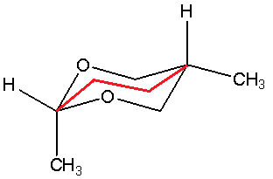
3.2. Examples
chiral
achiral
*
achiral
(plane of symmetry)
chiral
*
*
achiral
(plane of symmetry)
chiral
*
*
*
*
*
achiral (plane of symmetry)

Slide 11
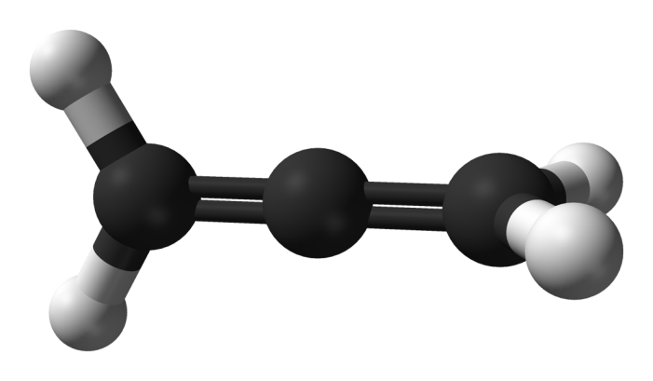
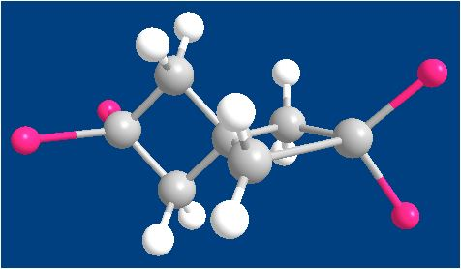
3.3. Chiral molecules without stereocenter
Molecules can be chiral even without stereocenters (we mentioned that stereocenters are not necessary). Axial Chirality and Planar Chirality.
In specific thermodynamic conditions, these show activity of chiral molecule. But, in high temprature, high pressure, energetic barrier of movement around double-bond decreases and there is no chiral molecule activity shown.
Allene
sp²
sp
sp²
Spirane

Slide 12
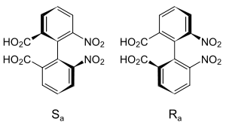
Atropisomerism was discovered by Richard Kuhn in 1933. Atropisomers are conformational isomers. They have axial chirality, as a result of rotation impossibility around sigma bond, because of steric barriers of substituents in ortho positions. (Atropo means without turn)
6,6'-dinitrobiphenyl-2,2'-dicarboxylic acid
Bridged Atropisomers have a bigger barrier because in here bridged chemical bonds must be fully detached.

Slide 13
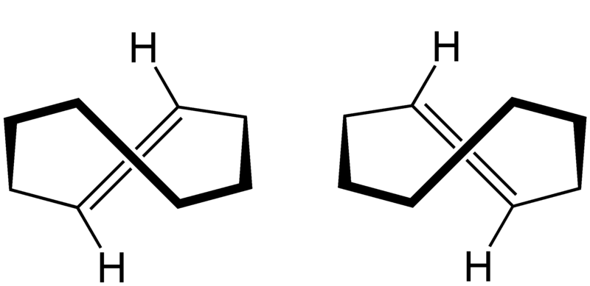
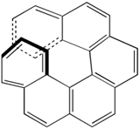
Planar Chirality
para-Cyclophane
trans-Cyclooctene
Helicenes (axial chirality) are ortho-condensed polycyclic aromatic compounds in which benzene rings or other aromatics are angularly annulated to give helically-shaped molecules.
meta-Cyclophane

Slide 14
3.4. Enantiomers and diastereoisomers
Two molecules that are chiral, are like their own mirror image and that do not superpose are configurational isomers that are called Enantiomers (must always be chiral). Diastereomers are molecules that aren't like their own mirror image. (they can be configurational and cis-trans geometric isomers). At diastereomers chirality it's not necessary. Terms 'chiral' and 'achiral' are referred to a single molecule, while 'enantiomer' and 'diastereomer' terms are referred to the relation between molecules. Maximal number of stereoisomers = 2^{n}; where n - number of stereocenters.
Erythrose
Threose
Enantiomers
Enantiomers
Diastereomers

Slide 15
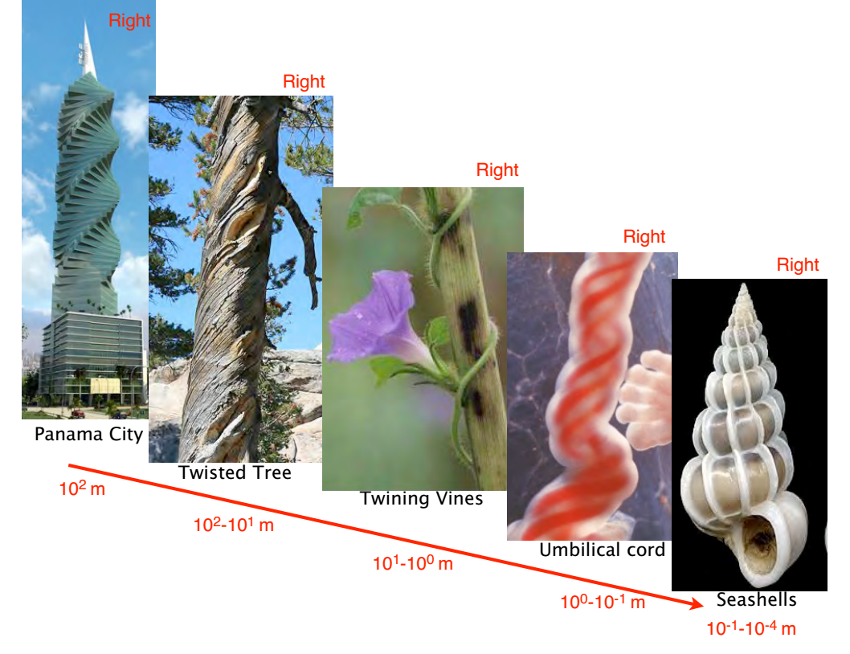
3.5. Stereoisomers configuration
The need to define the direction of asymmetric stuff (architects, botanists, biologists, chemists, doctors etc).

Slide 16
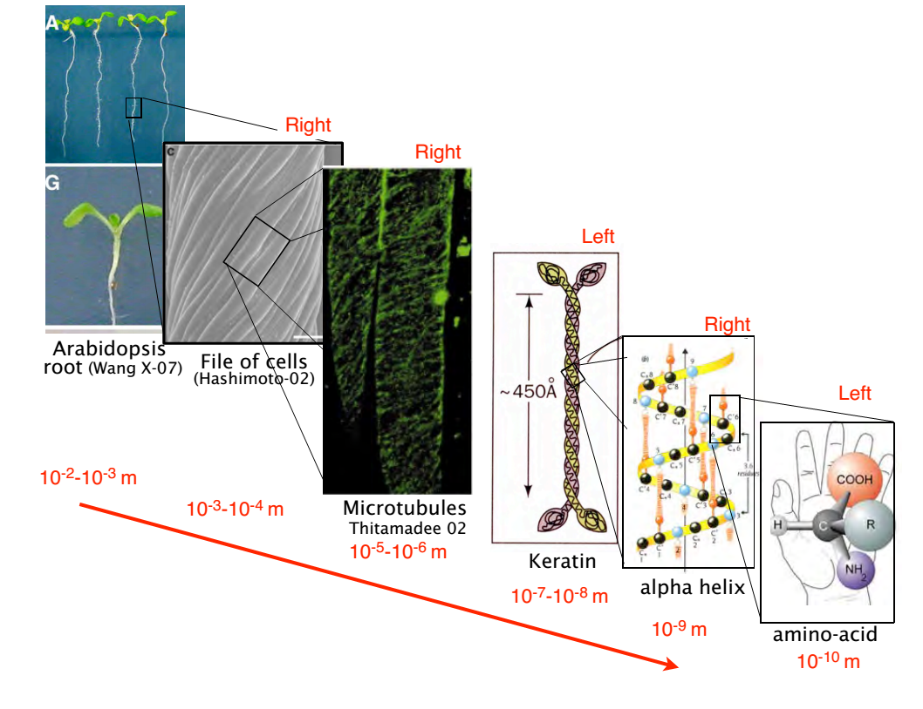

Slide 17
3.5. Stereoisomers configuration
1. Relative Configuration (D-L)
2. Absolute Configuration (R-S)
Relative Configuration
This type of configuration was defined by convention according to Glyceraldehyde. All compounds that with chemical reactions have shown association with (+) glyceraldehyde, were given D relative configuration (d-dextrorotatory) and for those associated with (-) glyceraldehyde, were given L relative configuration (l-levorotatory). Signs (+) (-) will be explained in Optical Activity thread.
Using difficulties of Relative Configuration
At some other compounds there is discrepancy between D-(+) and L-(-). For example at amino acids we have L(+) alanine and L(-) serine.
L(-)-glyceraldehyde
D(+)-glyceraldehyde
L(+)alanine
L(-)serine

Slide 18
Relative configuration at molecules with more than one stereocenters was completed with convention. For example at carbohydrates D-L is determined in the stereocenter where the primary alcohol is bonded (-CH₂OH).
Another more advanced system of configuration that describes exactly the chemical spatial structure and has no using difficulties is R-S system or CIP system. This system is called Absolute Configuration and differs from Relative Configuration because it is determined at every stereocenter.
D-(-)-Erythrose
L-(+)-Erythrose
D-(-)-Threose
L-(+)-Threose

Slide 19
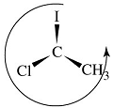
Absolute Configuration R-S (CIP system)
This is the most advanced system that describes the spatial orientation of substituents at every stereocenter. Signs R (rectus lat. - clockwise) and S (sinister lat. - counterclockwise). This system was founded from Cahn-Ingold-Prelog. Configuration determining is done according to the priority rule (atomic number of substituents).
1
Br
1
4
*
3
2
3
2
(S) – 1- brom -1-chloroethane
(S)

Slide 20
Priority Rule
Higher priority goes to the atom with a bigger atomic number. If two substituents have the same attached atom to the stereocenter, priority is defined from the following atom.
1
4
*
*
2
4
3
3
2
1
Sequence rule priorities
If substituents contain double and triple bonds, definition of priority is done by considering atoms (X and Y) as doubled and tripled in the other side of double respectively triple bonds.
S – stereocenter

Slide 21
Atomic number 35 17 16 15 8 7 6 (2) 1
High priority Br > Cl > S > P > O > N > C > ²H > ¹H Low Priority
Low Priority
High Priority
Low Priority
High Priority
High Priority
Low Priority
Low Priority
High Priority

Slide 22
Examples of absolute configuration defining and relation between fours stereoisomers (because the compound consists of 2² stereoisomers).
Enantiomers
(2S,3R)-3-brom-2-butanol
(2R,3S)-3-brom-2-butanol
Diastereomers
Diastereomers
Diastereomers
Enantiomers
(2S,3S)-3-brom-2-butanol
(2R,3R)-3-brom-2-butanol

Slide 23
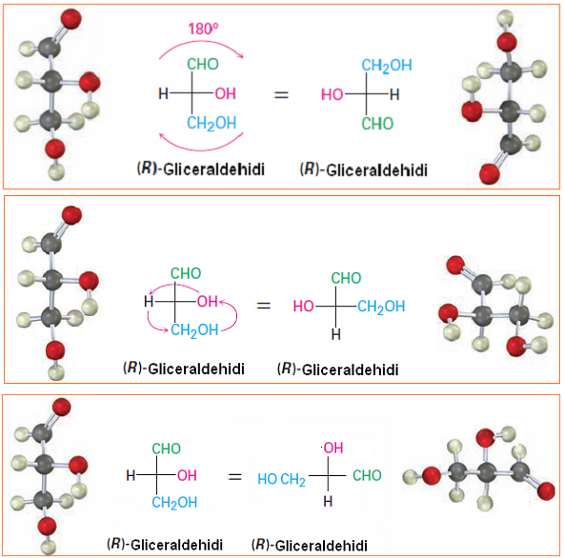
3.6. Allowed operations in Fischer's projections
During these manipulations absolute configuration must not change (we do these allowed manipulations to make the absolute configuration definition easier).
1.Rotation in paper plane for 180º only.
2. Place switching of three substituents, while the fourth substituent remains unchanged.
3. Switching the four substituents in doubles
(R) - Glyceraldehyde
(R) - Glyceraldehyde
(R) - Glyceraldehyde
(R) - Glyceraldehyde
(R) - Glyceraldehyde
(R) - Glyceraldehyde

Slide 24
3.7. Example of absolute configuration determining
( )
( )
②
__
[C, O, O]
*
①
④
__
__
[O]
*
③
__
[C, O, C]
*
*
②
①
2(R), 3(S), 4(R), 5(R) (+) Glucose
Switching the four substituents in doubles. The substituent with lesser priority must be placed below.
①
④
③
②
(R)
③
④

Slide 25
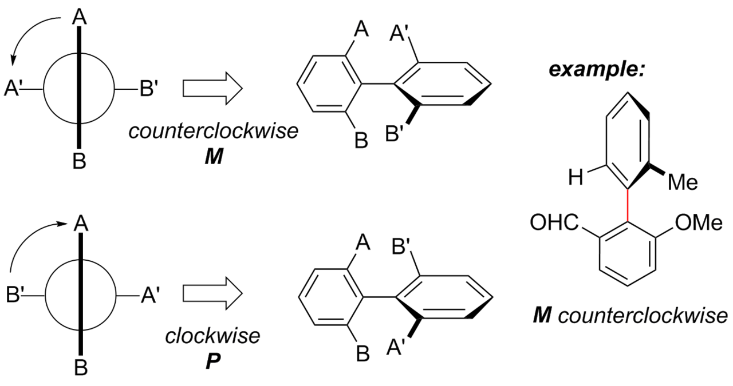
3.8. E-Z and P-M configurations
E-Z system is defined according to the priority rule, as mentioned above. Signs E (entgegen german - opposite) and Z (zusammen german - together).
High priority
Low priority
High priority
High priority
Low priority
High priority
Low priority
Low priority
(E)
(Z)
P-M system is defined also according to priority rule. Signs P - plus (clockwise) and M - minus (counterclockwise). It is used for Atropisomers, Allenes and Spiranes.

Slide 26
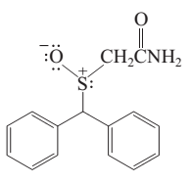
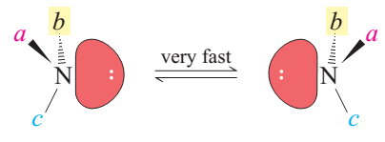
4. Other chiral centers except Carbon
Except carbon that we talked about so far, stereocenters can be also N, P, S, Si, As, Sb etc. We can apply the same rules in these stereocenters as well. In these cases the smallest priority goes to electronic pair, while at C-stereocenter hydrogen ¹H has the smallest priority.
Tertiary amines, are chiral in theory, but in practice changes because very fast interconversion makes them achiral and only when that interconversion is blocked, for example alike Troger's Base where the bridged bond N-CH₂-N manages to keep blocked this interconversion. Whereas at other stereocenters (S, P, …) there is no interconversion alike tertiary amines.
*
achiral
*
Modafinil - chiral sulfoxide that is used to treat sleep disorders and is given as racemate.
*
Troger’s Base- chiral

Slide 27
5. Stereoisomers properties
Enantiomers apart from diastereomers, have same physical and chemical properties: melting point, boiling point, refraction index, rate of reactions, solubility (ephedrine - intermolecular and intramolecular hydrogen bonds - can be seen in the next slide). Enantiomers have same physical and chemical properties because they have same distance between atoms in molecule.
Enantiomers show different properties when reacting with chiral substances (receptors, chiral solvents etc): different rates of reactions, different biological properties, physiological and pharmacological properties etc.
Diastereomers have different physical and chemical properties in any environment therefore can be separated much easier than enantiomers.
Enantiomers have opposite rotation of polarized light plane but share the same size of rotation angle.
Enantiomers are always chiral molecules.
Diastereomers can be chiral, but when there is a symmetric element it can be achiral (meso form) and as a result of that symmetry they do not rotate the plane of polarized light, because one half of the molecule rotates it for a certain angle, and the other half neutralises that rotation.

Slide 28
5.1. Case of ephedrine (the difference on solubility)
Easier dissolved
Harder dissolved

Slide 29
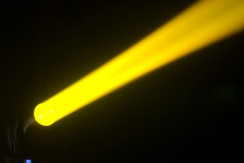
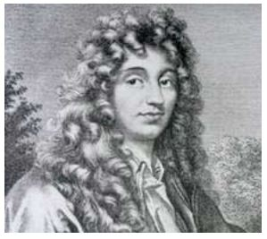
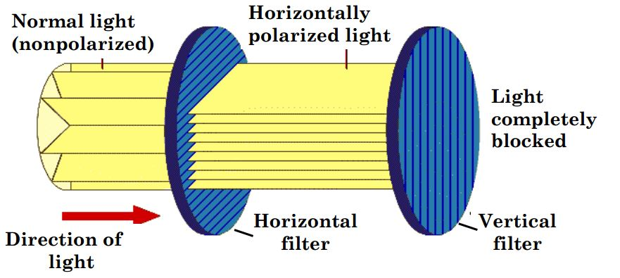
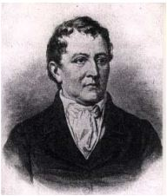
6. Optical activity
Christiaan Huygens is a Dutch scientist who discovered the plane of polarized light. Unpolarized light vibrates in all possible planes, while the polarized one vibrates only in one plane.
Nicol prism
Carl W. Scheele is a Swedish scientist who in 1769 discovered tartaric acid in fermentation containers of winemaking, in salts forms alike Potassium Tartrate.

Slide 30
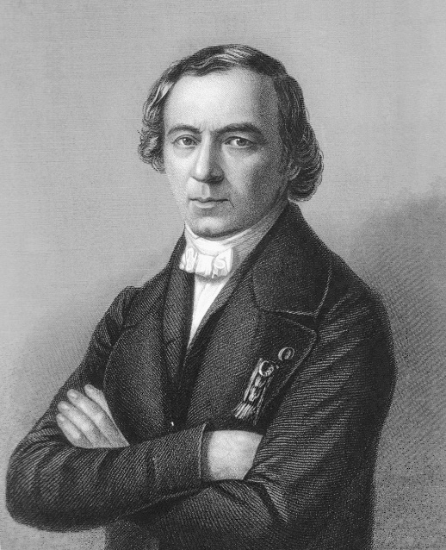
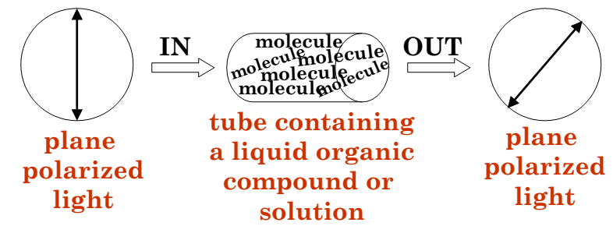
Jean Baptiste Biot is a French scientist who in 1835 showed that some natural organic compounds, in their solutions could rotate the plane of polarized light (they have optical activity).
Optically Active Compounds are able to rotate the plane of polarized light.
To be optically active, the sample must contain a chiral substance and one enantiomer must be present in excess of the other.
Racemic mixtures and achiral substances are optically inactive.
Dextrorotatory compounds [ (+) or (d) ] rotate the plane of polarized light clockwise.
Levorotatory compounds [ (-) or (l) ] rotate the plane of polarized light counterclockwise.

Slide 31
Jean Baptiste Biot in 1835 showed that tartaric acid is a dextrorotatory compound.
In 1838 he showed that the acid with the same chemical formula does not rotate the plane of polarized light. This was the racemic mixture, which was defined as an equimolar mixture of two enantiomers.

Slide 32
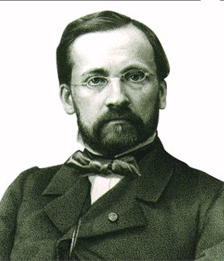
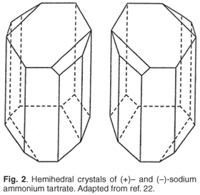
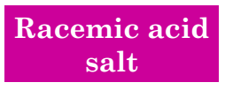
Louis Pasteur – is a French scientist whom in 1847 worked with tartaric acid's racemic mixture. He crystallized molecules of the two enantiomers in conglomerates forms. Conglomerate means one crystal who possesses only one type of enantiomers.
Pasteur saw that there was crystals who were like the object and its mirror image, for example hands model.
He separated them using tweezers and a magnifier, then he dissolved them separately from each other and observed them in polarimeter. He noticed that they rotate the plane of polarized light in the same angle, but opposite direction. This was the first separation of enantiomers and it is know as Mechanical Separation.

Slide 33
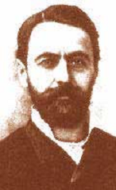
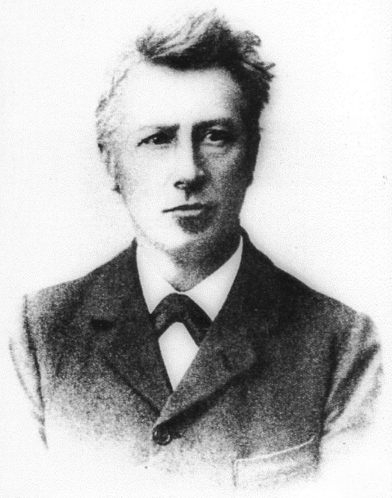
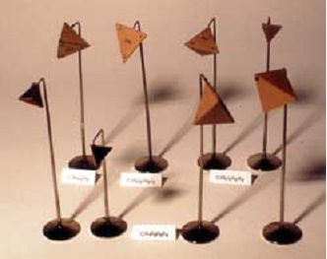
Louis Pasteur in 1853 studied the meso form of tartaric acid and he said that it has the same chemical formula with tartaric acid racemate, but cannot be separated in (+) and (-). Solution of Meso Tartaric Acid does not rotate the plane of polarized light because it isn't chiral molecule (it has internal plane of symmetry). So, meso form is the molecule which has two or more identical substituted stereocenters and internal plane of symmetry.
Then why it happened this way, after all these discoveries Joseph Le Bel and Jacobus van't Hoff explained that the asymmetric atom C in a molecule, which has no symmetric elements, offers two different ways of ordering the four different substituents in space. These two ways of ordering presents the Enantiomers.

Slide 34
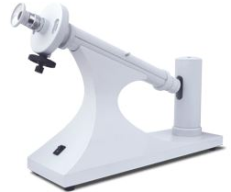
Polarimeter
Sodium lamb – yellow light (D line)λ= 589.3 nm
l=100 mm length of glass tube
t=25ºC
There is no relationship between R-S and (+) (-)
We cannot predict the direction and the angle that R enantiomer will rotate the plane of polarized light, but if we measure with polarimeter and define the angle for R enantiomer, we will know that S enantiomer will have the opposite sign with the same angle size.
*
*
(R)-(-)-Mandelic acid
It’s antibacterial for urinary tract infections
(R)-(+)Lipoic acid
This coenzyme is important in cellular respiration

Slide 35
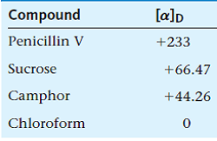
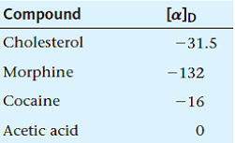
Specific Rotation [α]
[α] = $\frac{\text{α}}{C x l}$
[α] – Specific rotation
α – Observed rotation
C – Concentration or density (pure solvents) (g/ml)
l – length of the sample tube (1 dm)
Specific rotation is physical constant and it depends on: type of chiral compound, temperature (25ºC) and wavelength (λ = 589.3nm), length of the sample tube l, and concentration 1g/ml.
Application: In analysis, when we want to find the concentration of a certain substance, or via the specific rotation to know what substance we're dealing with. We can also apply when we want to know the enantiomeric excess.
T
λ
T
λ
T
λ
achiral
achiral
ee _{R} % = $\frac{\text{[}\text{α}\text{]}\text{mixture}}{\text{[}\text{α}\text{]}R}$ x 100
ee _{R} % = $\frac{nR −nS}{\text{Σ}\text{n}}$ x 100
n – number of moles

Slide 36
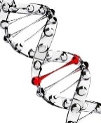
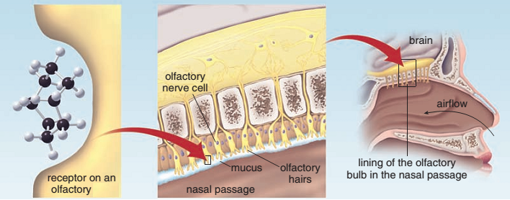
7. Biological role of chirality
Chirality is an important part of nature, and thanks to it many things have been perfectly regulated. In our cells, we have proteins from L-amino acids and carbohydrates from D-monosaccharides, DNA and RNA possess ribose and deoxyribose sugars of D form, and all the enzymes and receptors in our body possess L-amino acids. All the processes in our body are perfectly regulated, thanks to high stereoselectivity and stereospecificity of enzymes, hormones and receptors who aswell are chiral molecules. For example, we can smell only the substances that are fitted in the active place of the receptor in the ending parts of olfactory nerve – so this way the action potential can be generated.

Slide 37
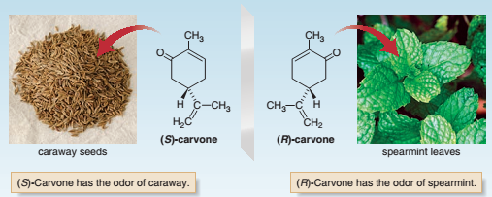
Chirality & Odor Perception
R-(-)-Carvone and (S)-(+)-Carvone don't have same aroma (odor). This difference in aroma comes as a result of the nose receptors behaving on these substances, this comes as the molecule’s accommodation availability in receptors.
*
*
*
*
R-(+)-Limonene (citrus flavor)
S-(-)-Limonene (pine or turpentine-like odour)

Slide 38
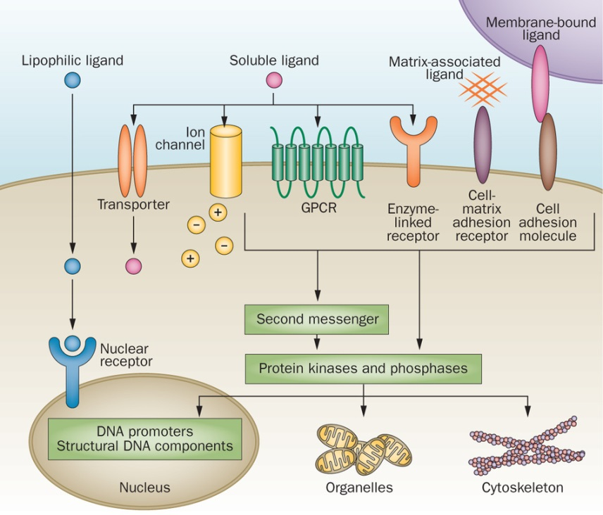
Receptors – are macromolecules with proteinic nature and since they contain chiral amino acids (19/20), they are chiral too. They are important compounds because they enable cell communication and regulation of many living processes. According to where receptors are located, they can be: receptors in outer surface of membrane, cytoplasmic receptors, nuclear receptors etc.

Slide 39
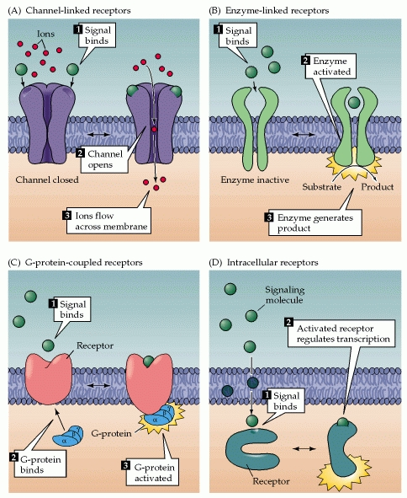
Receptors basing on structure, can be four types:
1st Type: Chanel-linked receptors. Ion channels are opened when ligand gets bonded to channel-receptor.
2nd Type: Enzyme-linked receptors.
3rd Type: G-protein-coupled receptors. When the ligand is bonded, receptor changes its form and activates G protein, which activates the adenylate cyclase (ATP → cAMP), then cAMP acts as a secondary messenger.
4th Type: Intracellular receptors, are found in cytosol but when they are bonded to ligands they travel to nucleus as complexes and they do their function there (gene expression by altering DNA transcription).

Slide 40
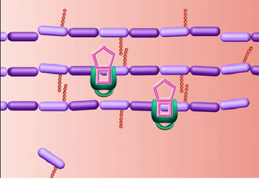
Penicillin also has stereoselectivity because it does its antibacterial role without acting on our cells. This process goes this way: penicillin act on bacterial cell wall, preventing the cell wall synthesis and due to cell wall absence, bacteria are blasted because of osmotic pressure.
Cell wall is formed by peptidoglycan, a polymer made of carbohydrates and peptides, where the carbohydrates layers are sticked together via the peptide chain through transpeptidase enzyme, and penicillin blocks that enzyme preventing sticking of fragments of the cell wall. Bacteria's enzyme and peptide chains contain D-amino acids whilst we have L-amino acids and that's why penicillin doesn't have any effect on our cells.
Another problem with importance is resistance on antimicrobials. Bacteria synthesize the enzyme (β – Lactamase) which secures bacteria's existence. This enzyme disables penicillin and similar antibiotics action because destroys β-Lactam ring.
NAM
NAG
Pentapeptide
Penicillin
Transpeptidase

Slide 41
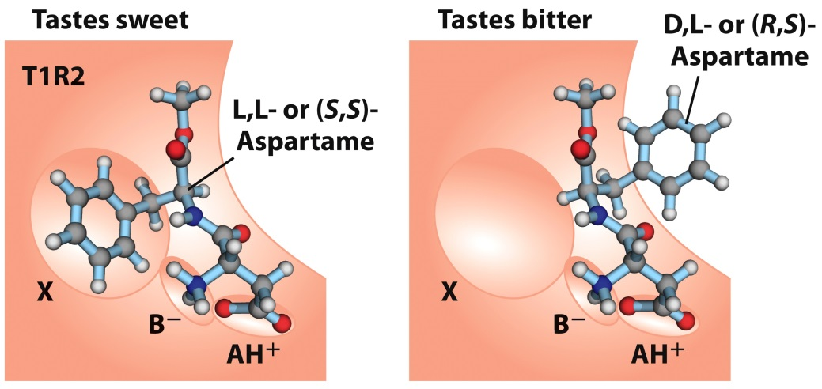
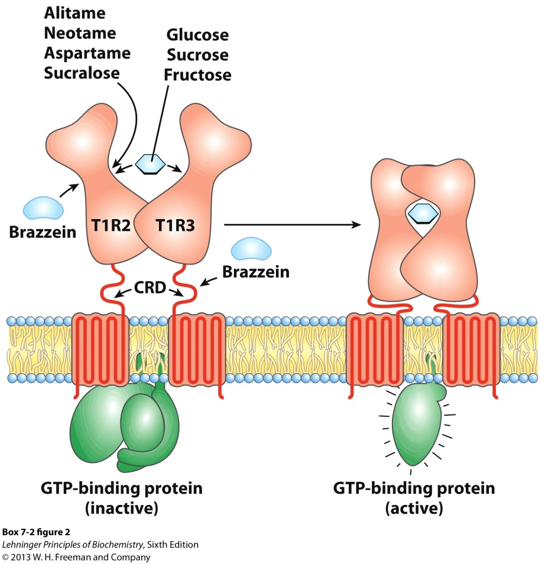
Tongue receptors are also chiral and behave differently for two stereoisomers. For example (S, S) Aspartame and (R, S) Aspartame. The first one shows sweet taste and is approximately 200 times sweeter than sucrose.
(S, S) Aspartame is used as artificial-synthetic sweetener, while the second one has bitter taste.
One stereoisomer of Aspartame (S,S) (left) binds with high affinity to the receptors and triggers the sweet signal to the brain. The other stereoisomer (R, S) (right) does not bind to the sweetness receptor. This other stereoisomer actually binds to a bitterness receptor, and tastes bitter instead of sweet.

Slide 42
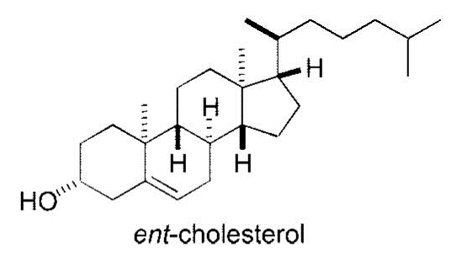
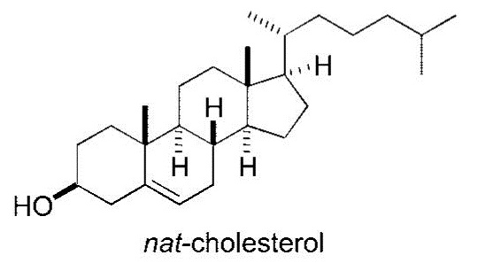
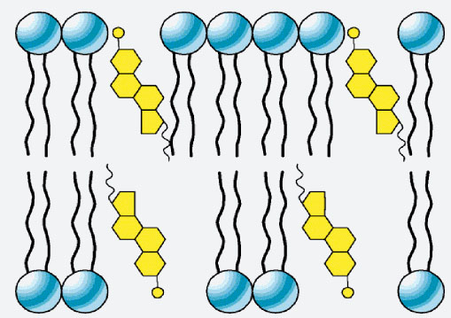
Steroids are very important organic compounds in our organism. Their base structure comes from cyclopentanoperhydrophenanthrene (Sterane). As important compounds we can mention: cholesterol, biliary acids, hormones of the Reproductive System (testosterone, estrogen), cortisol, aldosterone, D-vitamine etc.
We will take Cholesterol as an example, that serves as a precursor in other steroids synthesis. Cholesterol is also an important component of cell membranes that regulates fluidity (flexibility of cell membranes). Cholesterol just like phospholipids has polar (-OH) and nonpolar (hydrocarbon tail) parts, and through them bonds to phospholipids. Cholesterol has 8 stereocenters that means it has 256 stereoisomers, but only 2 of those stereoisomers have biological role (nat-cholesterol) and (ent-cholesterol) and only these two are synthesized through stereospecific enzymes. This is the principle of economic biological systems (not unnecessary synthesis).
*
*
*
*
*
*
*
*
*
*
*
*
*
*
*
*

Slide 43
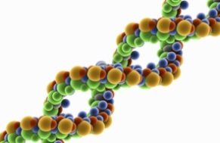
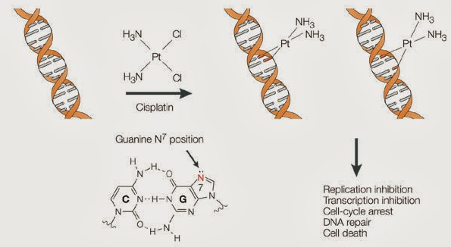
Cisplatin is a powerful cytostatic that is used as anti cancerogenic, whilst Transplatin is a stereoisomer of Cisplatin that has no pharmacological role, and is very toxic. Cisplatin mechanism: acts on DNA, releasing on two Chlorine atoms and bonding in the Nitrogen atoms in position 7, at nitrogenous bases Guanine.
Cisplatin bonds to two consecutive Guanines and blocks replication, transcription and therefore cell division and protein synthesis.
The binding of cisplatin to DNA leads to programmed cell death.
Cisplatina
cytostatic
Transplatin
toxic for the liver

Slide 44
*
*
Anti nausea
Teratogenicity
Thalidomide is a chiral drug produced for the first time in Germany. It is designed as a sedative for pregnancy and a means of preventing nausea and vomiting. Drug was produced as racemate, where R enantiomer (eutomer) has shown positive effect while S enantiomer (distomer) has shown negative effect causing phocomelia.
Thalidomide now it’s using to treat some types of cancer.

Slide 45
Captopril is a chiral drug used to treat hypertension. It is a inhibitor of the enzyme that converts Angiotensin I to Angiotensin II (ACE – Angiotensin Converting Enzyme). Renin-Angiotensin system regulates the blood pressure. The pressure is noticed by juxtaglomerular apparatus in nephrons (kidneys).
*
(S)
*
(S)
When blood pressure is low, cells of juxtaglomerular apparatus activates and secrets Renin, which activates Angiotensinogen (globular protein produced in liver) to Angiotensin I, then when through blood passes on pulmonary or renal capillaries, it gets converted to Angiotensin II via ACE.
Angiotensin II stimulates:
• Aldosterone secretion (adrenal cortex hormone) → reabsorption of Na⁺ in renal tubules (kidneys) and with it and water (keeps high blood volume = highest blood pressure)
• Vessel constriction of arterioles – increases blood pressure
• ADH secretion (antidiuretic hormone – neurohypophysis hormone) – increases water reabsorption in collecting duct system (kidneys).
Captopril decreases Angiotensin II forming and there is no blood pressure increase.

Slide 46
X
Captopril

Slide 47
*
*
*
*
*
*
*
Heroin more potent than Morphine. WHY?!
*
*
*
Heroin and Morphine have very similar chemical structure. Both have five same chiral centers with the same absolute configuration, but heroin acts more in central nervous system because it passes easier the blood-brain barrier. This passing is done easier by acetyl groups whilst at morphine there are hydroxyl groups that are more polar and that's why the morphine passing is more difficult through cell membranes, knowing that cell membranes have lipid nature (membranes where the polar substances are harder to pass).

