Slide 1
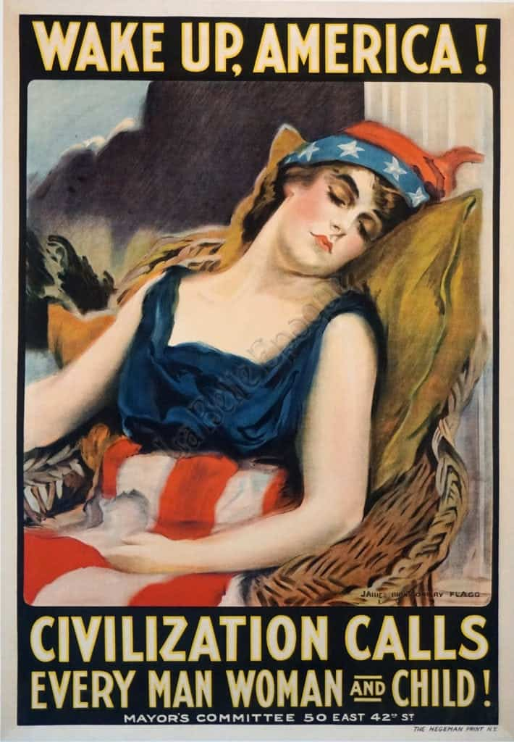
THE GREAT WAR (WWI)
AKE 118
Dr. Gamze Kati Gumus

Slide 2
Who fought in the wwi?
The Central Powers
The Allied Powers
Germany
Austria-Hungary
Turkey
France
Great Britain
Russia
Italy
Japan
The United States (as of from 1917)

Slide 3
How did it start?
With Serbia already much aggrandized by the two Balkan Wars (1912–13, 1913), Serbian nationalists turned their attention back to the idea of “liberating” the South Slavs of Austria-Hungary.
On June 28, 1914, in the Bosnian capital, Sarajevo, Franz Ferdinand (heir to the throne in Austria-Hungary) and his morganatic wife, Sophie, duchess of Hohenberg, were shot dead by a Bosnian Serb, Gavrilo Princip.
The Austrians decided to present an unacceptable ultimatum to Serbia and then to declare war, relying on Germany to deter Russia from intervention.
Notes:
https://www.britannica.com/event/World-War-I

Slide 4
THE OVERALL CONDITION
When war broke out, the Allied powers
possessed greater overall demographic, industrial, and military resources than the Central Powers
enjoyed easier access to the oceans for trade with neutral countries, particularly with the United States.
Notes:
https://www.britannica.com/event/World-War-I

Slide 5
Strength of the belligerents, Aug. 4, 1914
resources | Central Powers | Allied Powers
population (in millions) | 115.2 | 265.5
steel production (in millions of metric tons) | 17.0 | 15.3
army divisions available for mobilization | 146 | 212
modern battleships | 20 | 39
Notes:
https://www.britannica.com/event/World-War-I/Forces-and-resources-of-the-combatant-nations-in-1914

Slide 6
TECHNOLOGY
The chief developments of the intervening period had been the machine gun and the rapid-fire field artillery gun.
The modern machine gun, which had been developed in the 1880s and ’90s, was a reliable belt-fed gun capable of sustained rates of extremely rapid fire; it could fire 600 bullets per minute with a range of more than 1,000 yards (900 metres).

Slide 7
The Western Front

Slide 8
Why did the us entered the war?
When World War I erupted in 1914, President Woodrow Wilson pledged neutrality for the United States, a position that the vast majority of Americans favored.
Britain, however, was one of America’s closest trading partners, and tension soon arose between the United States and Germany over the latter’s attempted quarantine of the British Isles.
Several US ships traveling to Britain were damaged or sunk by German mines, and in February 1915 Germany announced unrestricted warfare against all ships, neutral or otherwise, that entered the war zone around Britain.
Notes:
https://www.history.com/this-day-in-history/america-enters-world-war-i

Slide 9
Notes:
Library of Congress, Rogers, W.A., "Watch Your Step," 1914

Slide 10
Why did the us entered the war?
One month later, Germany announced that a German cruiser had sunk the William P. Frye, a private American vessel. President Wilson was outraged, but the German government apologized and called the attack an unfortunate mistake.
On May 7, the British-owned Lusitania ocean liner was torpedoed without warning just off the coast of Ireland. Of the 1,959 passengers, 1,198 were killed, including 128 Americans.
In August, Germany pledged to see to the safety of passengers before sinking unarmed vessels, but in November sunk an Italian liner without warning, killing 272 people, including 27 Americans.
With these attacks, public opinion in the United States began to turn irrevocably against Germany.
Notes:
https://www.history.com/this-day-in-history/america-enters-world-war-i

Slide 11
Why did the us entered the war?
In 1917, Germany, determined to win its war of attrition against the Allies, announced the resumption of unrestricted warfare in war-zone waters.
Three days later, the United States broke diplomatic relations with Germany, and just hours after that the American liner Housatonic was sunk by a German U-boat.
The Zimmermann telegram revealed Germany’s plans to recruit Mexico to attack the United States if it did not remain neutral.
In late March, Germany sunk four more U.S. merchant ships, and on April 2 President Wilson appeared before Congress and Ccalled for a declaration of war against Germany. Four days later, his request was granted.
On June 26, the first 14,000 U.S. infantry troops landed in France to begin training for combat. After four years of bloody stalemate along the western front, the entrance of America’s well-supplied forces into the conflict marked a major turning point in the war and helped the Allies to victory.
Notes:
https://www.history.com/this-day-in-history/america-enters-world-war-I
https://www.neh.gov/humanities/2017/summer/feature/world-war-i-changed-america-and-transformed-its-role-in-international-relations

Slide 12
US Involvement IN WWI in numbers
The US entered the war on April 6, 1917.
The war ended on November 11, 1918.
By the end of the war
four million men had served in the United States Army
with an additional 800,000 in other military service branches
The United States army faced a casualty of
116,516 deaths
disease (63,114) (largely due to the influenza epidemic [the Spanish flu] of 1918)
combat (53,402)
320,000 sick and wounded
Notes:
From https://www.loc.gov/collections/stars-and-stripes/articles-and-essays/a-world-at-war/american-expeditionary-forces/
From https://encyclopedia.1914-1918-online.net/article/war_losses_usa

Slide 13
Notes:
https://prospect.org/power/american-war-dead-numbers/

Slide 14
Notes:
http://www.rationalrevolution.net/articles/casualties_of_war.htm

Slide 15
PROGRESSIVISM AND WWI
Progressives predicted that the war would
bring national unity
end class and ethnic division
destroy materialism
strengthen goals of service and sacrifice
foster moral virtue and civic purity in soldiers and civilians
purify democracy at home and abroad

Slide 16
Hysteria and repression
Self-styled patriots banded together and dedicated their groups to root out heresy and subversion, and punishing disloyalty.
German-Americans were often the targets of these groups.
Within six months of Wilson’s declaration of war, a rigid censorship, combined with political repression, had reached into American press, schools and universities, and churches.

Slide 17
ACTS restricting liberty and equality
1917
The Espionage Act of 1917
Intended to punish any person to convey information intended to interfere with the U.S. armed forces prosecution of the war effort or to promote the success of the country’s enemies.
Anyone found guilty of such acts would be subject to a fine of $10,000 and a prison sentence of 20 years.
1918
The Sedition Act of 1918
Aimed at socialists, pacifists and other anti-war activists, the Sedition Act imposed harsh penalties on anyone found guilty of making false statements that interfered with the prosecution of the war; insulting or abusing the U.S. government, the flag, the Constitution or the military; agitating against the production of necessary war materials; or advocating, teaching or defending any of these acts.
Those who were found guilty of such actions, the act stated, shall be punished by a fine of not more than $10,000 or imprisonment for not more than twenty years, or both.
Notes:
https://www.history.com/this-day-in-history/u-s-congress-passes-espionage-act
https://www.history.com/this-day-in-history/u-s-congress-passes-sedition-act

Slide 18
FIRST RED SCARE: 1917-1920
The first Red Scare occurred in the wake of WWI. The Russian Revolution of 1917 saw the Bolsheviks, led by Vladimir Lenin, topple the Romanov dynasty, kicking off the rise of the communist party and inspiring international fear of Bolsheviks and anarchists.
In the United States, labor strikes were on the rise, and the press sensationalized them as being caused by immigrants bent on bringing down the American way of life.
The Sedition Act of 1918 targeted people who criticized the government, monitoring radicals and labor union leaders with the threat of deportation.
Notes:
https://www.history.com/topics/cold-war/red-scare#section_1

Slide 22
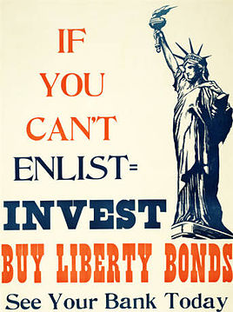
Financing the War
This Photo by Unknown Author is licensed under CC BY-SA

Slide 23
Liberty Bonds
Wilson’s secretary of the Treasury, William Gibbs McAdoo suggested that printing money was off the table.
The experience with issuing “greenbacks” during the Civil War suggested that fiat money would generate inflation, which he thought would lower morale and damage the reputation of the newly issued paper currency, the Federal Reserve Note.
McAdoo also opposed printing money because it would hide the costs of war rather than keeping the public engaged and committed.
Notes:
https://www.federalreservehistory.org/essays/liberty-bonds

Slide 24
LIBERTY BONDS
McAdoo chose a mix of taxation and the sale of war bonds.
The original idea was to finance the war with an equal division between taxation and borrowing.
Taxation would work directly and transparently to reduce consumption.
Taxes are compulsory, and those who must pay are left with less purchasing power.
Their expenditures will fall, freeing productive resources (labor, machines, factories, and raw materials) to be employed in support of the war.
President Wilson and the Democrats in Congress insisted on a sharply progressive schedule – taxing those with very high incomes at higher rates than the middle class and exempting the poor.

Slide 25
LIBERTY BONDS
It was at this point that McAdoo conceived of the Liberty Loan plan. It had three elements.
First, the public would be educated about bonds, the causes and objectives of the war, and the financial power of the country. McAdoo chose to call the securities “Liberty Bonds” as part of this educational effort.
Second, the government would appeal to patriotism and ask everyone – from schoolchildren to millionaires -- to do their part by reducing consumption and purchasing bonds.
Third, the entire effort would rely upon volunteer labor, thereby avoiding the money market, brokerage commissions, or a paid sales force. The Federal Reserve Banks would coordinate and manage sales, while the bonds could be purchased at any bank that was a member of the Federal Reserve System.
Notes:
https://www.federalreservehistory.org/essays/liberty-bonds

Slide 26
LIBERTY BONDS
To the war planners, the appeal of borrowing funds from the public was that it would be good for morale.
Individuals could demonstrate their support for the war by purchasing bonds.
Indeed, during the bond campaigns, purchasers were given buttons to wear and window stickers to display, thus advertising their patriotism.

Slide 27
LIBERTY BONDS
Fears of inadequate demand were proved unwarranted.
The first loan was oversubscribed by 50 percent, with more than four million subscribers accepted. Nationally, that would represent about one in every six households.
Subscribers for the smallest amounts were given priority. Large subscribers were rationed. According to the New York Times, John D. Rockefeller, who pledged $15 million, was allotted only “something over $3 million.” Fifty percent of the bonds sold were for the lowest face value, $50; another one-third of those sold were for the $100 bond.
Seventeen billion dollars was raised through the sale of Liberty Bonds and $8.8 billion was raised through taxation.
Notes:
https://www.federalreservehistory.org/essays/liberty-bonds
https://www.gilderlehrman.org/history-resources/spotlight-primary-source/selling-world-war-i-buy-liberty-bonds-1917-1919

Slide 33
WWI ENDS…

Slide 34
The War ends
11 Nov. 1918
Germany signed an armistice agreement with the Allies on November 11, 1918.
June 1919
The Treaty of Versailles was signed in June 1919 in Paris.

Slide 35
Wilson outlined his famous Fourteen Points in January 1918
1. Diplomacy should be public, with no secret treaties.
2. All nations should enjoy free navigation of the seas.
3. Free trade should exist among all nations, putting an end to economic barriers between countries.
4. All countries should reduce arms in the name of public safety.
5. Fair and impartial rulings in colonial claims.
6. Restore Russian territories and freedom.
7. Belgium should be restored to independence.
8. Alsace-Lorraine should be returned to France and France should be fully liberated.
9. Italy’s frontiers should be drawn along clearly recognizable lines of nationality.
10. People living in Austria-Hungary should be granted self-determination.
11. The Balkan states should also be guaranteed self-determination and independence.
12. Turks and those under Turkish rule should be granted self-determination.
13. An independent Poland should be created.
14. A general association of nations must be formed to mediate international disputes.
Notes:
https://www.history.com/topics/world-war-i/treaty-of-versailles-1

Slide 36
The fourteen points
Wilson wanted to create a new world order along the lines of the Fourteen Points. The other leaders of the Big Four (United States, Great Britain, France, and Italy) saw Wilson as too naive and idealistic, and his principles were difficult to translate into policy.
The U.S. Congress failed to ratify the treaty.
President Woodrow Wilson was the primary architect of the League of Nations, an international peacekeeping organization that was the centerpiece of the Treaty of Versailles.
The Senate rejected the treaty for ratification, and the United States never joined the League of Nations. The Senate did approve for ratification of separate peace treaties with Germany, Austria, and Hungary.
Notes:
https://www.history.com/topics/world-war-i/treaty-of-versailles-1
https://www.visitthecapitol.gov/exhibitions/artifact/treaty-peace-germany-treaty-versailles-1919

Slide 37
A note
Radical right-wing political forces—especially the National Socialist Workers’ Party, or the Nazis—would gain support in the 1920s and ‘30s by promising to reverse the humiliation of the Versailles Treaty.
With the onset of the Great Depression after 1929, economic unrest destabilized the already vulnerable Weimar government, setting the stage for Nazi leader Adolf Hitler’s fateful rise to power in 1933.
Notes:
https://www.history.com/topics/world-war-i/treaty-of-versailles-1

Slide 38
The home front
The war shaped the writings of Ernest Hemingway and John Dos Passos.
On the home front, millions of women went to work, replacing the men who had shipped off to war, while others knitted socks and made bandages.
When the American Expeditionary Forces shipped off to Europe, so too did approximately 16,500 women. They worked as clerks, telephone operators, and nurses; they also ran canteens that served meals to soldiers and offered a respite from battle.
Notes:
https://www.neh.gov/humanities/2017/summer/feature/world-war-i-changed-america-and-transformed-its-role-in-international-relations

Slide 39
THE HOME FRONT
For African-American soldiers, the war opened up a world not bound by America’s formal and informal racial codes.
The U.S. Army shunted African-American soldiers into segregated units and issued them shovels more often than rifles.
Some, however, fought alongside the French as equals, prompting questions about their treatment by their own country.
African-American soldiers came home as citizens of the world with questions about their place in American society.
Notes:
https://www.neh.gov/humanities/2017/summer/feature/world-war-i-changed-america-and-transformed-its-role-in-international-relations

Slide 51
WWI SONGS
https://www.youtube.com/watch?v=_8kNpGTPbvk&list=PL9-qGPmFEWNMXw57S_q3TZNZg-f99GUMC
https://www.youtube.com/watch?v=2q3jh-tqt9c

