Slide 1
Reproductive Cycles in the Female

Slide 2
Terminology
Estrus is a noun.
The cow is displaying estrus.
Estrous is an adjective.
The length of the estrous cycle is 21 days.
Oestrus and Oestrous
British and European spellings
Estrus and Heat are synonymous

Slide 3
Terminology (cont.)
Anestrus
When the female is not having repeated estrous cycles.

Slide 4
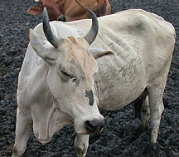
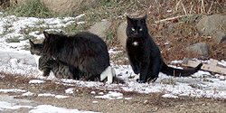
Types of Cyclicity
Polyestrus
Queen
Cow
Sow
Relative E₂
J
F
M
A
M
J
J
A
S
O
N
D

Slide 5
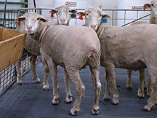
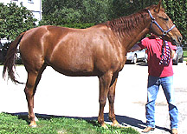
Types of Cyclicity
Seasonally Polyestrus
Short day breeders
(Fall)
Long day breeders
(Spring)
Relative E₂
Relative E₂
J
F
M
A
M
J
J
A
S
O
N
D
J
F
M
A
M
J
J
A
S
O
N
D

Slide 6
Type of Cyclicity
Monoestrus
Dog
Wolf
Bear
Relative E₂
J
F
M
A
M
J
J
A
S
O
N
D

Slide 7
Average Reproductive Cycles
Species Length of Length of Ovulation Length of
Estrous Cycle Estrus Pregnancy
cow 21 days 18 hr 11 hr after 282 days
polyestrus end estrus
ewe 17 days 29 hr near end 148 days
seasonal (fall) estrus
sow 21 days 48-72 hr 35-45 hr 115 days
polyestrus after start
estrus
mare 21 days 4-8 days 3-6 day of 335 days
seasonal (spring) estrus
polyestrus (1-2 days
before end of
estrus)

Slide 8
Average Reproductive Cycles
Species Length of Length of Ovulation Length of
Estrous Cycle Estrus Pregnancy
Bitch 6 months 9 days 4 - 24 days 63 days after start of estrus
Queen 17 days 9 days Induced 63 days

Slide 9
Variation in Cycle Types
Example Type of Follicular Ovulation & CL
Cycle Development CL Formation Function
Cow, ewe, Long Spontaneous Spontaneous Spontaneous
sow, mare
rats, mice, Short Spontaneous Spontaneous Induced
hamsters (4 days) (prolactin)
rabbit, cat, Induced Spontaneous Induced Induced
mink, ferret, (LH surge)
otter, alpaca

Slide 10
CL
Ovulation
CA
Progesterone
PGF
2
α
Estradiol
FSH
LH
-7
- 6
- 5
- 4
- 3
- 2
-1
0
1
2
3
4
5
6
7
8
Days Relative to the Gonadotropin Surge
Diestrus
Proestrus
Estrus
Metestrus
Diestrus

Slide 11
CL
Ovulation
CA
Progesterone
PGF
2
α
Estradiol
FSH
LH
-7
- 6
- 5
- 4
- 3
- 2
-1
0
1
2
3
4
5
6
7
8
Days Relative to the Gonadotropin Surge
Diestrus
Proestrus
Estrus
Metestrus
Diestrus

Slide 12
CL
Ovulation
CA
Progesterone
PGF
2
α
Estradiol
FSH
LH
-7
- 6
- 5
- 4
- 3
- 2
-1
0
1
2
3
4
5
6
7
8
Days Relative to the Gonadotropin Surge
Diestrus
Proestrus
Estrus
Metestrus
Diestrus

Slide 13
CL
Ovulation
CA
Progesterone
PGF
2
α
Estradiol
FSH
LH
-7
- 6
- 5
- 4
- 3
- 2
-1
0
1
2
3
4
5
6
7
8
Days Relative to the Gonadotropin Surge
Diestrus
Proestrus
Estrus
Metestrus
Diestrus

Slide 14
CL
Ovulation
CA
Progesterone
PGF
2
α
Estradiol
FSH
LH
-7
- 6
- 5
- 4
- 3
- 2
-1
0
1
2
3
4
5
6
7
8
Days Relative to the Gonadotropin Surge
Diestrus
Proestrus
Estrus
Metestrus
Diestrus

Slide 15
CL
Ovulation
CA
Progesterone
PGF
2
α
Estradiol
FSH
LH
-7
- 6
- 5
- 4
- 3
- 2
-1
0
1
2
3
4
5
6
7
8
Days Relative to the Gonadotropin Surge
Diestrus
Proestrus
Estrus
Metestrus
Diestrus

Slide 16
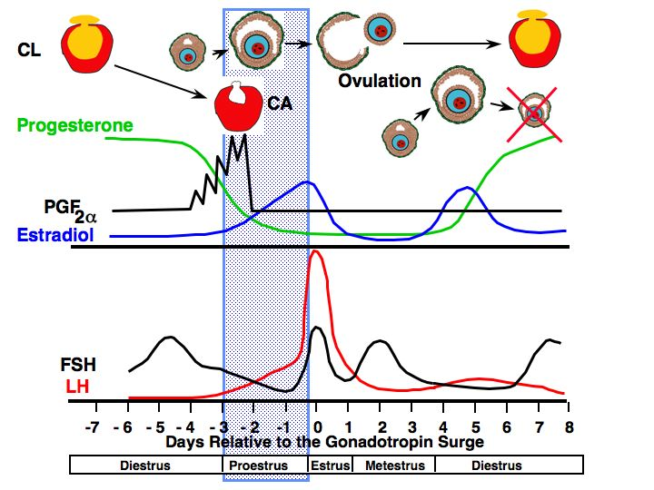
Follicular Phase
Proestrus
Preovulatory follicle enlarges
estrogen increases
vascularity of the female reproductive tract increases
endometrial glands begin to grow
estrogen levels peak

Slide 17
CL
Ovulation
CA
Progesterone
PGF
2
α
Estradiol
FSH
LH
-7
- 6
- 5
- 4
- 3
- 2
-1
0
1
2
3
4
5
6
7
8
Days Relative to the Gonadotropin Surge
Diestrus
Proestrus
Estrus
Metestrus
Diestrus

Slide 18
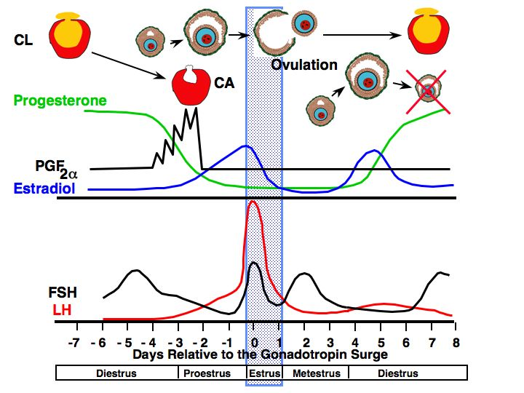
Follicular Phase
Estrus
allows male to mount
estrogen decreases
LH surge occurs
ovulation 24-48 hr after surge of LH
uterine motility high with contractions moving toward oviduct
sperm transport is optimal
cervical mucus volume increases

Slide 19
CL
Ovulation
CA
Progesterone
PGF
2
α
Estradiol
FSH
LH
-7
- 6
- 5
- 4
- 3
- 2
-1
0
1
2
3
4
5
6
7
8
Days Relative to the Gonadotropin Surge
Diestrus
Proestrus
Estrus
Metestrus
Diestrus

Slide 20
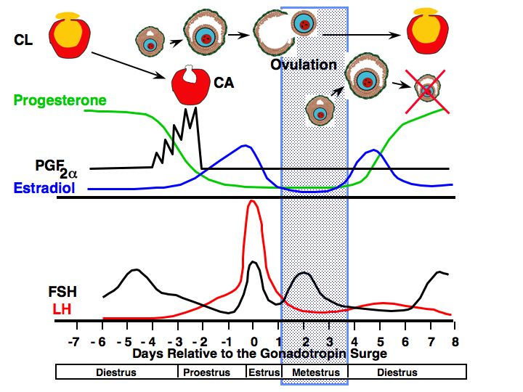
Luteal Phase
Luteal Phase
Metestrus
estrogen low
ovulation in cow
corpus hemorrhagicum present
uterus
contractions subside
endometrial glands continue to grow and become coiled
in cattle bleeding occurs
FSH increases
triggering growth of follicles

Slide 21
CL
Ovulation
CA
Progesterone
PGF
2
α
Estradiol
FSH
LH
-7
- 6
- 5
- 4
- 3
- 2
-1
0
1
2
3
4
5
6
7
8
Days Relative to the Gonadotropin Surge
Diestrus
Proestrus
Estrus
Metestrus
Diestrus

Slide 22
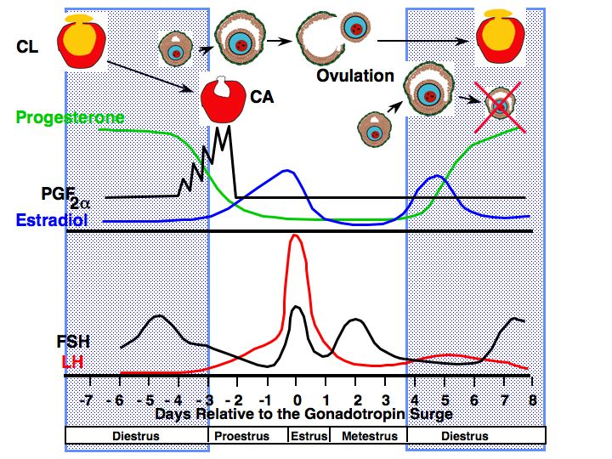
Luteal Phase
Luteal Phase
Diestrus
progesterone high
FSH
Increases at some point to cause growth of ovulatory follicle
Uterus
secrets fluid but volume gradually decreases
contraction stop
CL regresses at the end of this period if female is not pregnant due to PGF release

Slide 23
Characteristics of Estrous Cycles
Cow Ewe Sow Mare
Estrous cycle (days) 21 17 21 21
Proestrus (days) 3-4 2-3 3-4 2-3
Estrus 12-18 hr 24-36 hr 48-72 hr 4-8 days
Metestrus (days) 3-4 2-3 2-3 2-3
Diestrus (days) 10-14 10-12 11-13 10-12

Slide 24
Hormonal Changes in the Bitch
Estrus
Proestrus
Anestrus
Progesterone
LH
Ovulation
FSH
E₂
-20
0
10
20
Days

Slide 25
Heat
20 day
Metestrus I
Metestrus II 70 days
Progesterone
Parturition
E₂
Prolactin
-20
0
20
40
60
80
Day of Metestrus

Slide 26
Hormonal Changes in the Queen
Queen in Estrus (no mating)
Estrus
(9 days)
E₂
E₂
P₄
P₄
4
8
12
16
4
8
12
16
20
Weeks

Slide 27
Hormonal Changes in the Queen
Queen in Estrus (no mating)
Estrus
E₂
E₂
P₄
Proestrus
(8 days)
P₄
4
8
12
16
4
8
12
16
20
Weeks

Slide 28
Hormonal Changes in the Queen
Queen in Estrus (no mating)
Mating
Estrus
Parturition
Pregnancy
Lactation
E₂
E₂
P₄
Proestrus
P₄
4
8
12
16
4
8
12
16
20
Weeks

Slide 29
Causes of Anestrus
Pregnancy
Presence of Offspring
Season
Pathology
Nutrition
Stress

Slide 30
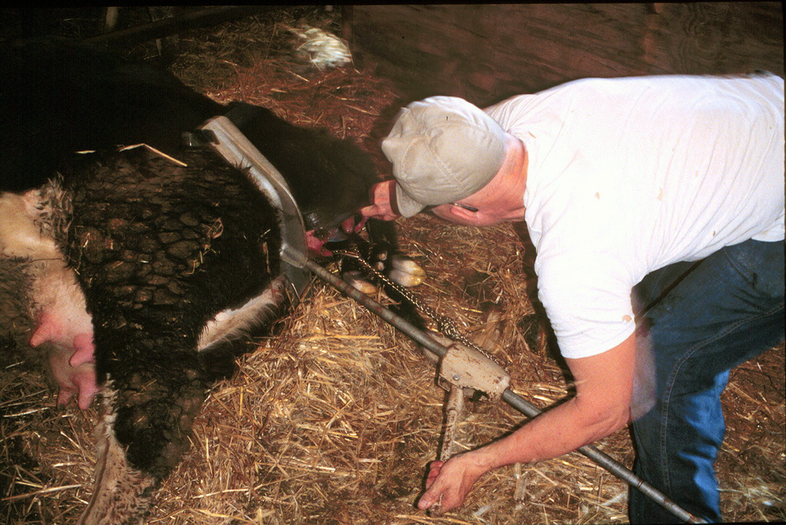
Gestational Anestrus

Slide 31
Gestational Anestrus
Progesterone during pregnancy
negative feedback
After parturition anestrus continues
progesterone exposure during pregnancy
hypothalamus
Lacks estradiol positive feedback
allows time for uterine involution

Slide 32
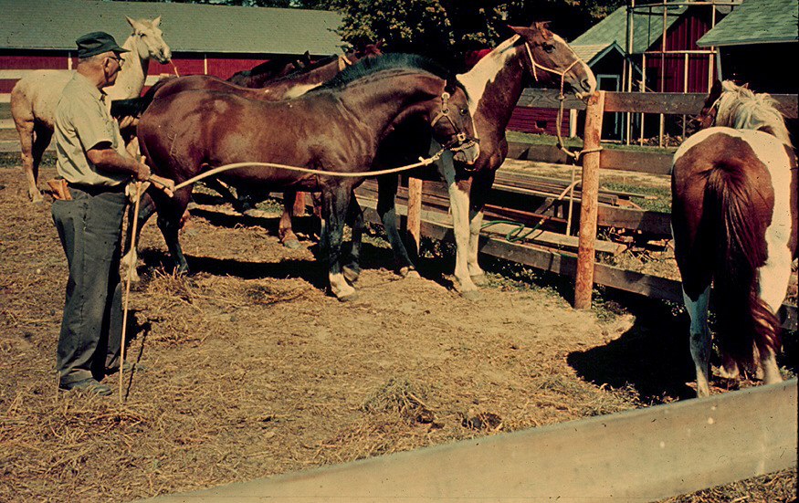
Seasonal Anestrus
Horses are long day breeders!

Slide 33
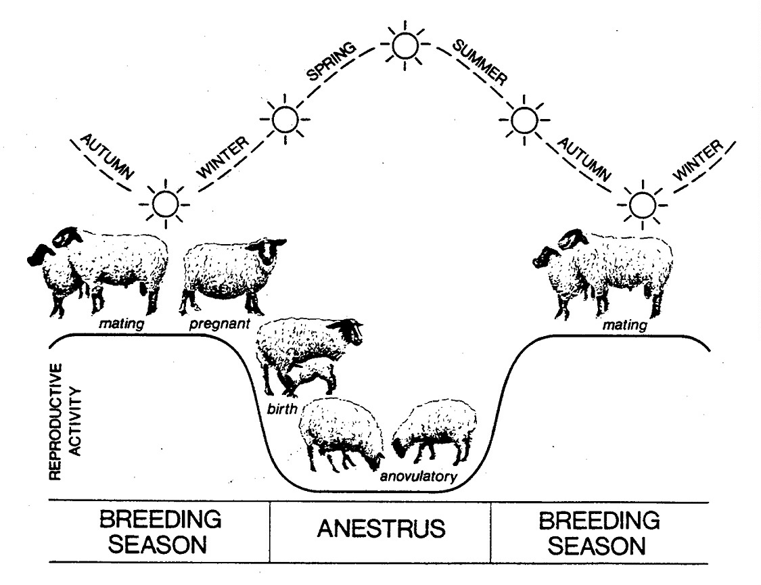
Sheep are short day breeders!

Slide 34
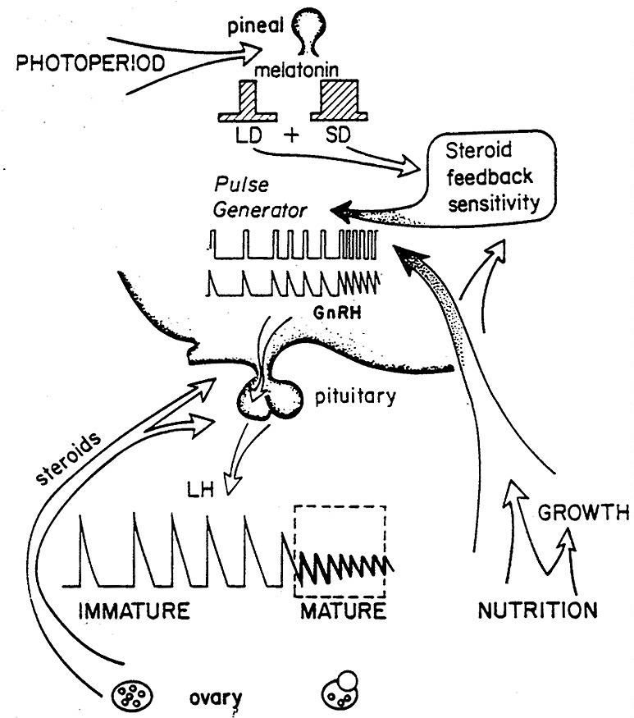
Estradiol

Slide 35
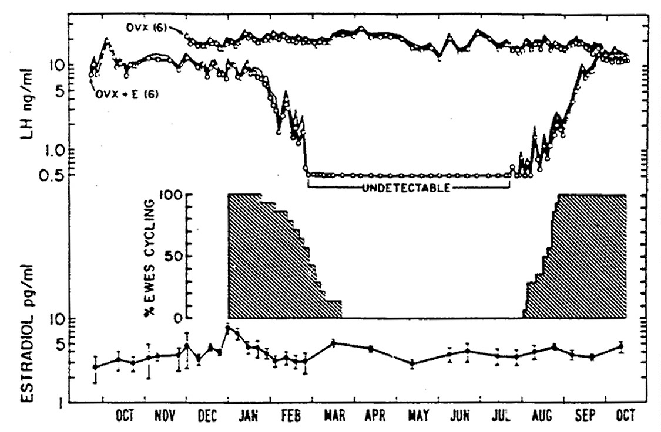
Negative
Feedback
increases
Decreased Negative Feedback

Slide 36
Estradiol

Slide 37
Seasonal Anestrus
just like entering puberty
silent ovulation

Slide 38
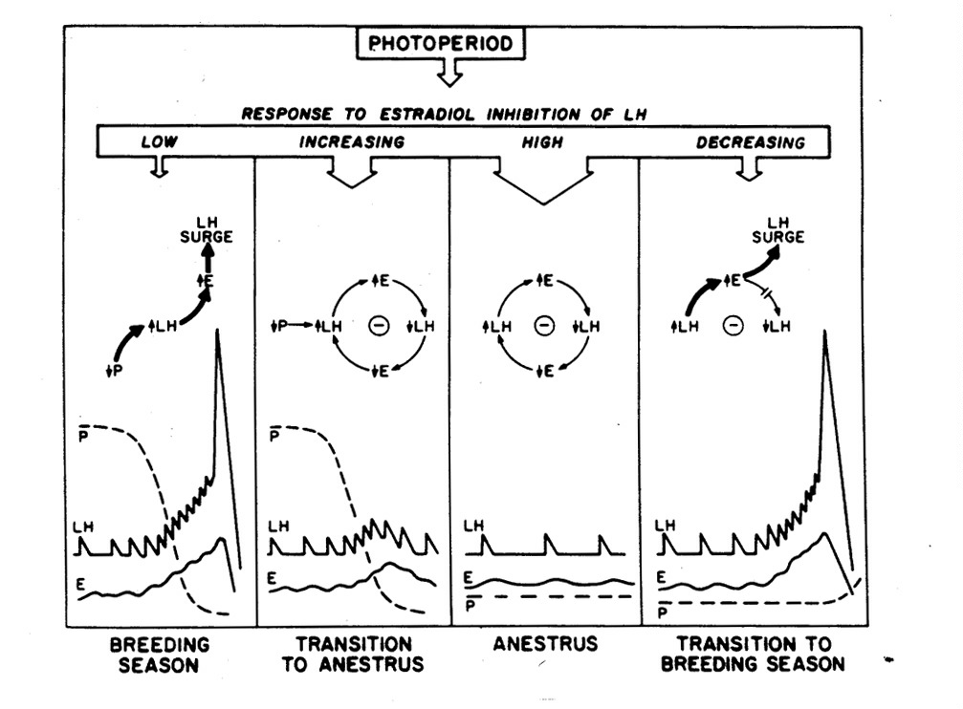
+
+

Slide 39
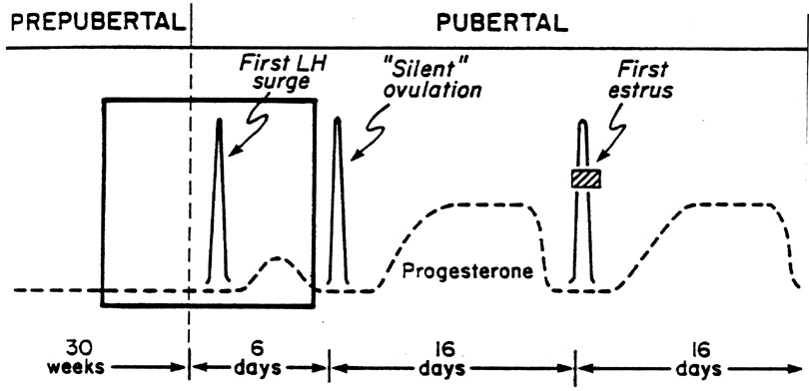
Silent Ovulation
Anestrus
Estrus
Brain (hypothalamus) must be primed with Progesterone
To Express Estrus in Response to Estrogen

Slide 40
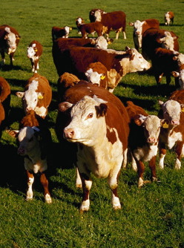
Lactational Anestrus

Slide 41
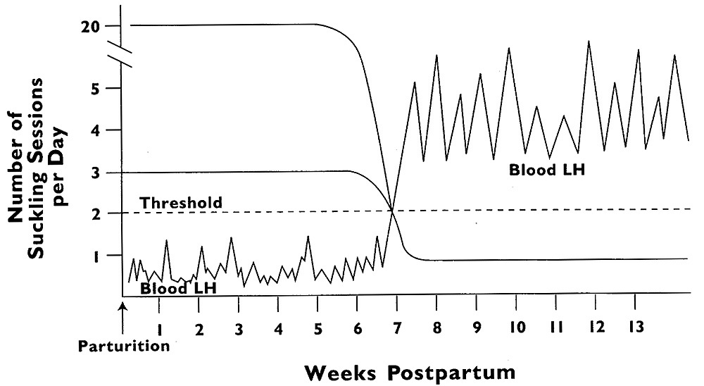
Suckling Effect on LH

Slide 42
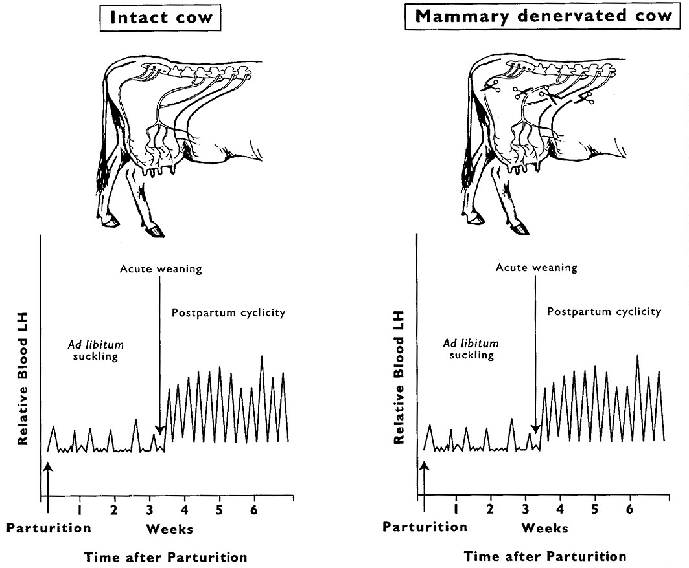

Slide 43
Lactational Anestrus
Suckling
Other offspring factors
visual encounter
olfactory encounter
auditory encounter
Prolactin
inhibits GnRH release
major infertility problem in women who are not lactating

Slide 44
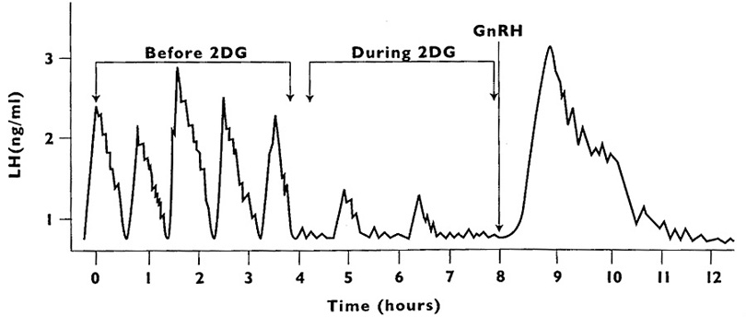
Nutritional Anestrus

