Slide 1
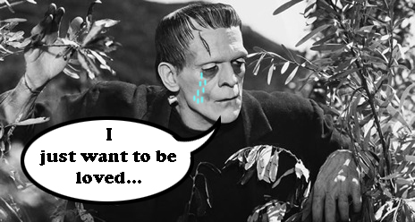
Several monsters ın frankenstein and
the concept of the other

Slide 2
Justine: A poor girl living with the Frankenstein family.
Victor: Gradually turns into a monster.
Frankenstein’s Monster

Slide 3
others
Minorities
Marginal People
Misfits
Opposite of normal

Slide 4
“I was benevolent and good; misery made me a fiend. Make me happy, and I shall again be virtuous.”
“I will treat you the way you treat me.”
“All men hate the wretched.”

Slide 5
prejudice
Felix, Safie and the blind father
The injured girl in the woods

Slide 6
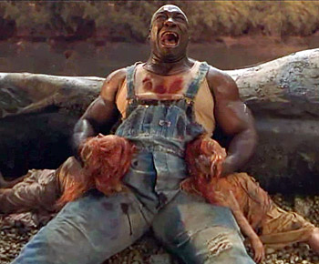

Slide 7
the monsters
Justine: A poor girl living with the Frankenstein family.
Victor: Gradually turns into a monster.
Frankenstein’s Monster
The society

Slide 8
Is there any difference between Victor and his Monster?
Whose fault is it?
“Am I the only criminal?”

Slide 9
The crımınals/monsters
Victor
Frankenstein’s Monster
The Society

Slide 10
Not just for young adults
Not just horror studies
Symbolic overtones
Messages concerning life, universe, everything

Slide 11
