Slide 1
Anglophone Literature

Slide 2
INDIA

Slide 3
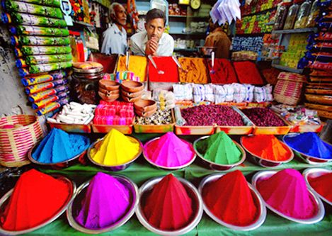
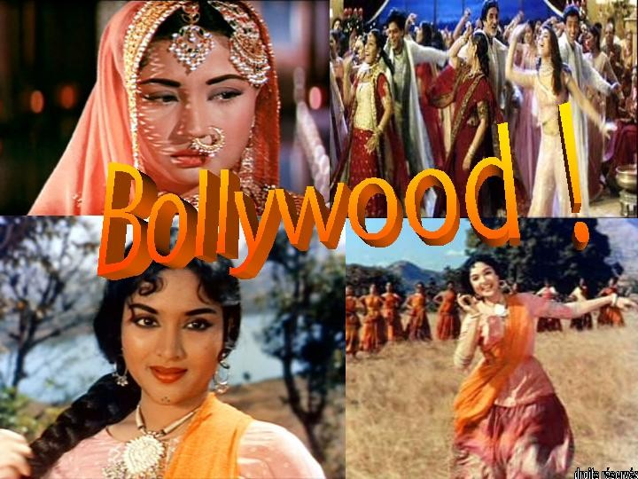
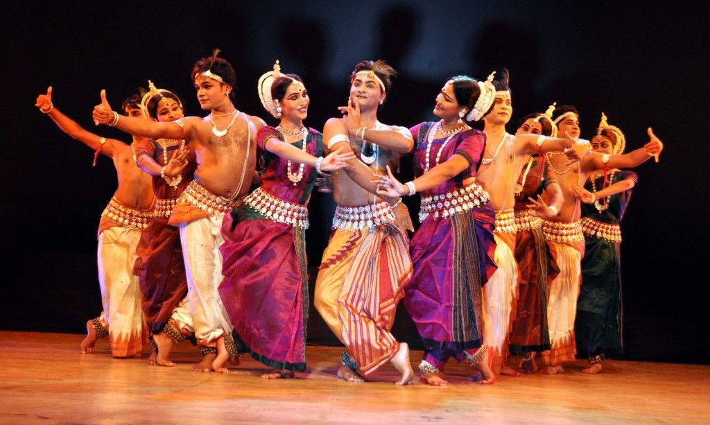
INDIA

Slide 4
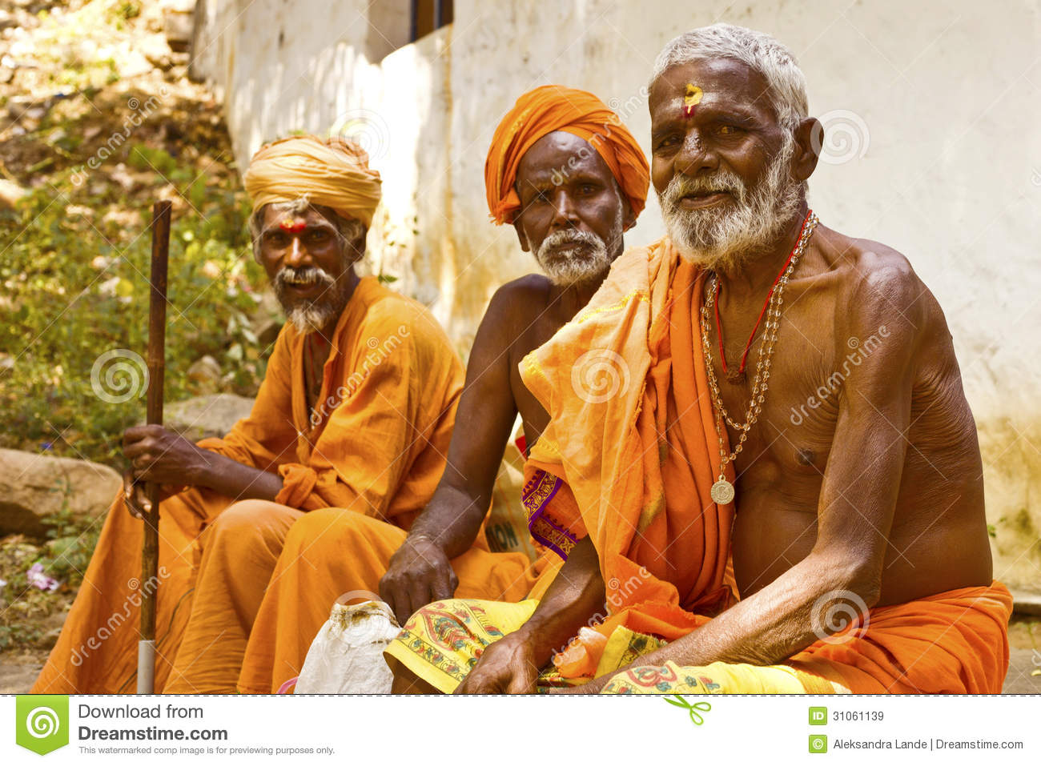
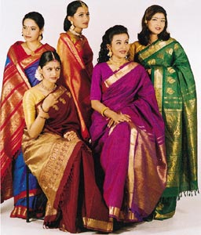
INDIA

Slide 5
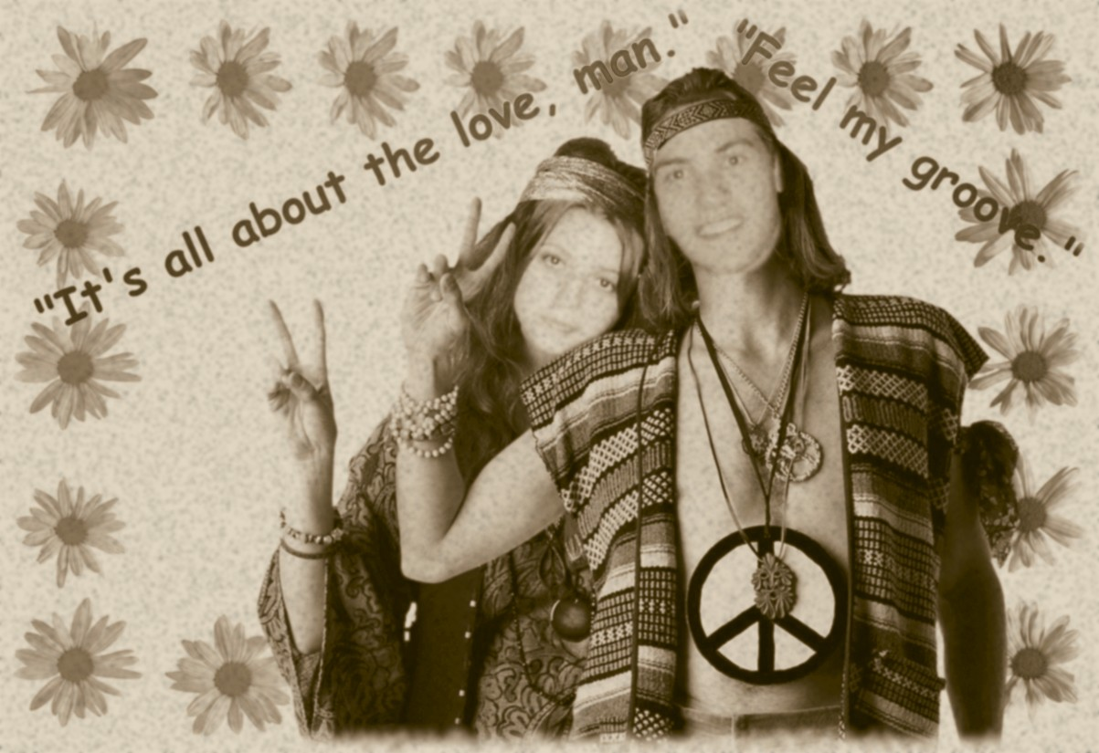

Slide 6
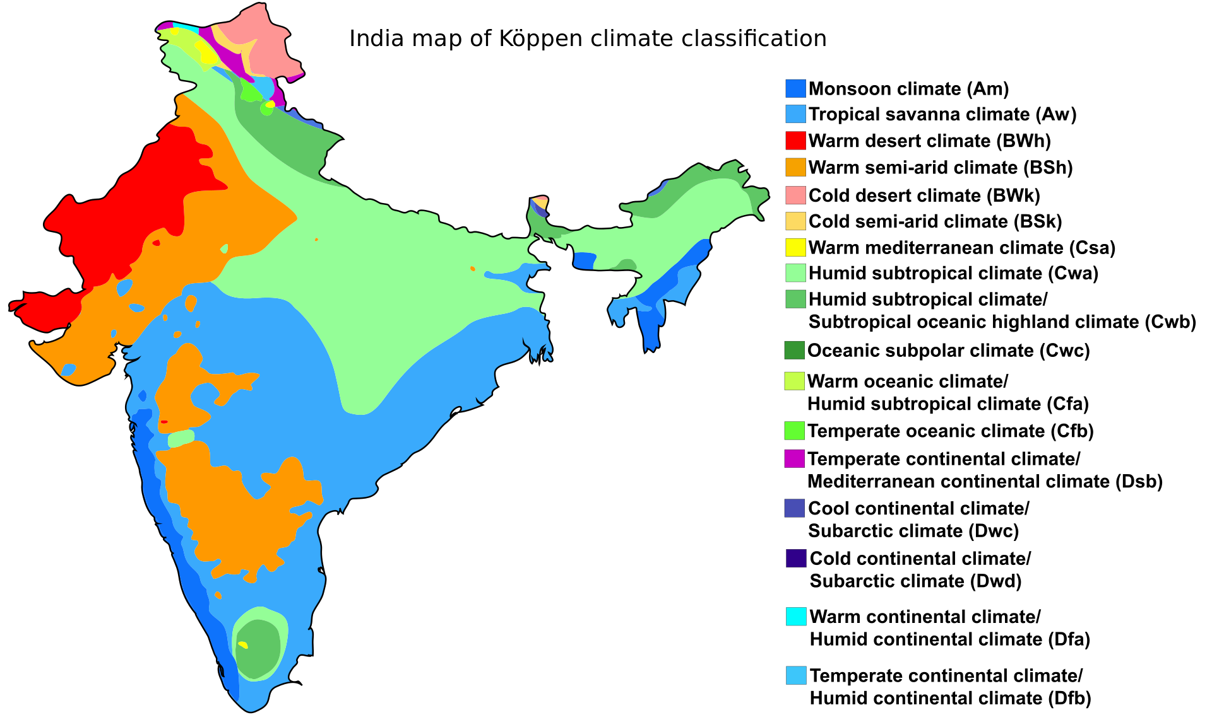

Slide 8
“The sun never set on the British Empire”
For decades, this was true: the British colonial Empire touched all corners of the globe.
Britain ruled almost 25 percent of the world population and has colonies all around the world.
The British Empire lost its power and prestige after the Second World War.

Slide 9
How did the British come to rule India?
The British presence in India dates back to the early part of the seventeenth century.
At first, British rule in India was in the hands of the private East India Company, whose purpose was just to carry on trade.
But because of rivalry between England and France, the company began to extend its control over more and more of India, and then the British government took direct control over India in 1857.
This was followed by a rapid expansion of British power through the greater part of South Asia in the early 19th century.
By the middle of the century the British had already gained direct or indirect control over almost all of India.
India became a valuable part/source of the British Empire and thus became known as "the jewel in the British crown".

Slide 10
There was a case in which 100, 000 British soldiers were ruling a country of more than 200 million. There was a big difference between the lives of the British in India and the lives of the native Indians, as you can see from these pictures.

Slide 11
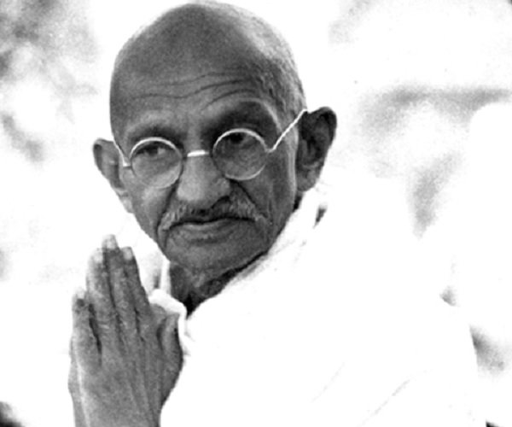
The Indian Independence Movement and Mahatma Gandhi:
In the 20th century Mahatma Gandhi led millions of people in a national campaign of non-violent civil disobedience to obtain independence from the British.
Therefore, 1947 became a particular moment in Indian history which heralded the end of the one hundred year of British colonialism.
There was a long-running religious tension between the Hindus and Muslims, triggered by the British policy of divide and rule.
Mahatma Gandhi called for unity among the two religious groups.
The British Empire, whose economy had been weakened after World War-II, decided to leave India and paved the way for the formation of an interim (temporary) government.

Slide 12
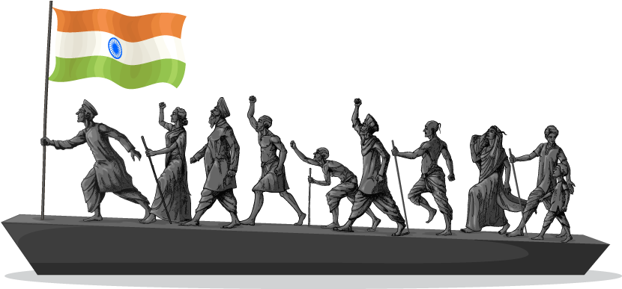
1947 THE INDEPENDENCE OF INDIA

Slide 13
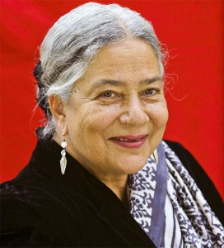
ANITA DESAI
Born in India, 1937 (age 79)
Indian novelist who was born to a German mother and an Indian father.
Though she was born in India and spent her early life there, she moved to the US to work and write there.
She has travelled extensively and taught creative writing in several colleges.
Many of her works have been turned into films.

Slide 14
Anita Desai’s Work
Her works are different from those of other Indian women writers in English: Nayantara Sahgal, Kamala Markandaya, and Ruth Prawer Jhabvala, who mainly concern themselves with politics, East-West encounter and social themes respectively.
She puts great emphasis on characterization.
Her characters have a tendency to turn inward. Her work unravels the mystery of their inner lives.
The characters often indulge in a self-analysis and discover themselves in the process.

Slide 15
The writer shows through characters’ narratives their fears, obsessions and neurosis and how they accommodate or alienate themselves from their surroundings.
The problems and passions of most of these characters are rather existential.
Her female characters are more realized and more neatly drawn.
Her works abound in vivid description and life like portrayals.
In Anita Desai’s novels and short stories one can trace a symbolic representation of the equality of status achieved by India after her independence.

Slide 16
‘’Scholar and Gypsy’’ is one of the short stories in Anita Desai’s story collection book named Games at Twilight, first published in 1978. The story follows an American couple, Pat and David, who have travelled to India for the husband's research for his sociology thesis. It looks closely into their relationship throughout their travels in Bombay, Delhi and Manali.
Throughout the story, she deals with the cultural clash between a newly married American couple (Pat and David) and the natives living in India, the complexities of human relations, and the unexplorable depths or the unpredictability of human nature.

Slide 17
HOW TO ANALYSE A SHORT STORY?
Setting
Characterization
Plot and Structure
Narrator and Point of View
Conflict
Climax
Theme
Style

Slide 18
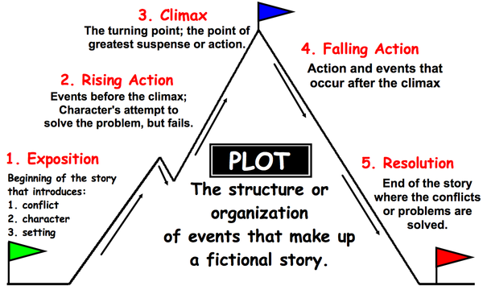

Slide 19
WHAT IS THE SIGNIFICANCE OF THE TITLE OF THE STORY?
How does it prepare us for the action that takes place?

Slide 20
SCHOLAR X GYPSY

Slide 21
In the title of the story, a binary opposition is established between scholar and gypsy. As reader, we follow the trace how meaning is produced by means of this binary opposition between scholar and gypsy.
One might assume that a scholar has such connotations as educated, civilized, smart, intellectual, and therefore willing to be open to ideas and opinions of others, and that they would be culturally open.
When one thinks of gypsy - they think of an uneducated person, someone who sticks mostly to their own group of people and is unwilling to open up to the rest of society.

Slide 22
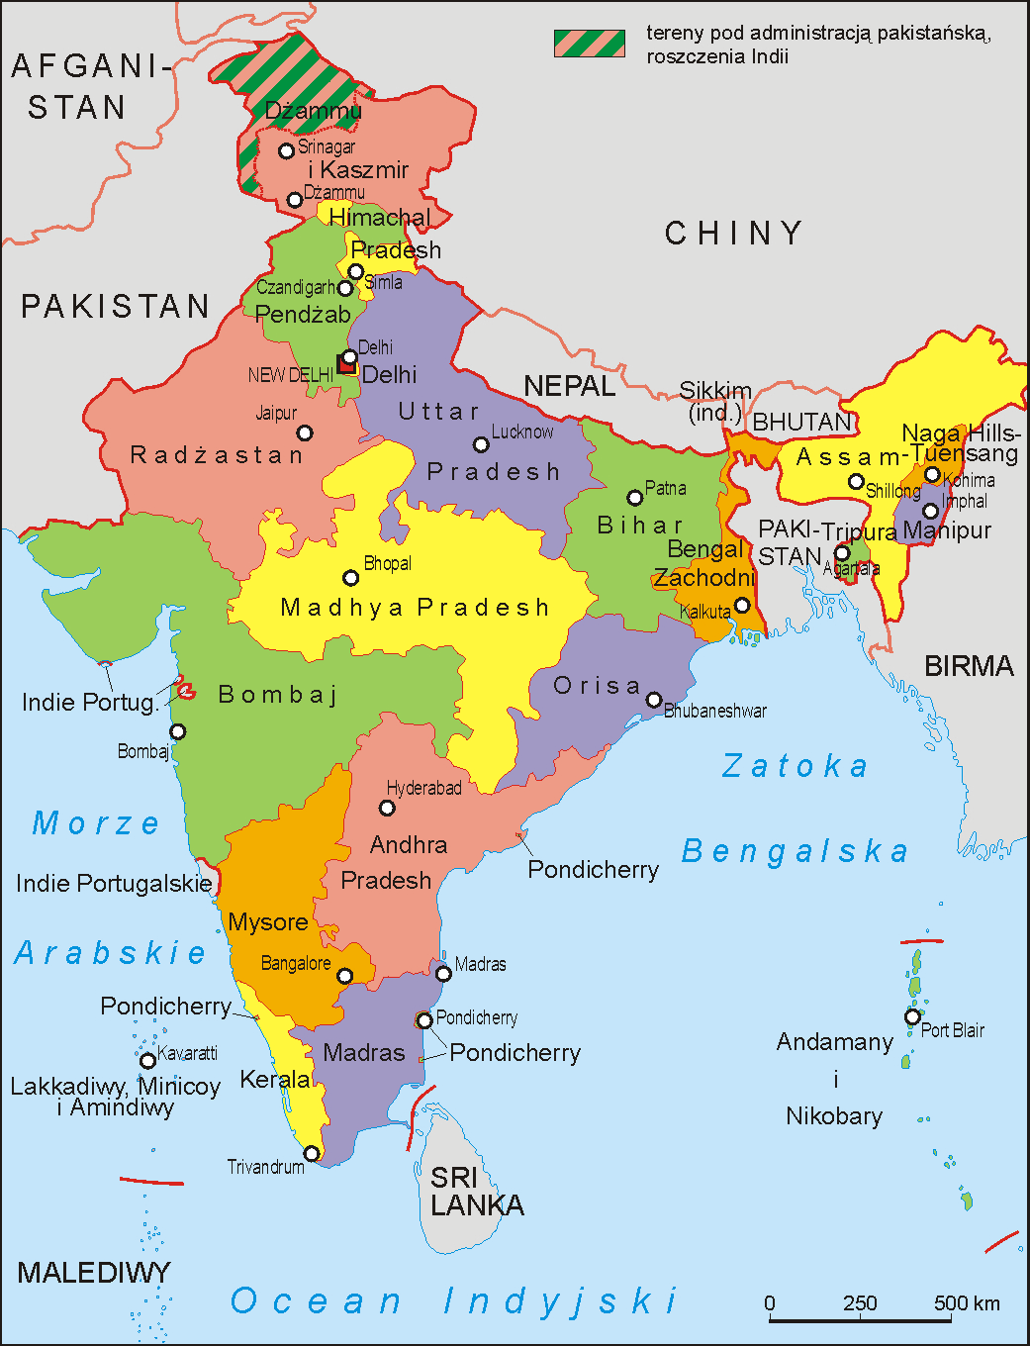
SETTING

Slide 23
SETTING
The story is set in three different cities around India –
Bombay,
Delhi
Manali.
While Delhi and Bombay is overflowing with people, colours and nightlife; in Manali the bazaar is busy with cultural flavour and hippies. In the work, setting plays a significant role. It is the substantial component which contributes to meaning since it serves as a test field for the characters that will lead them to self-realization.

Slide 24
BOMBAY: The beginning of the story is set in Bombay and opens with the following sentences:
“Her first day in Bombay wilted her. If she stepped out of the air-conditioned hotel room, she drooped, her head hung, her eyes glazed, she felt faint. Once she was back in it, she fell across her bed as though she had been struck by calamity, was extinguished, and could barely bring herself to believe that she had, after all, survived. Sweating, it seemed to her that life, energy, hope were all seeping out of her” (1).
Unlike Pat, David “looked so right, so fitting on the Bombay streets” (1).

Slide 25
‘’Her first day in Bombay wilted her. If she stepped out of the air-conditioned hotel room, she drooped, her head hung, her eyes glazed, she felt faint. Once she was back in it, she fell across her bed as though she had been struck by calamity, was extinguished, and could barely bring herself to believe that she had, after all, survived. Sweating, it seemed to her that life, energy, hope were all seeping out of her’’
Unlike Pat, David “looked so right, so fitting on the Bombay streets” (1).

Slide 26
BOMBAY: is crowded, a bustling city and has a hectic life style.
FOR PAT:
The stifling weather
Excessive heat
The city is intimidating
People are primitive.
The smell of food is disgusting.
The chief occupation is going to the parties.
FOR DAVID:
David feels comfortable
The weather is not suffocating
Bombay’s hectic life style is quite enjoyable for him.
David easily socializes with people

Slide 27
DELHI: This is the second setting of the story which has drier weather when compared to Bombay.
‘’Delhi was drier. It was dry as a skeleton. Yellow sand seethed and stormed, then settled on wood, stone, flesh and skin, brittle and gritty as powdered bone. Trees stood leafless. ... Pat said, walking determinedly through the piled yellow dust, I must pull myself together. Her body no longer melted, it did not ooze and seep out of her grasp any more. It was dry, she would hold herself upright, she would look into people’s eyes when they spoke to her and smile pleasantly – like David, she thought. But the dust inside her sandals made her feet drag. If she no longer melted, she burnt’’ (6).

Slide 28
David: “But you can’t let climate get you down, dear” (6).
Pat: “I’m just not sophisticated enough for you” (7).
David: “I expect you knew about such things – you must have learnt them in college”
Pat: “You know I only went to high school and stayed at home after that” (8).
Remarkably, this dialogue reveals the disparity in their backgrounds (class, education) for the first time. Her family is farmer people. The reader gets the implication that the bond between them is being shattered. Harsh environmental conditions are steadily causing the dissolution of their relationship. They are frightened at realizing this.

Slide 29
MANALI: The third and last setting of the story is Manali. Manali is a small town, merely an overgrown village. There are Indian gurus (in loincloth or saffron robes with beads around their necks) and gypsies (in pantaloons or spangled skirts, some of them were in rags and tatters). All are in barefoot.

Slide 30
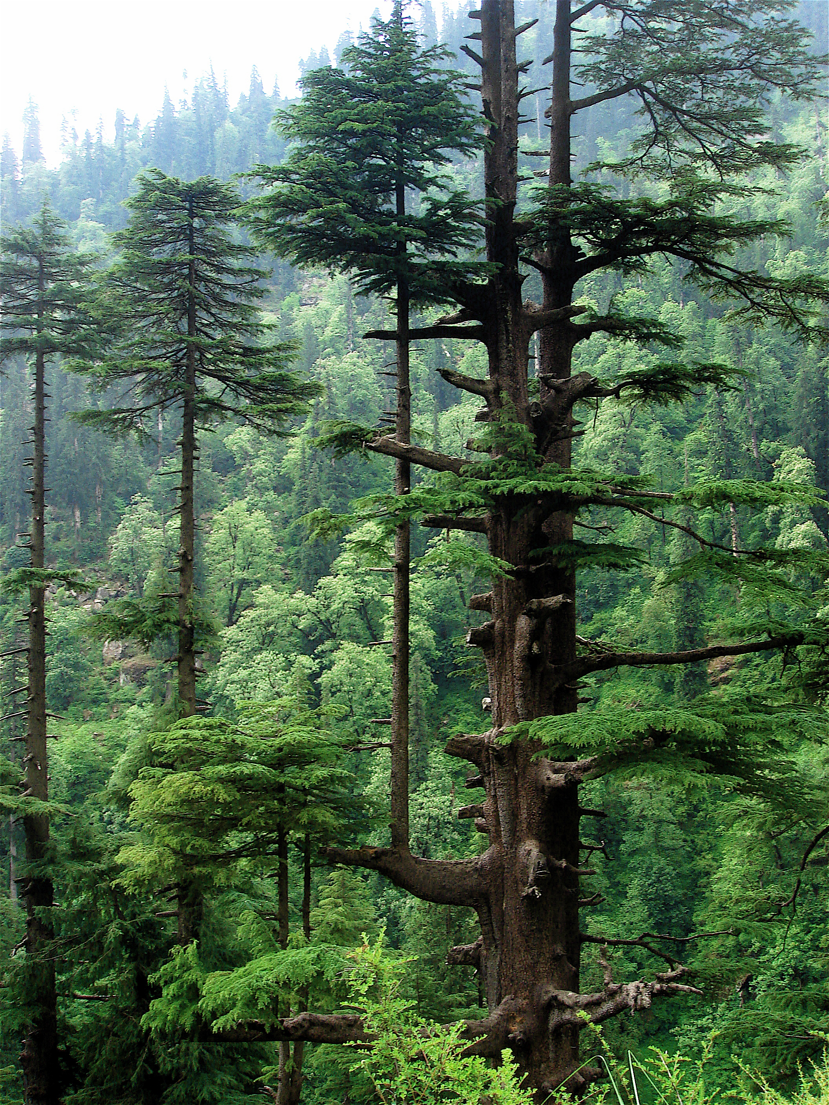

Slide 31
Upon her insistence to go out, they go out for their first exploration of the environment. They come across a “jack in the pulpit”. As a country woman, Pat immediately identifies the plant. She appreciates its beauty resembling it to a sinister gentleman while for David it connotes “a silent cobra” (18).

Slide 32
Their roles are reversed
FOR PAT:
The landscape is liberating and familiar.
She calls the people there as ‘true mountain people’.
She enjoys walking around, going to the bazaar and socializing with people.
FOR DAVID:
It is irritating and unfamiliar.
David calls them “damn vagabonds” (23).
David is bored, hates the people there, humiliates the natives and hippies.

Slide 33
One day, Pat takes David for a walk. Destination is a temple. Tension between them climbs when David ridicules her for her mistaking a Hindu temple for a Buddhist one. This becomes breaking point between them. David says “You’re sitting outside a Hindu shrine, this is a Hindu temple, and you’re making it out to be a source of Buddhist strength and serenity! Don’t you even know that the Kulu Valley has a Hindu population, and the shrines you see here are Hindu shrines?” (27).

Slide 34
Remarkably, previously loving husband David loses his attraction to her and feels as follows:
As she grew browner from the outdoor life and her limbs sturdier from the exercize, it seemed to him she was losing her fragility, the gentleness that he had loved in her, that she was growing into some rough, sharp countrywoman who might very well carry loads, chop wood, haul water and harvest, but was scarcely fit to be his wife – his, David’s, the charming and socially graceful young David of Long Island upbringing – and her movements were marked by rough angles that jarred on him, her voice, when she bothered at all to reply to his vague questions, was brusque and abrupt. It was clear there was no meeting-point between them any more – he would have considered it lowering in status to make a move towards her and she clearly had no interest in meeting him halfway, or anywhere (Desai 28-9).

Slide 35
“What particularly anguished him was the sight of the Indian tourists who had made an outer circle around this central core of seekers of nirvana and bliss-through-bhang, as if this were one of the sights of the Kulu Valley that they had paid to see. They stood about with incredulous faces, smiling uneasily, exchanging whispered asides with one another, exactly as if they were watching some disquieting although amusing play. There was condescension and, in some cases, pity in their expressions and attitudes that he could not bear to see directed at his fellow fair-heads, much less at his own wife. He turned and almost raced back to the boarding house” (31).

Slide 36
CLIMAX
David: “A Buddhist, you crackpot? In a Hindu temple?” (37).
She answered that she found something in the forest and mountains that cannot be found in the cocktail parties in Bombay and Delhi (37).
David: “Are you trying to imply I’m a social gadabout, not a serious student of sociology, working on a thesis on which my entire career is based?” (37).
Pat: “Working on thesis? … Sociology? … You don’t even know it’s possible to find him in a church, a forest, anywhere. Do you think he’s as narrow-minded as you?” (38).
She slangs him.

Slide 37
RESOLUTION
After this climax, Pat and David make their choices.
Pat goes to live with the gypsies, David returns back to Delhi and to civilisation.
In the end, Pat sets off leaving everything behind towards a new life without any backward look. As for David, “he felt greater regret at having to arrive in Delhi with a face like a painted baboon’s than to arrive without arrive without without a wife” (38).

Slide 38
What do think about the changes in the characters? In what ways, do they they change?

Slide 39
ASSIGNMENT QUESTION
COULD THE STORY HAVE HAPPENED AT ANY PLACE OR AT ANY TIME? WHAT IF IT TOOK PLACE IN AMERICA?

