Slide 1
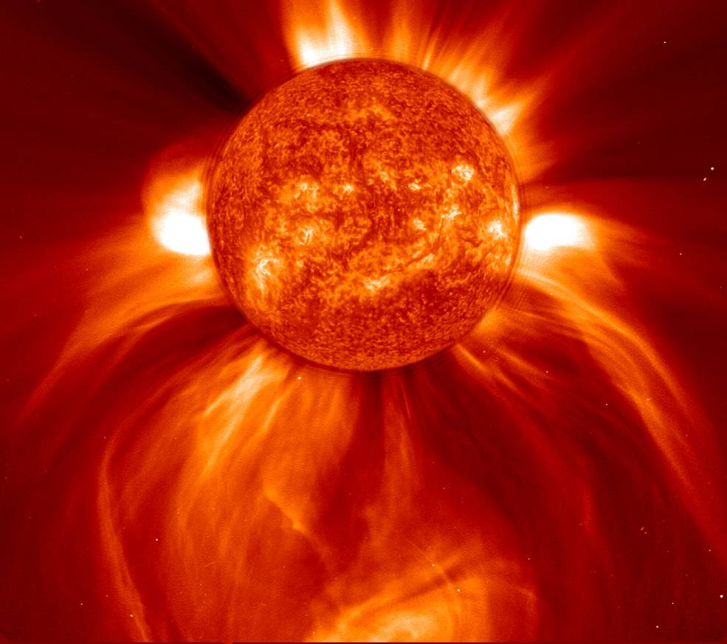
SUN
Notes:
https://www.nasa.gov/feature/goddard/winner-of-sohos-birthday-image-contest

Slide 2
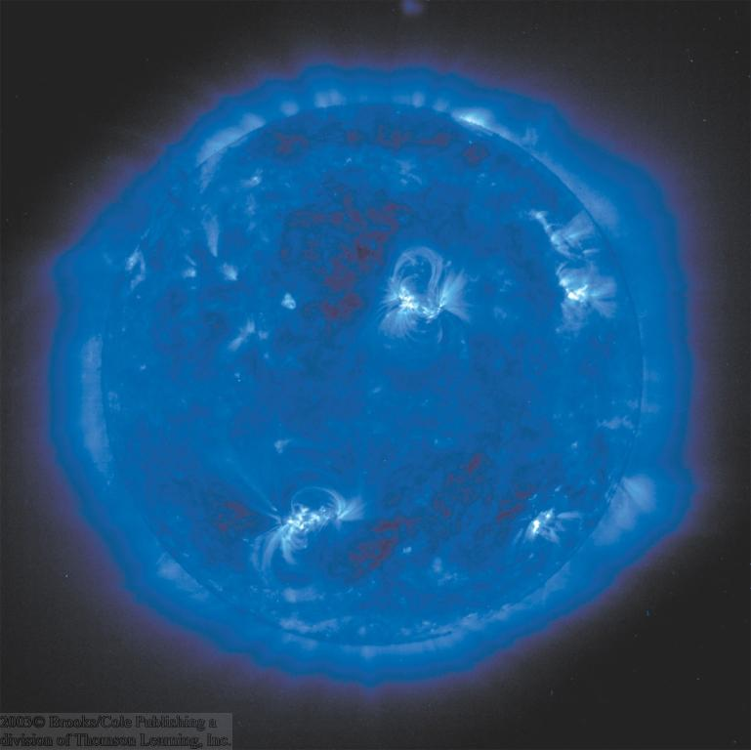
The Properties of the Sun
Radii → ~ 700,000 km
Mass: 1.99x10³⁰ kg
Mean Density= 1.4 g/cm³
Surface temperature= 5780 K
Central Temperature = 15 milyon K
Mass%74 H, %25 He, %1 other elemenrts

Slide 3
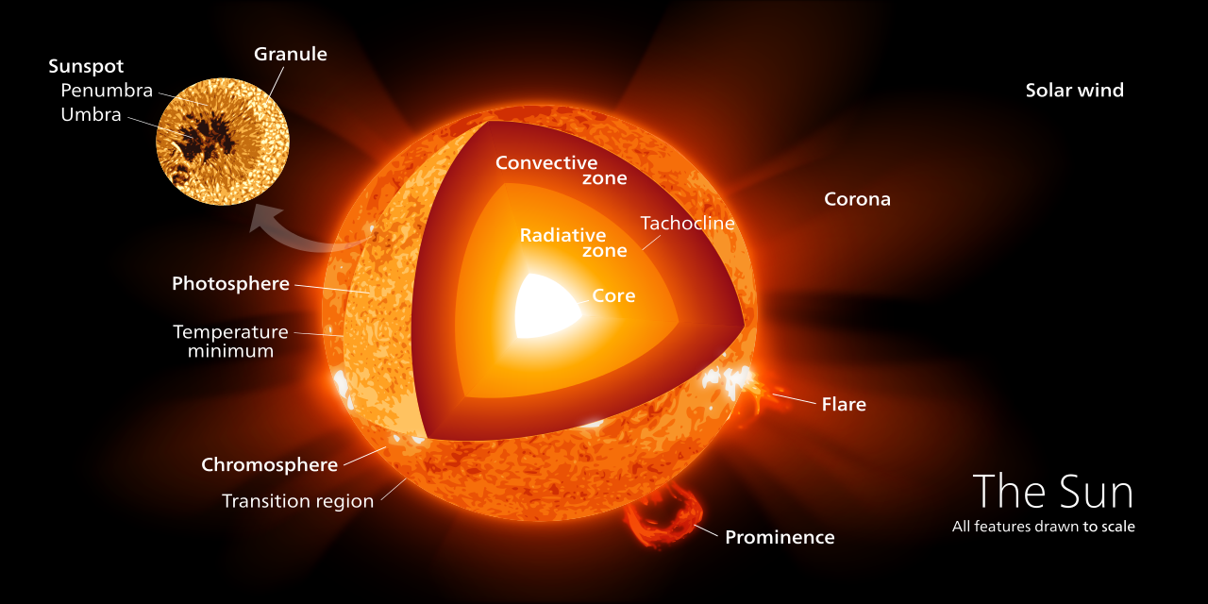
Notes:
https://briankoberlein.com/2015/01/28/inner-beauty/

Slide 4
Notes:
https://sciworthy.com/the-sun-is-hiding-extra-light-and-energy-from-us/

Slide 5
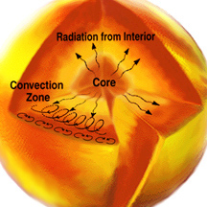
Notes:
https://www.windows2universe.org/sun/Solar_interior/Sun_layers/radiative_zone.html

Slide 6
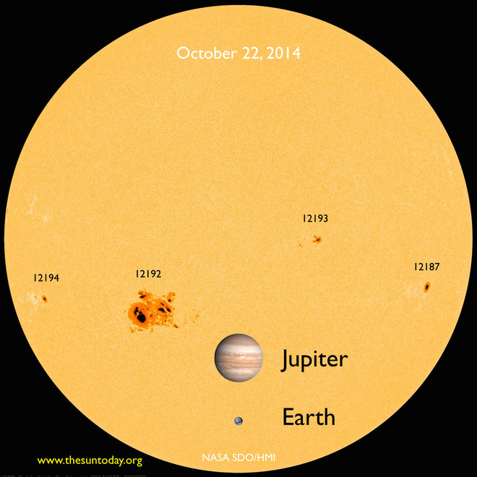
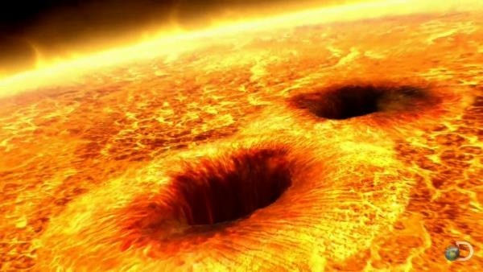
Güneş Lekeleri
Fotosferin soğuk bölgeleri (T ≈ 4200 K).
Parlak Güneş üzerinde karanlık lekeler olarak görülürler.
Notes:
https://www.space.com/27610-giant-sunspot-mystifies-scientists.html http://qrznow.com/sun-is-sunspot-free-for-fifth-straight-day/

Slide 7
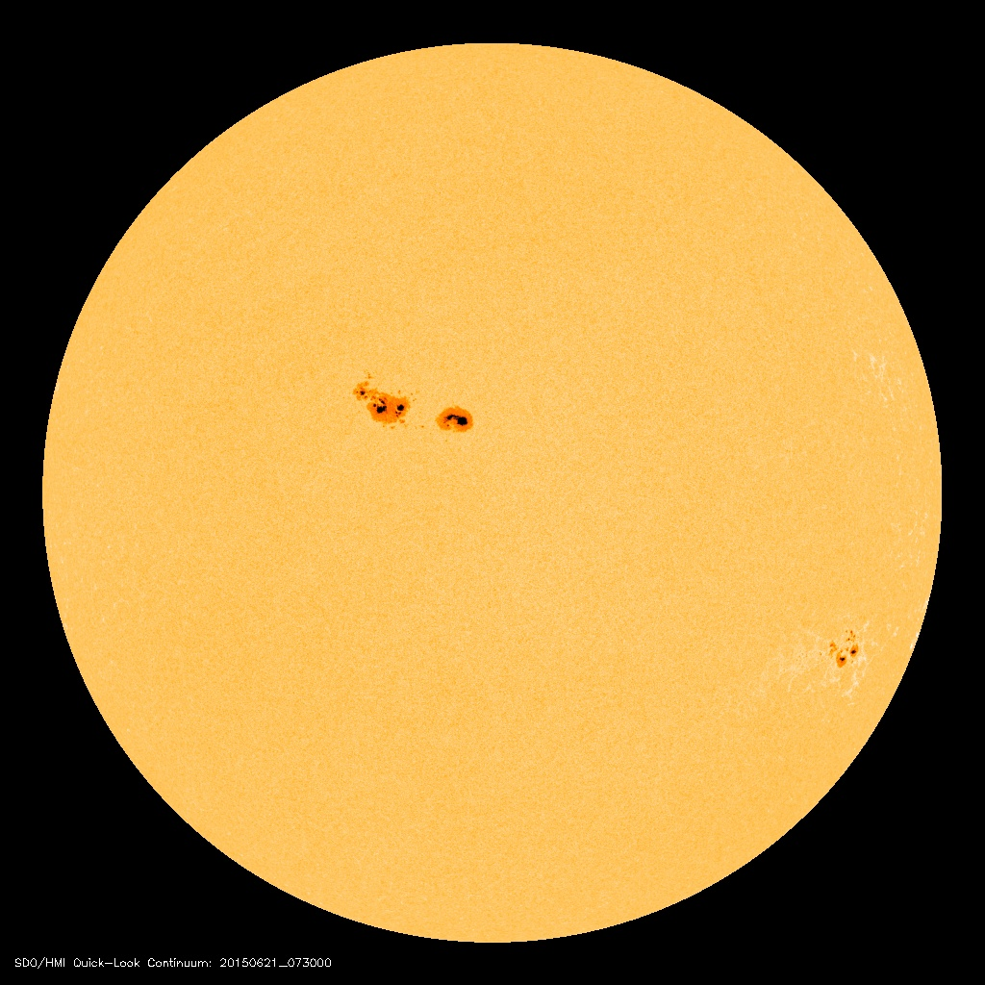
Güneş Lekeleri (3)
21 Haziran 2015
animasyon
Notes:
SOHO uydusu verisi

Slide 8
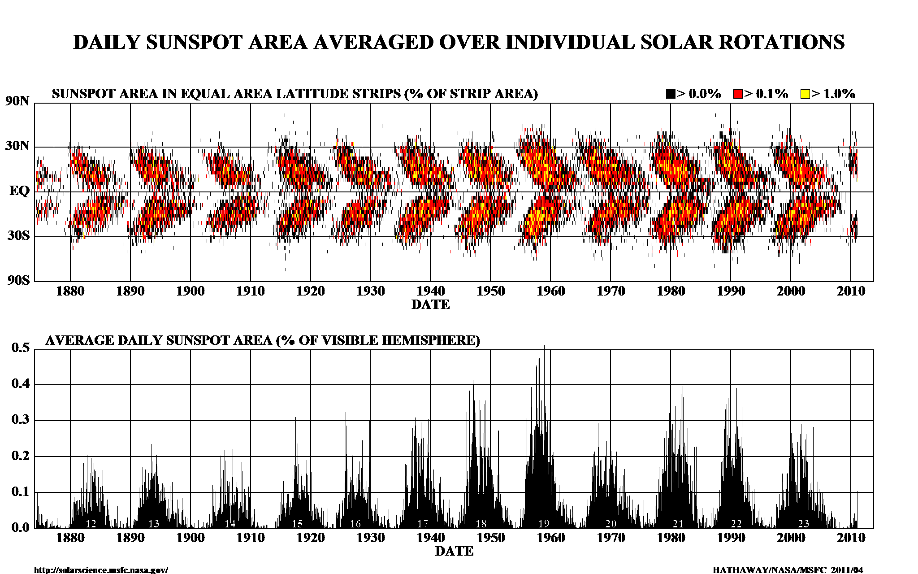
11-yıllık Güneş etkinliği
Notes:
https://cbdakota.wordpress.com/2011/05/25/solar-cycle-24-and-the-sunspot-butterfly-diagram/

Slide 9
Güneş etkinliği minimum iken
Güneş etkinliği maksimum iken
Notes:
SOHO uydusu verisi

Slide 10
Güneş’in Yaşamı
Notes:
https://en.wikipedia.org/wiki/File:Sun_Life.png

