Slide 1
General Structure of Hair

Slide 3
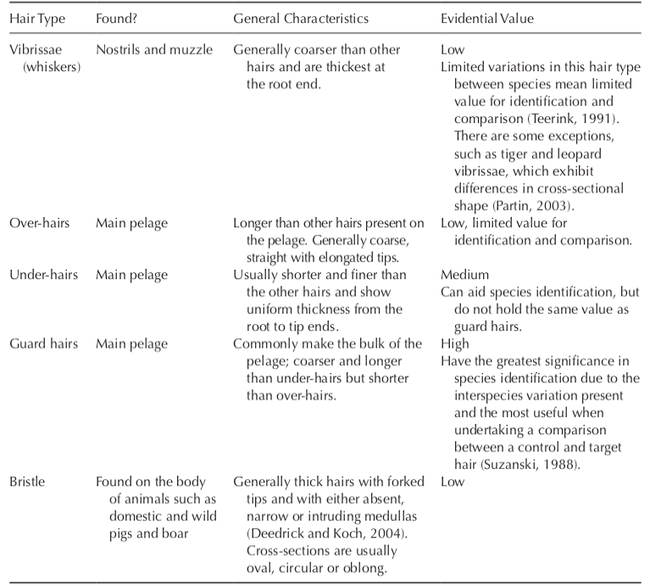

Slide 4
Forensic Animal Hair Analysis
A variety of questions beyond the species of the hair may be asked of the forensic hair analyst regarding a case, either by the police or in court. These may include the following:
Do all species of animal have a combination of unique hair characteristics?
How confident are you that the hair has originated from the particular animal in question?
How and when did the hair evidence transfer to the scene/victim?
Could the hair have been transferred innocently?

Slide 5
Stages of hair analysis
Analysis of hair evidence usually starts with general observations about the number, condition and position of the hairs found.
Analysis will also include some macroscopic observations, where the hairs are placed upon a contrasting backing to allow general features such as colour, length, shaft profile and condition to be observed and can allow samples to be divided into smaller groups, e.g. under hairs and guard hairs.
Shaft profile can sometimes be particularly useful when identifying species; for example, deer hairs have a distinctive crimped appearance

Slide 6
Microscopy preparation of animal hairs
Any target samples, or even control samples, which are covered in debris or body fluid must be cleaned prior to analysis. This can be completed by gently washing with distilled water and a mild detergent if necessary.
Organic solvents such as isopropyl alcohol or acetone can be used to remove grease and other surface impuritie.
If DNA analysis is possible, hairs should initially be mounted in distilled water
so as to prevent any nuclear DNA being destroyed by a mounting medium.

Slide 7
Microscopical analysis of animal hairs
In microscopical analysis of hairs, a balance exists between observing the whole hair to identify species and/or any similarities and differences between control and target hairs.
Analysis evidence sheets can be used that provide a systematic method for noting down relevant characteristics, sketches and comments using standardized terminology
It is logical for an analyst to start at the root end, move through to the shaft area and then to the tip to identify any variation in characteristics and to view the whole hair.
Each area can provide information specific to that region; for example, the root can provide information about the growth stage of the hair, the shaft can provide information about the pigment and medulla and the tip can provide information about damage and whether a fork or split is present.

Slide 9
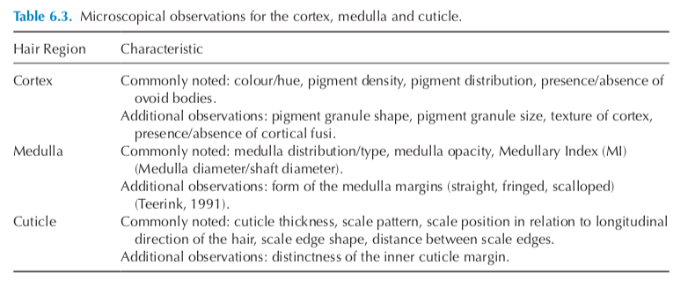

Slide 11
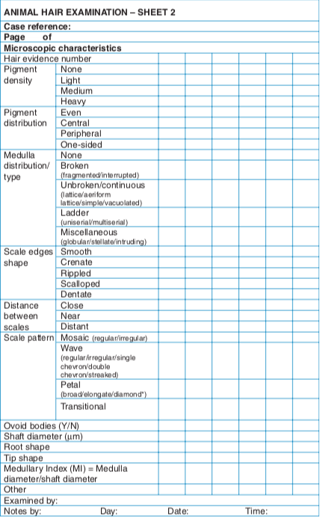

Slide 12
In addition to these observations, the root growth stage may be noted: this can be categorized into anagen (active growth stage with the presence of nuclear material), catagen (transitional growth stage with limited nuclear material) or telogen (dormant stage where hairs are readily shed and no nuclear material present)

Slide 13
Species Identification from Animal Hair

Slide 14
Scale morphology
Broadly the scale pattern of animal hairs can be classified into two main groups: coronal (where the scales go around the entire shaft, completely encircling it); and imbricate (where there are multiple scales encircling the shaft). Further classifications can be made of the scales on the cuticle by observing four main characteristics.

Slide 15
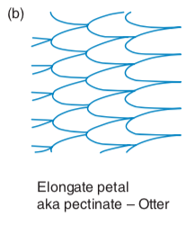
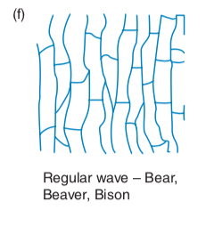
1. Scale position in relation to the longitudinal axis:

Slide 16
2. Shape of the scale margin:
This is the shape of the distal end of the scale, which can be smooth, crenate (shallow and rela- tively pointed indentations), rippled, frilled, scalloped or dentate (pointed, like teeth)

Slide 17
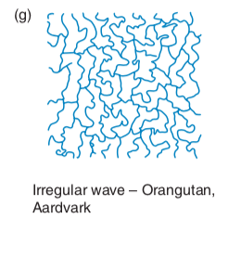
3. Distance between the external margins of the scales:

Slide 18
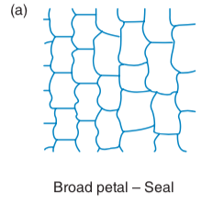
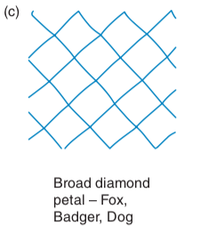
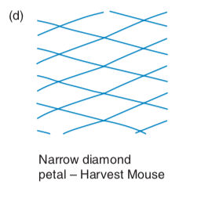
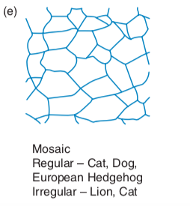
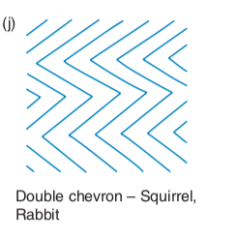
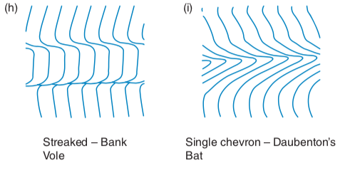
4. Scale pattern: this describes the overall shape and regularity of the outer scales.

Slide 19
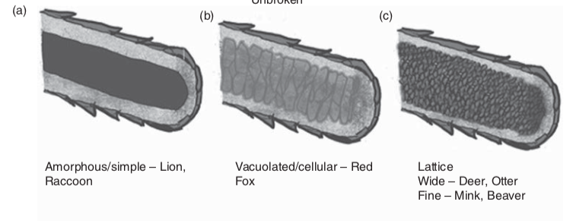
Fig. 6.5. Animal hair medulla distributions and structures.

Slide 20
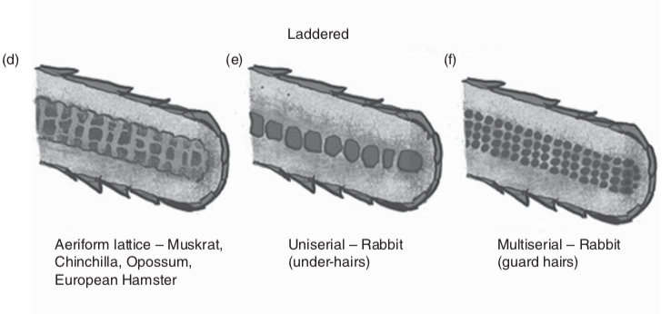
Fig. 6.5. Animal hair medulla distributions and structures.

Slide 21
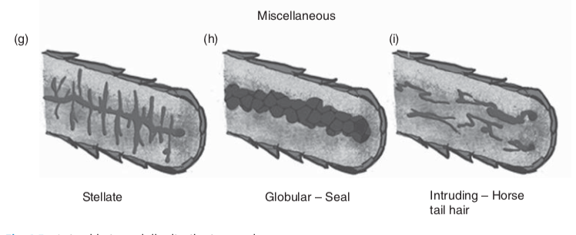
Fig. 6.5. Animal hair medulla distributions and structures.

Slide 22
Medullary fraction (MF) aka medullary index (MI)
The medullary fraction (MF) is the ratio between the width of the hair and width of the medulla. The width of both the shaft of the hair and the medulla are measured in micrometres and can be compared as a quantitative characteristic or used to aid identification

Slide 23
Colour banding
Pigment distribution in animal hair may not only differ across the width of the hair, but also quite dramatically along its length. The length, order, colour and number of bands can help identify different species. For example, badger hair can be differentiated from dog and fox hair primarily by its distinct white proximal end, black shaft and white tip

Slide 24
Root shape
Further to identifying growth stage, animal hair root bulbs can have particular shapes that are useful in identifying species.
Examples of this include deer (wine glass), horse (elongated), cow (elongated but with a medulla present in the root portion), dog (spade) and cat (‘paint brush’ with the inclusion of fibrils)

Slide 25
Root shape
Further to identifying growth stage, animal hair root bulbs can have particular shapes that are useful in identifying species.
Examples of this include deer (wine glass), horse (elongated), cow (elongated but with a medulla present in the root portion), dog (spade) and cat (‘paint brush’ with the inclusion of fibrils)

Slide 26
Conclusions from comparing control and target hairs
The interpretation of the characteristics observed between target hairs and control hairs is different to species identification and must attempt to identify any differences rather than similarities.
Differences due to the hairs being from different animals can be difficult to distinguish from differences due to variation seen across hairs from the same animal; therefore care must be taken when interpreting results.

Slide 27
Transfer and persistence for interpreting animal crimes
Animal hair may be transferred in a variety of ways: directly from the animal to an object (for example, to a wooden baton used for dog fighting); from animal to an environment (such as its living quarters); from an animal to a human; and from an animal to another animal. Transfer of hairs can be primary, secondary or even tertiary.
Primary transfer is where the hair has been transferred from the donor directly to an object, suspect or victim; for example, from a dog to a weapon used to cause head injuries
to the dog.
Secondary transfer is where hair is transferred to an intermediary object/person/animal before being transferred to the object/person/animal that it is found upon; for example, a hair being transferred from a person to a chair and then a second person sitting on the chair and the hair being transferred to that individual.
Tertiary is the presence of two intermediary objects.

Slide 28
Persistence of hairs is the length of time a hair will adhere to an object/person/animal after deposition. Knowledge of how long different hairs persist on different surfaces can help identify time of deposition and therefore help reconstruct a crime scene. To aid with this, reconstruction experiments can be carried out to identify the persistence of particular hairs on particular surfaces.
Factors that could affect the persistence of animal hairs include:
1. The recipient surface.
a. Another animal as the recipient surface –density and length of fur, cleanliness of fur, position on body.
b. Other surfaces – smoothness, fibre and weave type (if fabric)
2. Activity since deposition.
3. Washing/cleaning behaviour of the animal.

