Slide 1
Sağlık İletişimi Uygulamaları
14. Hafta

Slide 2
#icebucketchallenge

Slide 3
#icebucketchallenge

Slide 4
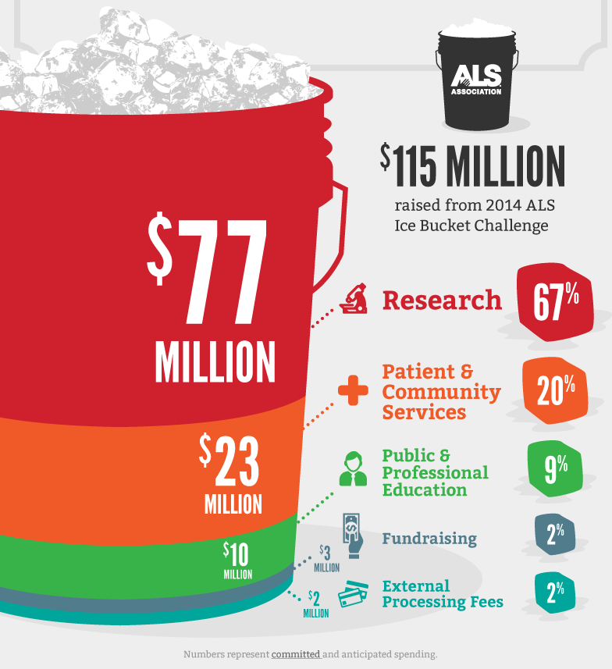
#icebucketchallenge
Bill Gates
Oprah
Mark Zuckerberg
Steven Spielberg
Lady Gaga
Selena Gomez
Justin Timerberlake
Justin Bieber

Slide 5
Betty Ford
“Betty Ford patlaması” 1974

Slide 6
Prenses Diana

Slide 7
Magic Johnson

Slide 8
Michael J. Fox

Slide 9
Elton John

Slide 10
Katie Couric

Slide 11
Kylie Minogue

Slide 12
Christy Turlington

Slide 13
