Slide 1
DRAMA IN TWENTIETH CENTURY

Slide 2
Realism was on top in the drama of the early twentieth century ,but Shaw´s comedy of ideas predominated the drama.An example for realism John Millington Synge´ Riders to the Sea which was a peasant tragedy.Along with Shaw ,there were several trends which did not draw attention as much as him
Synge´The Play of Western World and W.B. Yeats(in verse)were specifically designed as the ‘renaissance’ of an Irish theatre movement ,their style met with a mixture of hostility,bewilderment and approval on their performances at Yeats’Abbey Theatre in Dublin.

Slide 3
There were also verse plays other than Yeats´plays composed by English poets, had little success except for Eliot´s Murder in Cathedral which was written to commemorate Thomas Becket
Bertolt Brecht´Mother Courage shows the constant warfare that marks the twentieth century,and the defiance of peril,pain, terror that are part of modern condition

Slide 4
The playwrights were concerned in society,social problems such as Easter 1916(especially Irish playwrights),and the problem of using English language.

Slide 5
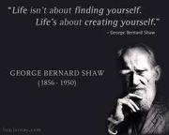

Slide 6
GEORGE BERNARD SHAW
He was born in Dublin 1856 but left the city at the age of twenty due to the love-hate relation with his native land like Joyce.
Shaw was an Irish man predominated English Language alongside Yeats and Joyce.
His first play ,Widower`s House was published in 1893.He was one of the founders of Fabian Society(non-revolutionary socialist organization)commited to reforms in education and to the liberation of women.

Slide 7
His plays were known for their entertaining exposition of social problems and far from politic.They began with preface which he justified and explained the issue behind the plays.These comedy of ideas were designed for morally improving the audience.
His major works;Ceaser and Cleopatra, Major Barbara,Pygmalion, Man and Superman,Heartbreak House and Back to Methuselah(philosophical work)

Slide 8
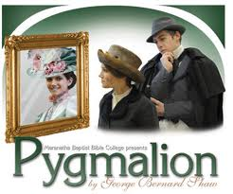

Slide 9
PYGMALION
Shaw indicates the defects of the English language and inner structure,he examines the power of language and its relation to the class and authority. He concentrates on the relationship between man and language,the parallelism between class and language and language as a ‘etiquette’.It is because in early twentieth century London was home to commerce and British Empire,so there was an organized class system,categorized people in accordance with their language pattern,did not permit crssing boundries.Eliza overcomes the class system by exchancing her cockney accent for upper-class.

Slide 10
MYTH OF PYGMALION
Pygmalion is the name of a sculptor and king of Cyprus who curved an ivory statue of a maiden and fell in love with it.It was brougt to life,in response to his prayers,by Aphrodite.Similar to the myth of Pygmalion,Professor Higging takes a flower girl with a cockney accent and is able to transform her to another person.

Slide 11
PREFACE
In preface of Pygmalion Shaw states that the English do not know how to speak their own language and can not teach it to their children,they can not spell it because it is composed of consonants without any agreed value ,is not phonetic.He mentions the importance of phoneticians and shows that it is possible for people to change their native dialects ,implying that it may lead to move to a higher class .

Slide 12
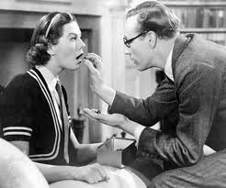

Slide 13
The Plot of Pygmalion
It is a romantic comedy . The play turns on the claim made by Professor Higgings ,a professor of phonetics,to his friend Colonel Pickering that he could pass off a cockney flower ,Eliza Doolittle,as a duchess by teaching her to speak properly.She asks Higgins for lessons and he takes her as a pupil.In the course of her educatıon she emerges not merely as a presentable lady but as a beautiful woman of increasing sensivity.To Higgins however ,just a successful experiment.

