Slide 1
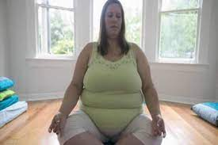
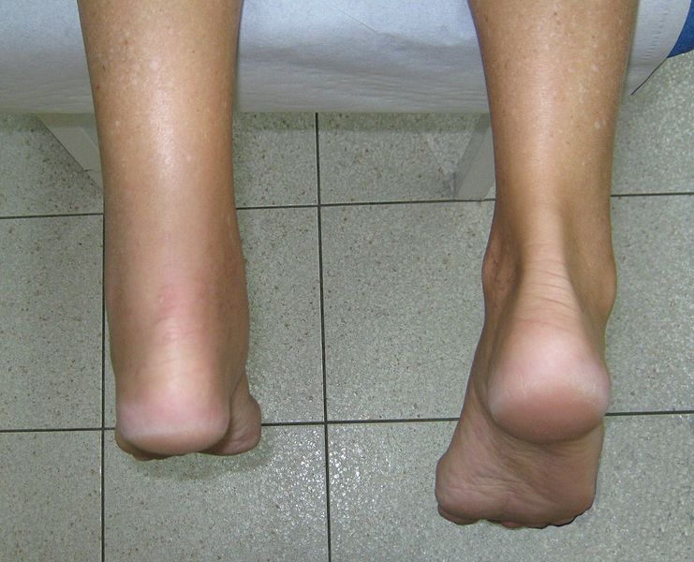
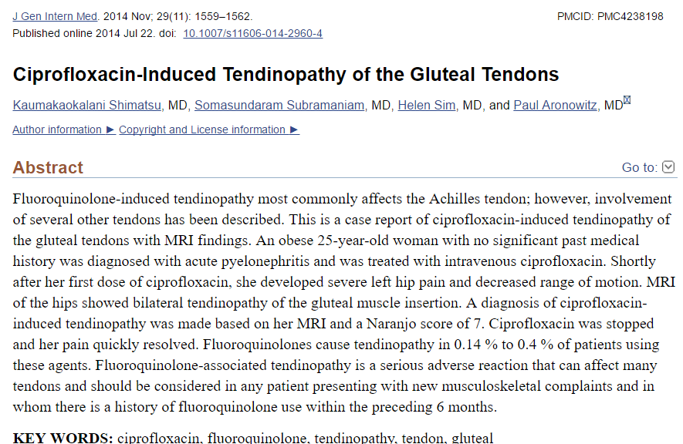

Slide 2
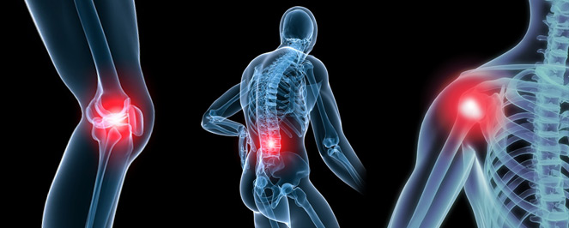
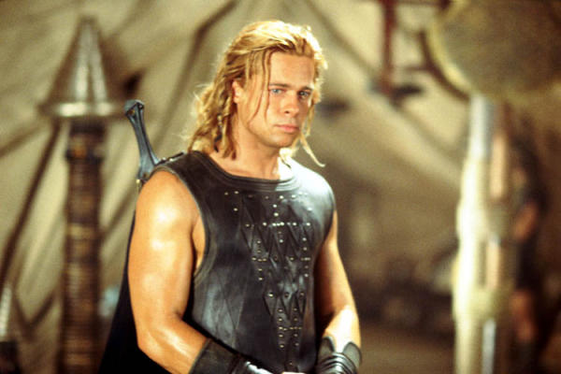
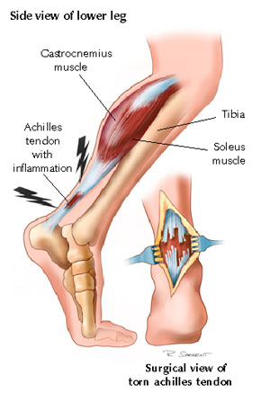
Musculoskeletal pain
muscles, bones, joints and connective tissue
Idiopahtic, iatrogenic, or related to injury
Muscle injuries: strains, contusions, delayed
muscle soreness
Strains: streching or tearing of muscle or
tendon
OTC DRUGS, AOB

Slide 3
Musculoskeletal pain
Contusion: bruising of muscle caused by
blunt trauma
Delayed onset muscle soreness: begins ≥ 8
hrsafter repeated, unaccustomed eccentric
muscle contraction
Soreness peaks at 24-48 hours but can last
for days
OTC DRUGS, AOB

Slide 4
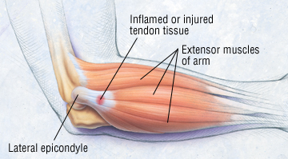
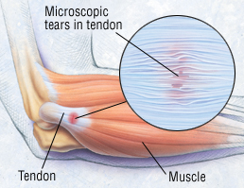
Tendonitis
OTC DRUGS, AOB

Slide 5
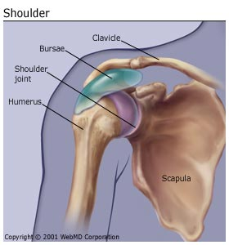
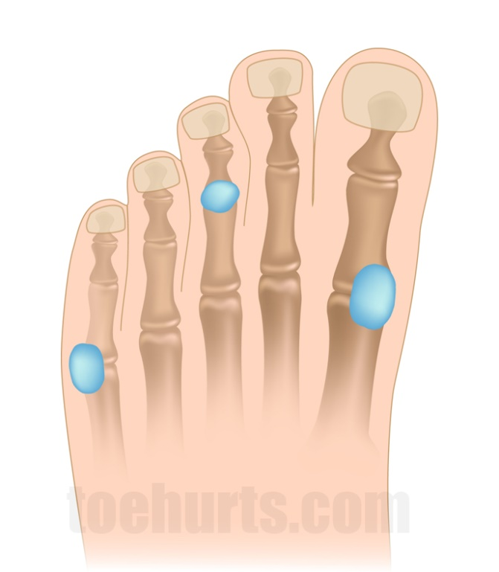
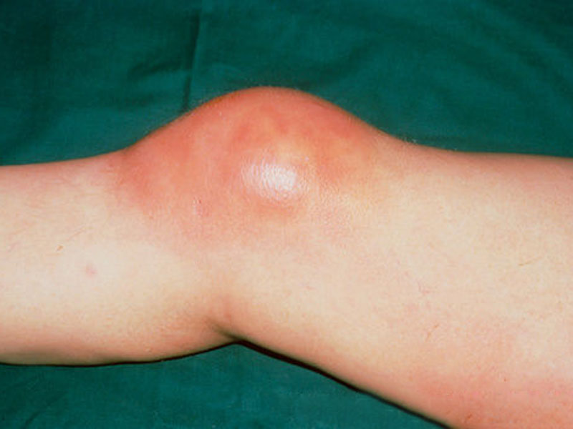
Bursitis
inflammation of bursa
OTC DRUGS, AOB

Slide 6
Osteoarthritis
gradual softening and destruction of the cartilage between bones
degenerative joint disease
weight-bearing joints, knees, hip, low back and hands
no inflammation, narrowing of joint space, restructuring of bone and cartilage; joint swelling
dull joint pain, relieved by rest
joint stiffness <20-30 minutes, symtoms localized to joint
OTC DRUGS, AOB

Slide 7
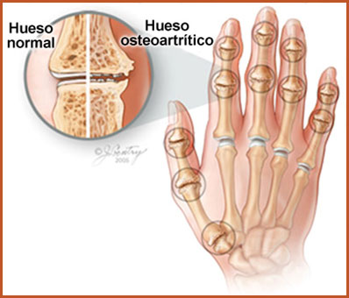
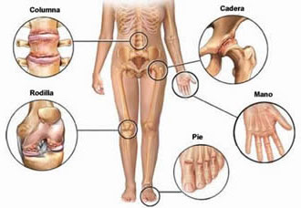
Osteoarthritis

Slide 8
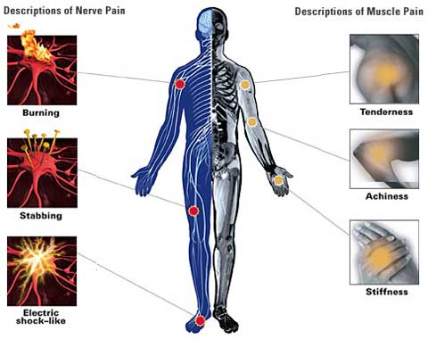
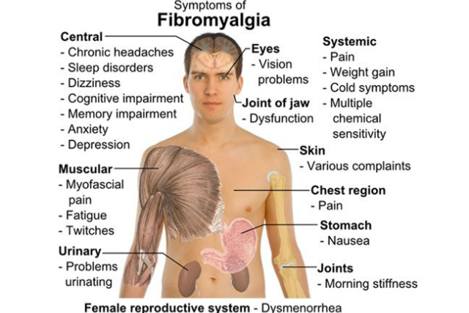
Miyalji, Fibromiyalji

Slide 9
Fibromyalgia is a disorder characterized by widespread musculoskeletal pain accompanied by fatigue, sleep, memory and mood issues
Researchers believe that fibromyalgia amplifies painful sensations by affecting the way your brain processes pain signals

Slide 10
complaint of pain..
moderate-to-severe pain
pain that lasts > 2 weeks or continues >7 days after treatment
pelvic or abdominal other than dysmenorrhea
accompanying nausea, vomiting, fever,
other signs of systemic infection
third trimester of pregnancy
< 2 years of age
medical referral
OTC DRUGS, AOB

Slide 11
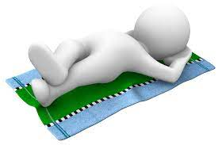
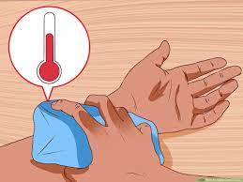
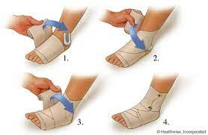
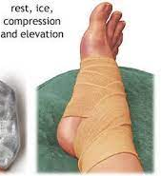
RICE
Rest Ice Compression Elevation
Rest
Ice
Compression
Elevate
OTC DRUGS, AOB

Slide 12
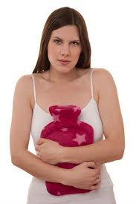
heat therapy??
for pain of noninflamatuary nature
3-4 tiems per day, 15-20 minutes
heat should NOT be applied to recently
injured (<48 hours) !!
heat or cold for osteoarthritis
OTC DRUGS, AOB

Slide 13
Farmakolojik Tedavi
Pharmacologic Therapy
NSAIDs or acetamiophene are essentially
equivalent in analgesic efficacy
Acetaminophene is first-line therapy of
osteoarthritis
Topical (external) analgesics
(counterirritants) for minor aches and
pains of muscles and joints
reduce pain through nerve stimulation
camphor, capsicum preparations, menthol, methyl
nicotinate,methyl salicylate
Capsimax®, Capsi-Gel®
OTC DRUGS, AOB

Slide 14
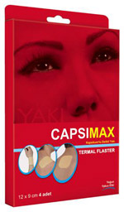
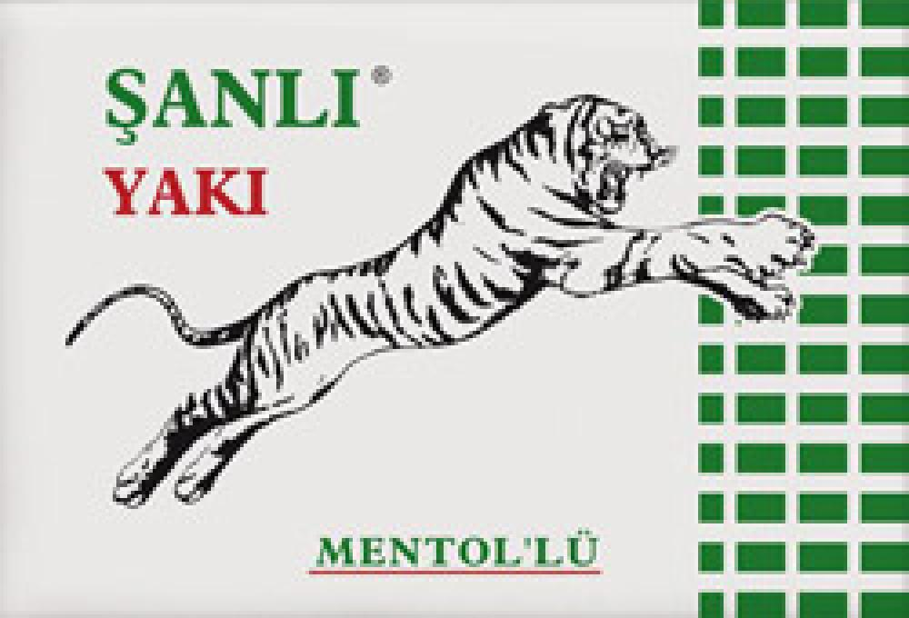
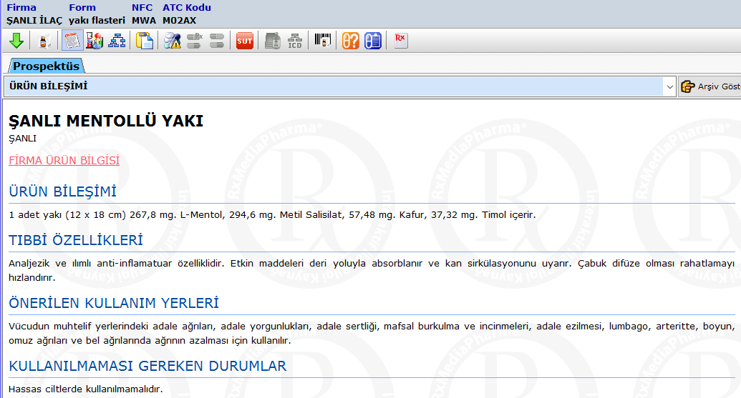

Slide 15
Counterirritants
avoid heating pads, tight bandaging,
or occlusive dressing !
DO NOT apply to skin that is abraded,
sunburned, or otherwise damaged
accidental ingestion of camphor may cause
CNS tixicity (tonic-clonic seizures)
burning and stinging with capsaicin in
40-70% of patients
Menthol can cause sensitization in
certain individuals
OTC DRUGS, AOB

Slide 16
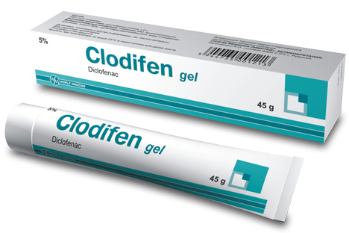
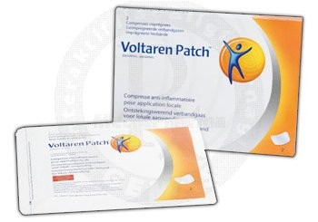
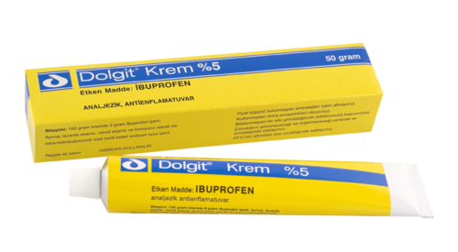
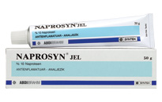
TOPICAL NSAIDs
İbuprofen, diclofenac,
naproksen
Masse Y T, et al. 2010, Topical NSAIDs for acute pain
in adults

Slide 17
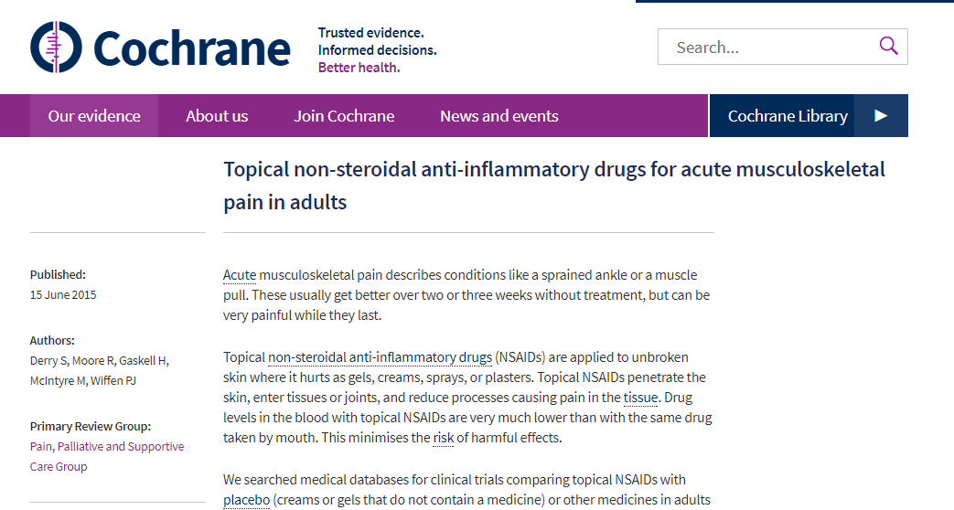
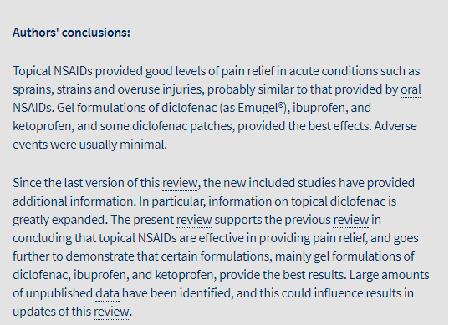
…topical NSAIDs provide good pain relief in sprains, strains and overuse injuries

Slide 18
Chondroitin sulfate
Glukosamine sulphate
Methyl-Sulfonyl-Methan (MSM)
S-Adenosyl-L-Methionine (SAM)
OTC DRUGS, AOB

Slide 19
Glucosamine/Chondroitin Arthritis
Intervention Trial (GAIT)
large, randomized, placebo-controlled trial conducted at several sites across the US
NO BENEFIT in mild pain
Reduction in pain in moderate-to-severe pain (22% of patients)
A FOLLOW-UP in patients from the GAIT showed NO DIFFERENCE in pain or function or joint space

