Slide 1
Evrim, Kurumlar ve İktisat Kuramı Neden Coğrafya? (2)
Altug Yalcintas
Ankara University
altug.yalcintas@politics.ankara.edu.tr

Slide 2
Why Geography?
Where else is geography significant? (1)
Residential Segregation:
Why do you prefer to live in Aşağı Ayrancı, Ümitköy, Etlik, Keçiören, Mamak, or Dikmen?
Did anybody force you to live in where you live today?
If not, there can be a micro regulatory principle leading to a macro pattern of segregation
I live in the same neighbourhood as my parents’
I live where the working class people live
I live in conservative neighbourhoods
I live close to the bars, restaurants, and nightlife
How many of you did consider at least of these reasons?

Slide 3
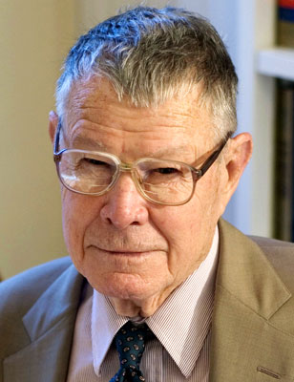
Why Geography?
Where else is geography significant? (2)
Residential Segregation:
«Segregation model» developed by Thomas Shelling
(2005 Nobel Laureate) in the 1970s.
Individual preferences and incentives matter
Such as: income, religion, language, age, education, way of life etc.
A simple rule → a complicated pattern

Slide 4
Why Geography?
Where else is geography significant? (3)
Residential Segregation:
How does the model work?
The model works through an algorithm. Such as:
I continue living in where I currently live if my neighbours are X [X: muslim, high income, conservative]
I move to another house if one of my neighbours are Y [Y: homosexual, single, smoker, drunkard]
A simulation is available here: http://www.avanderw.co.za/schellings-segregation-simulation/

Slide 5
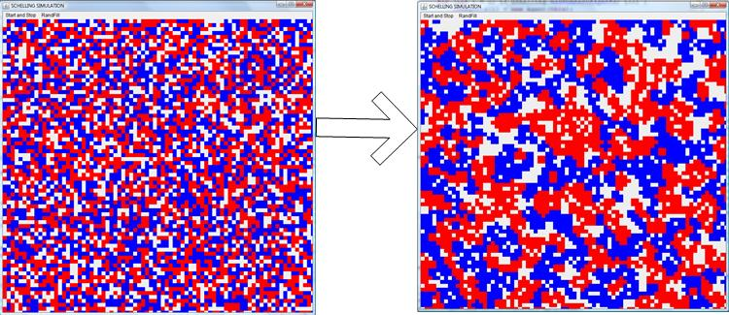
Why Geography?
Where else is geography significant? (1)
Residential Segregation:
Unhappier
Happier

Slide 6
Why Geography?
Where else is geography significant? (1)
Residential Segregation:
Unhappier
Happier

Slide 7
Why Geography?
Where else is geography significant? (1)
What does Shelling’s segregation model explain?
Segregation between the North of Ankara (Keçiören, Etlik etc.) and South of Ankara (Ayrancı, GOP etc.)
China Town in New York
Noord Plein in Rotterdam (where mostly Turks live)
Others?

Slide 8
Why Geography?
Where else is geography significant? (2)
Economic clusters:
Why are bars and restaurants geographically concentrated in Tunalı, GOP, Bahçeli, and Kızılay?
Why are METU, Bilkent, and Hacettepe located as close?
Why are industries geographically concentrated in Marmara and Ege regions?
Shoe shops in Sıhhiye, rent-a-car companies in Esat, …

Slide 9
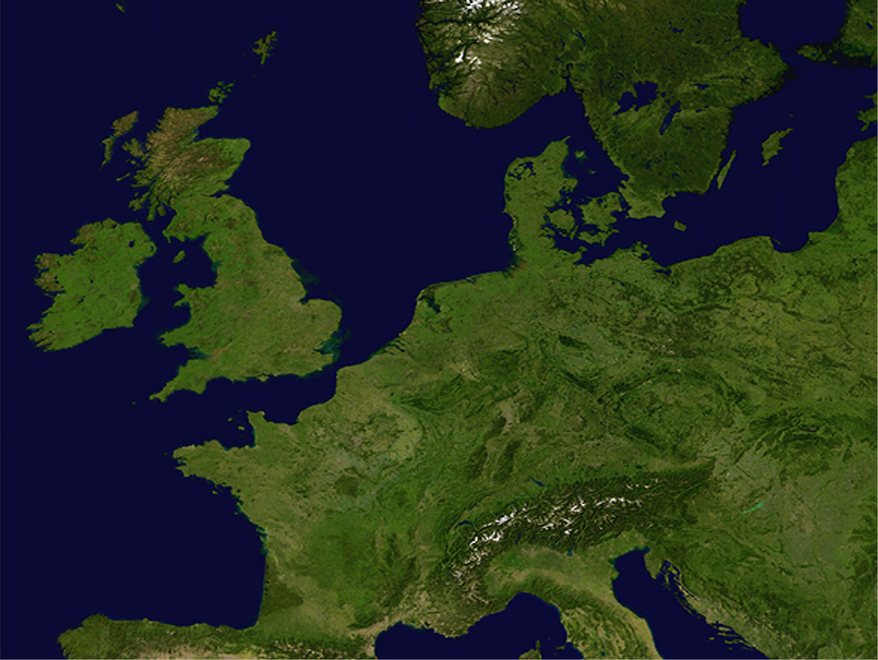

Slide 11
Why Geography?
Where else is geography significant? (3)
Historical cases (a):
The Embarrasment of Riches by Schama (1987)
«Moral geography» → the Dutch struggle with water
Democracy or «polder model» as a geographical construct

Slide 12
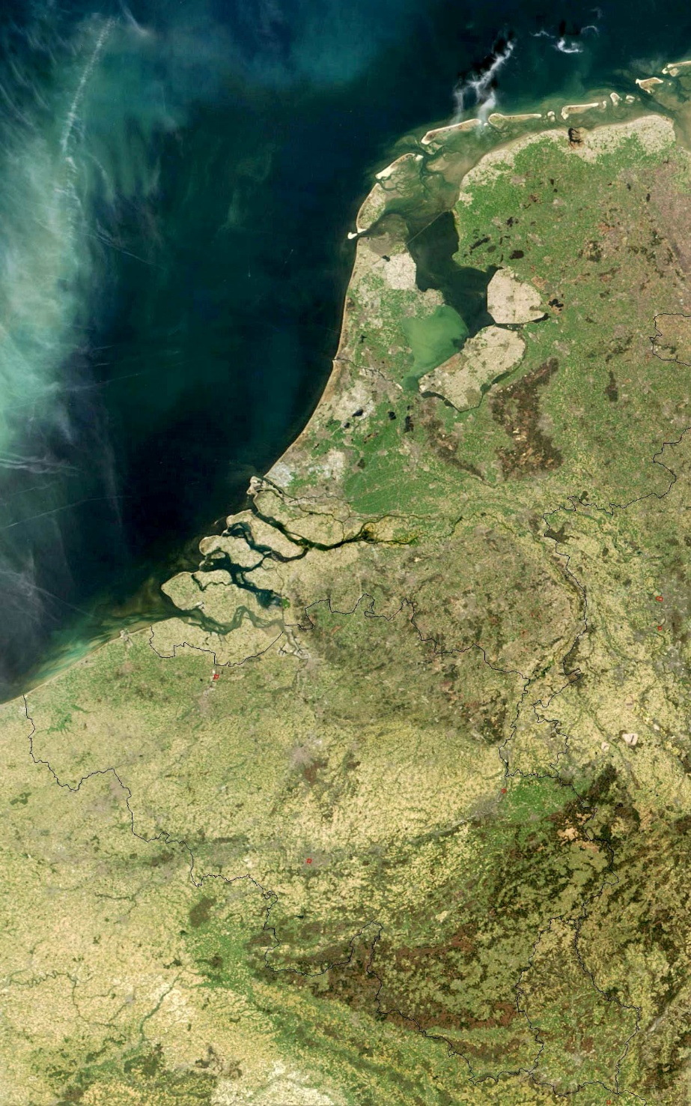
Why Geography?
Where else is geography significant? (3)
Historical cases (b):
Spread of Calvinism in the Low Countries (the 1500s)
The Low Countries (Belgium, Luxemburg, and the
Netherlands)
Nederland (or Holland):
Neder: alçak
Land: ülke, toprak

Slide 13
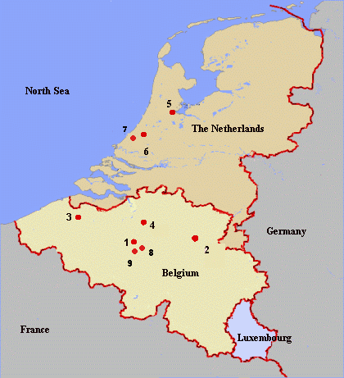
Why Geography?
Where else is geography significant? (3)
Historical cases (b):
Spread of Calvinism in the Low Countries (the 1500s)
The Low Countries (Belgium, Luxemburg, and the
Netherlands)
Nederland (or Holland):
Neder: alçak
Land: ülke, toprak

Slide 14
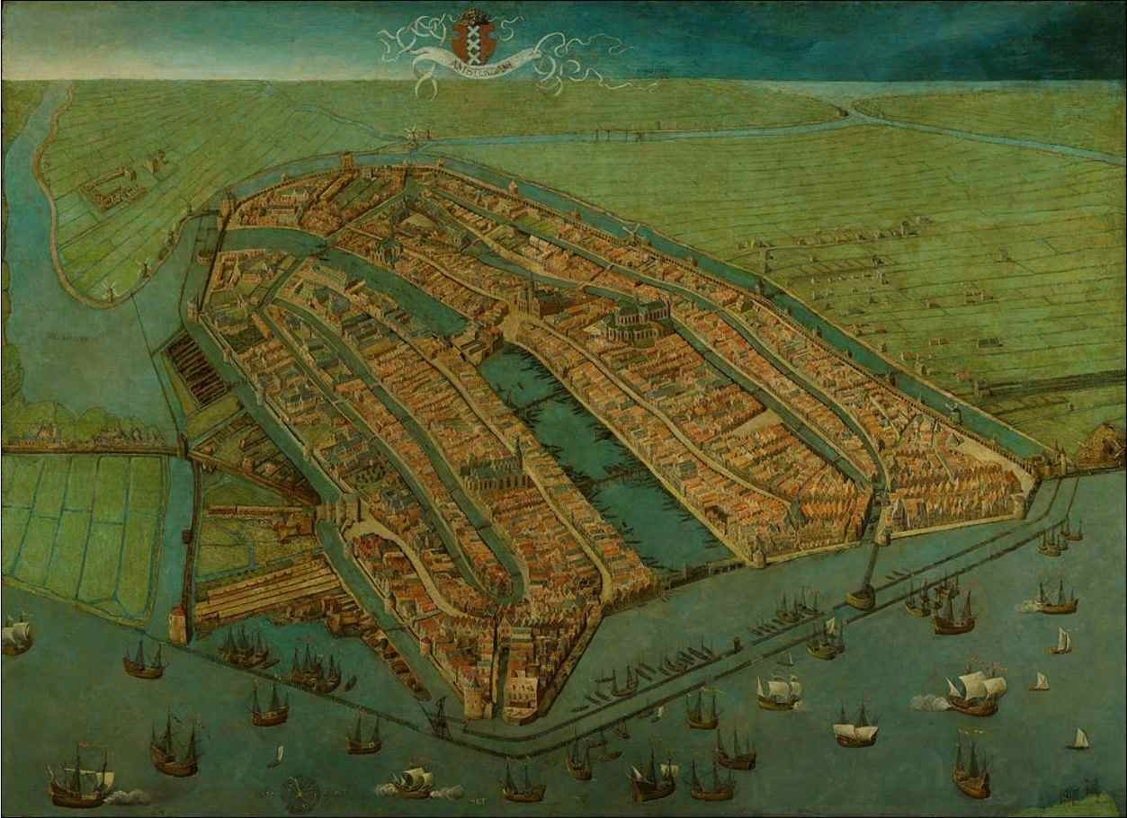
Why Geography?
Where else is geography significant? (3)
Historical cases (d):
Urbanization (Amsterdam)
Bourg → Bourgeoisie (kent soylu)
Strasbourg, Edinbourg, Hamburg,
Türkçe’de: Burç, Burgaz Ada vs.
Kaynak: http://www.amsterdamology.com/wp-content/uploads/2011/09/amsterdam1.jpg

Slide 15
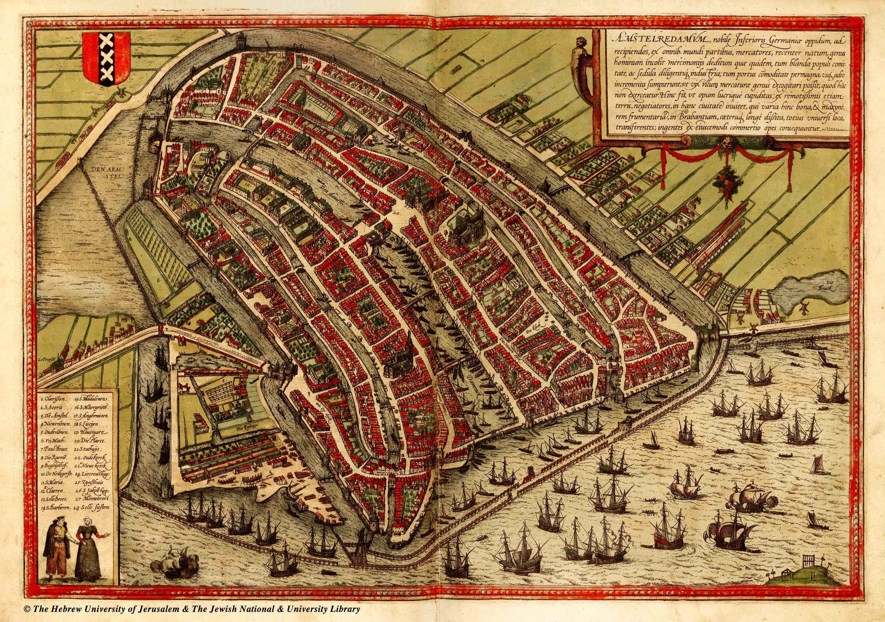
Why Geography?
Where else is geography significant? (3)
Historical cases (d):
Urbanization (Amsterdam)
Bourg → Bourgeoisie (kent soylu)
Strasbourg, Edinbourg, Hamburg,
Türkçe’de: Burç, Burgaz Ada vs.
Kaynak: http://historic-cities.huji.ac.il/netherlands/amsterdam/maps/braun_hogenberg_I_20_b.jpg

Slide 16
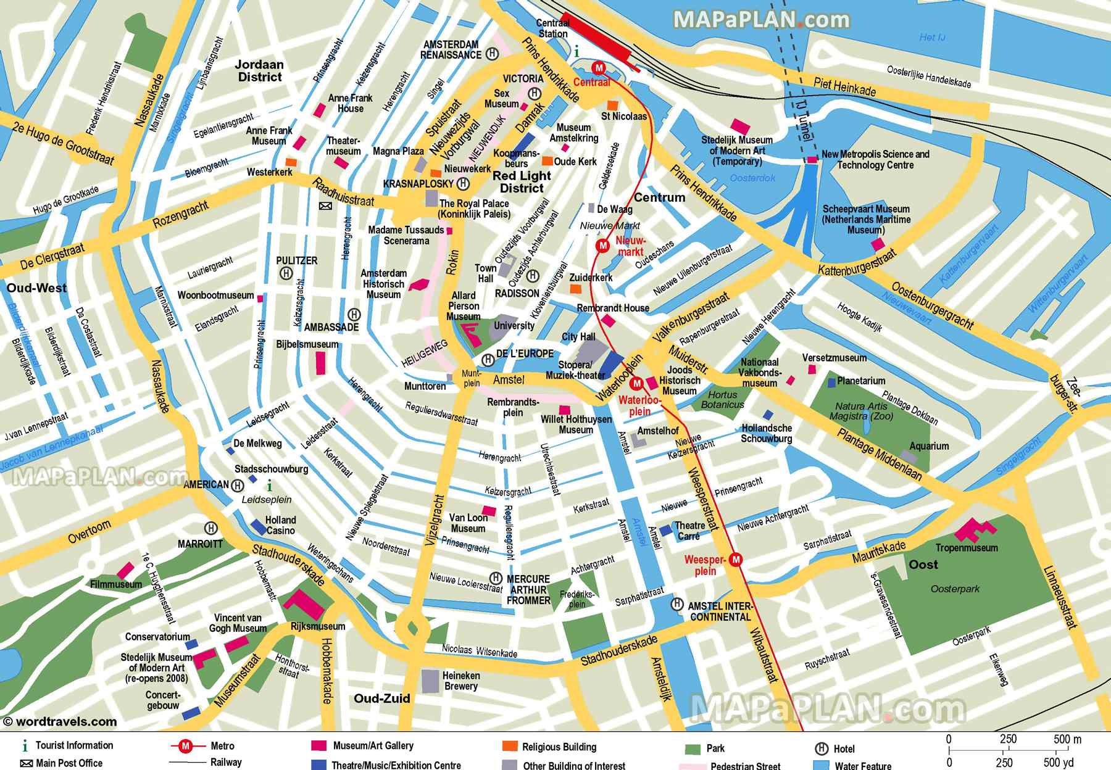
Why Geography?
Where else is geography significant? (3)
Historical cases (d):
Urbanization(Amsterdam)
Bourg → Bourgeoisie (kent soylu)
Strasbourg, Edinbourg, Hamburg,
Türkçe’de: Burç, Burgaz Ada vs.
Kaynak: http://www.mapaplan.com/travel-map/amsterdam-netherlands-top-tourist-attractions-printable-street-plan/high-resolution/amsterdam-top-tourist-attractions-map-21-What-to-do-in-a-week-diagram-with-scale-high-resolution.jpg

Slide 17
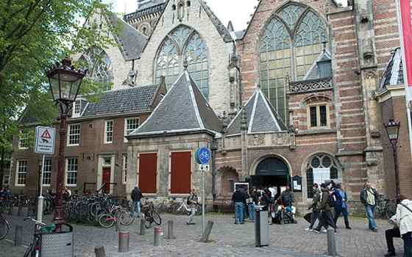
Why Geography?
Where else is geography significant? (3)
Historical cases (d):
Kalvinizm: Oude Kerk, Amstedam
Kaynak: http://www.holland.com/upload_mm/9/3/3/26998_fullimage_Oude_Kerk-Amsterdam1_560x350.jpg

Slide 18
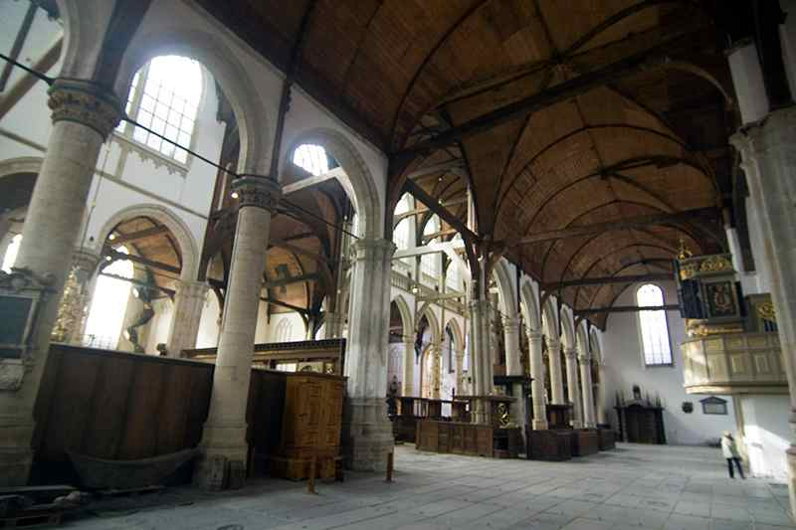
Why Geography?
Where else is geography significant? (3)
Historical cases (d):
Kalvinizm: Oude Kerk, Amsterdam
Kaynak: http://europaenfotos.com/amsterdam/oude-kerk-9416.jpg

Slide 19
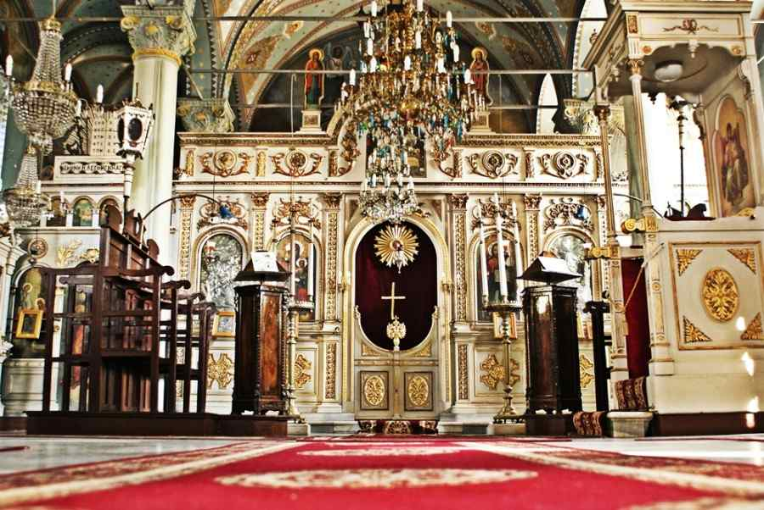
Why Geography?
Where else is geography significant? (3)
Historical cases (d):
Ortodoksi: Aya Yorgi
Kaynak: http://blog.karaderiligroup.com/wp-content/uploads/2015/01/45505_orig.jpg

Slide 20
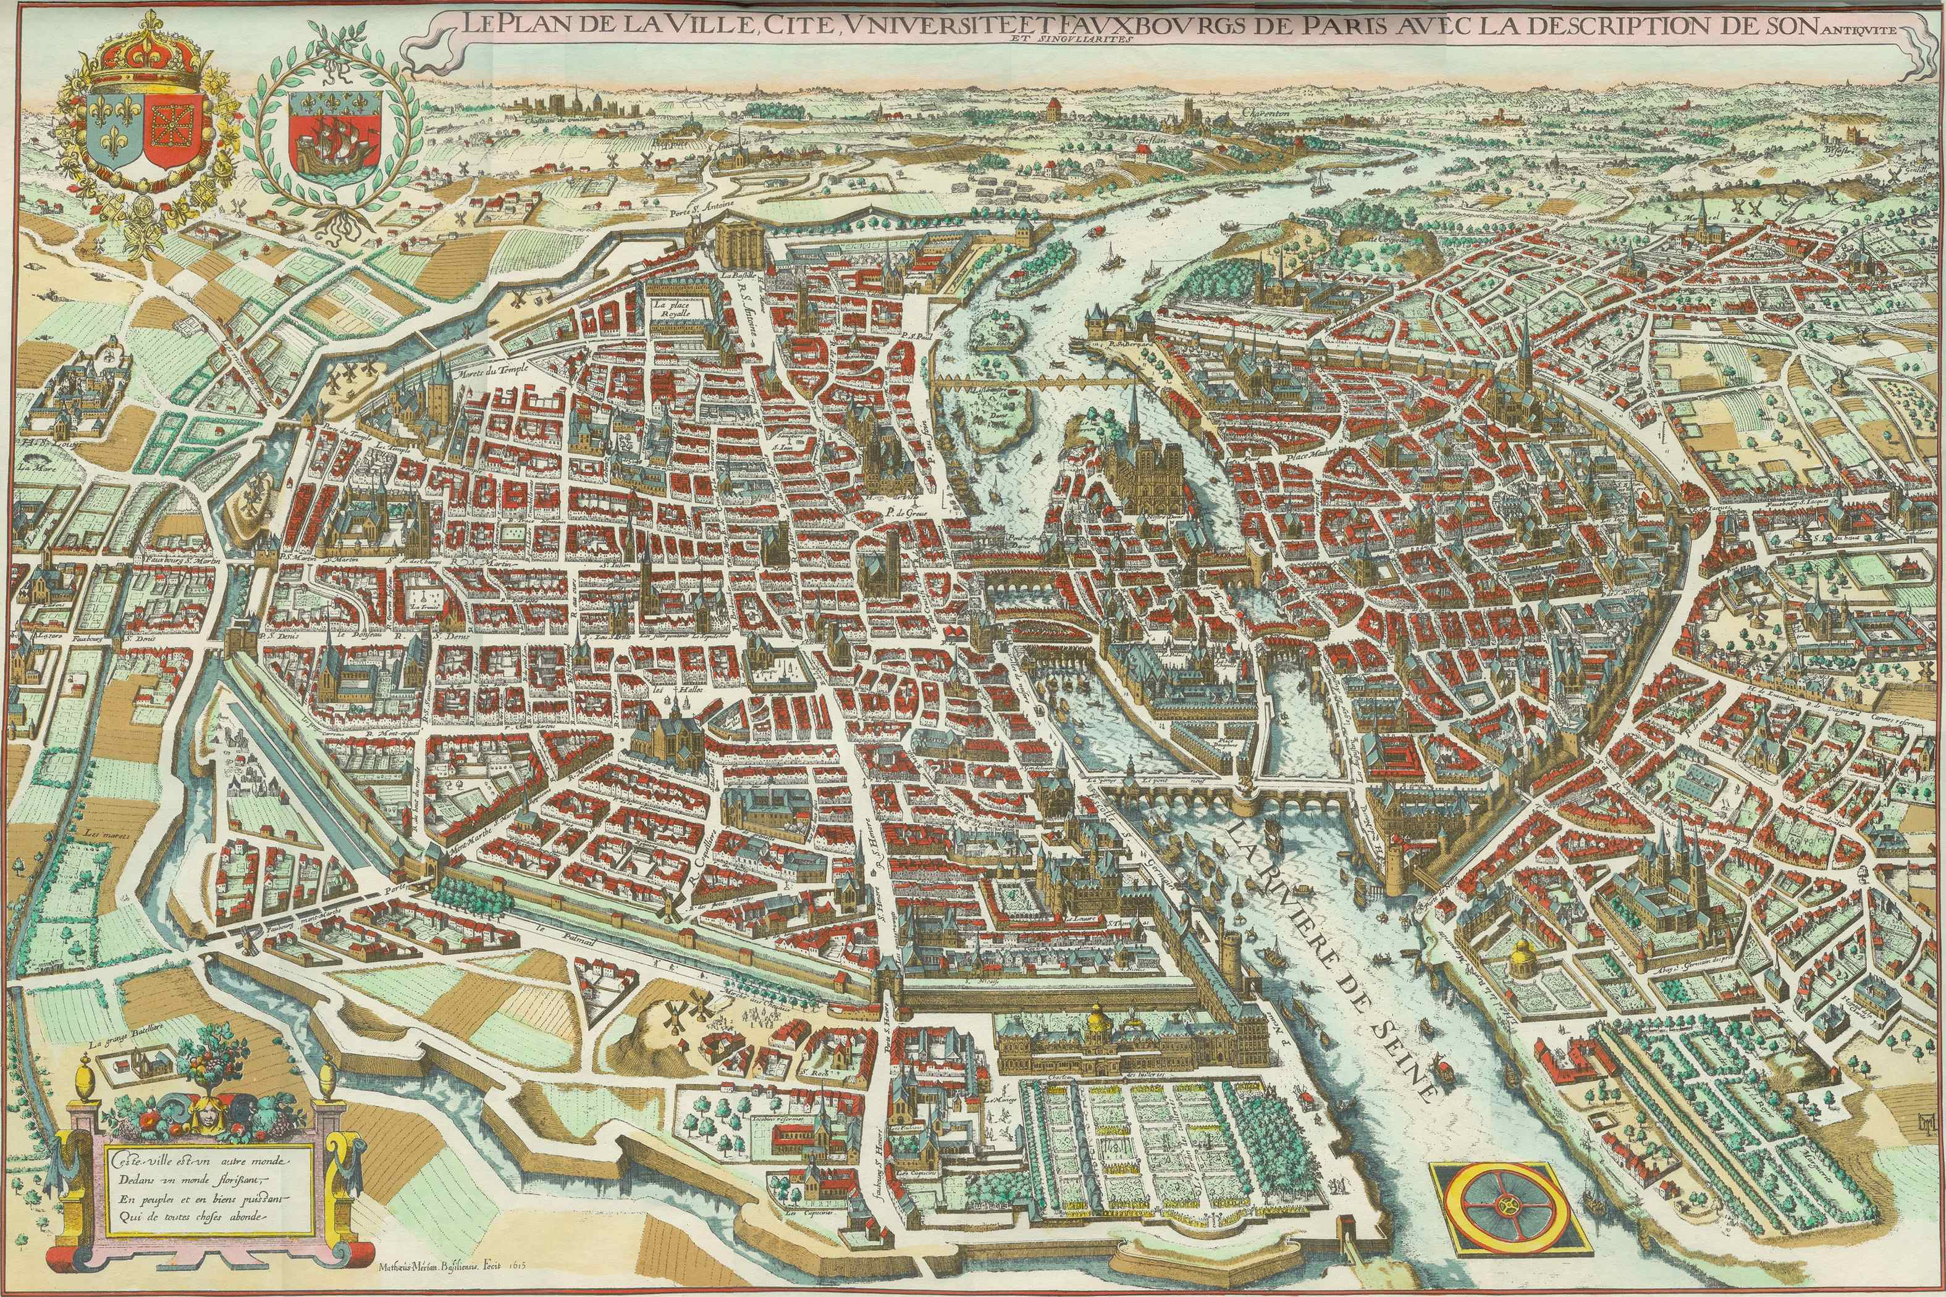
Why Geography?
Where else is geography significant? (3)
Historical cases (d):
Kentleşme (Paris)
Bourg → Bourgeoisie (kent soylu)
Strasbourg, Edinbourg, Hamburg,
Türkçe’de: Burç, Burgaz Ada vs.
Kaynak: http://www.oldmapsofparis.com/system/maps/9/original/paris1615.jpg?1329722213

Slide 21
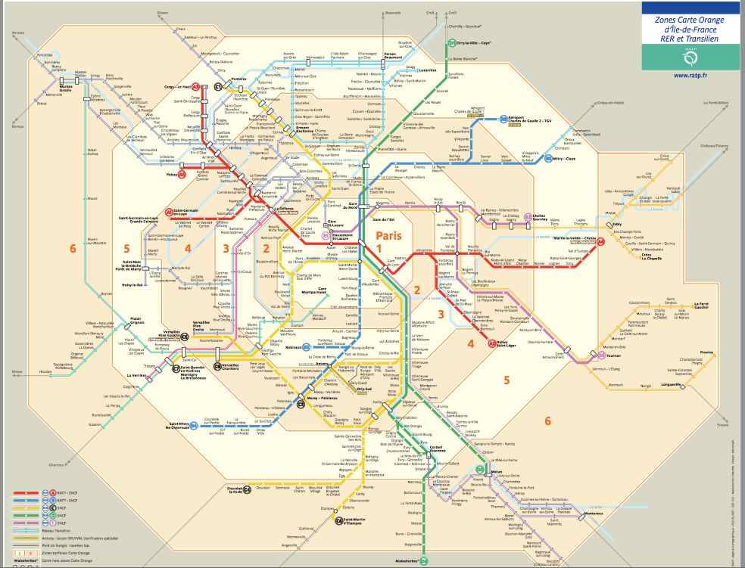
Why Geography?
Where else is geography significant? (3)
Historical cases (d):
Kentleşme (Paris)
Bourg → Bourgeoisie (kent soylu)
Strasbourg, Edinbourg, Hamburg,
Türkçe’de: Burç, Burgaz Ada vs.
Kaynak: http://thecityfix.com/files/2010/10/Screen-shot-2010-10-22-at-5.25.55-PM1.png

Slide 22
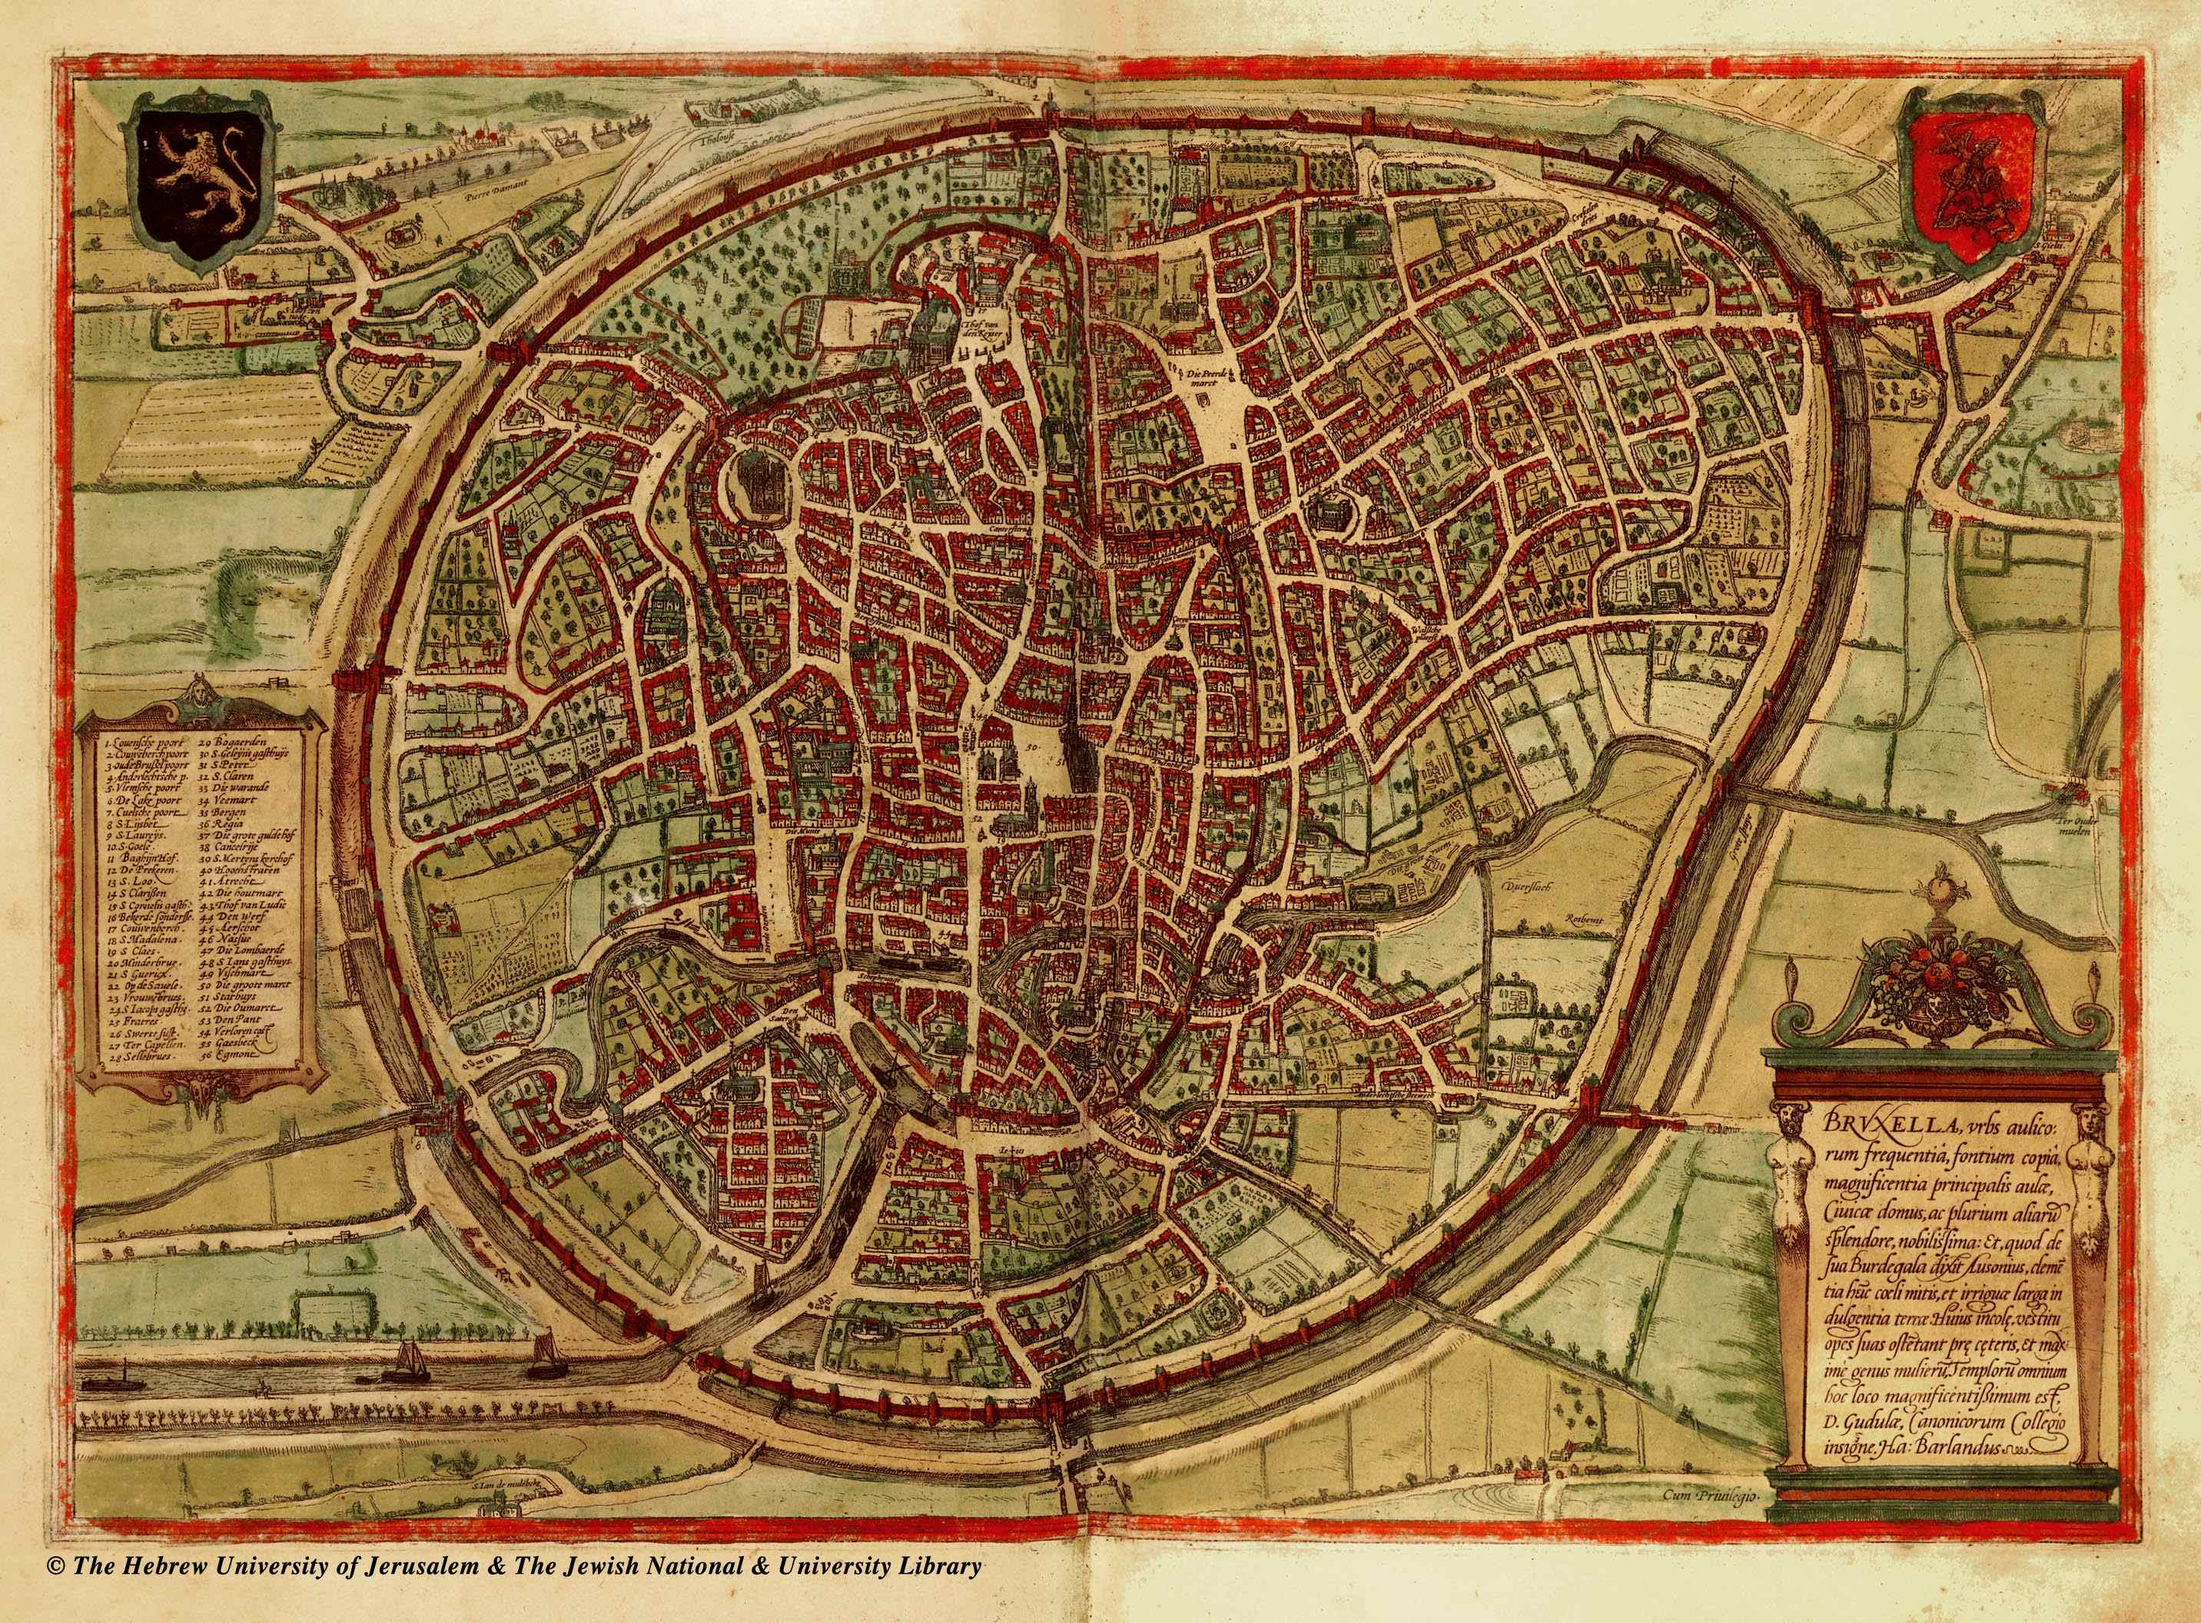
Why Geography?
Where else is geography significant? (3)
Historical cases (d):
Kentleşme (Brugge)
Bourg → Bourgeoisie (kent soylu)
Strasbourg, Edinbourg, Hamburg,
Türkçe’de: Burç, Burgaz Ada vs.
Kaynak: http://historic-cities.huji.ac.il/belgium/brussels/maps/braun_hogenberg_I_14_b.jpg

Slide 23
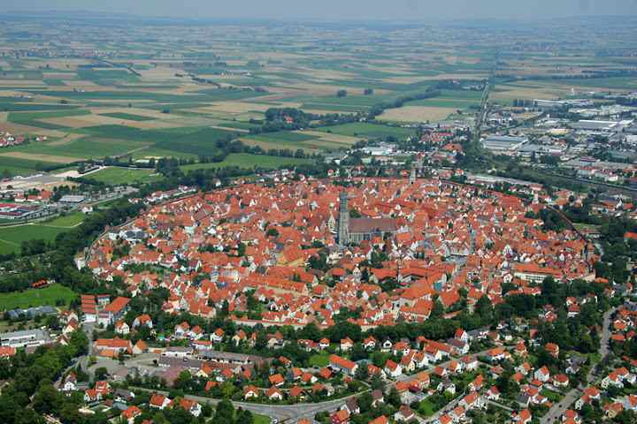
Why Geography?
Where else is geography significant? (3)
Historical cases (d):
Kentleşme (Brugge)
Bourg → Bourgeoisie (kent soylu)
Strasbourg, Edinbourg, Hamburg,
Türkçe’de: Burç, Burgaz Ada vs.
Kaynak: http://lh5.ggpht.com/_hVOW2U7K4-M/SmFRFj1VfcI/AAAAAAABDbE/4khfXlhK3sw/s720/23r2t5tg5gtgt.jpg

Slide 24
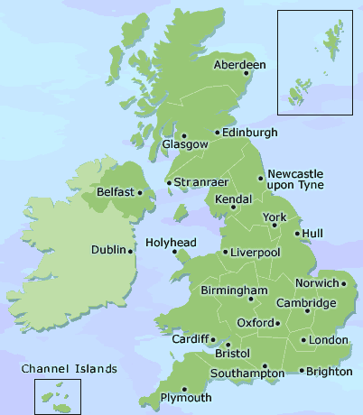
Why Geography?
Where else is geography significant? (3)
Historical cases (c):
Nowhere in the UK is more than 120 km to the sea
(Cotton-in-the-Elms)
What can the effect of geographical shape of the UK
be on overseas expansion, emergence of capitalism,
colonialism, and the Industrial Revolution?

Slide 25
Why Geography?
Where else is geography significant? (3)
Two fields of research:
Economic Geography: Spatial distribution of economic activities, urbanisation, economic clusters, transportation, real estate etc.
Ecological and Environmental Economics: sustainability of natural resources, green energy usage, effects of market economies on environment, externalities etc.

